Slide 2
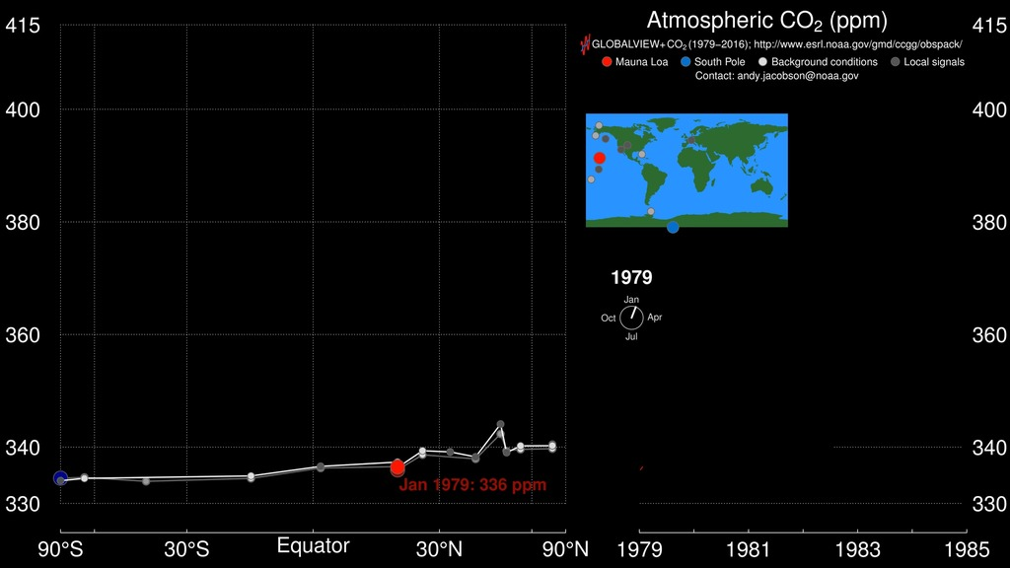
Notes:
2. Carbon dioxide pump handle (1:01) - http://svs.gsfc.nasa.gov/30556 Atmospheric CO₂ Trends Fossil fuel combustion and other human activities are now increasing the atmospheric carbon dioxide (CO₂) abundance to unprecedented rates. It is estimated that approximately 36 billion tons of CO₂ are added to the atmosphere each year. The large graph shown here is an animated version of the standard Keeling curve from 1980 to September 2014. The red line denotes ground-based measurements from the Mauna Loa Observatory in Hawaii, while yellow denotes observations from the South Pole Observatory. Purple denotes the global trend. The smaller graph in the upper left shows satellite measurements of tropospheric CO₂ concentrations (white dots) at different latitudes from September 2002 to September 2014, obtained by the Atmospheric Infrared Sounder (AIRS) and Advanced Microwave Sounding Unit (AMSU) instruments. Note how the Northern Hemisphere has greater variably and generally higher levels of CO₂ than the Southern Hemisphere. In May of 2013, these emissions pushed the monthly average CO₂ concentrations above 400 parts per million (ppm)—a level that has not been reached during the past 800,000 years. These ever-increasing levels are raising concerns about greenhouse-gas-induced climate change. Data from NASA’s Orbiting Carbon Observatory-2 (OCO-2), launched in July 2014, are helping scientists better identify how human activities, as well as the natural processes on Earth are influencing rising concentrations of atmospheric CO₂ and the global carbon cycle.

Slide 3
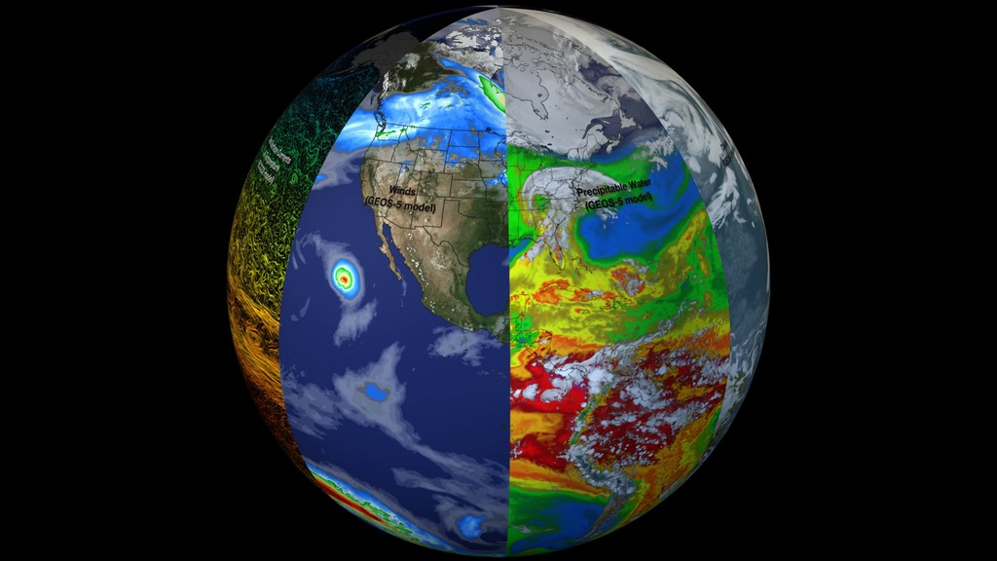
Notes:
3. System of systems/beachball (0:33) - http://svs.gsfc.nasa.gov/30701 Earth: A System of Systems This visualization reveals that the Earth system, like the human body, comprises diverse components that interact in complex ways. Heat absorbed by the ocean is transported by ocean currents—shown here as ECCO2 model output. This energy is constantly released into Earth’s atmosphere. Heat and moisture from the ocean and land influence Earth’s weather patterns—represented here as 500 mb wind speeds from GEOS-5. Moisture in the atmosphere—represented as precipitable water from the GEOS-5 model—forms clouds and precipitation—shown here using the GPM IMERG product. Precipitation significantly impacts water availability, which influences soil moisture and ocean salinity—shown here as data from SMAP. Lastly, data from multiple satellites show the density of plant growth on land and chlorophyll concentrations in the ocean. While scientists learn a great deal from studying each of these components individually, improved observational and computational capabilities increasingly allow them to study the interactions between these interrelated geophysical and biological parameters, leading to unprecedented insight into how the Earth system works—and how it might change in the future.

Slide 4
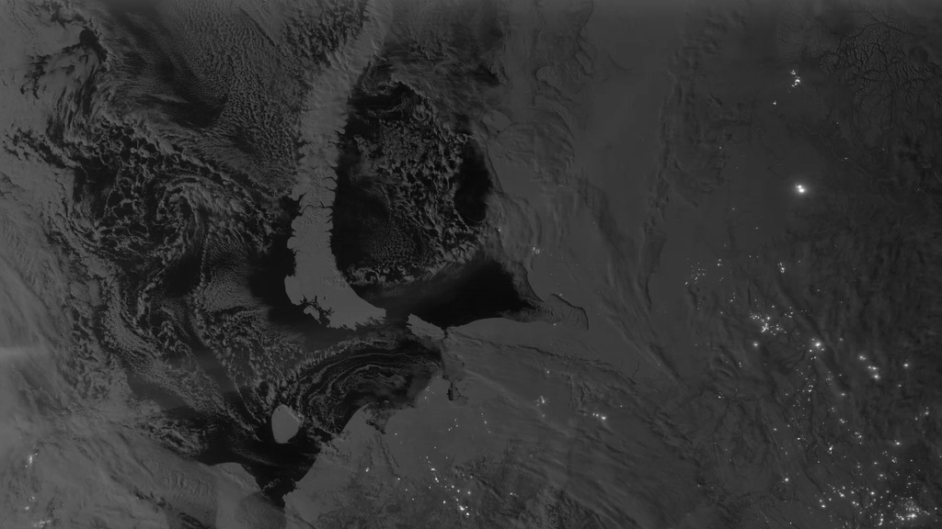
Notes:
4. Night lights animation (1:30) - http://svs.gsfc.nasa.gov/30028 This new space-based view of Earth's city lights is a composite assembled from data acquired by the Suomi National Polar-orbiting Partnership (Suomi NPP) satellite. The data was acquired over nine days in April 2012 and thirteen days in October 2012. It took the satellite 312 orbits and 2.5 terabytes of data to get a clear shot of every parcel of Earth's land surface and islands. This new data was then mapped over existing MODIS Blue Marble imagery to provide a realistic view of the planet.
The view was made possible by the "day-night band" of Suomi NPP's Visible Infrared Imaging Radiometer Suite. VIIRS detects light in a range of wavelengths from green to near-infrared and uses "smart" light sensors to observe dim signals such as city lights, auroras, wildfires, and reflected moonlight. This low-light sensor can distinguish night lights tens to hundreds of times better than previous satellites.

Slide 5
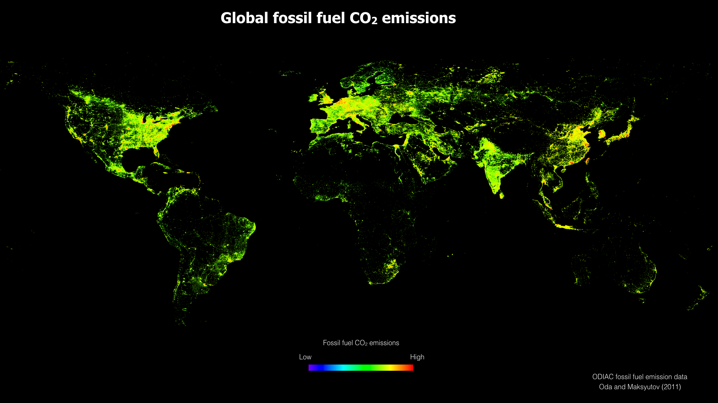
Notes:
5. ODIAC global image https://svs.gsfc.nasa.gov/hyperwall/index/download/events/2016-cop/ott/ott_flux_slide4.jpeg

Slide 6
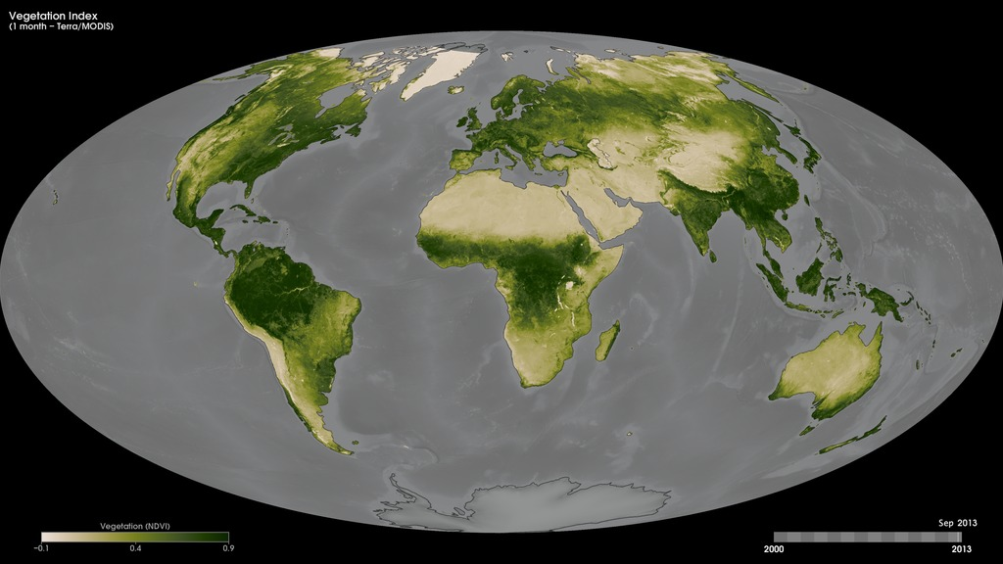
Notes:
6. MODIS NDVI animation (0:33) - http://svs.gsfc.nasa.gov/30376 Monthly Vegetation Index One of the primary interests of NASA's Earth Sciences Program is to study the role of terrestrial vegetation in large-scale processes with the goal of understanding how our world functions as a system. These maps show monthly Normalized Difference Vegetation Index (NDVI) values—a measure of the "greenness" of Earth's landscapes—from February 2000 to the present. The values, derived using data collected by the Moderate Resolution Imaging Spectroradiometer (MODIS) onboard NASA's Terra satellite, range from -0.1 to 0.9 and have no unit. Rather, they are index values in which higher values (0.4 to 0.9) show lands covered by green, leafy vegetation and lower values (0 to 0.4) show lands where there is little or no vegetation. Dark green areas show where there was a lot of green leaf growth; light greens show where there was some green leaf growth; and tan areas show little or no growth. Black means no data.

Slide 7
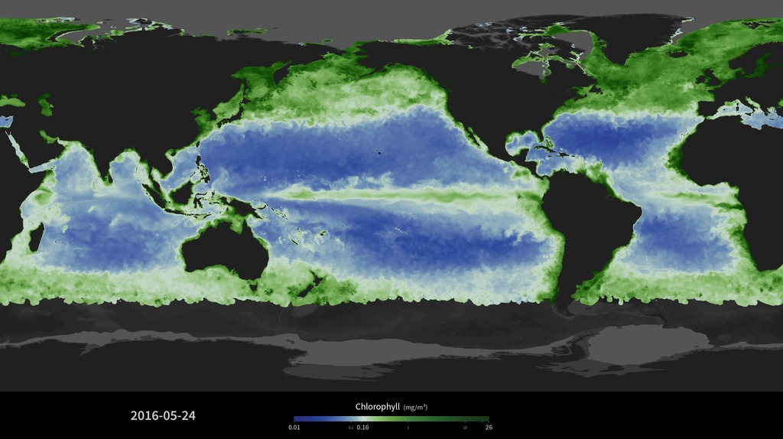
Notes:
7. MODIS ocean color animation (1:20) - http://svs.gsfc.nasa.gov/30786 MODIS Ocean Bioproductivity This visualization, derived using data from the Moderate Resolution Imaging Spectroradiometer (MODIS), shows a daily running weighted 31-day average of sea surface chlorophyll from January 2010 through May 2016. The MODIS data have been smoothed with a spatial filter to fill in areas of missing data caused by clouds. Chlorophyll is a proxy for phytoplankton abundance. Phytoplankton are microscopic algae: primary producers that turn sunlight into chemical energy that supports the ocean food web. Like plants on land, phytoplankton need sunlight and nutrients to bloom. The main source of ocean nutrients comes from cold, deep ocean water that wells up to the surface, called upwelling. The circulation of the ocean and atmosphere determine where nutrients upwell. Areas of upwelling, and thus phytoplankton productivity, include the subpolar gyres, along the equator, along the west coast of continents, along western boundary currents (e.g., Gulf Stream) and near islands. Other sources of nutrients include run-off from land and atmospheric deposition of minerals. Phytoplankton bloom patterns change with short-term weather systems, with the seasons, and with longer-term climate patterns such as El Niño. Ocean color satellite data such as these allow scientists to study global phytoplankton distribution, crucial for understanding the differences between long-term trends caused by natural oscillations and anthropogenic climate changes (i.e., ocean warming, stratification, acidification).

Slide 8
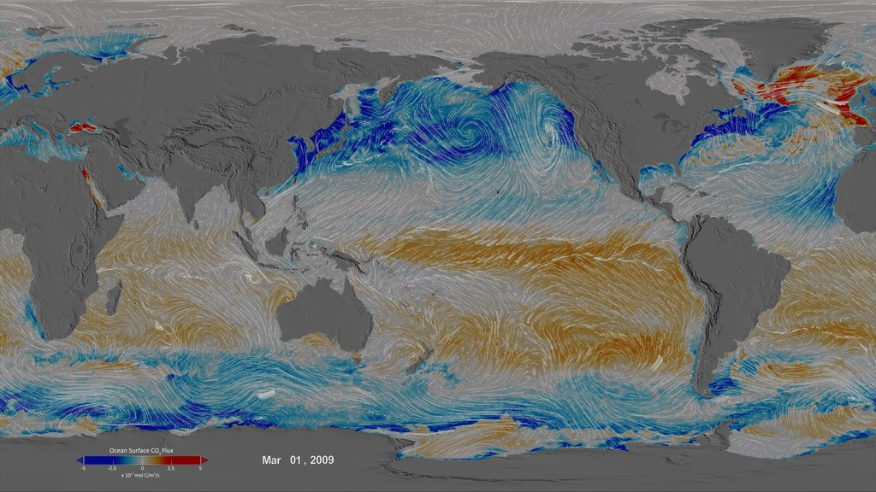
Notes:
8. ECCO2 CO2 flux and winds (3:15) - http://svs.gsfc.nasa.gov/4398 Ocean Surface CO₂ Flux with Wind Stress There are no direct global-scale observations of carbon fluxes between the land and oceans and the overlying atmosphere. Understanding the carbon cycle requires estimates of these fluxes, which can be computed indirectly using models constrained with global space-based observations that provide information about the physical and biological state of the land, atmosphere, and ocean. This animation shows results from the ECCO2-Darwin ocean carbon cycle model, which was developed as part of the NASA Carbon Monitoring System (CMS) Flux Project. The objective of the CMS-Flux project is to attribute changes in atmospheric accumulation of carbon dioxide to spatially resolved fluxes by utilizing the full suite of NASA data, models, and assimilation capabilities.

Slide 9
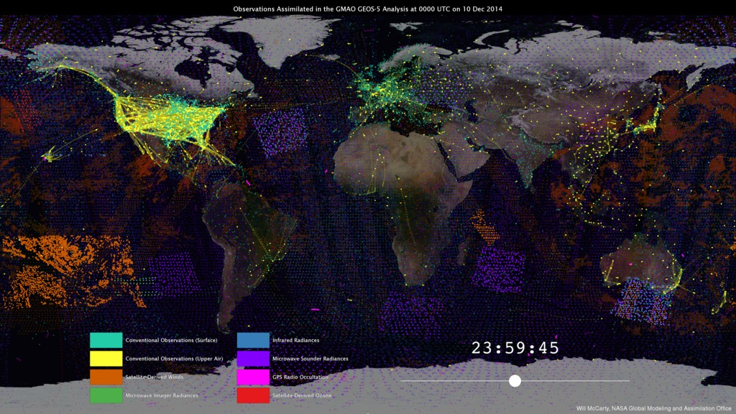
Notes:
9. From Observations to Models (0:49) - http://svs.gsfc.nasa.gov/30590 From Observations to Models NASA’s Global Modeling and Assimilation Office (GMAO) uses the Goddard Earth Observing System Model, Version 5 Data Assimilation System (GEOS-5 DAS) to produce global numerical weather forecasts four times a day. For each forecast, it is necessary to combine the latest observations from satellites, aircraft, and ground stations with a short-term, 6-hour forecast—a process known as data assimilation. The GEOS-­5 DAS assimilates more than 5 million observations during each 6-hour assimilation period. These observations are assembled from a number of sources from around the globe, including NASA, NOAA, EUMETSAT, commercial airlines, the U.S. Department of Defense, and many others. This visualization shows how different observation types have different strategies. One of the main challenges of data assimilation is to understand how all these observations are alike, how they differ, and how they interact with each other.

Slide 10
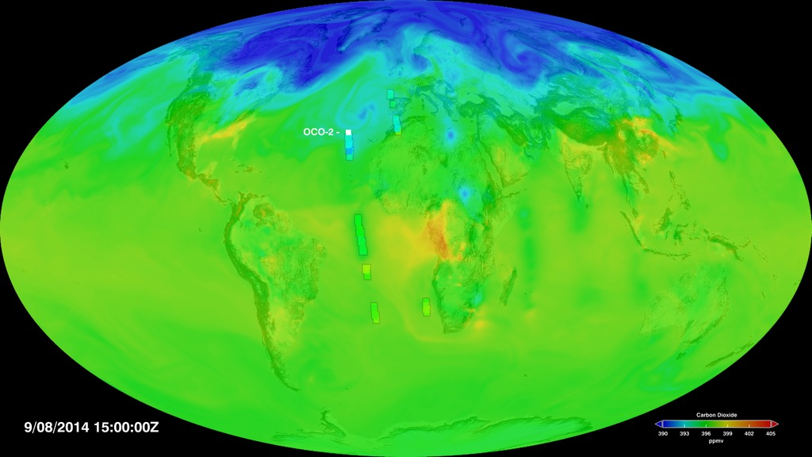
Notes:
10. OCO-2 Carbon data assimilation movie (2:46) - https://svs.gsfc.nasa.gov/4519 This visualization starts by showing carbon dioxide values (colored squares) being measured by the OCO-2 sensor. Soon the total carbon dioxide from the GEOS global atmosphere simulation is shown under the OCO-2 data. Every six hours, the OCO-2 measurements are used to adjust the GEOS simulation values to agree with observed values at those locations, a process called data assimilation. In order to see this process, look for locations where OCO-2 values are shortly followed by local changes in the background data. Carbon dioxide is shown in parts per million by volume (ppmv).
CMS contributors: Lesley Ott (PI, NASA GSFC), Heather Graven (PI, Imperial College London), Kevin Bowman (PI, JPL), Michelle Gierach (co-I, JPL), Dimitris Menemenlis (co-I, JPL), Tomohiro Oda (co-I, GESTAR/USRA), Steven Pawson (co-I, NASA GSFC), Brad Weir (co-I, GESTAR/USRA) Other contributors: Andrew Jacobson (NOAA), Merit Jentoft-Nilsen (Global Science and Technology, Inc.), William McCarty (NASA GSFC), Horace Mitchell (NASA GSFC), Amy Moran (Global Science and Technology, Inc.), Greg Shirah (NASA GSFC), Robert Simmon (Sigma Space Corporation), Cindy Starr (Global Science and Technology, Inc.)

Slide 11
1. Title slide 2. Carbon dioxide pump handle (1:01) - http://svs.gsfc.nasa.gov/30556 3. System of systems/beachball (0:33) - http://svs.gsfc.nasa.gov/30701 4. Night lights animation (1:30) - http://svs.gsfc.nasa.gov/30028 5. ODIAC global image https://svs.gsfc.nasa.gov/hyperwall/ott_flux_slide5.jpeg
6. MODIS NDVI animation (0:33) - http://svs.gsfc.nasa.gov/30376 7. MODIS ocean color animation (1:20) - http://svs.gsfc.nasa.gov/30786 8. ECCO2 CO2 flux and winds (3:15) - http://svs.gsfc.nasa.gov/4398 9. From Observations to Models (0:49) - http://svs.gsfc.nasa.gov/30590 10. OCO-2 Carbon data assimilation movie (2:46) - https://svs.gsfc.nasa.gov/4519
11. Playlist

