Slide 1

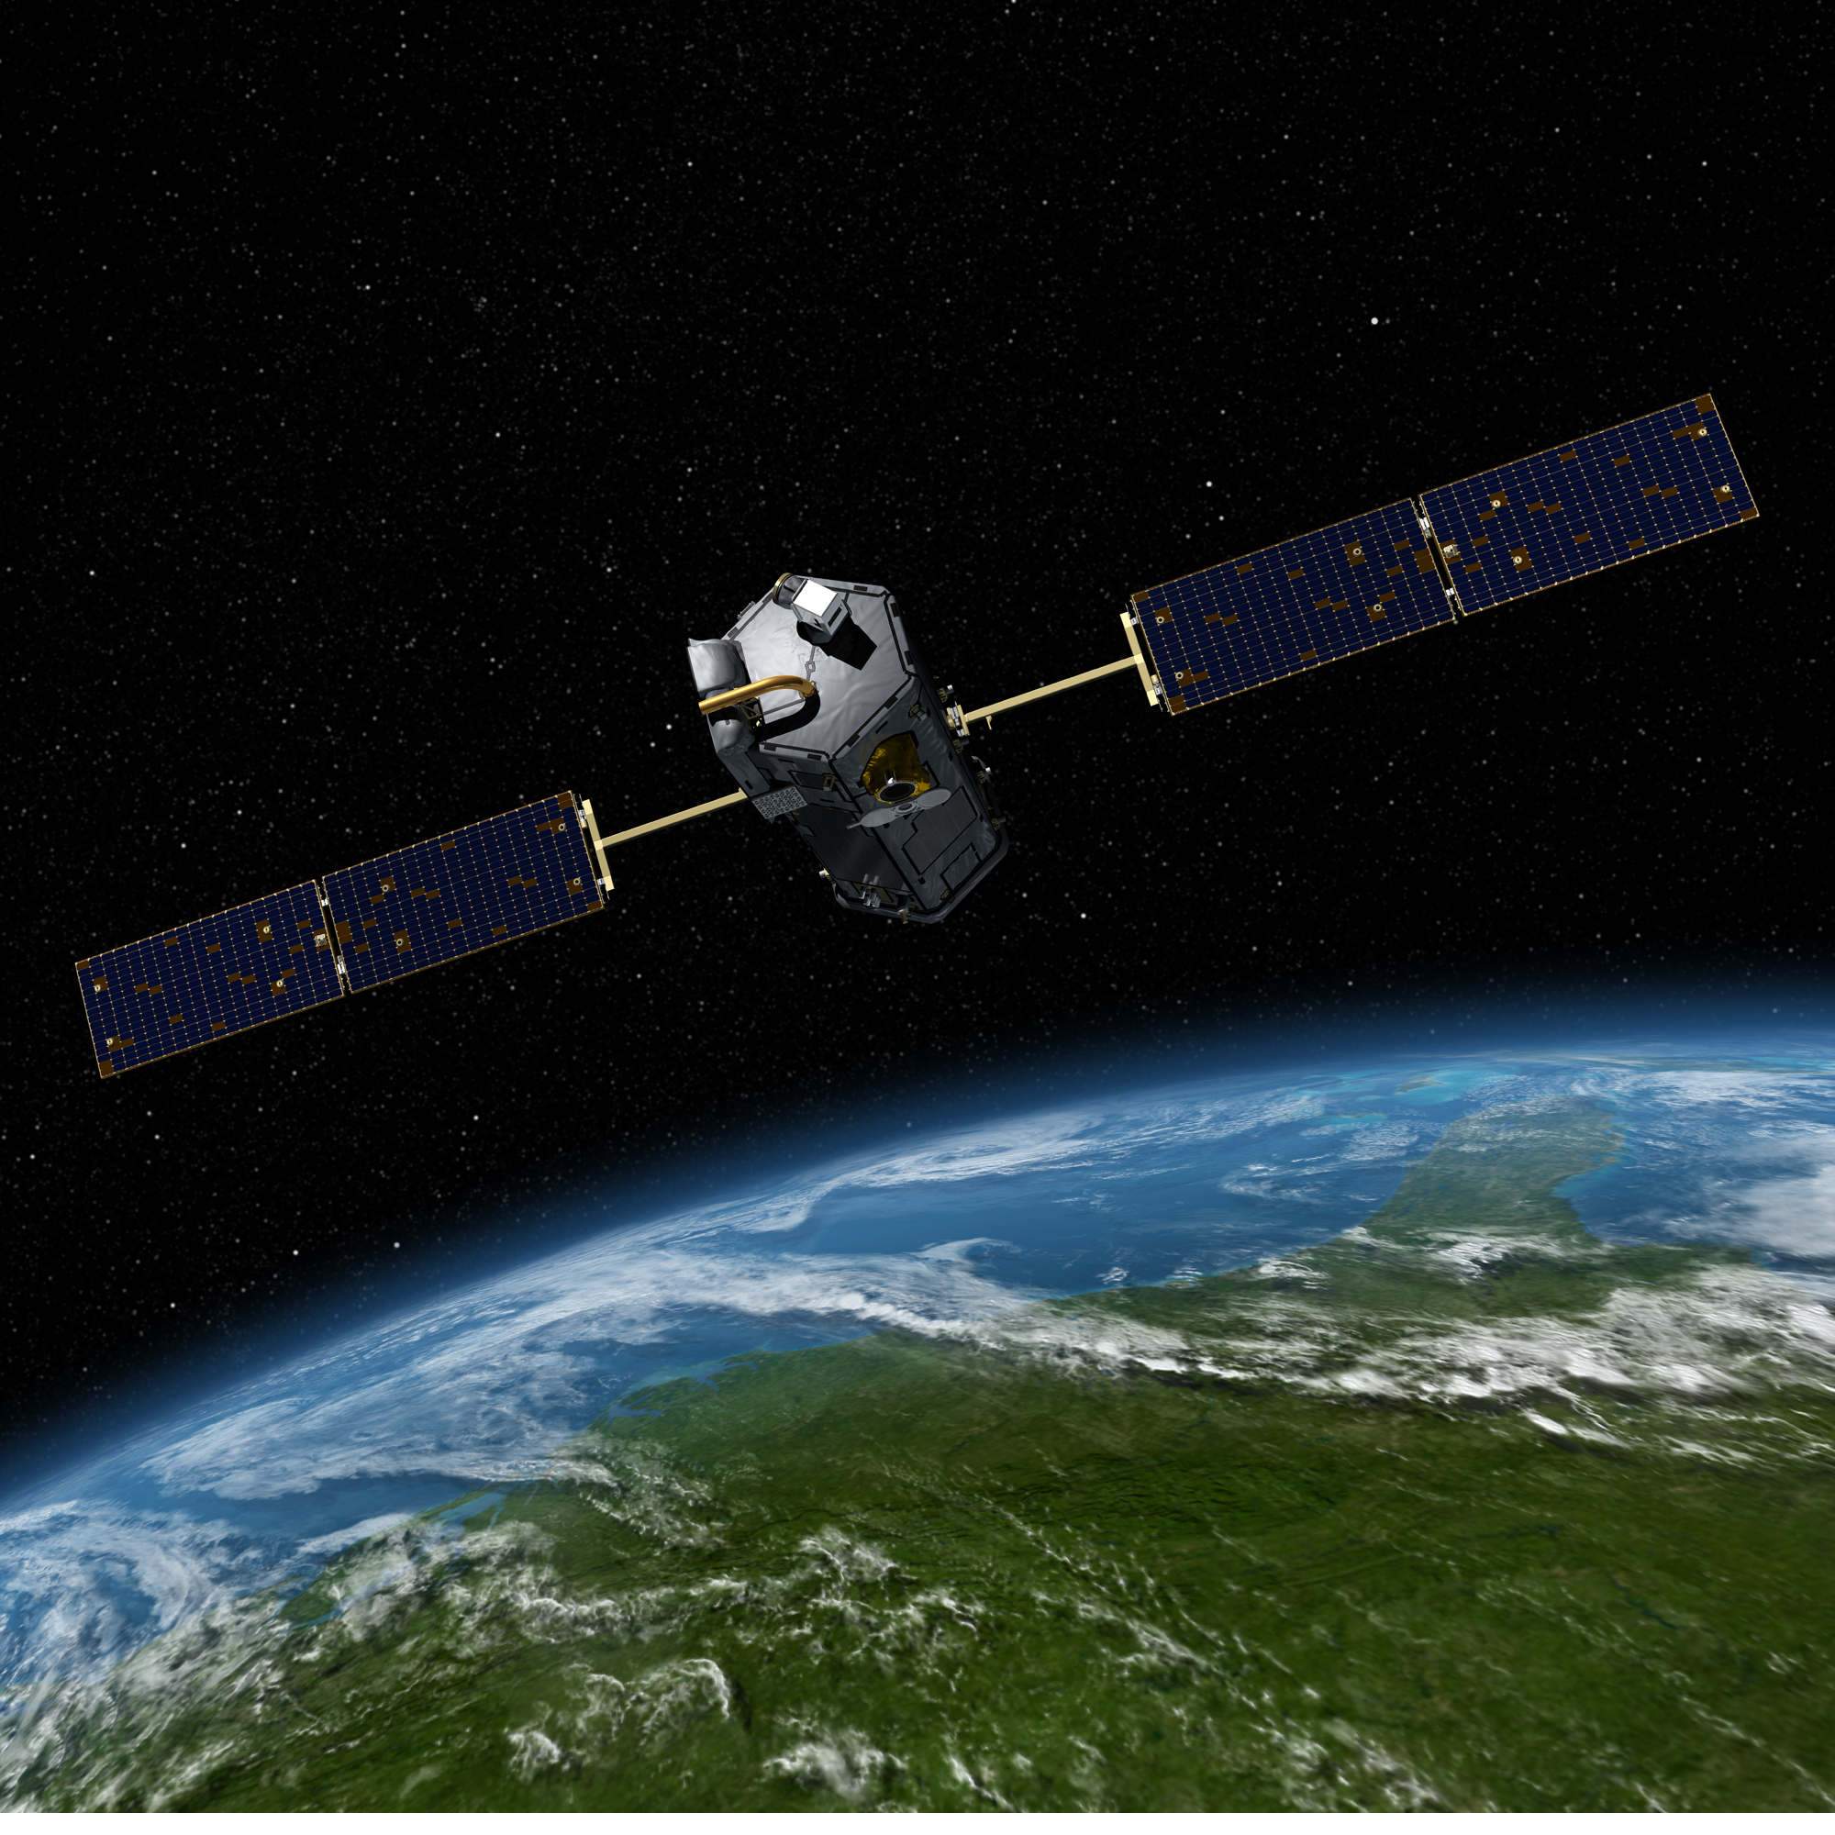
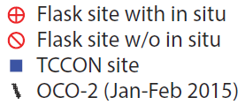
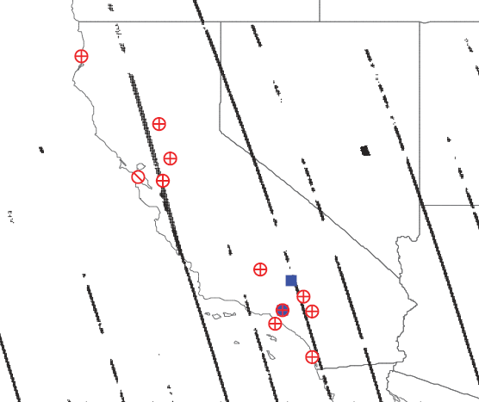










Quantifying Fossil and Biosphere CO₂ Fluxes in California Using Ground-based and Satellite Observations
Heather Graven, Kieran Brophy, Imperial College London
Marc Fischer , Xinguang Cui, Seongeun Jeong, LBNL
Ralph Keeling and Tim Lueker, SIO
Tom Guilderson, LLNL
Nick Parazoo, Junjie Liu, JPL
Jim Collatz, GSFC; Debra Wunch, University of Toronto
Matthias Falk, Jorn Horner, Abhilash Vijayan, Ying Hsu, California Air Resources Board
Bill Callahan and Chris Sloop, Earth Networks
John Miller, NOAA; Laura Iraci, NASA
Sally Newman, Christian Frankenberg, Caltech
Brian LaFranchi, Ray Bambha, Hope Michelson, Sandia

Slide 2
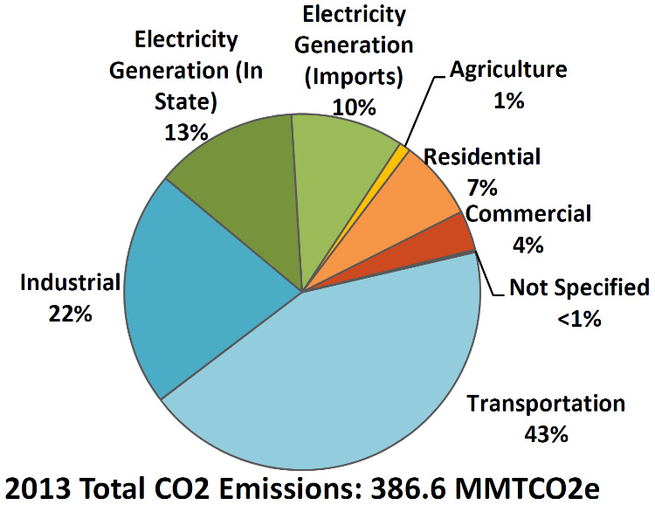
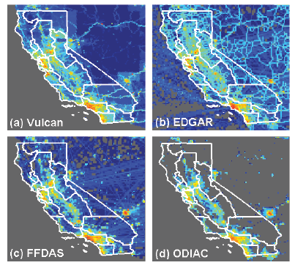


California’s CO₂ emissions
Sectoral CO₂ emissions,
California Air Resources Board
Legislated GHG emissions reductions: 15% by 2020, 40% by 2030, & 80% by 2050
~ 80% of CA GHG ffCO₂ ~100 Tg C/yr
Spatial distribution varies by ±15% across emission models (not all equally certain)
Biosphere Fluxes Less Certain
Vary with climate from -24 (sink) to +15 (source) Tg C yr⁻¹ (Potter et al. 2010)
Recently, California carbon stocks decreased 14 +/- 3.5 Tg C yr⁻¹ from 2001 to 2008 (Battles et al., 2014, ARB #10-78 )
Model variations from mean (%)
 | CA Total | South Coast | SF Bay | SJ Valley
Vulcan 2002 | -4 % | -10 % | +11 % | -39 %
EDGAR 2008 | +12 % | +9 % | +14 % | +40 %
ODIAC 2008 | -8 % | +2 % | -25 % | -1 %

Slide 3
CMS Project Goal:
Develop Prototype Monitoring System to Estimate Annual Regionally Resolved Fossil Fuel and Biosphere CO₂ Fluxes
Observations:
Tower campaigns:
11 tower ^{14,13,12}CO₂, CO network
May 2014, Oct-Nov 2014, Jan-Feb 2015
Column Remote Sensing:
OCO-2 – Western US & Eastern Pacific during campaign periods
TCCON – Caltech and Dryden during campaign periods
Aircraft:
Airborne (AJAX) – campaigns
Analysis for California
Prior Fluxes:
Biosphere fluxes: CASA (CMS)
Fossil fuel fluxes: Vulcan, adding FFDAS, ODIAC, EDGAR
Met/Transport:
WRF-STILT (nested domains, 1km resolution in urban regions)
UM-NAME (17-25km resolution)
Bayesian Inversions:
Observation Simulation Experiment w/ prior fluxes for CA air basins
Data-driven inversion of fossil fuel CO2 emission at air-basin and pixel (0.3 degree ) levels

Slide 4
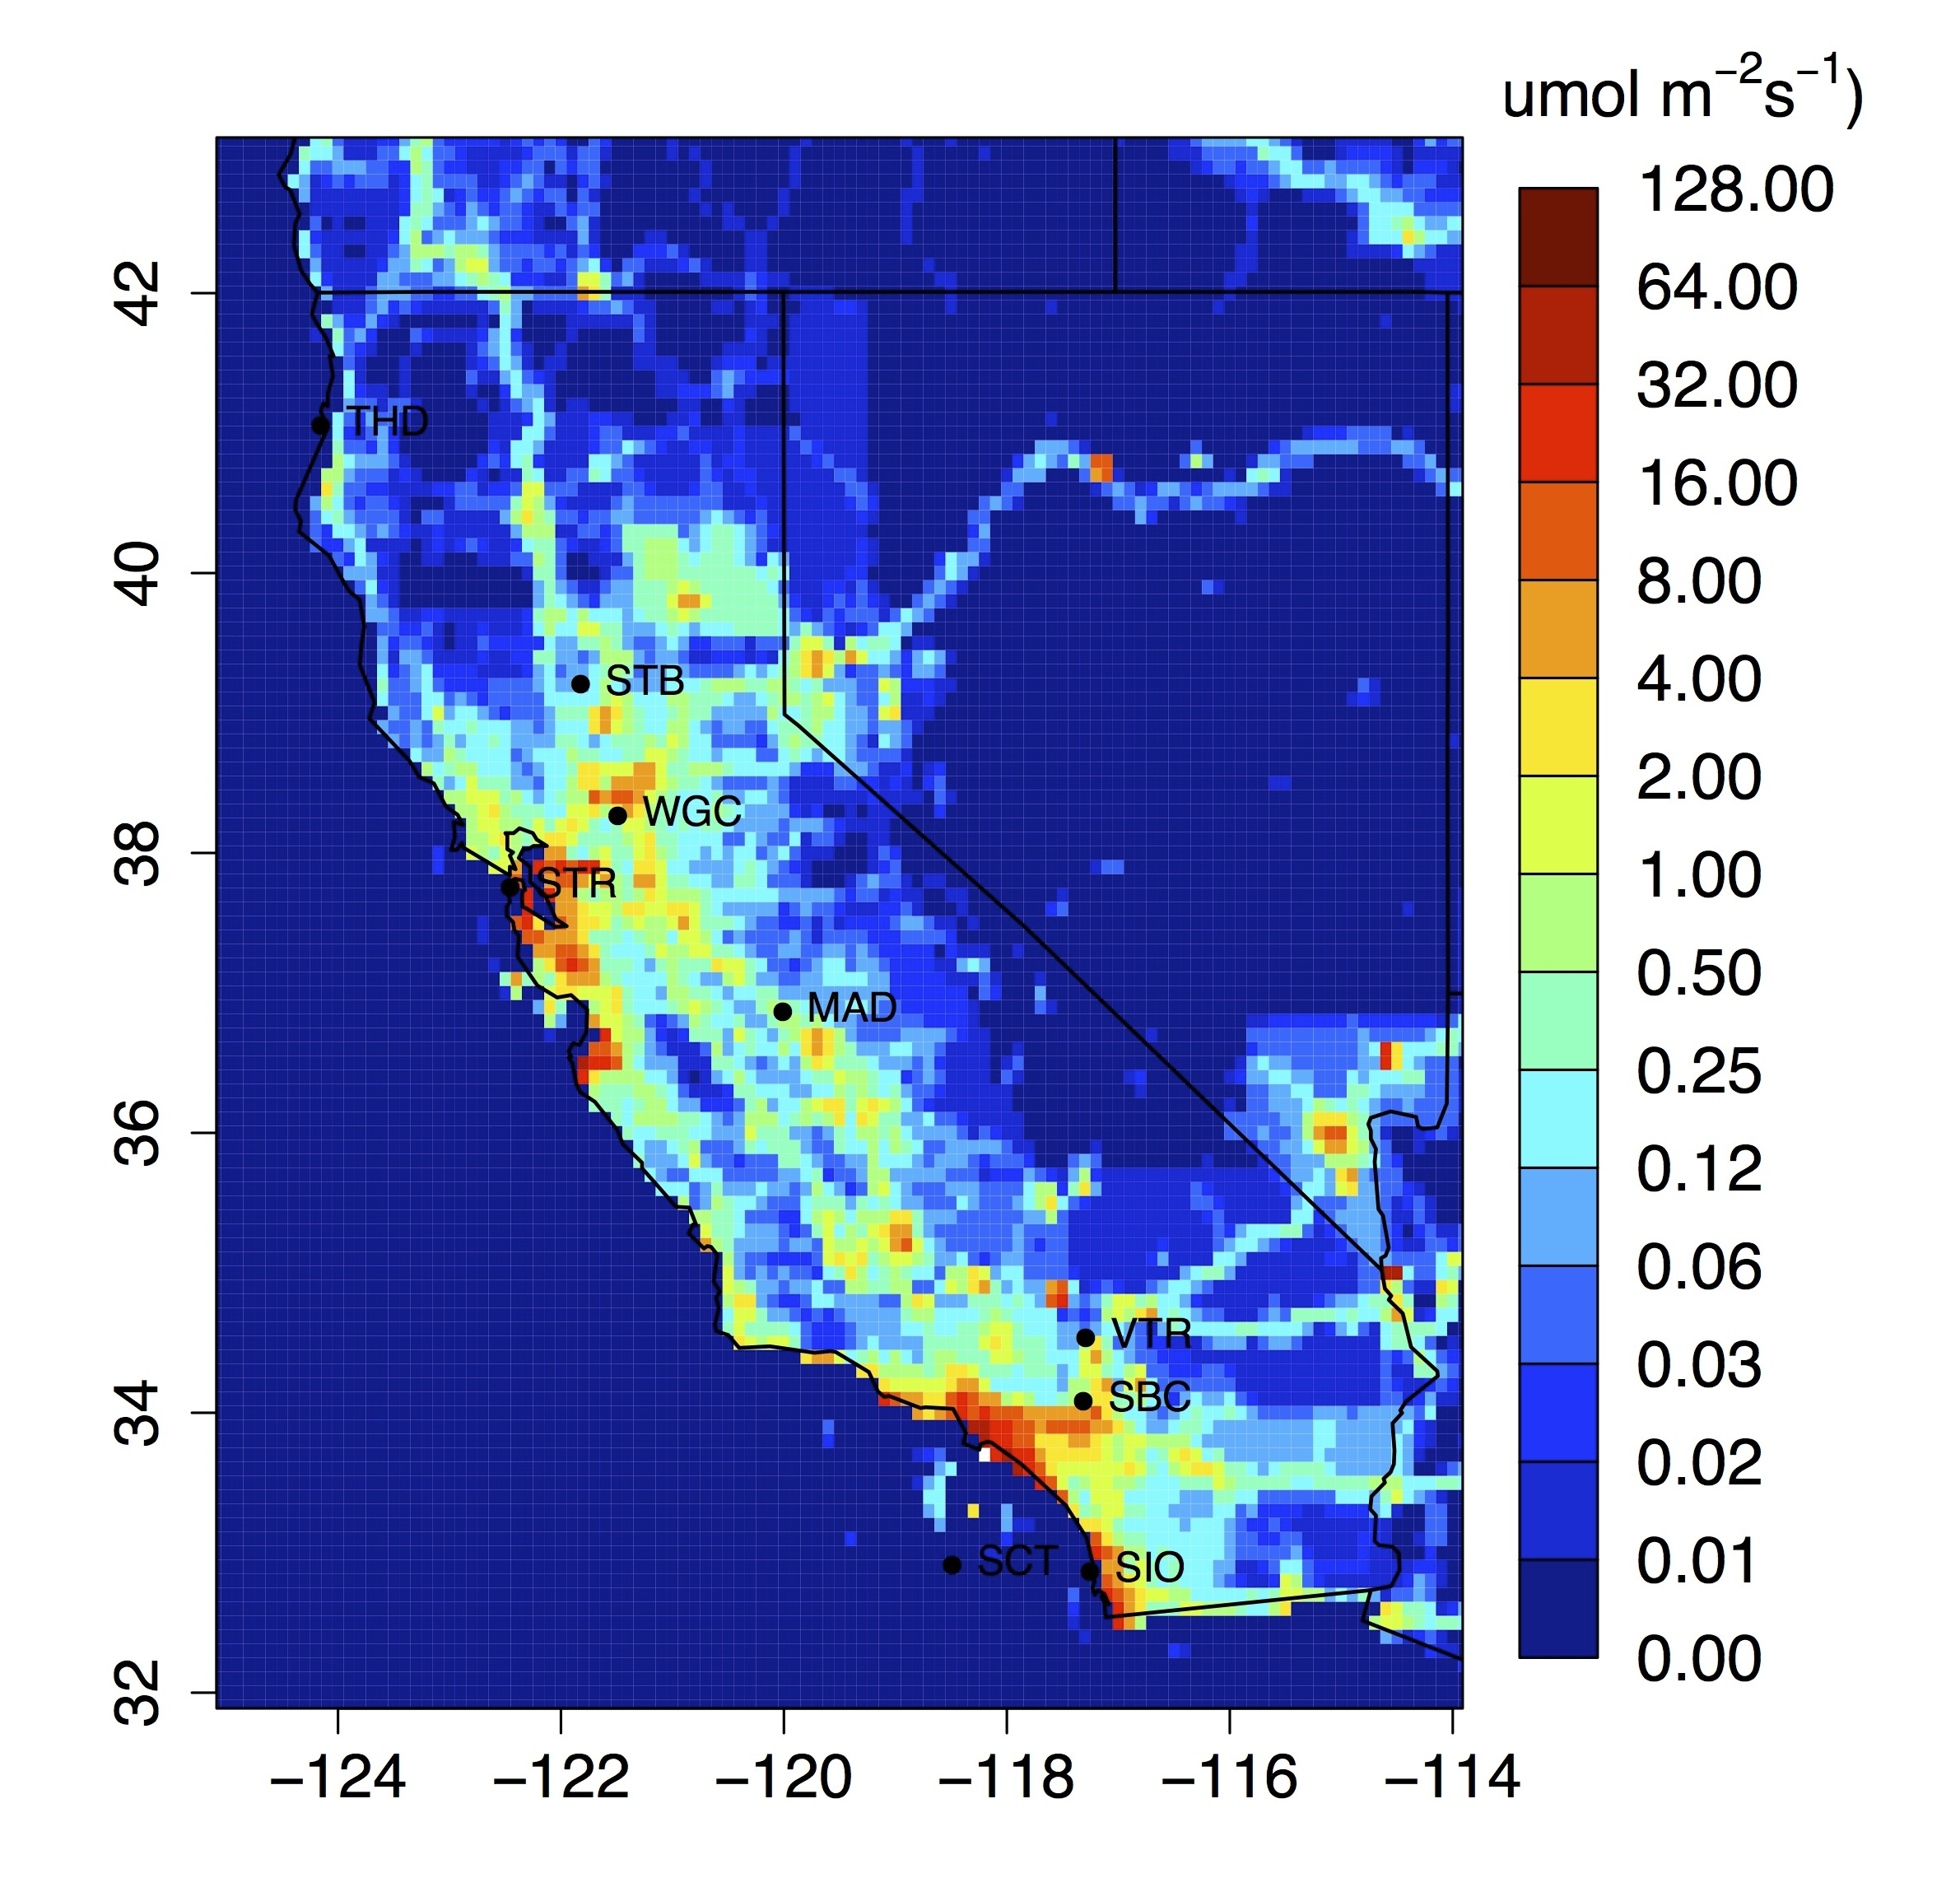
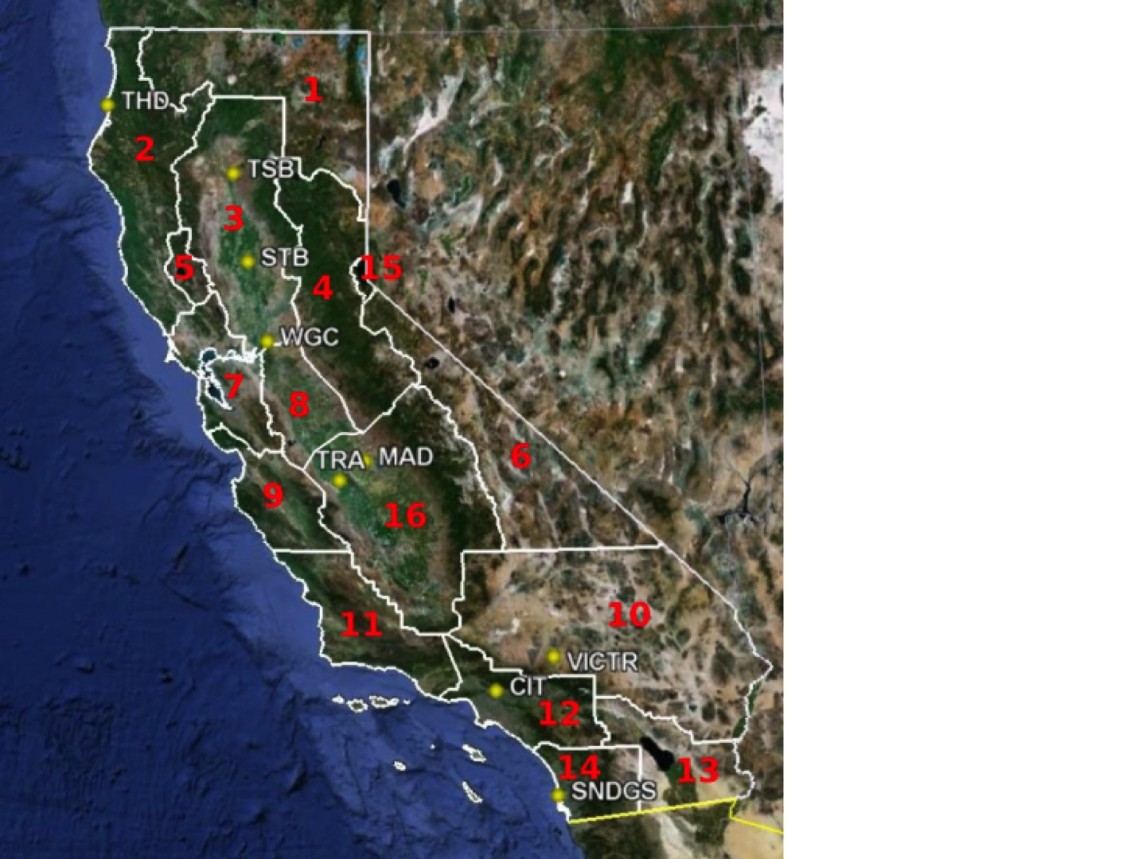
Prior Flux Models
VULCAN 2.2 ffCO₂ CA Air Basins
Fossil fuel (0.1 deg)s:
  Vulcan
  Adding ODIAC, others
Biosphere (0.5 deg- 1 deg):
  CMS CASA
  Adding VPRM
Gurney et al., 2009
CMS CASA bioCO₂ (Collatz)
May Nov.

Slide 5
Predicted Tower CO₂ Signals for OSSE
ffCO2
May Nov.
Prior fluxes
WRF-STILT footprints
Assume tower flasks sampled every 2 days (~15/mo)
40 ppm
bioCO2
May Nov.

Slide 6
Predicted OCO2 Signals for OSSE
OCO2 nadir tracks averaged to 0.1 deg bins
Signals dilute (1/10 th) that obtained from surface flasks
Full column predictions less sensitive to height of planetary boundary layer
ffCO2
May Nov.
bioCO2
May Nov.

Slide 7
Pseudo Data Inversions
Combine flask and OCO2 pseudo obs to estimate ffCO₂ and bioCO₂ exchange
Uncertainty assumptions (1σ, 68% CL):
  Flasks: 1.5 ppm ffCO₂, 0.1 ppm total CO₂
  OCO2 : 0.5 ppm XCO2 retrievals
  Background subtractions increase obs uncertainties by ~ 50%
  Model-measurement error, R: 30% (OCO2) to 50% (Flask) mean signal for each site, where OCO2 less sensitive to PBL error
  Prior uncertainties, Q: ffCO2 = 10-40% & with bioCO2 = 50-75%
Bayesian inversion on emission scaling air basin factors estimate data constraints on posterior variance, V_{post} ,
,
where K are predicted signals

Slide 8
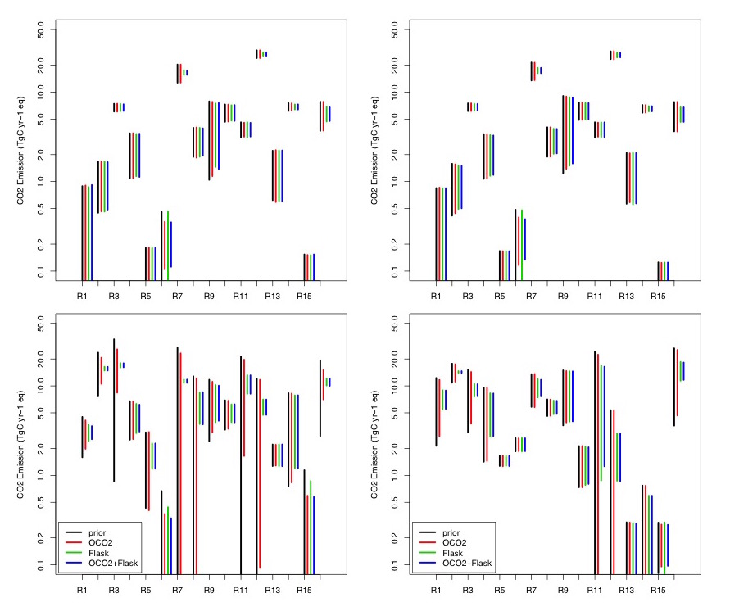
Uncertainties in Pseudo Inversions
Estimate posterior uncertainties using OCO2, flask, and flask + OCO2
ffCO2 uncertainties reduced for large urban regions
bioCO2 reduced for selected forests, range, and crop lands
CA total ffCO2 uncertainties reduced from ~ 8% to 5-6% (68% CL) depending on season
ffCO2
May Nov.
SFBay Sac SoCAB SanDiego
bioCO2
Forests Crops
d

Slide 9
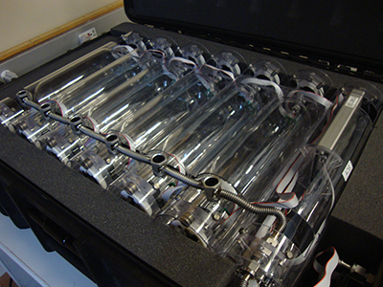
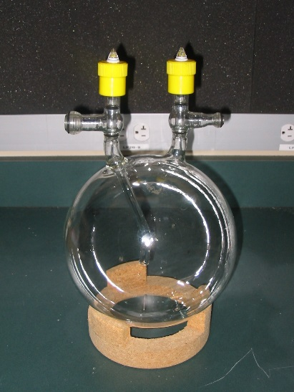
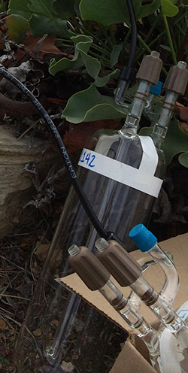
Flask sampling campaigns across California
11 tower sites (ARB, CIT, EN, LBNL, NOAA, SIO, SNL)
May 2014, Oct-Nov 2014, Jan-Feb 2015 – flasks sampled approx. every 3 days at 14:30 PST
Flasks analyzed for CO₂ and CO concentrations with Picarro G2401 at SIO
CO₂ extracted and analyzed for δ¹³C with IRMS at SIO, “freeze-back” method
CO₂ analyzed for Δ¹⁴C with AMS at LLNL, (small samples ~ 0.25 mgC)
In-situ CO₂ available at most sites, in situ CO at some sites
TCCON, OCO-2, aircraft data, other in situ sites
PFPs
Manual
flasks

Slide 10
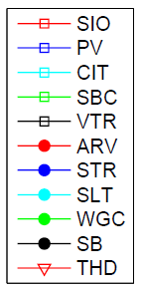
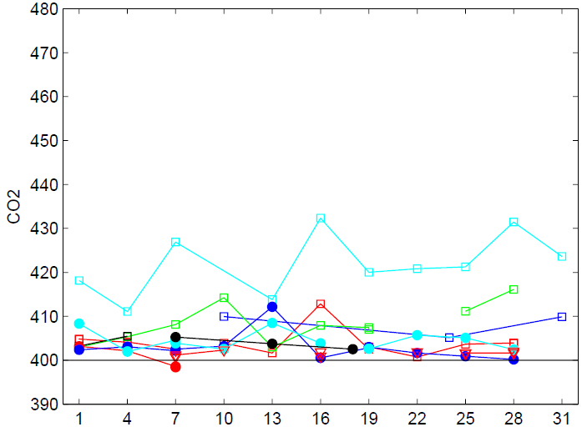


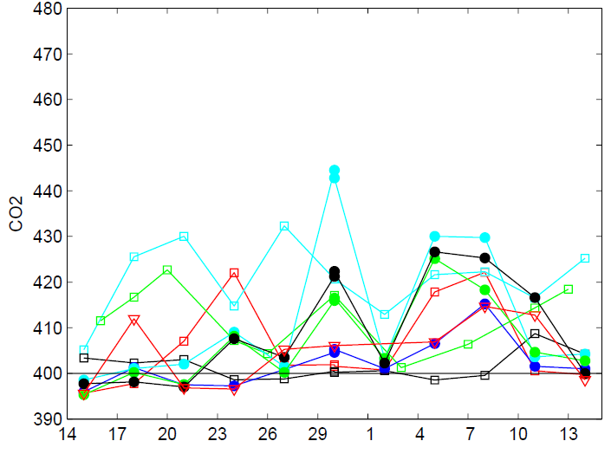
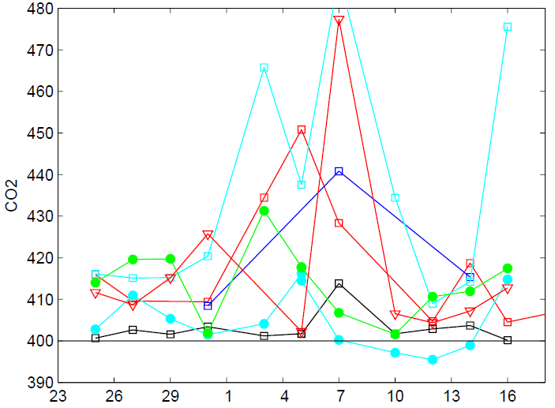
Observed
Total CO₂ (ppm)
Cobs = Cbg + Cff + Cbio

Slide 11
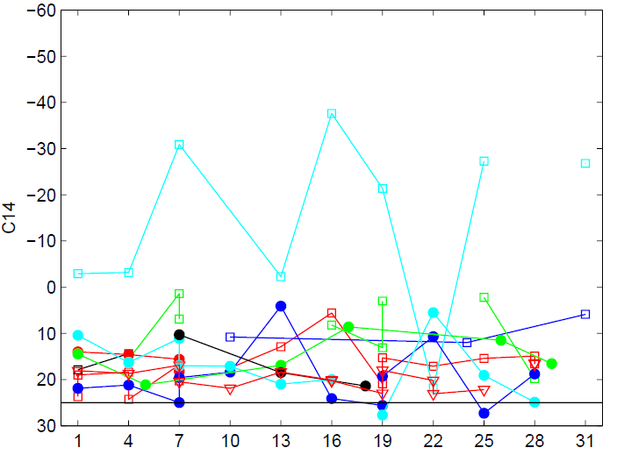
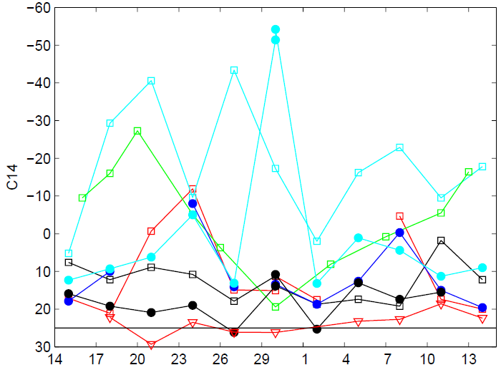
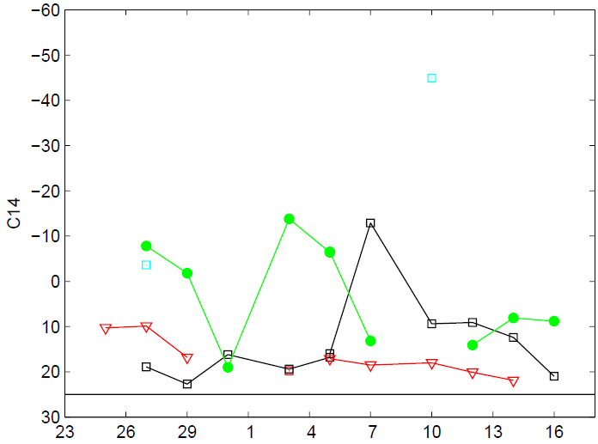

Observed
Δ¹⁴C

Slide 12
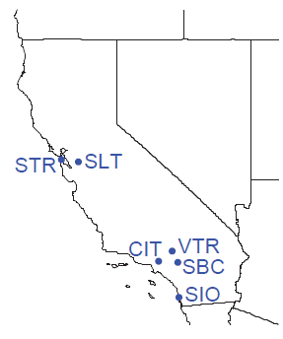
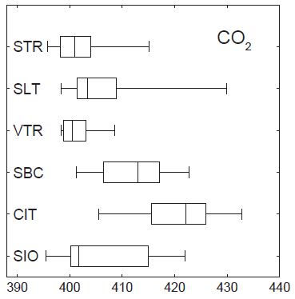
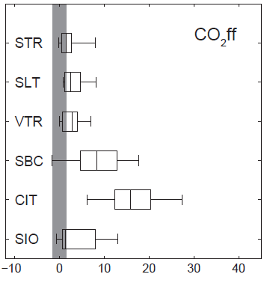
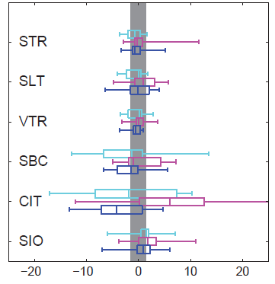

Compare Predicted and Observed ffCO2
Simulated and Observed CO₂ff generally agree to within uncertainty
Some patterns in model-data mismatch
Boxplots w/ quartiles for Oct-Nov 2014
CO₂ (ppm)
CO₂ff (ppm)
difference in CO₂ff (ppm)
simulated – observed
in individual flasks

Slide 13
Initial Fossil Fuel CO₂ Inversions for Campaigns
Oct-Nov, 2014
Inversions follow previous work on CH₄ (Jeong, JGR, et al., 2013, 2016)
  Scaling factor by region SFBI w/ specified uncertainties (50% model-measurement)
  Hierarchical Bayesian inversion for 0.3 deg pixels w/ optimized uncertainties
CA total ffCO₂ emissions
  Uncertainties ~ 12% (68%CL)
  Incorportate in-situ and remote sensing data to further constrain emissions
Prior
HBI
SFBI
 |  | tgC/yr
Date | SFBI | SFBI.err (68%) | HBI.med | HBI.5pct | HBI.95pct
May-14 | 90.0 | 12.0 | 97.6 | 71.5 | 130.9
Oct-Nov 14 | 90.3 | 12.3 | 110.2 | 79.6 | 151.6
Jan-Feb 15 | 93.5 | 14.7 | 99.5 | 73.9 | 129.0

Slide 14
OCO2 Observations
Oct-Dec, 2014
Quarterly nadir+glint obs overlapping two campaign periods
  Oct-Dec, 2014
  Jan-March, 2015
  Screen QC flag <= level 10
Next steps:
  Bias correction
  background subtraction
  uncertainty analysis
Jan-Mar, 2015

Slide 15
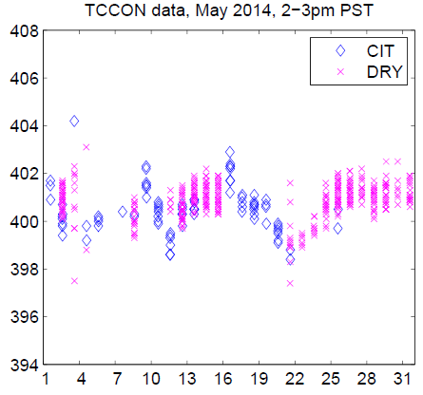
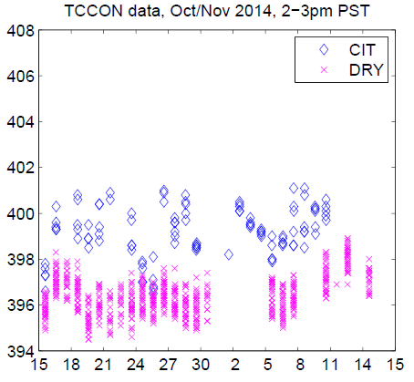
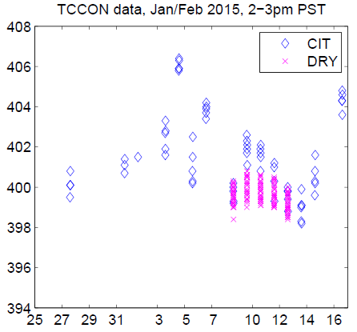
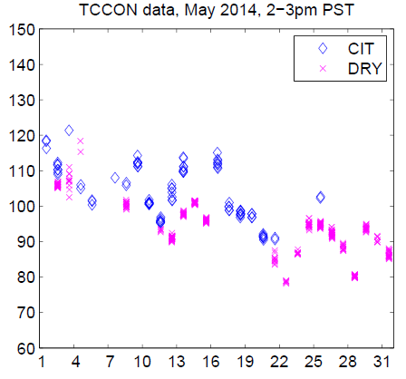
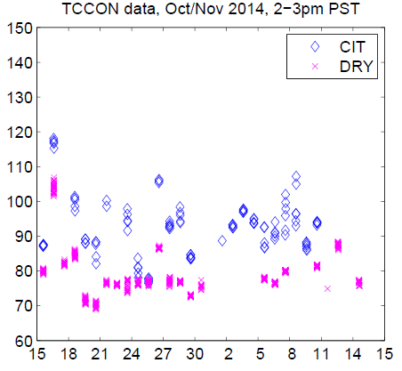
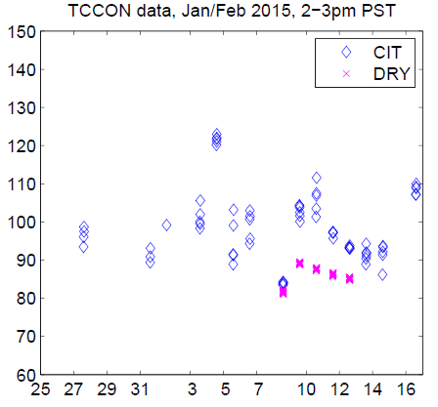
TCCON Observations
CO₂
CO

Slide 16
Summary
Project combines tower and OCO2 observations to study fossil fuel and biospheric CO₂ fluxes across California
OSSE suggests flask and OCO2 provide constraint on fossil fuel emissions and biosphere exchange in some urban and rural regions
2014-2015 campaign data exhibits similar patterns of CO₂
Initial inversions for ffCO₂ emissions using ¹⁴CO₂ campaign data consistent with prior
Further work
Finalize and incorporate OCO2, TCCON, and other data for campaign periods – bias and uncertainty estimates key
Conduct combined ffCO2 and bioCO2 flux inversions

