Slide 1
Characterizing methane emissions from the largest oil producing basin in the US
Ritesh Gautam
Environmental Defense Fund, Washington DC
Brief Overview of EDF’s oil & gas methane science efforts
CMS products & EDF Collaboration with Daniel Jacob’s group at Harvard
Permian Basin methane emission quantification

Slide 2
EDF oil & gas methane science efforts
Assessment of methane emissions from US oil & gas supply chain
EDF Synthesis of recent bottom-up & top-down measurement based results (Alvarez et al. 2018 in Science).
Permian Basin methane emission quantification.
International methane studies
EDF, Climate and Clean Air Coalition (CCAC), Oil and Gas Climate Initiative (OGCI) and European Commission are working together on a series of peer-reviewed scientific studies to measure methane emissions in the oil and gas sector.
Data collected will help companies and governments prioritize actions and policies to reduce methane emissions.
MethaneSAT
EDF leading development of MethaneSAT program.
Goal- map and quantify methane emissions with an initial focus on the oil/gas production areas.
Science team at Harvard & SAO. Prime Instrument developer- Ball Aerospace. Launch – 2022.

Slide 3
CMS relevant products & EDF Collaboration with Daniel Jacob’s group at Harvard
Daniel Jacob (PI), Yuzhong Zhang (Joint Harvard/EDF postdoc), Jianxiong Sheng (Joint Harvard/EDF postdoc, now at MIT), Tia Scarpelli (PhD Student), Bram Maasakkers (PhD Harvard, now at SRON)
Gridded EPA methane emissions inventory for US (Maasakkers et al. 2016)
Gridded methane emissions inventory for Mexico (Sheng et al. 2017, Scarpelli et al. in prep)
Yuzhong’s analytical inversion method for the Permian follows the method developed at Harvard through CMS
Tracking Gas Flaring activity in offshore Mexico using satellite-based multi-pollutant data products (Zhang et al. 2019)
Globally gridded methane emissions inventory from oil, gas, and coal exploitation based on UNFCCC reports (Scarpelli et al. in review)

Slide 4
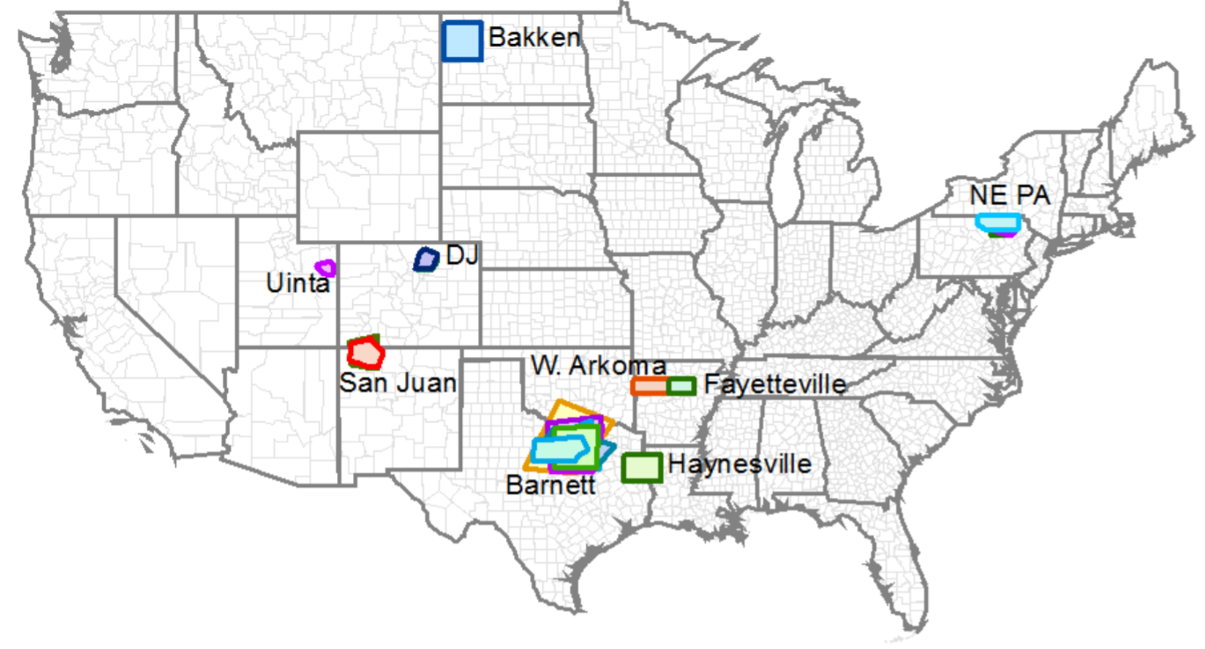
EDF-led US O&G emissions Synthesis study
When scaled up nationally, the Synthesis study indicates US natural gas supply chain emissions to be 13 ± 2 Tg/y (for year 2015), equivalent to 2.3% of gross U.S. gas production (Alvarez et al. 2018).
These areas are distributed across the U.S. and account for ~33% of natural gas, ~24% of oil production, and ~14% of all wells.

Slide 5
Maasakkers et al gridded inventory used to allocate emissions spatially in EDF Synthesis study. Spatially disaggregated emissions were then used to compare Top-Down and Bottom-Up estimates.
Maasakkers, J.D., Jacob, D.J., Sulprizio, M.P., Turner, A.J., Weitz, M., Wirth, T., Hight, C., DeFigueiredo, M., Desai, M., Schmeltz, R. and Hockstad, L., Gridded national inventory of US methane emissions, ES&T (2016).

Slide 6
EDF-led US O&G emissions Synthesis study
When scaled up nationally, the Synthesis study indicates US natural gas supply chain emissions to be 13 ± 2 Tg/y (for year 2015), equivalent to 2.3% of gross U.S. gas production (Alvarez et al. 2018).
Permian Basin (not part of the 9-basin Synthesis study) is located across the states of Texas and New Mexico, and covers an area of 400 km x 400 km.

Slide 7
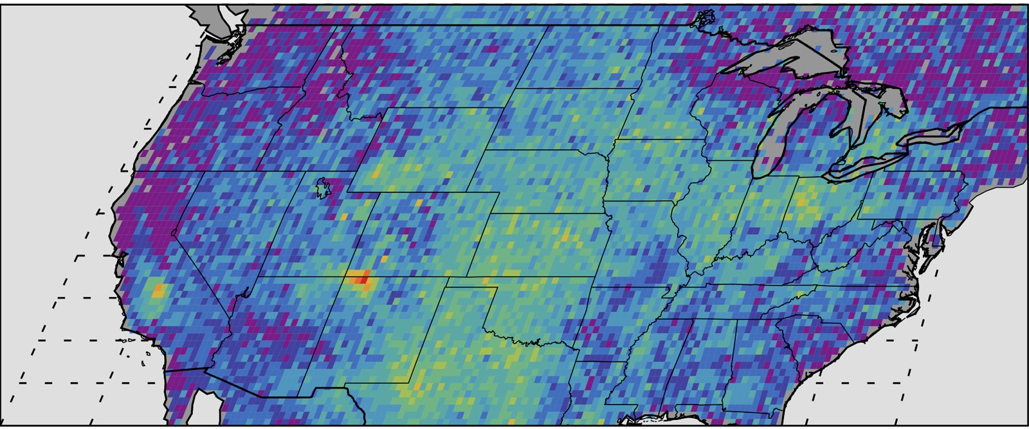
Permian Basin associated with weak methane enhancement in the previous decade
Map below shows anomalous U.S. methane emissions (or how much the emissions differ from average background concentrations) for 2003 to 2009, as measured by the European Space Agency's SCIAMACHY instrument (Kort et al. 2014).

Slide 8
The Permian Oilfield is among the most prolific oil producing basins in the world (largest in the US).
Contributes to >30% of total US oil production.

Slide 9
Oil & Gas production has been on significant rise in the Permian Basin during the past decade, especially the last five years.
Permian Basin
Delaware sub-basin
Midland sub-basin
Zhang et al. (under review)

Slide 10
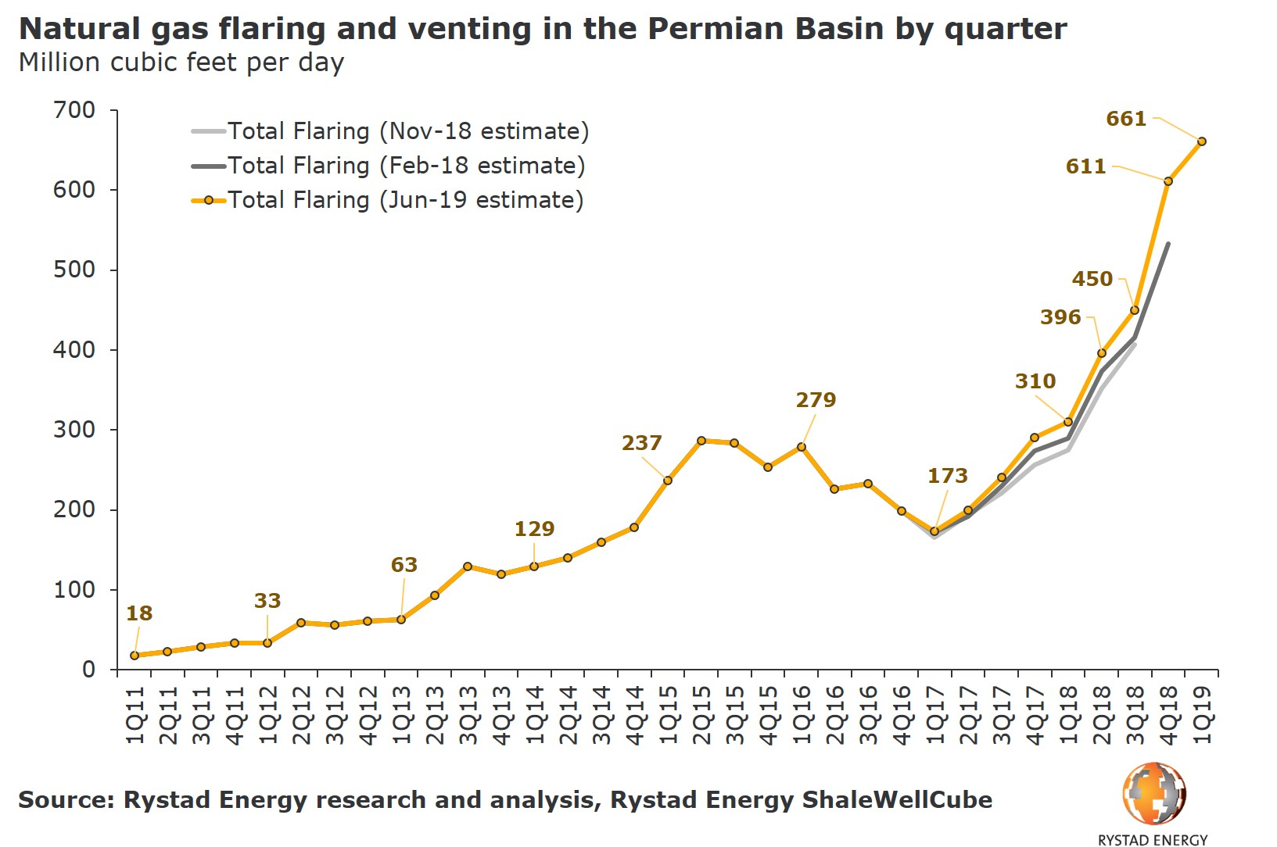

Slide 11
The central question(s) we set out to address-
What is the magnitude of Permian methane emissions and how it compares to emissions from other oil/gas basins in the US?
And whether satellite data can be used to detect & quantify methane emissions from Permian Basin?

Slide 12
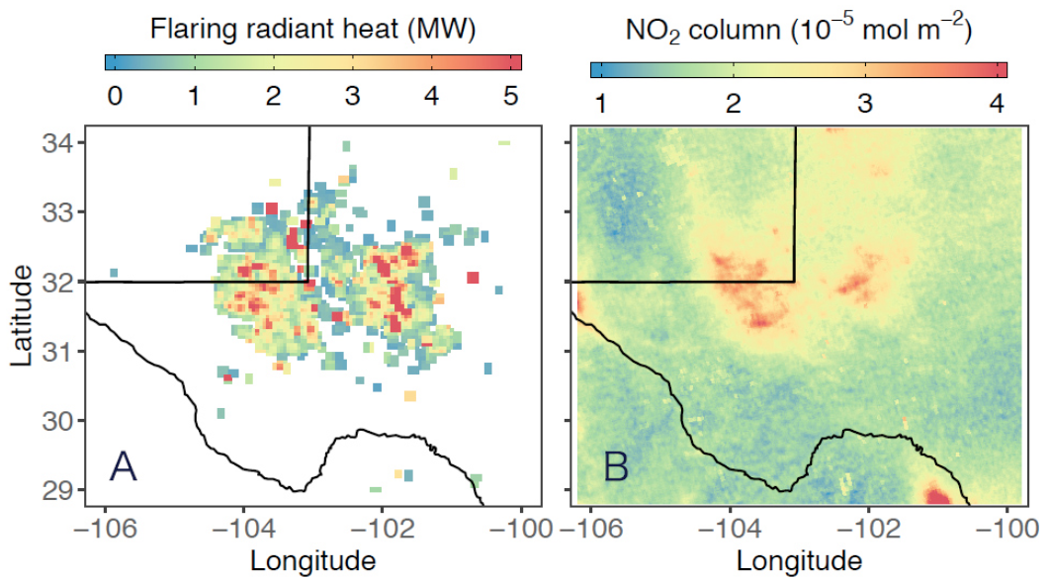
Satellite observations of gas flaring radiant heat (VIIRS data on left) and NO₂ tropospheric column density (TROPOMI data on right) over the Permian Basin
Zhang et al. (under review)

Slide 13
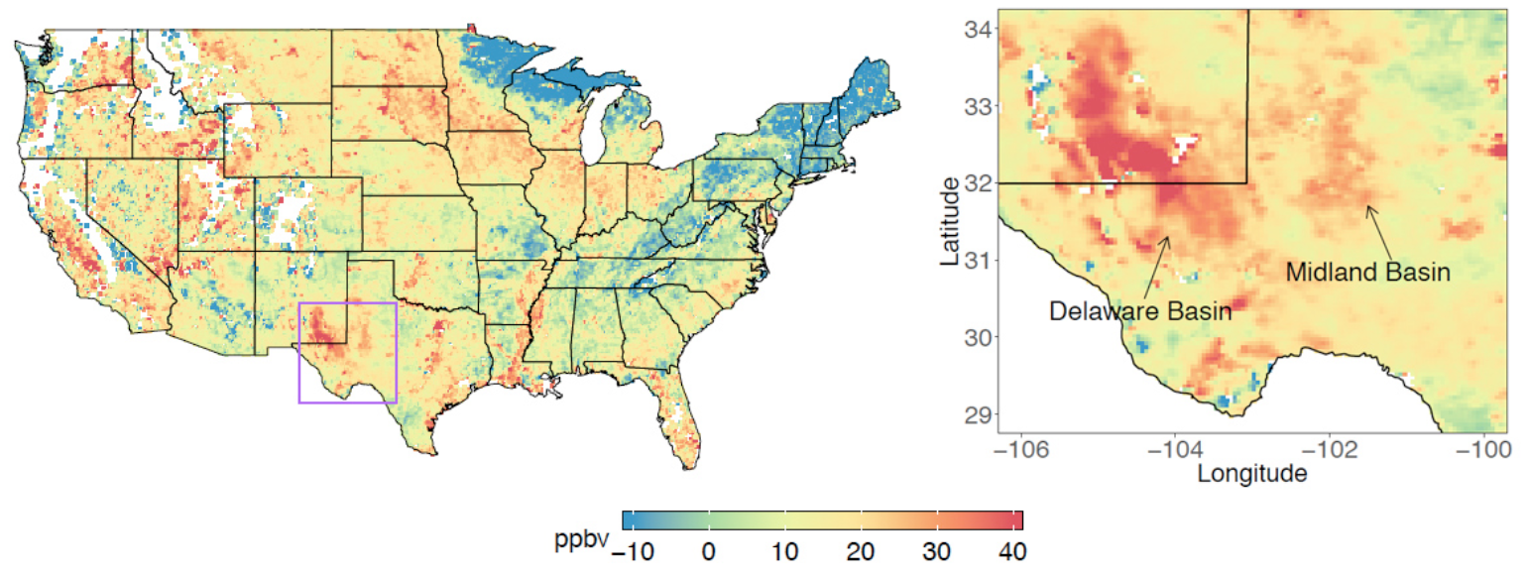
Permian methane anomaly
(10 months of TROPOMI XCH₄ data averaged during May 2018 – March 2019)
Zhang et al. (under review)

Slide 14
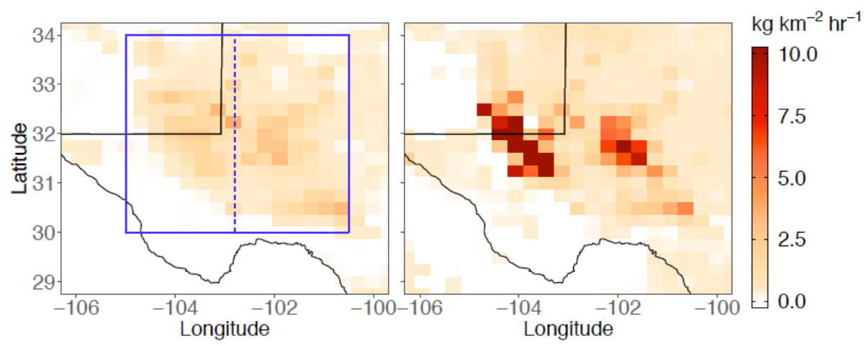
Prior Methane Flux
Posterior Methane Flux
Zhang et al. (under review)
Permian methane emissions derived from TROPOMI data, using full inverse analysis and mass balance, represent the largest methane flux relative to previously-reported U.S. oil & gas producing basins.
This estimate is >2 times larger than emissions extrapolated from recent EPA GHGI data.
EI_{_prior1} – Emissions inventory extrapolated from recent EPA GHGI data (Maasakkers et al.)
EI_{_prior2} – Emissions derived from recent EDF/U. Wyoming data (Mark Omara et al.)
Atmospheric Inversion using TROPOMI data – Yuzhong Zhang et al.
Mass Balance estimate using TROPOMI data– Pankaj Sadavarte et al. (SRON)
Alvarez et al. 2018 – EDF synthesis of US oil/gas methane emissions

Slide 15
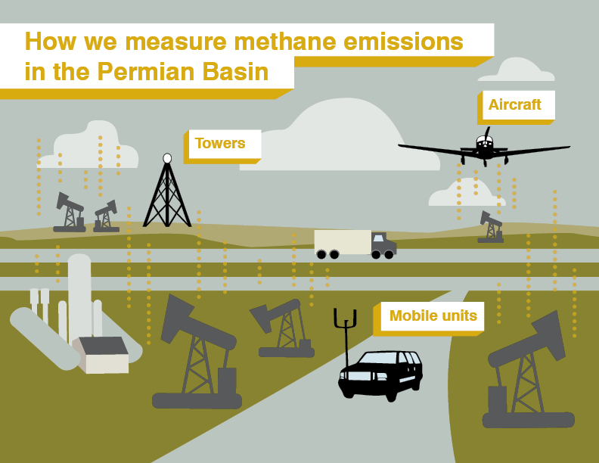
Permian Basin Methane Campaign Lead Organization – EDF (David Lyon et al.) Partners- Penn State Univ. (Ken Davis et al.) Scientific Aviation (Steve Conley et al.) Univ. Wyoming (Shane Murphy et al.)

Slide 16
Permian Basin Campaign (Oct. 2019 – Sep. 2020)
Twelve month campaign with science and advocacy goals
Uses multiple methods to detect and quantify methane emissions
How do total and site-level emissions change over time?
What is the statistical and spatial distribution of site-level emissions?
Emissions data will be published frequently on a public website (prior to submitting for peer-review).

Slide 17
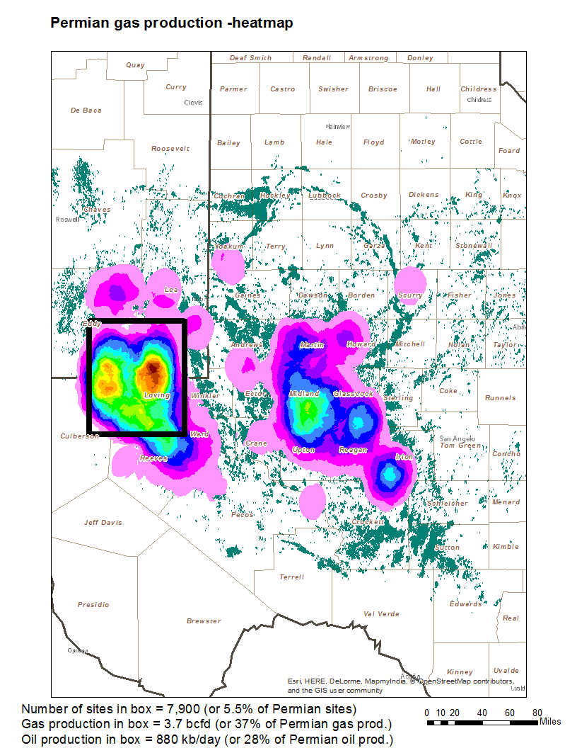
Target Area: 10,000 km² area of Permian Basin (Delaware sub-basin in Texas and New Mexico) Area of highest production and recent development

Slide 18
Development of Well Pad detection/classification and Storage Tanks database in Permian Basin derived using high-res satellite imagery
EDF working with Descartes Labs to build a publicly-available database of well pad locations and their classification (simple vs. complex sites) and number of storage tanks.
This effort uses from machine learning applications to high-resolution satellite imagery (1 – 10 m satellite imagery).
First version of the database expected to complete by Nov-end, and will soon after be made publicly available.
Additional updates to the database made available on a quarterly basis throughout 2020.

Slide 19
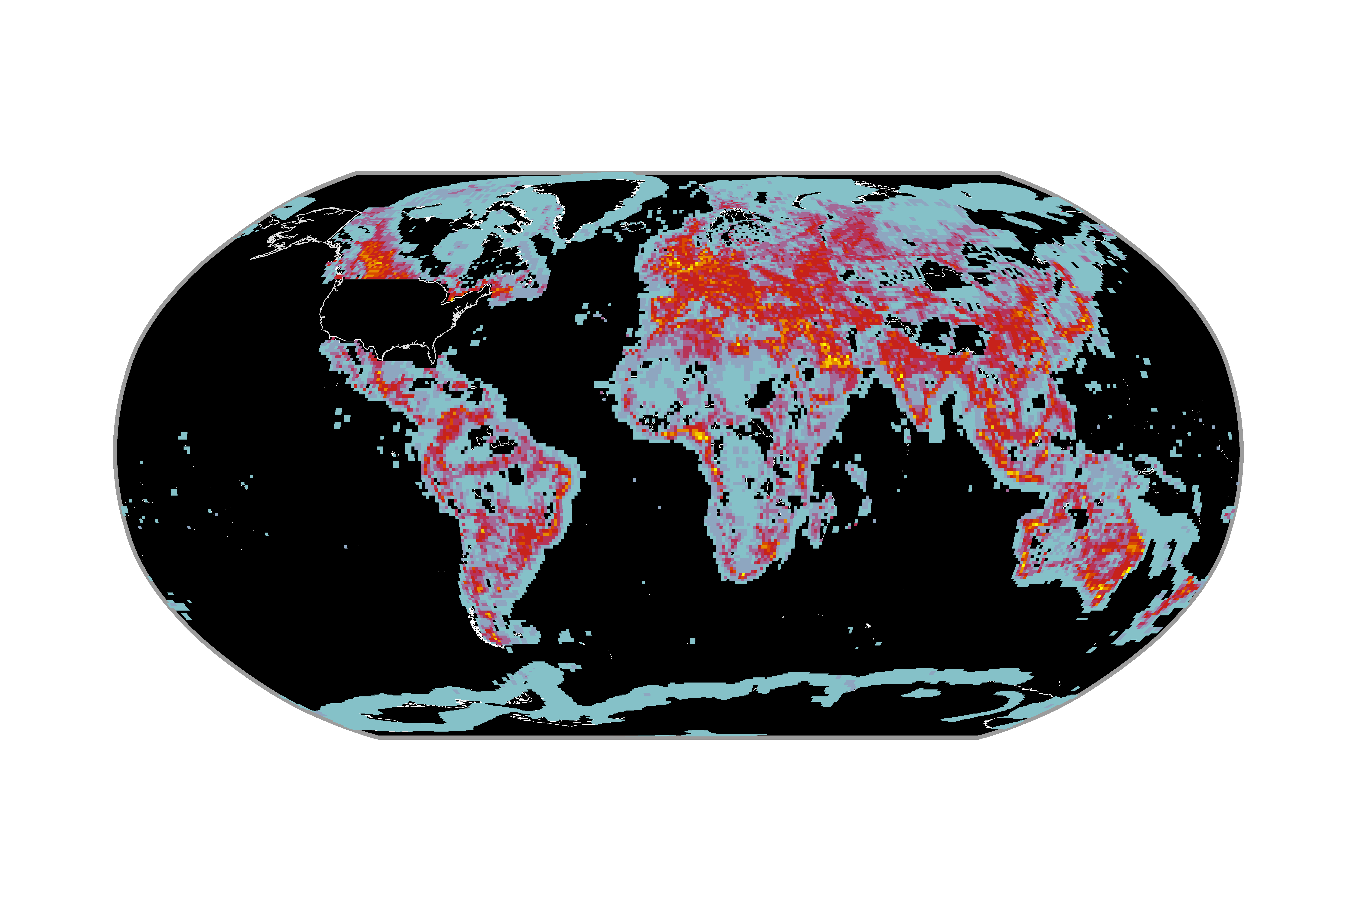
Global Oil & Gas Infrastructure (GOGI) database (outside the US)
Analysis helps highlight areas with more GOGI feature types (warm colors) vs areas with less (cool colors)
Database developed by National Energy Technology Lab (NETL), sponsored by EDF.
Feature Types per Grid Cell
*Feature Types = A collection of one kind of feature (e.g., refineries, wells, pipelines, etc.)
1
4
7
10
14
# of GOGI Feature Types per 111km²

Slide 20
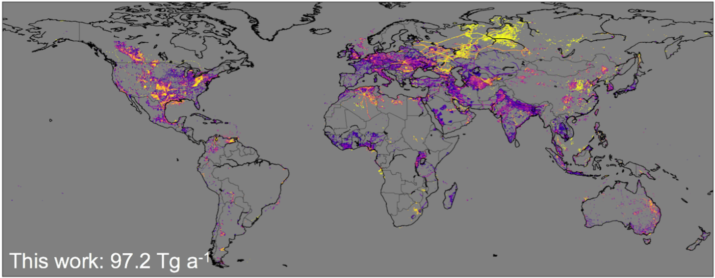
A global gridded (0.1° x 0.1°) inventory of methane emissions from oil, gas, and coal exploitation based on national reports to the UNFCCC (Scarpelli, Jacob et al. 2019)
Uses the GOGI database for oil & gas infrastructure information globally

Slide 21
Closing thoughts
EDF has been increasingly using data products and knowledge gained from CMS projects (PI- Daniel Jacob) focusing on characterizing oil & gas related methane emissions (US and internationally).
Specifically, CMS products including gridded methane emissions inventories for US, Mexico, updated Permian inventory - AND - the analytical inversion method for quantifying total emissions and generating spatial distribution of methane flux follows the method developed at Harvard through CMS – have all been highly useful in quantifying methane emissions at regional-to-national scales.
Within the US, Permian Basin is a priority area of methane science and policy efforts.
One of the questions we are presently trying to address globally relates to characterizing methane emissions linked to gas flaring. Permian Basin could serve as a testbed to better understand flaring related emissions. Are there existing or planned CMS datasets that help in quantifying flaring related emissions?
We are also highly interested in building an oil & gas infrastructure database, in support of MethaneSAT. Are there existing or planned CMS products that EDF could access or partner to incorporate into our plans for developing a temporally dynamic, spatially complete and granular oil & gas infrastructure database?
Acknowledgements/EDF methane science team-
Steve Hamburg, Ramon Alvarez, David Lyon, Mark Omara, Daniel Zavala-Araiza.
rgautam@edf.org

