Slide 1
Welcome to:
The CMS Science Team Meeting & Applications Workshop

Slide 2
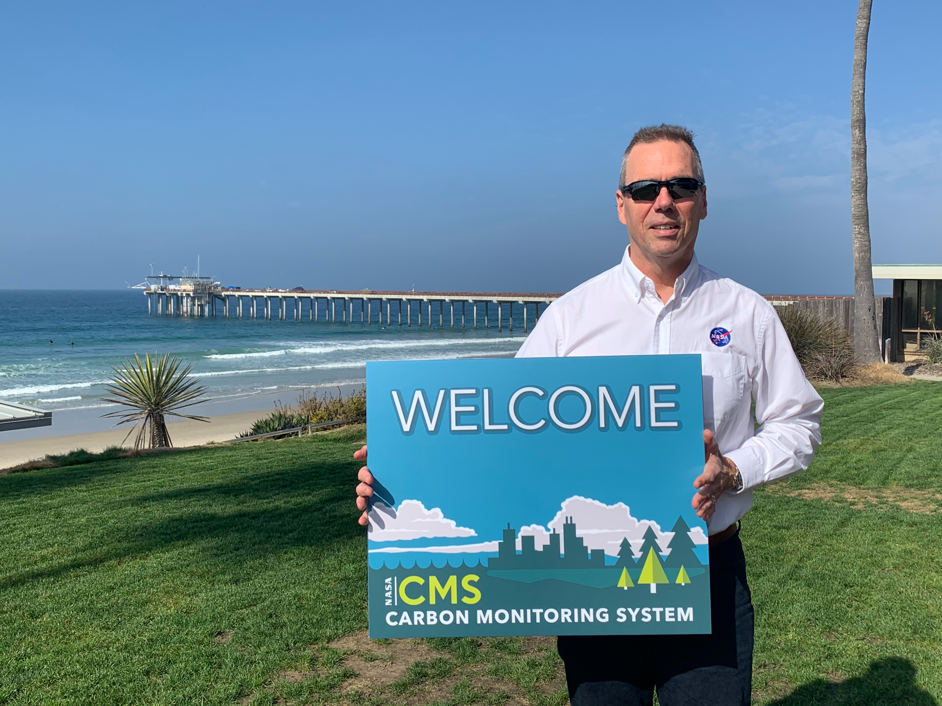

Slide 3
Code of Conduct
CMS leadership and the staff of the Carbon Cycle & Ecosystems Office are committed to providing safe, welcoming, and productive environments in the field and the lab, and at meetings and conferences, and have adopted the American Geophysical Union Scientific Code of Conduct.
If you have any concerns or need an ally contact: Mike Falkowski, Peter Griffith, or Laura Lorenzoni. To formally file a complaint with NASA, consult Harassment and Discrimination Reporting for NASA Employees, Contractors and Grantee Beneficiaries.

Slide 4
Poster Sessions
Poster location and time is on back of badge and online poster agenda
Poster Session 1 - Wed. 1:15 pm
Informal Poster Session - Wed. 6:15 pm
Poster Session 2 - Thurs. 1:30 pm

Slide 5
Presentations
During the meeting: Presentations are available behind sign-in.
After the meeting: Presentations will be made public.
If any slides shouldn’t be publicly available, send support@cce.nasa.gov a redacted version after the meeting.

Slide 6
Breakout Sessions Day 2
4:30 pm
Biomass (Chair: Andy Hudak) – Madera (first floor)
Flux (Chair: Reem Hannun) – Plenary
Methane (Chair: Daniel Jacob) – Santa Rosa office
Uncertainties (Chair: Robert Kennedy) – San Rafael
Wet Carbon (Chairs: Meghan Halabisky & Catherine Mitchell) – San Marino

Slide 7

CMS Storefront

