Slide 1
Welcome to:
The CMS Science Team Meeting & Applications Workshop

Slide 2
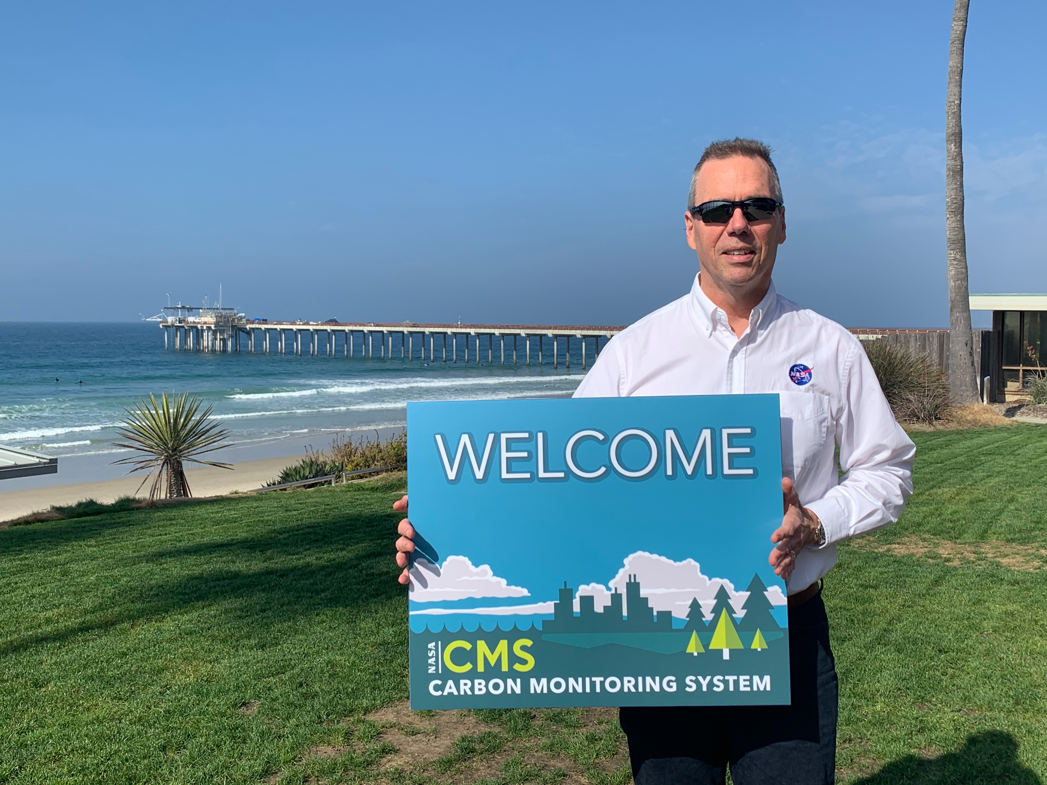

Slide 3
Code of Conduct
CMS leadership and the staff of the Carbon Cycle & Ecosystems Office are committed to providing safe, welcoming, and productive environments in the field and the lab, and at meetings and conferences, and have adopted the American Geophysical Union Scientific Code of Conduct.
If you have any concerns or need an ally contact: Mike Falkowski, Peter Griffith, or Laura Lorenzoni. To formally file a complaint with NASA, consult Harassment and Discrimination Reporting for NASA Employees, Contractors and Grantee Beneficiaries.

Slide 4
Announcements
Social Sign Up – limited space (40), sign up sheet at registration desk
6:30 pm – ANAYAS Restaurant
0.5 mile/10 min walk
Mexican food

Slide 5
Poster Sessions
Poster location and time is on back of badge and online poster agenda
Poster Session 1 - Wed. 1:15 pm
Informal Poster Session - Wed. 6:15 pm
Poster Session 2 - Thurs. 1:30 pm

Slide 6
Presentations
During the meeting: Presentations are available behind sign-in.
After the meeting: Presentations will be made public.
If any slides shouldn’t be publicly available, send support@cce.nasa.gov a redacted version after the meeting.

Slide 7
WiFi
Network
NASA CMS
Password
Carbon2023

Slide 8
Lunch Options Nearby:
California Pizza Kitchen (Pizza, 0.2 mi)
Alexander's Steakhouse (Steak, 0.2 mi)
Rotisserie Chicken of California (American, 0.3 mi)
The Mixx (American, 0.3 mi)
Ruth's Chris Steak House (Steak, 0.3 mi)
Yard House (American, 0.4 mi)
Rubio's Coastal Grill (Mexican, 0.4 mi)
Great Maple (American, 0.4 mi)
Tokyo Wako Pasadena (Japanese, 0.4 mi)
El Cholo Café (Mexican, 0.4 mi)

Slide 9
Lunch Options Nearby Cont’d:
Fogo de Chao (Brazilian, 0.5 mi)
Lunasia Dim Sum House (Dim Sum, 0.5 mi)
Fleming's Prime Steakhouse (Steak, 0.5 mi)
Maestro Restaurant (Mexican, 0.5 mi)
Sushi Enya Pasadena (Sushi, 0.6 mi)
Noodle St (Asian, 0.6 mi)
Jimmy John's (Sandwiches, 0.6 mi)
Naughty Vegan (Vegan, 0.6 mi)
Paper Rice (Vietnamese, 0.6 mi)

Slide 10
Breakout Sessions Day 1
4:15 pm
1. Biomass – Plenary
2. Atmospheric Flux – San Marino
3. Oceans and Wet Carbon – San Rafael

Slide 11
Breakout Sessions Day 2
4:30 pm
Biomass (Chair: Andy Hudak) – TBD
Flux (Chair: Reem Hannun) – Plenary (in-person only)
Methane (Chair: Daniel Jacob) – Plenary (in-person only)
Uncertainties (Chair: Robert Kennedy) – TBD
Wet Carbon (Chairs: Meghan Halabisky & Catherine Mitchell) – TBD

Slide 12
Federal Shutdown

