Slide 1


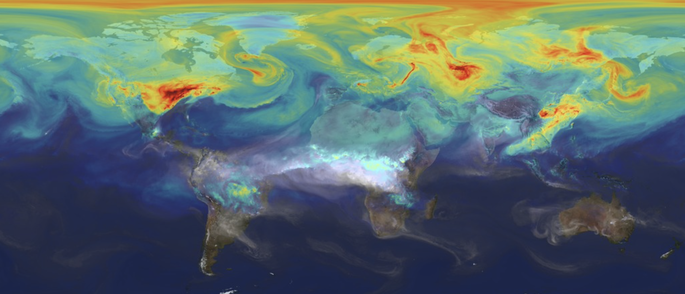
Updates and Panel Discussion on International Assessments & Efforts on Carbon

Slide 2
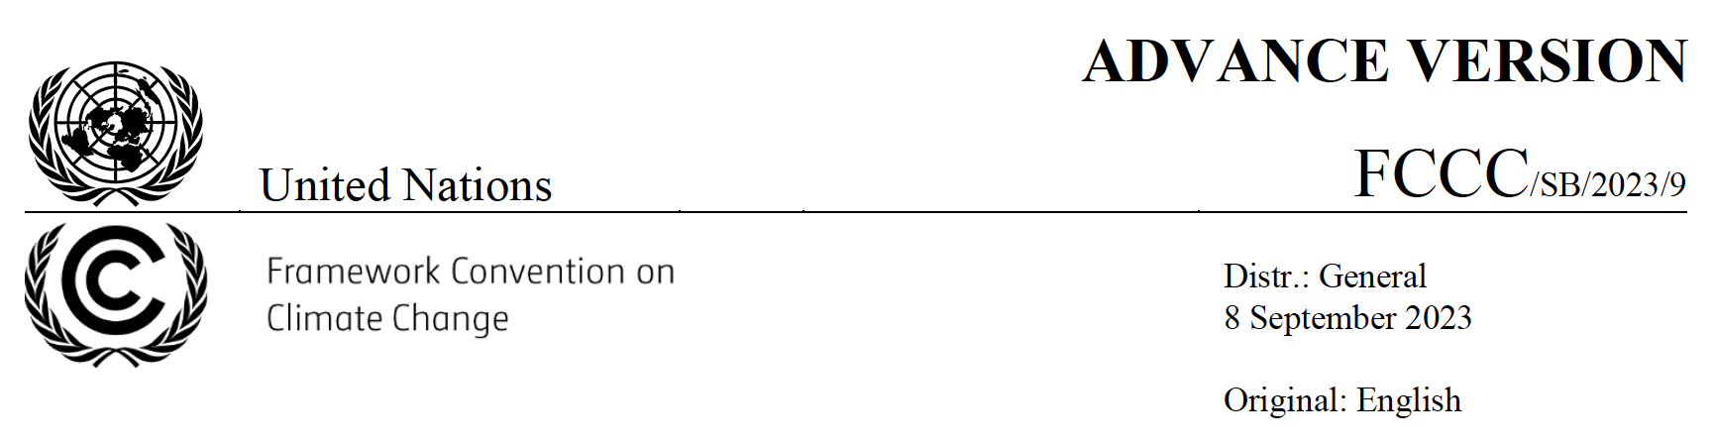
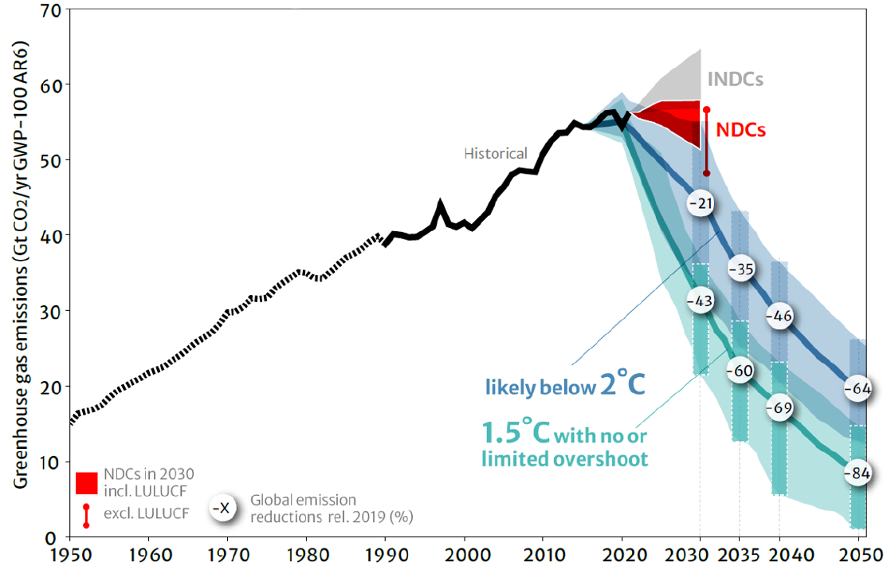
Article 14 of the Paris Agreement provides that the CMA shall periodically take stock of the implementation of the Paris Agreement to assess collective progress towards achieving its purpose and long-term goals…

Slide 3
Dr. Deborah Gordan, Senior Principal, Climate Intelligence Program, RMI
Dr. Phil DeCola, Co-Chair, Integrated Global GHG Information System (IG3IS)
Dr. Yasjka Meijer, CO2M Mission Scientist & GHG Task Team Lead, European Space Agency
Dr. Steven Hamburg, Project Lead, MethaneSAT & Senior Vice President, Chief Scientist, Environmental Defense Fund

Slide 5


GHG Monitoring and Mitigation at COP28:
NASA CMS Science Team Meeting, September 26, 2023
“The oil and gas industry should phase out its methane emissions by 2030.”
-- Sultan al-Jaber,
UAE COP28 president
Deborah Gordon, Senior Principal, RMI

Slide 6
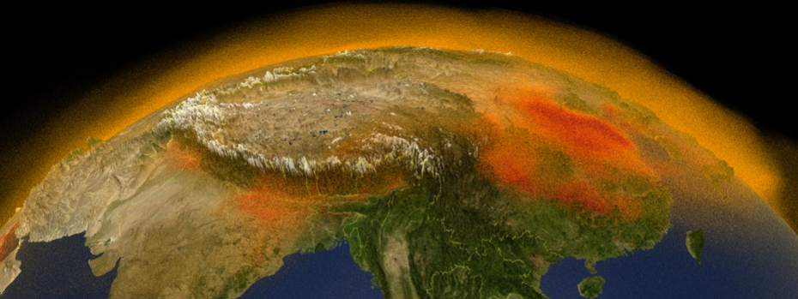
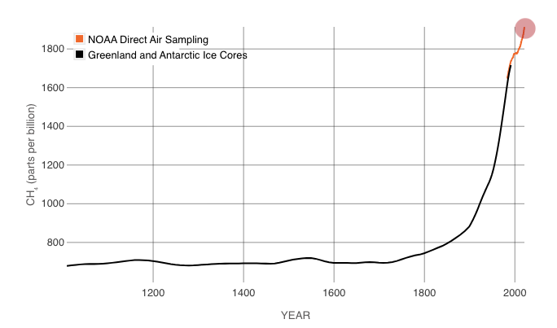
Atmospheric methane levels are on the rise.
Rates of increase have risen dramatically over the past couple of years.
ATMOSPHERIC METHANE CONCENTRATIONS
SINCE THE YEAR 1010
VISUALIZATION OF METHANE EMISSIONS AROUND THE NORTHERN HEMISPHERE AND OVER
Sources: NASA, https://svs.gsfc.nasa.gov/4789; and Etheridge et al., 1998 and NOAA Global Monitoring Laboratory, https://climate.nasa.gov/vital-signs/methane/.

Slide 7
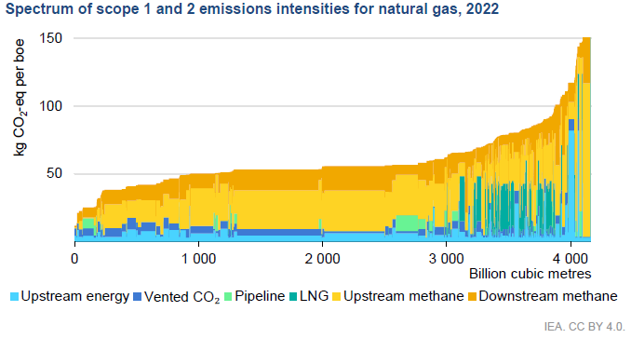
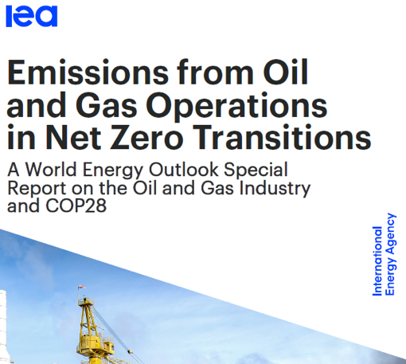
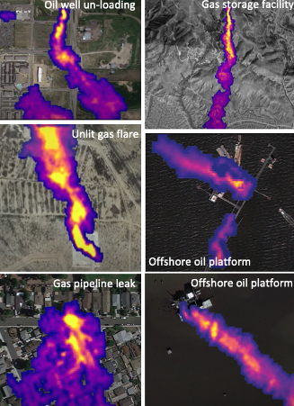
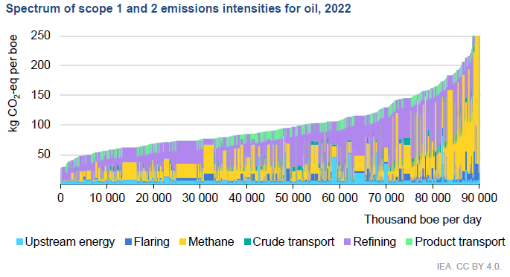
Methane drives variable oil & gas emissions.
“
Invaluable input to the [oil and gas industry] analysis was provided by [RMI's] Oil Climate Index plus Gas (OCI+).
– INTERNATIONAL ENERGY AGENCY, MAY 2023
Source: Carbon Mapper, 2021-22

Slide 8
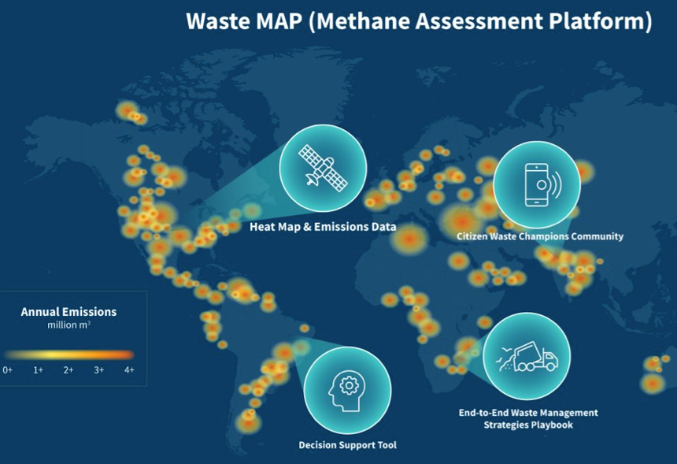
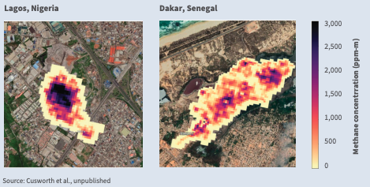
Landfills are another major methane source.
Methane Emissions from Landfills in Nigeria and Senegal
Observed by the PRISMA Satellite
Mapping methane from waste worldwide and developing models to mitigate emissions.

Slide 9
Delivering on RMI’s Theory of Change
Emissions visibility drives market activation & durable action.
Emissions visibility
Will drive decarbonization on several fronts
Measure, Model & Quantify
Account, Digitize & Track
Emissions-differentiated market activation
Standardize & Certify
Climate-aligned corporate business models
Better investor portfolio allocations
Informed government policy and regulation
Notes:
In my team, emissions transparency – or visibility – is our core focus.
Our Oil & Gas Solutions Initiative (OGSI)’s theory of change seeks to:
1) Better measure, model, track and verify emissions across the value chain.
And 2) with more robust, actionable data, we aim to accelerate decarbonization with a range of stakeholders.
The solution: We need to dramatically improve emissions visibility and create market-based mechanisms that reflect the costs associated with oil and gas use.
This includes in:
Market design and activation – better internalizing the negative externality of oil and gas emissions across the value chain.
Corporate business models – increasing transparency and accountability around companies’ emissions targets and their strategies for meeting them.
Investor portfolio allocations – as investors themselves pursue climate-aligned portfolios.
Government policy and regulation – informing policies and regulations, such as SEC and EPA rulemaking currently underway.

Slide 10
Solutions are at the ready to make methane visible and stop leakages.
Detection technology and quantification |  | Satellites, aerial campaigns, and sensors can better measure and monitor leaks.​ Integrate top-down point source super-emitters into bottom-up models fully account for methane.
Control measures |  | Operations and maintenance fixes to prevent equipment leakage.​ Eliminate flaring and venting from operations.​ Create performance and certification standards to monitor industry progress, and market mechanisms to incentivize cuts.
Data and Pricing |  | Government funds for open-source data platforms from point-source methane satellites (e.g., EMIT, Carbon Mapper). Methane fees (e.g., Inflation Reduction Act)

Slide 12

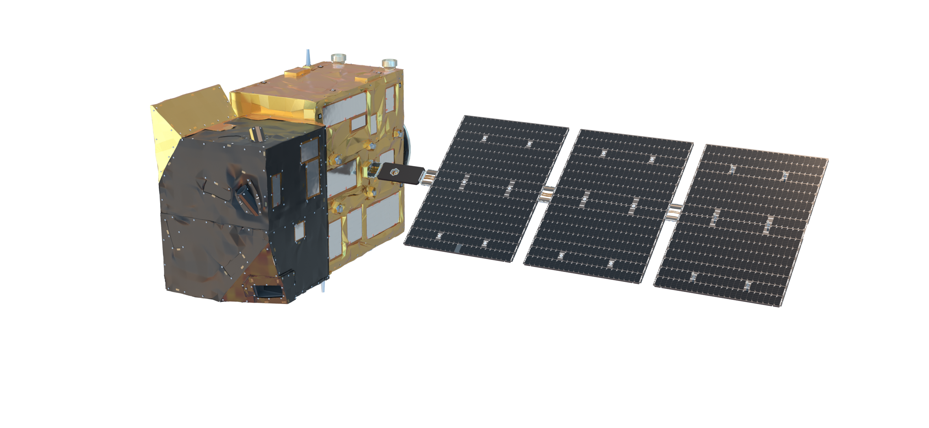
Anthropogenic Greenhouse Gas Monitoring with the Copernicus CO₂ Monitoring (CO2M) Mission
Dr. Yasjka Meijer
European Space Agency (ESA)
CO2M Mission Scientist &
GHG Task Team Lead

Slide 13

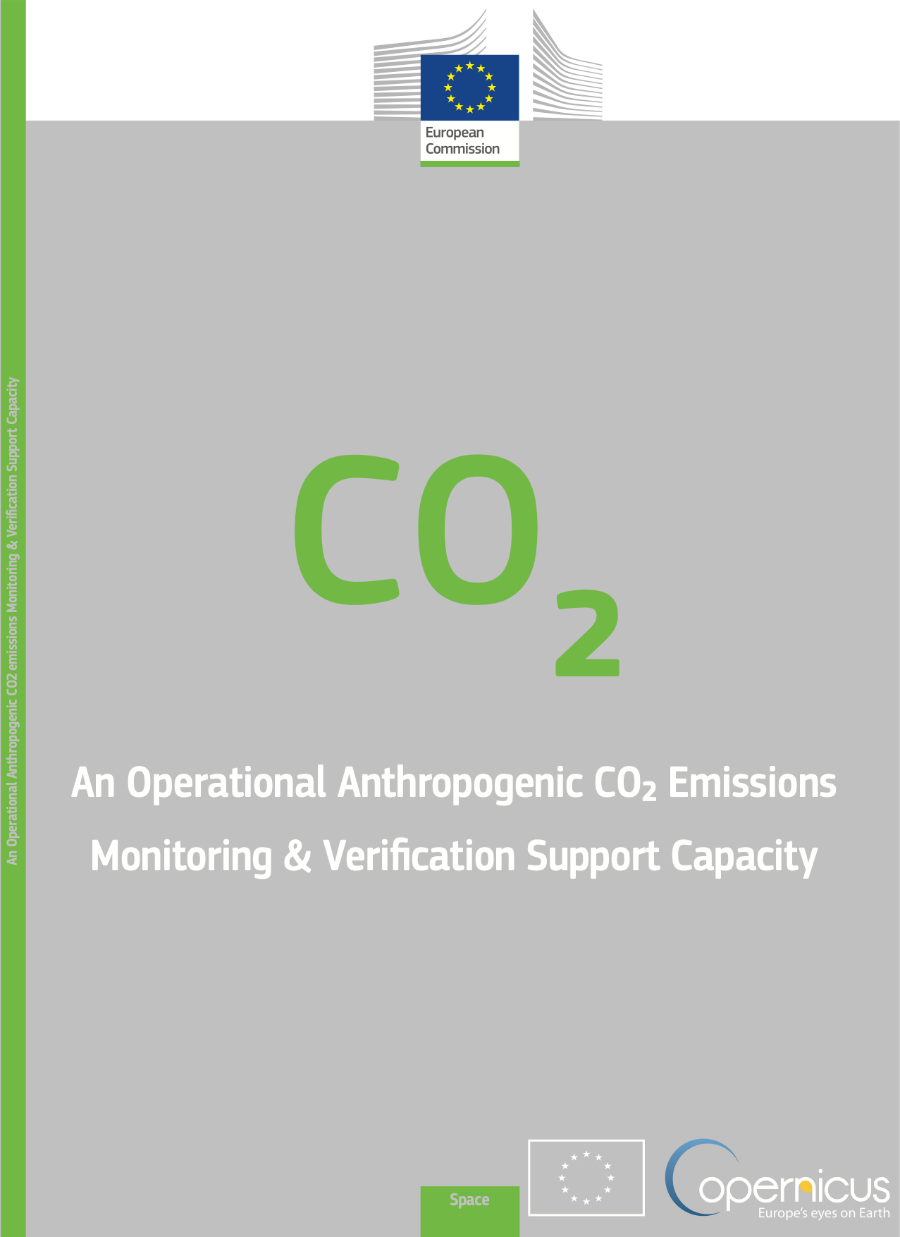
Monitoring & Verification Support Capacity
System requirements
Detection of emitting hot spots
such as megacities or power plants
Monitoring the hot spot emissions
to assess reductions or increase in emissions
Assessing emission changes against local reduction targets
to monitor impacts of the Nationally Determined Contributions
Assessing the national emissions and changes
in 5-year time steps to estimate the Global Stock Take

Slide 14
Monitoring & Verification Support Capacity
System requirements & impact on satellite requirements
Detection of emitting hot spots such as megacities or power plants
→ high precision CO₂ data, high spatial resolution, no local biases
Monitoring the hot spot emissions
to assess reductions or increase in emissions
→ quantify emissions (plume info), frequent revisit
Assessing emission changes against local reduction targets
to monitor impacts of the Nationally Determined Contributions
→ no regional biases, separate biogenic from anthropogenic
Assessing the national emissions and changes
in 5-year time steps to estimate the Global Stock Take
→ no long-term drifts, high accuracy data, inter-calibrated

Slide 15
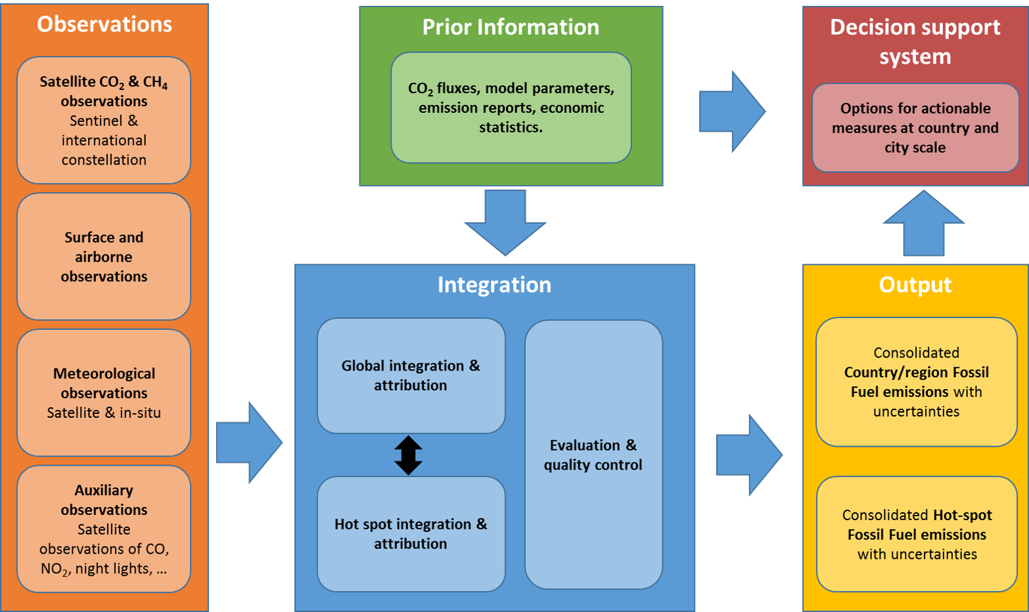


An Operational Anthropogenic CO2 Emissions
Monitoring & Verification Support Capacity

Slide 16
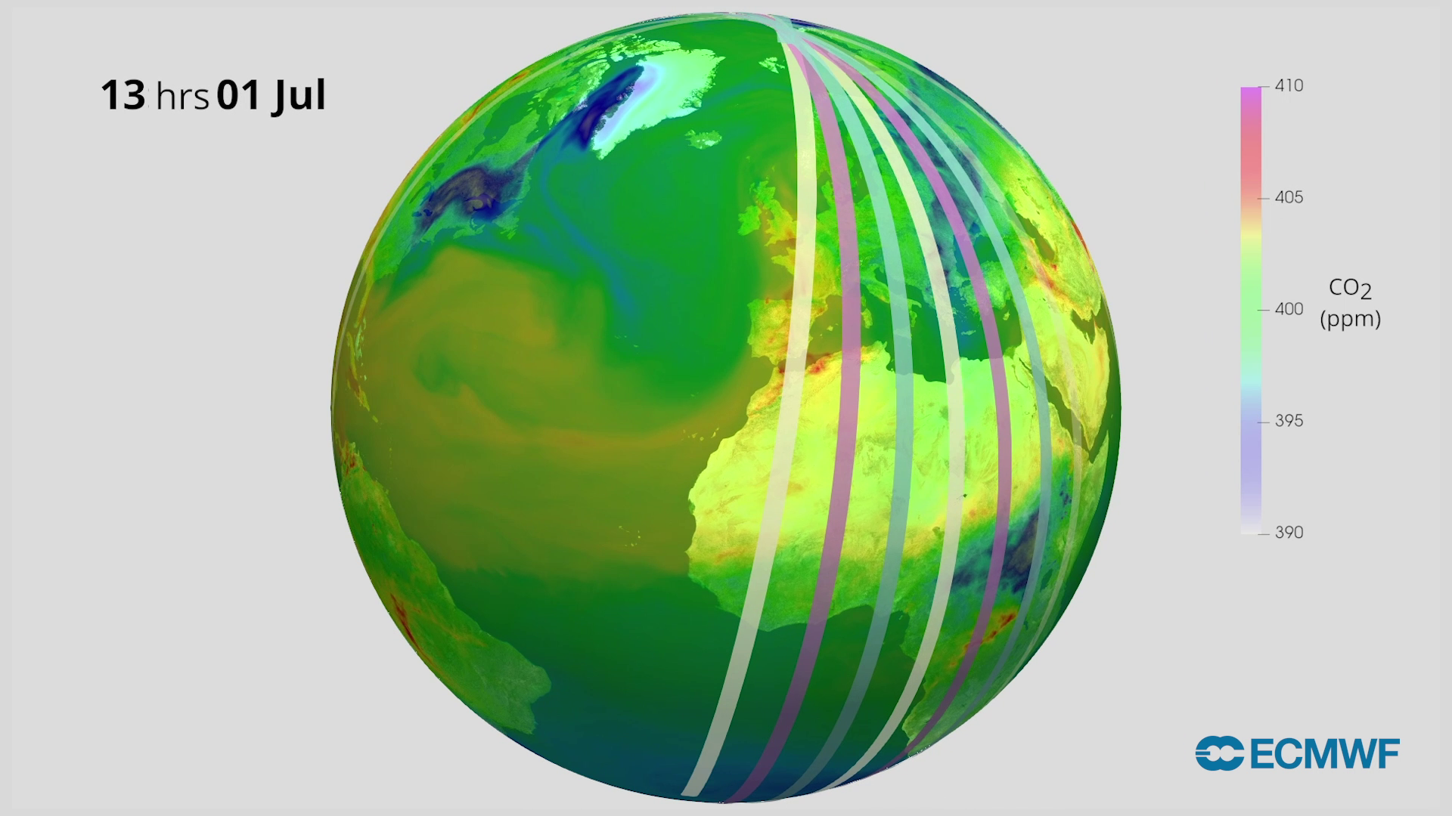
Copernicus CO2M Mission – Status
Project status:
Constellation of satellites
Each satellite >250 km swath
First and second satellite will have their
Flight Acceptance expected early 2026
Possible 3rd satellite pending EC decision
Product | Spatial | Precision
CO₂ | 4 km² | 0.7 ppm
CH₄ | 4 km² | 10 ppb
NO₂ | 4 km² | 1.5 10¹⁵ molecules cm⁻²
Vegetation SIF | 4 km² | 0.7 mW m⁻² sr⁻¹ nm⁻¹
Aerosol params | 16 km² | 0.05 AOD, 500 m LH
Cloud fraction | 1% | Water clouds & cirrus
Copernicus data is made freely available
to any person and organisation around the world
EUMETSAT performs operational data processing
Credits: EMPA

Slide 17
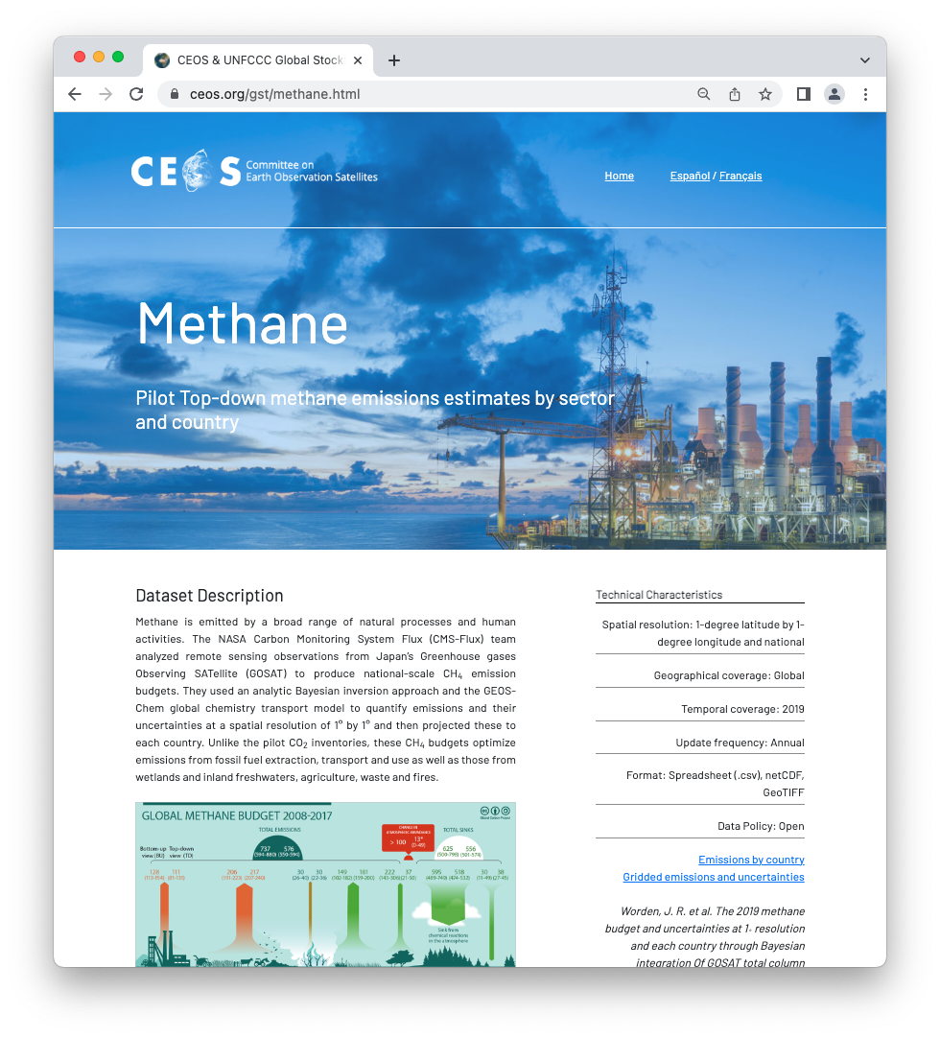

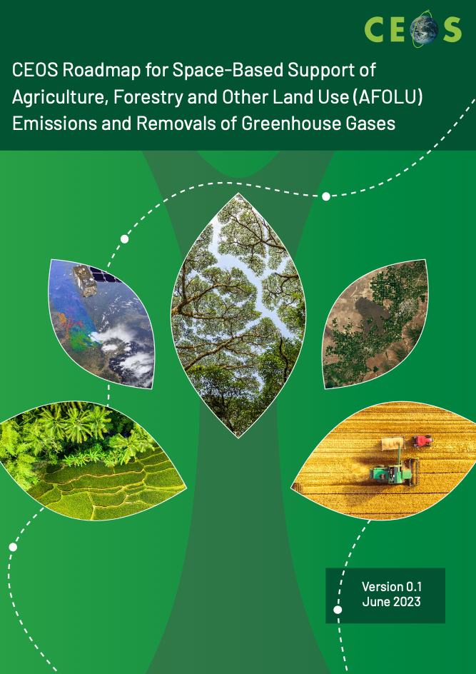
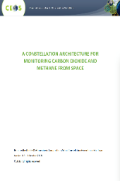

Committee on Earth Observation Satellites
Working Group on Climate jointly with CGMS
  Focal point for UNFCCC Engagement
  ECV Inventory
  CEOS responses to the GCOS IP
Roadmaps of CEOS on
  GHG
  AFOLU
  Aquatic Carbon (TBD)
GHG Task Team (lead Yasjka meijer)
  Interface with all relevant CEOS WGs
  Responsible for implementing GHG Roadmap

Slide 18
CEOS Virtual Constellations
Coordinated set of capabilities from different partners focusing on observing a particular parameter
GHGs are covered under AC-VC,
which is led by John Worden (NASA)
Atmospheric Composition (AC-VC)
Land Surface Imaging (LSI-VC)
Ocean Colour Radiometry (OCR-VC)
Ocean Surface Topography (OST-VC)
Ocean Surface Vector Wind (OSVW-VC)
Precipitation (P-VC)
Sea Surface Temperature (SST-VC)

Slide 19
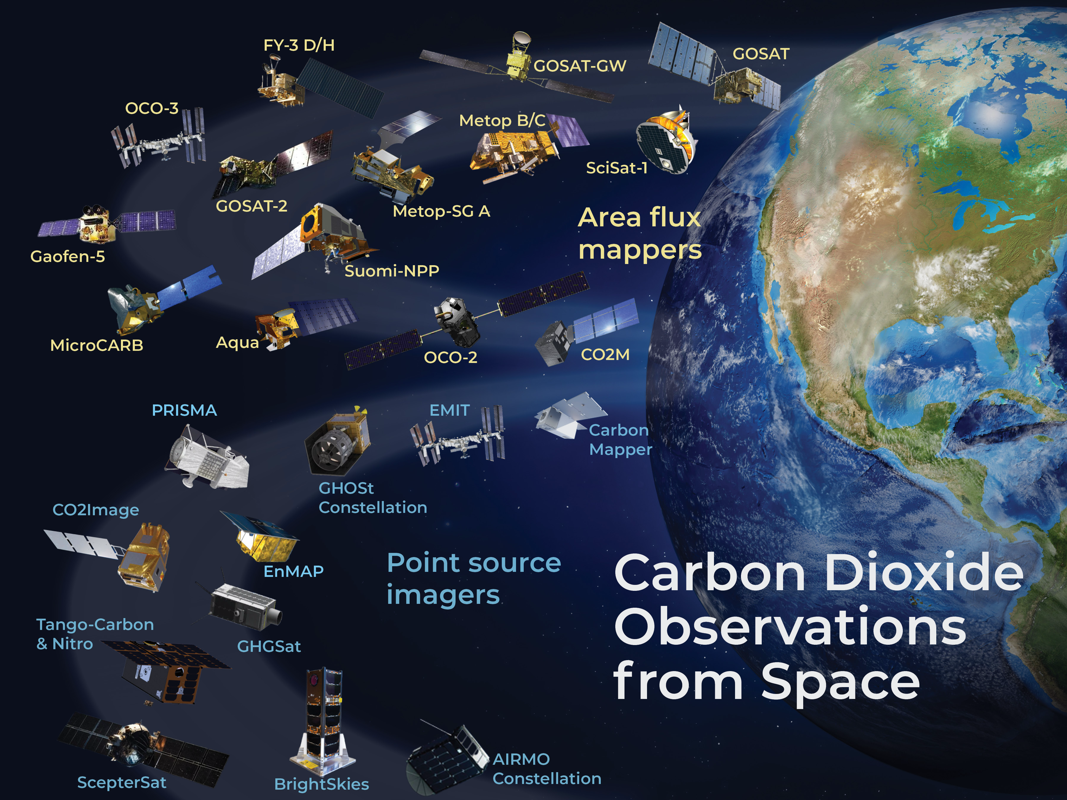
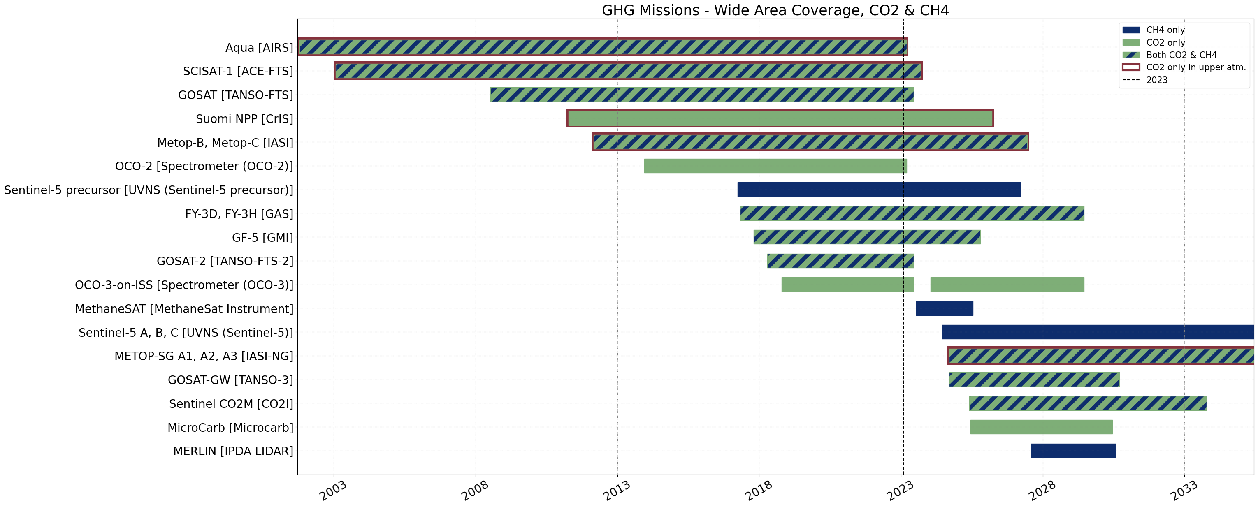
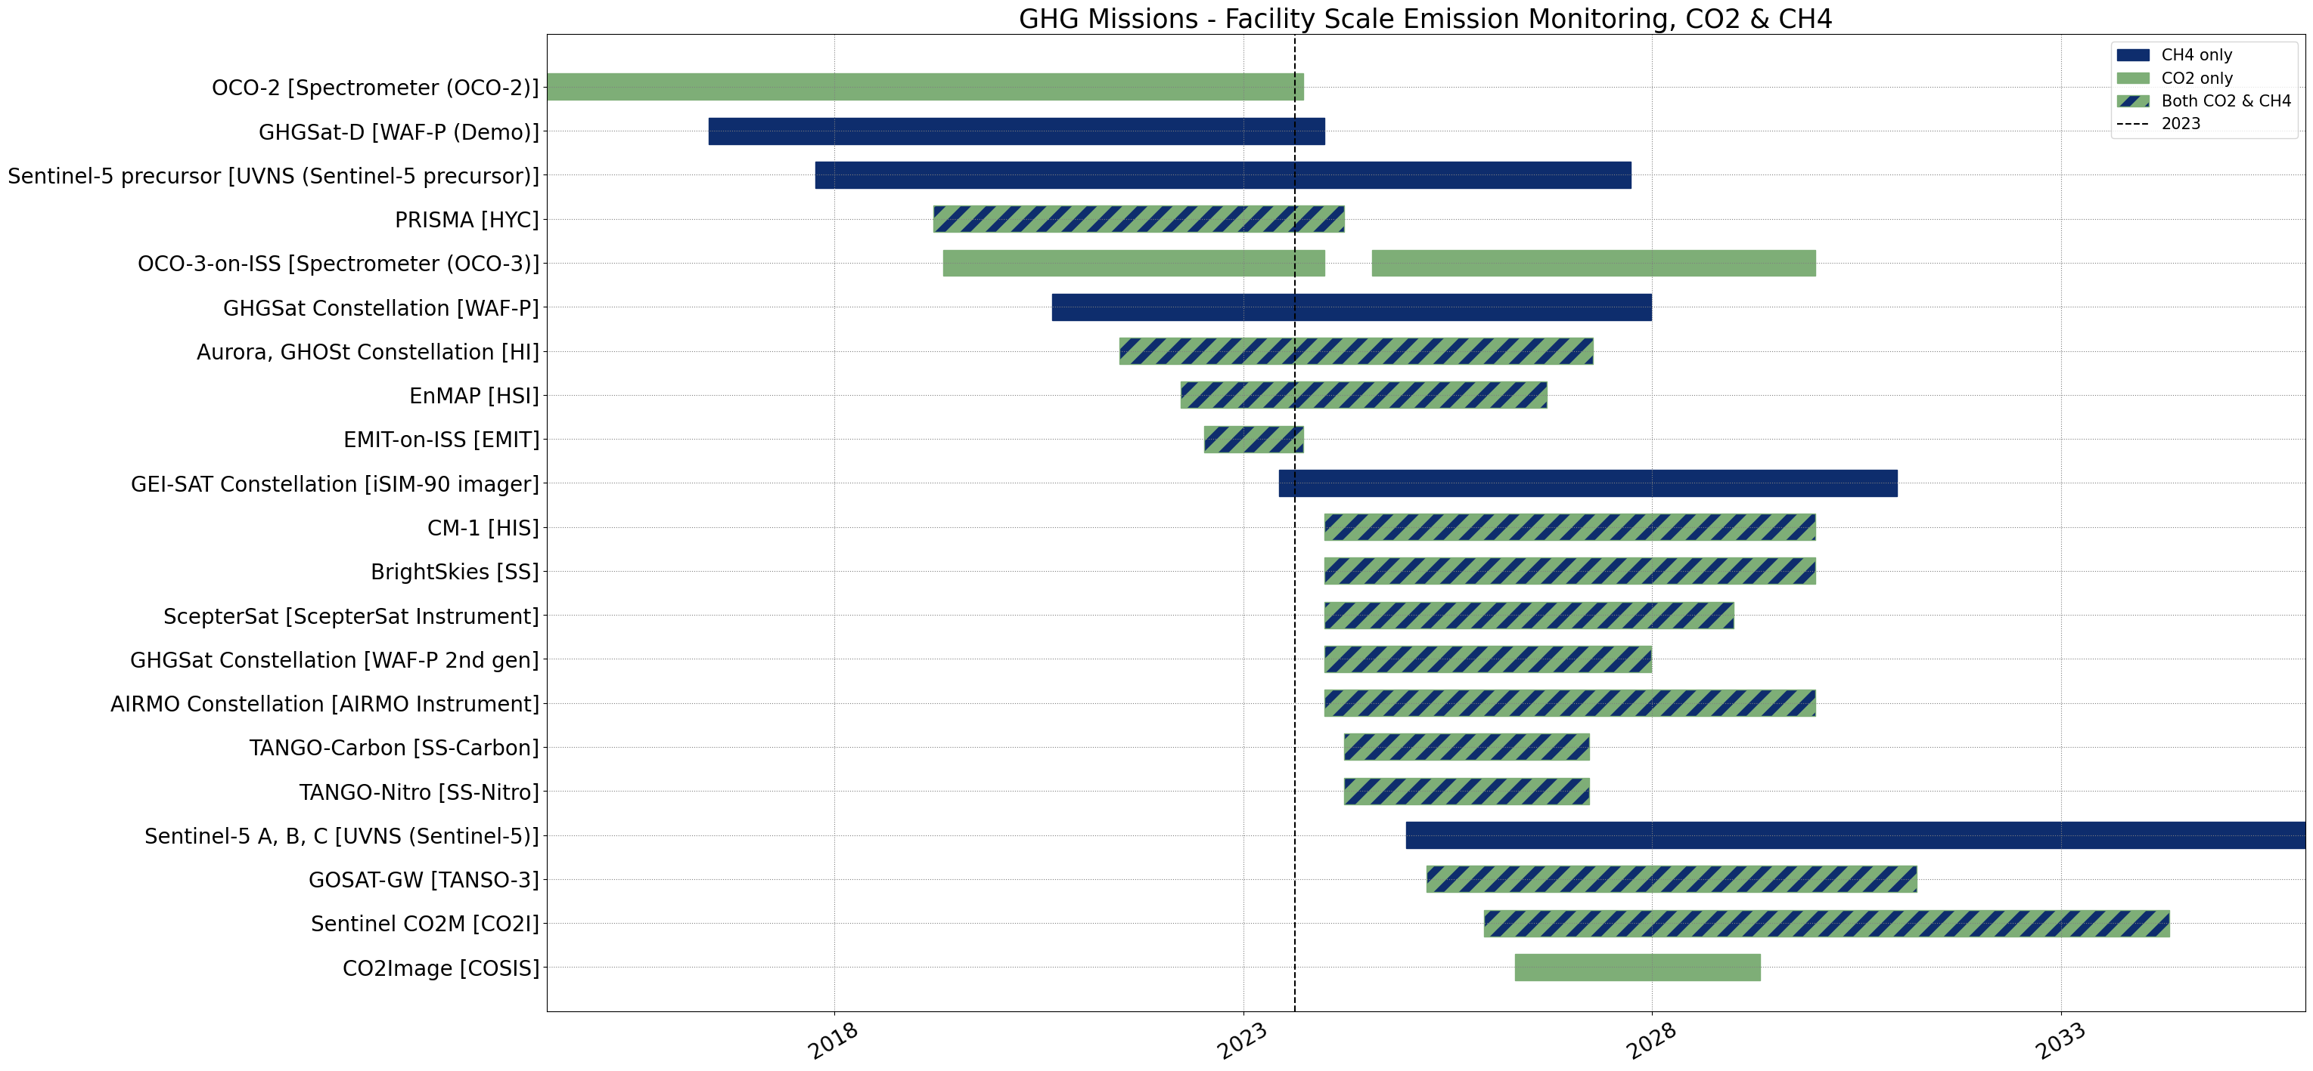
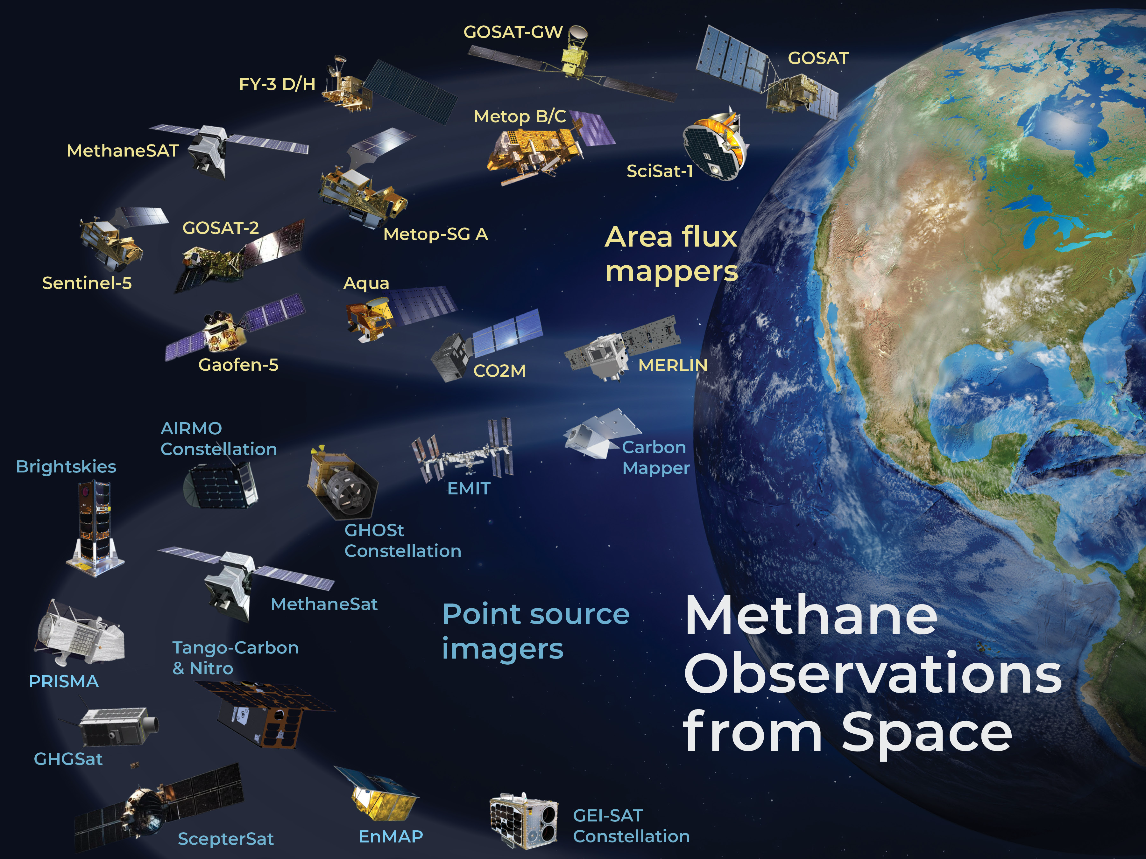
AC-VC of GHG observations
In development, CEOS GHG Satellite Missions Portal

Slide 20
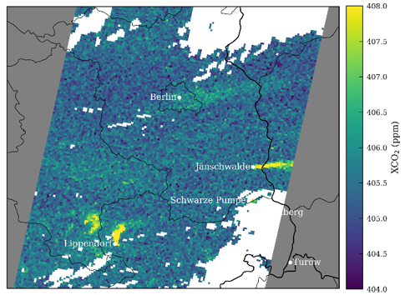
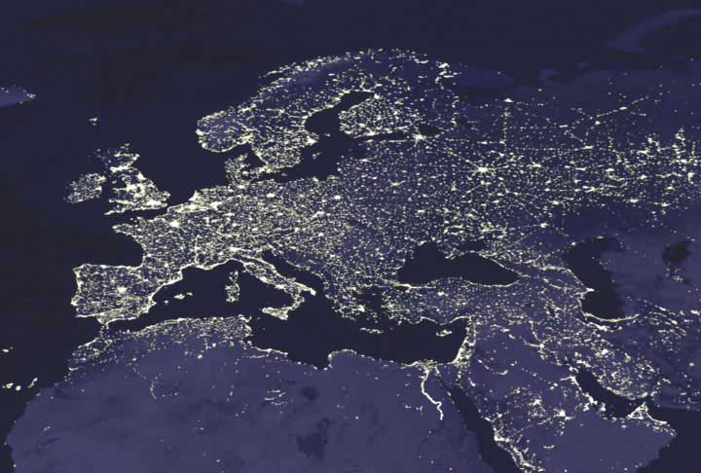
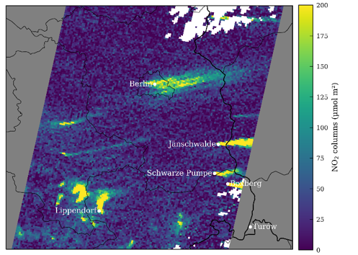
Other space-based observations
Besides column-averaged mixing ratios of CO₂ & CH₄
Also other relevant gases and/or related products:
  Plume mappers looking at local enhancements of (mainly) CH₄ (& CO₂)
  NO₂ leading to to plumes of CO₂
  Biomass, vegetation indices, landcover,
  deforestation maps and other land products
Or other input in upport of models
  Solar-induced vegetation fluorescence
  Nightlights
  Inundation maps
XCO₂ plumes
NO₂ plumes
Europe at Night
Courtesy: DMSP and NASA
Credits: EMPA

Slide 21
CEOS, specifically through GHG TT
and AC-VC, is your partner for GHG
and other Earth Observation from space

Slide 22
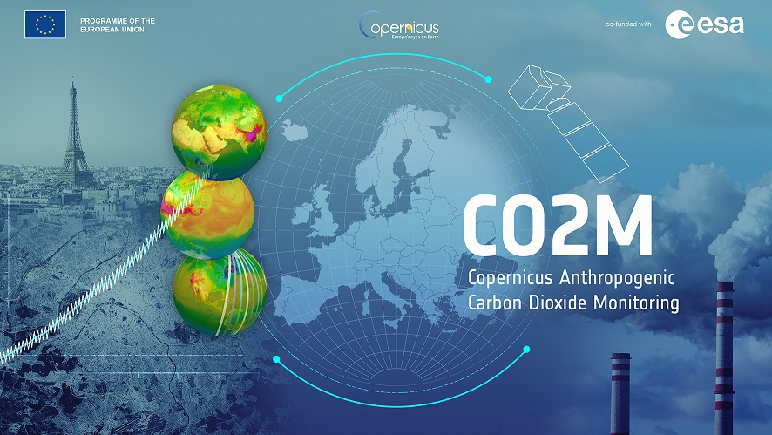
THANK YOU

Slide 24


International Methane Emissions Observatory
Providing the data to drive mitigation
September 2023
Steven Hamburg
Chair – Scientific Oversight Committee
Notes:
Thanks for the invitation and for the opportunity to present the work of UNEP on the International Methane Emissions Observatory.

Slide 25







An International Methane Emissions Observatory will provide
consistency among multiple methane programs
Assess measurement methodologies and technologies.
Collect and verify company reporting
Produce policy-relevant science to support enhanced government ambition
Integrate and analyze methane emissions data
from various sources
Hold companies accountable to methane performance goals
Develop and publish a dataset on methane emissions sources, magnitudes, and patterns

Slide 26
We need empirical GHG emissions data to drive effective methane mitigation
More than a decade of extensive methane emissions data collection has consistently shown that observed emission patterns seldom match modeled or estimated emissions
Understanding temporal and spatial variability in emissions is key to driving mitigation – managing to average assumed emissions is seldom effective

Slide 27
Methane emissions Surat Basin, New South Wales, Australia
Neininger et al. 2021

Slide 28
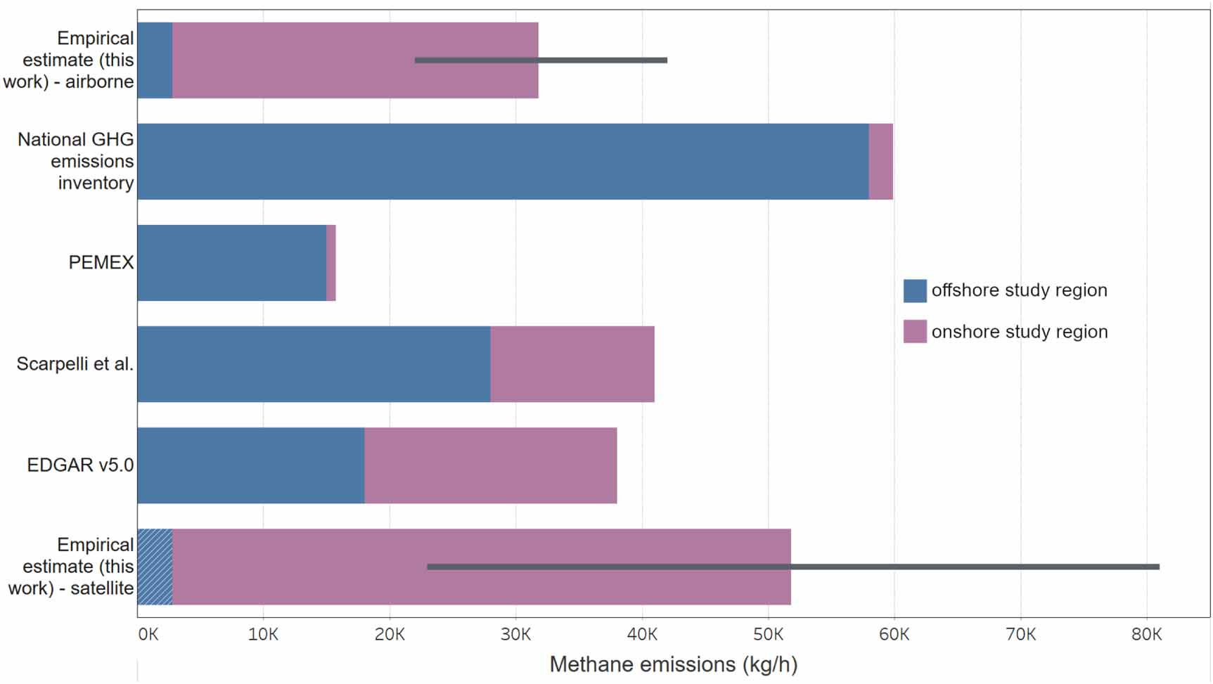
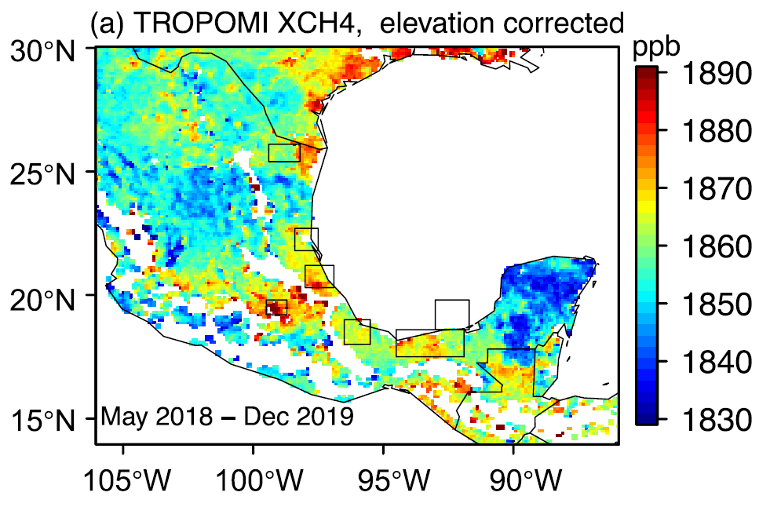
Mexico: multi-scale empirical data to guide mitigation
(Mg/hr)
offshore
Offshore emissions are significantly overestimated by current inventories while onshore emissions are significantly underestimated.
onshore
60
Oil and gas emissions are 2 times higher than national inventory (loss rate of 4.3%).
40
One basin (Sureste) is responsible for 50% of national O&G emissions.
20
Aerial
meas.
National
inventory
Satellite
meas.
0
(Source: Shen, et al. 2021; Zavala-Araiza et al. 2021)

Slide 29
Norway Offshore
O&G production
Foulds et al. 2022

Slide 30
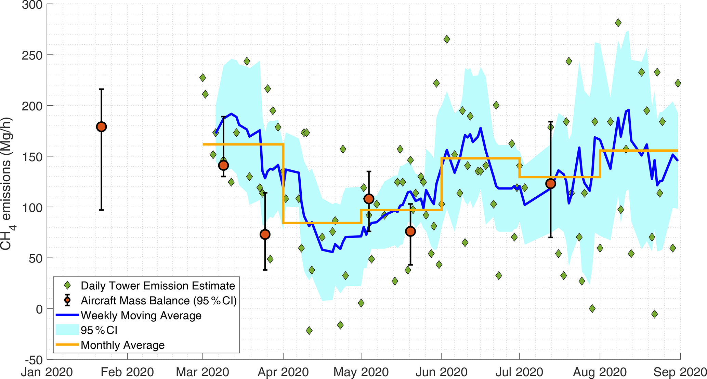
Permian Basin Methane Emissions Trends
2020
Lyon et al. 2021. Concurrent variation in oil and gas methane emissions and oil price during the COVID-19 pandemic.
Atmospheric Chemistry and. Physics 21: 6605–6626, https://doi.org/10.5194/acp-21-6605-2021

Slide 31

IMEO supported Science: Ongoing studies
Coal
Direct measurements of coal emissions globally, connecting bottom-up, top-down, and satellite measurements to develop emissions estimates for individual mines.
Arctic region of Russia
Long-term, continuous measurements of methane, ethane, and carbon dioxide at a fixed station in Western Siberia. Remote determination of average methane concentrations and their sources and sinks.
Canada - Root Cause Analysis
Reconciling methane emission inventories with site-level measurements.
Azerbaijan
Aerial measurements and flux estimates from off- and onshore facilities.
Partially funded by CCAC Methane Science Studies
Middle East – Oman
Aerial methane survey characterizing O&G site-level emission distribution and potentially also regional-level fluxes. First in-depth, independent, study of O&G methane emissions on the Arabian Peninsula.
US - Permian synthesis study
Catalyze a synthesis of as much of the data collected to date as is possible, allowing multiscale data to be compared and contrasted.
South America – Colombia
Combining measurements at regional, site and source level, characterize emissions from oil and gas production in Colombia.
Central Africa
Offshore O&G methane study focusing on Angola with potential measurements in Congo and Gabon. The region has been identified as a flaring hotspot.
Partially unded by CCAC Methane Science Studies

Slide 32
Recent projects
1. Satellite remote sensing
To increase capacity to accurately measure emissions globally and better understand comparisons between satellites and other measurements
2. Validation of methane Measurement technologies
To provide uniform data on the accuracy and precision of a diversity of methane measurement technologies, from satellites to drones
3. Flaring efficiency
To better understand flaring efficiency around the world and identify factors that affect/improve efficiency

Slide 33






How will IMEO answer the methane emissions data problem?
Data flow of the IMEO
Generate final products
Reconcile inconsistencies and identify gaps
Collect data
Apply Big Data, data science, and machine learning
OGMP companies’ assets data
Science measurements studies
National inventories
Satellite data
Full methane emissions dataset
Annual methane report
Direct measurement studies
Science-based implementation support

