Slide 1
Biomass WG Breakout Report
1. Goals
2. Accomplishments
3. Plans

Slide 2
1. Goals
• Connecting projects with similar themes, goals via round-robin of WG member presentations.
• Finish and write up the Oregon aboveground biomass (AGB) map comparison
• More biomass map comparisons, beyond the current one in Oregon
o Particularly at national or larger scale
o Not be just forest-centric, but other woody vegetation, woodlands, shrublands, and savannas.
o We tend to concentrate on OG and mature forest, but what about regeneration, secondary forest?
• Merge with Uncertainty WG?

Slide 3
2. Accomplishments 2022-23
• Several presentations within WG
o Recordings for most are available on CMS website
• Progress on OR AGB map comparison at county, hex, stand levels

Slide 4
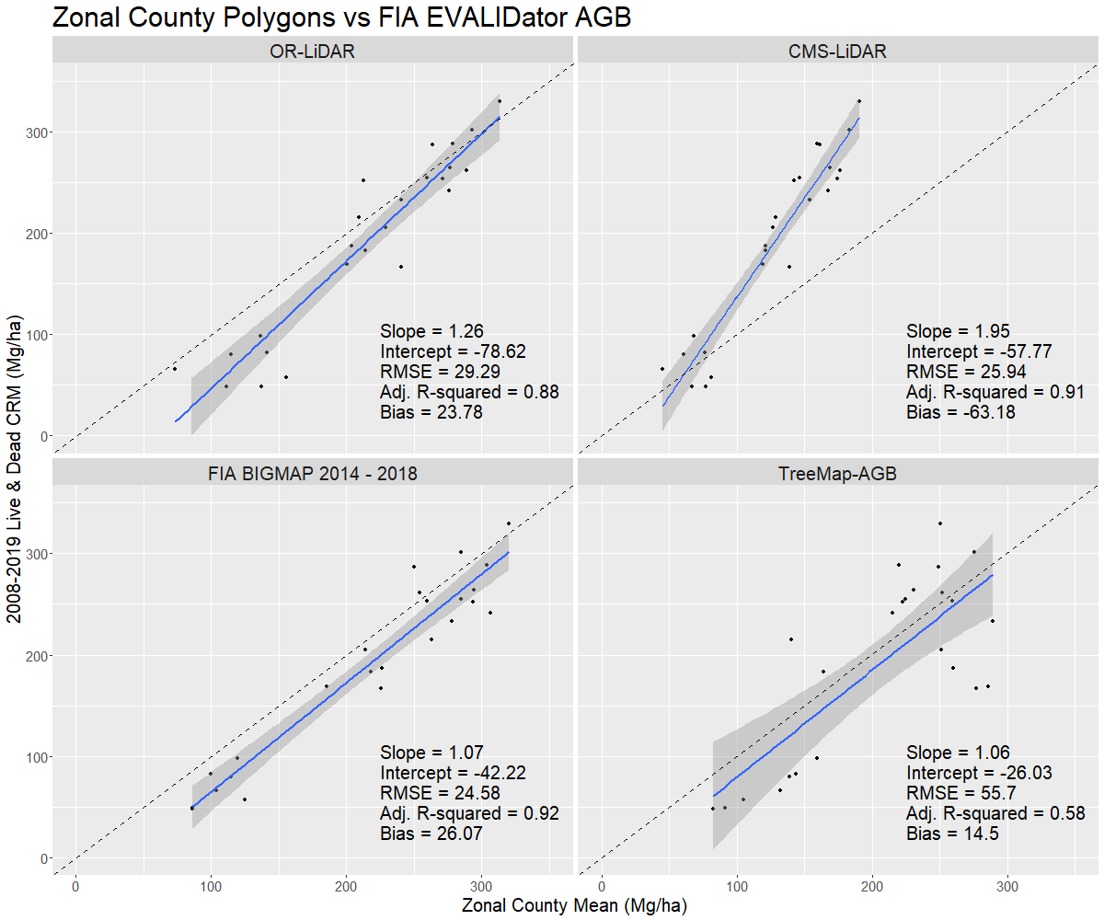
County polygons

Slide 5
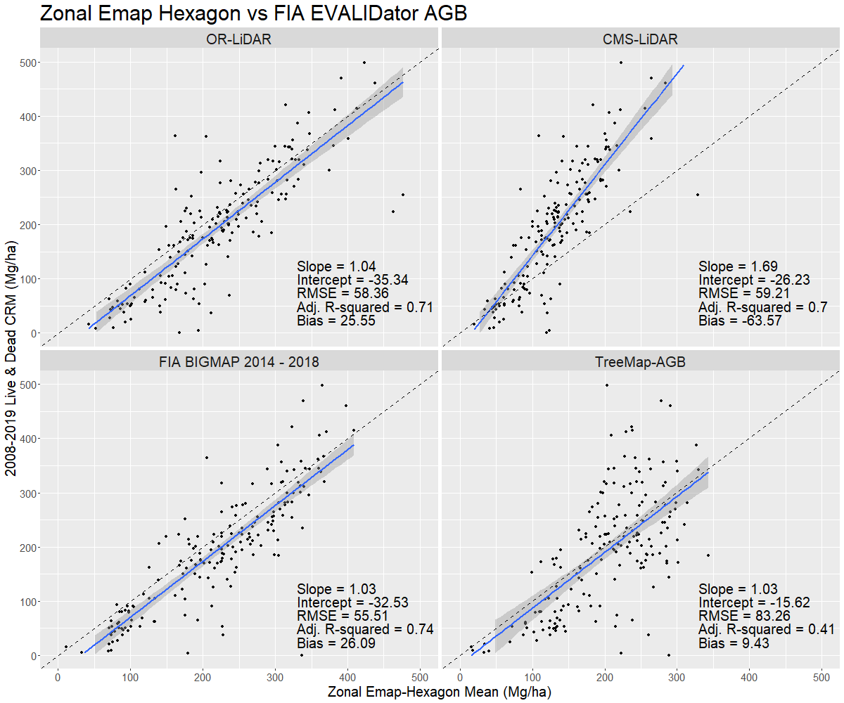
FIA Hexagons

Slide 6
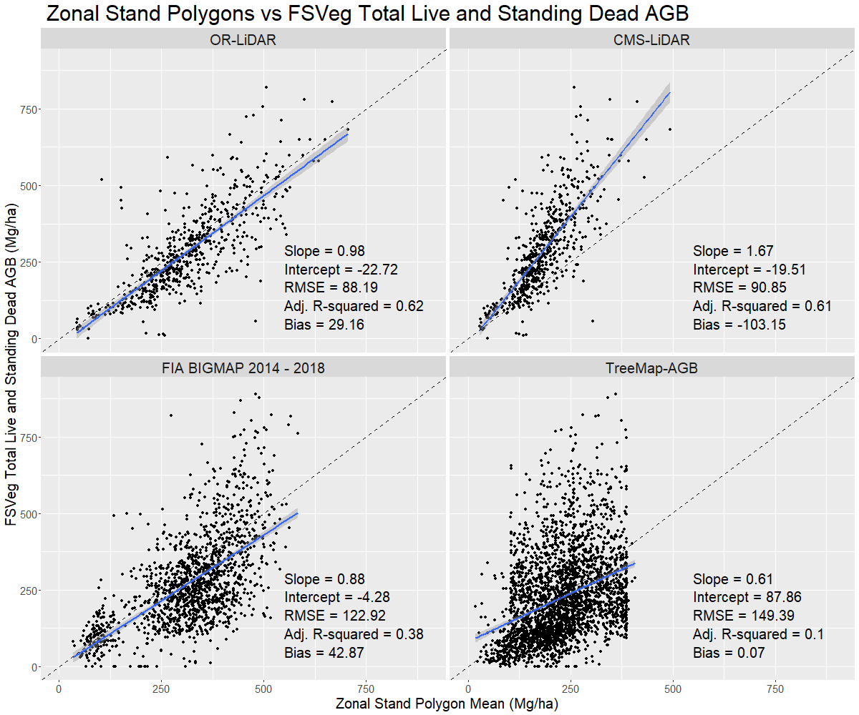
Stand polygons

Slide 7
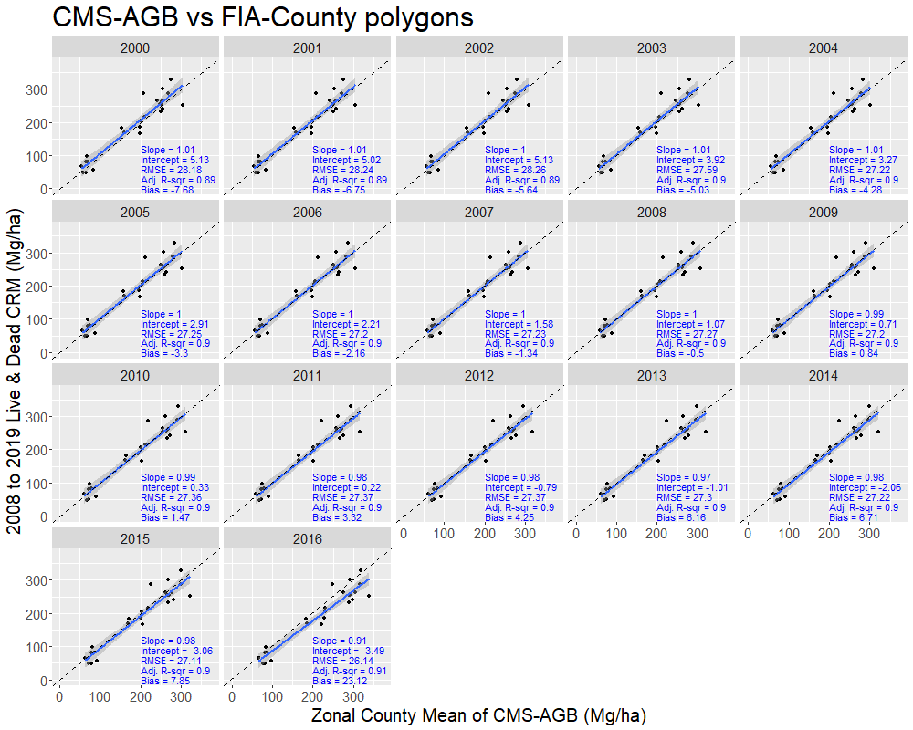
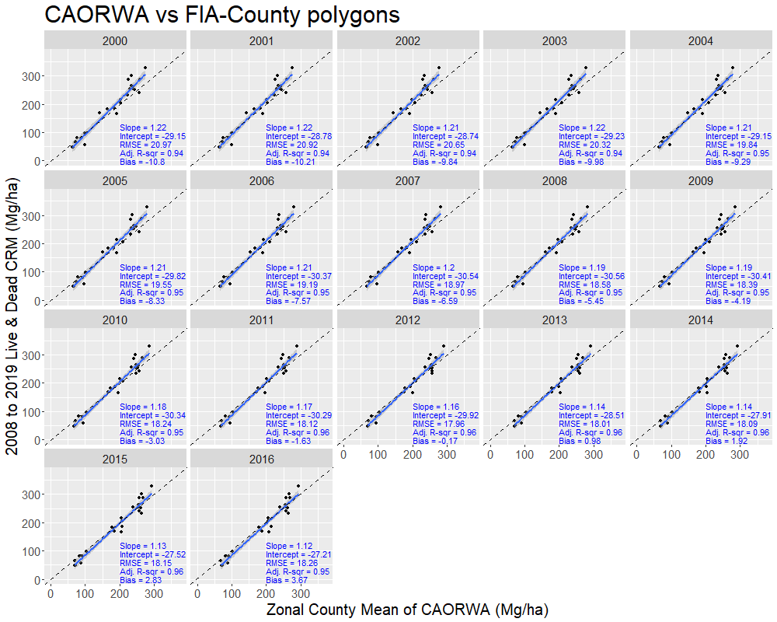
County polygons
Summary (n = 17 maps)
Slope = 0.98 RMSE = 28.38
Intercept = 2.7 Adj. R-squared = 0.9
Bias = 1
Summary (n = 17 maps)
Slope = 1.18 RMSE = 20.1
Intercept = -28.11 Adj. R-squared = 0.95 Bias = -4.57

Slide 8
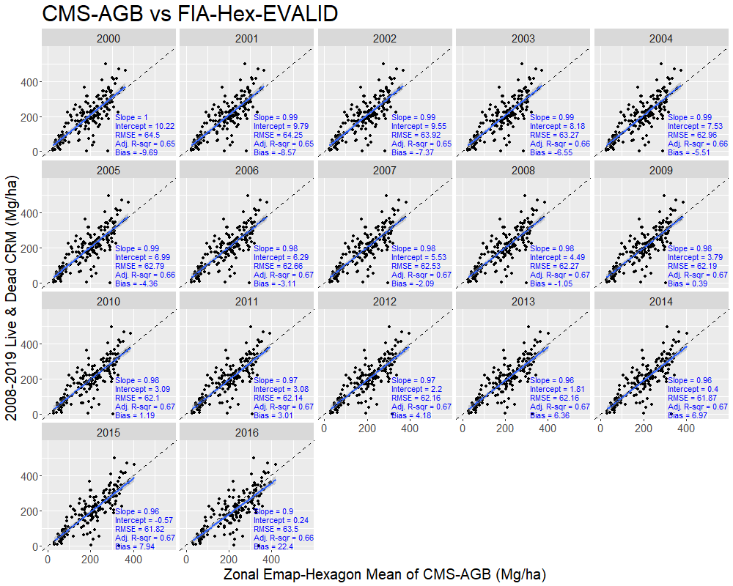
FIA Hexagons
Summary (n = 17 maps)
Slope = 0.97 RMSE = 63.26
Intercept = 6.26 Adj. R-squared = 0.66
Bias = 0.24
Summary (n = 17 maps)
Slope = 1.17 RMSE = 48.71
Intercept = -25.11 Adj. R-squared = 0.8 Bias = -7.09

Slide 9
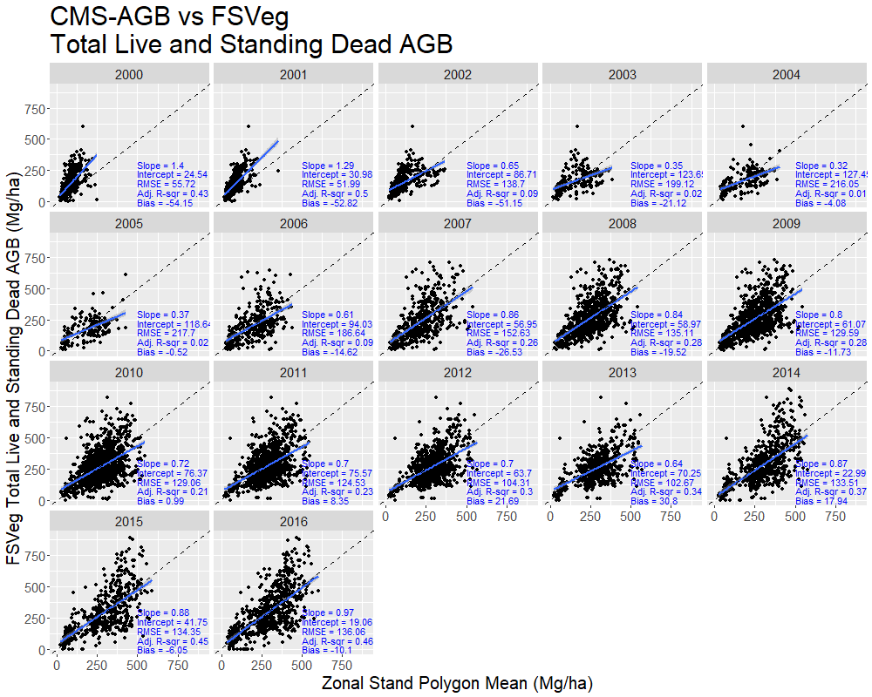
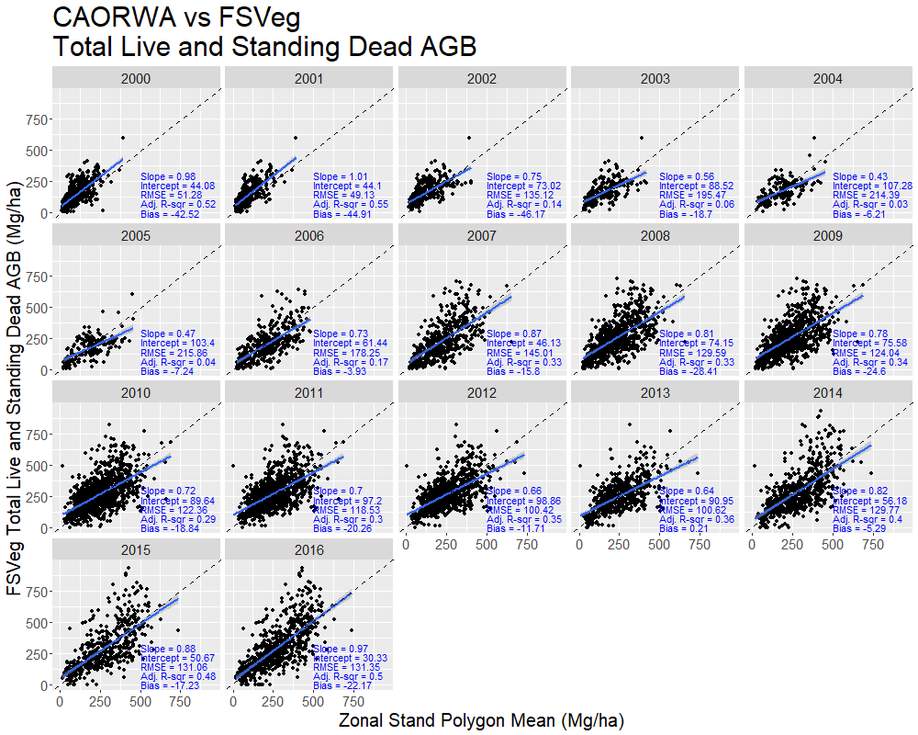
Stand polygons
Summary (n = 17 maps)
Slope = 0.76 RMSE = 131.99
Intercept = 66.43 Adj. R-squared = 0.34
Bias = -9.28
Summary (n = 17 maps)
Slope = 0.8 RMSE = 126.72
Intercept = 66.34 Adj. R-squared = 0.39 Bias = -21.15

Slide 10
County Polygons | Slope | Intercept | RMSE | Adj. R-squared | Bias
OR-LiDAR (2008 – 2015) | 1.26 | -78.62 | 29.29 | 0.88 | 23.78
CMS-LiDAR (2008 – 2015) | 1.95 | -57.77 | 25.94 | 0.91 | -63.18
FIA BIGMAP (2014 – 2018) | 1.07 | -42.22 | 24.58 | 0.92 | 26.07
TreeMap-AGB (2007 – 2016) | 1.06 | -26.03 | 55.70 | 0.58 | 14.50
CMS-AGB (2000 – 2016 (n=17)) | 0.98 | 2.70 | 28.38 | 0.90 | 1.00
CAORWA (2000 – 2016 (n=17)) | 1.18 | -28.11 | 20.10 | 0.95 | -4.57
FIA Emap Hexagons (64,000 ha) | Slope | Intercept | RMSE | Adj. R-squared | Bias
OR-LiDAR (2008 – 2015) | 1.04 | -35.34 | 58.36 | 0.71 | 25.55
CMS-LiDAR (2008 – 2015) | 1.69 | -26.23 | 59.21 | 0.70 | -63.57
FIA BIGMAP (2014 – 2018) | 1.03 | -32.53 | 55.51 | 0.74 | 26.09
TreeMap-AGB (2007 – 2016) | 1.03 | -15.62 | 83.26 | 0.41 | 9.43
CMS-AGB (2000 – 2016 (n=17)) | 0.97 | 6.26 | 63.26 | 0.66 | 0.24
CAORWA (2000 – 2016 (n=17)) | 1.17 | -25.11 | 48.71 | 0.80 | -7.09
Stand Polygons | Slope | Intercept | RMSE | Adj. R-squared | Bias
OR-LiDAR (2008 – 2015) | 0.98 | -22.72 | 88.19 | 0.62 | 29.16
CMS-LiDAR (2008 – 2015) | 1.67 | -19.51 | 90.85 | 0.61 | -103.15
FIA BIGMAP (2014 – 2018) | 0.88 | -4.28 | 122.92 | 0.38 | 42.87
TreeMap-AGB (2007 – 2016) | 0.61 | 87.86 | 149.39 | 0.10 | 0.07
CMS-AGB (2000 – 2016 (n=17)) | 0.76 | 66.43 | 131.99 | 0.34 | -9.28
CAORWA (2000 – 2016 (n=17)) | 0.80 | 66.34 | 126.72 | 0.39 | -21.15

Slide 11
3. Planned Activities 2023-24
• Coordinate comparison of dryland biomass estimates and uncertainty between Armston 2020 (South Africa and Australia) and Silva 2022 (Brazil) CMS projects
• National-scale biomass map comparison here in the data-rich USA
• State, county, FIA hex aggregation units make this powerful quantitatively, analytically
o Design-based FIA ground truth data makes this scale advantageous
• Mexico is another good candidate for comparing multiple CMS products, also within administrative/jurisdictional polygons
• How do evaluate/compare map estimates at pixel level?
• How to deal with different Forest/Nonforest masks and resulting effects on aggregated estimate within a jurisdiction? How much does this F/NF classification contribute to uncertainty?

Slide 12
3. Planned Activities 2023-24
• How much does allometry contribute to uncertainty?
• How do those allometric errors scale upon aggregation?
• Next iteration of CEOS biomass protocol will be validation of biomass change estimates (Neha Hunka and Kim Calders)
• Integrate with biomass harmonization activity (Laura and Neha)
• How many biomass map products are out there, nationally, regionally, and globally?
o Moving target
• Review/synthesis paper at large scale (national and above)

