Slide 1
CMS Methane Working Group
Goals:
Promote collaboration and information-sharing
Promote cross-projects engagement of stakeholders Produce stakeholder-directed synthesis/perspective papers reflecting on the state of the science

Slide 2
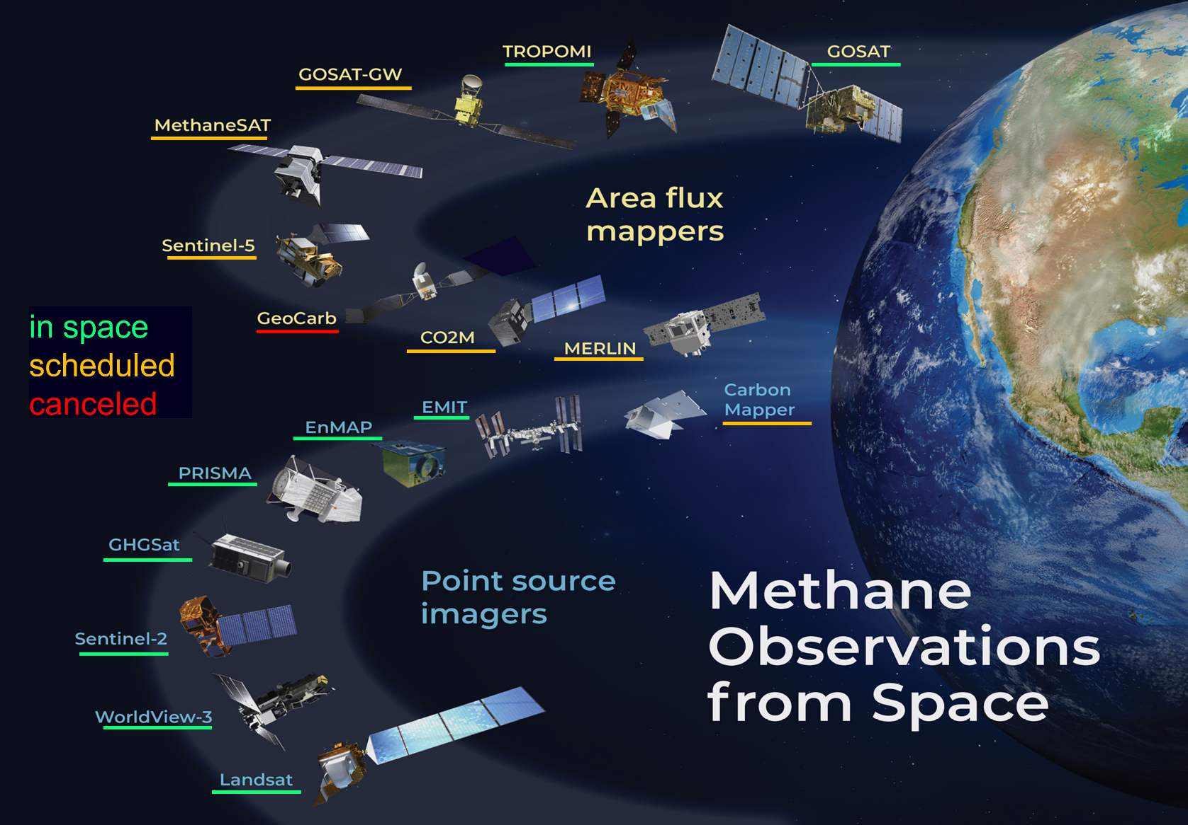
Accomplishment in past year: synthesis paper
Jacob, D.J., D.J. Varon, D.H. Cusworth, P.E. Dennison, C. Frankenberg, R. Gautam, L. Guanter, J. Kelley, J. McKeever, L.E. Ott, B. Poulter, Z. Qu, A.K. Thorpe, J.R. Worden, and R.M. Duren, Quantifying methane emissions from the global scale down to point sources using satellite observations of atmospheric methane, Atmos. Chem. Phys., 22, 9617–9646, https://doi.org/10.5194/acp-22-9617-2022, 2022.

Slide 3
Methane WG plans for next year
Wetland emissions: produce synthesis/perspective paper on current state of bottom-up models for methane wetland emissions and satellite observation needs. Leads: Qing Zhu (LBNL) and Min Chen (U. Wisconsin).
Rice emissions: exploit fine-resolution information available in US to evaluate global rice emission inventory. Leads: Zichong Chen (Harvard), Ben Runkle (U. Arkansas)
Landfill emissions: provide top-down information on landfill emissions for consideration by EPA under the IRA by working with Harvard Law School and Harvard Climate Initiative (workshop in January 2024). Leads: Daniel Jacob (Harvard), Dan Cusworth (Carbon Mapper), Hannah Nesser (JPL)
Satellite observations of point sources for climate action: produce synthesis/perspective paper on current/future capabilities and needs for point source observations from space to serve stakeholder communities. Leads: Dan Cusworth (Carbon Mapper), Daniel Varon (Harvard)

