Slide 1
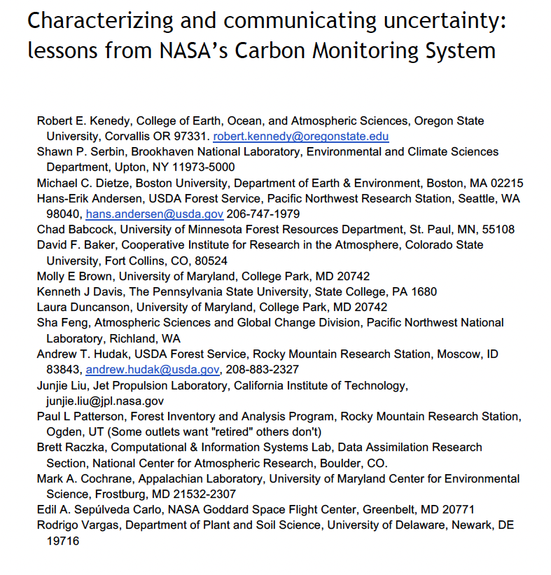
Finalized and submitted our synthesis paper on uncertainty to the special issue of ERL

Slide 2
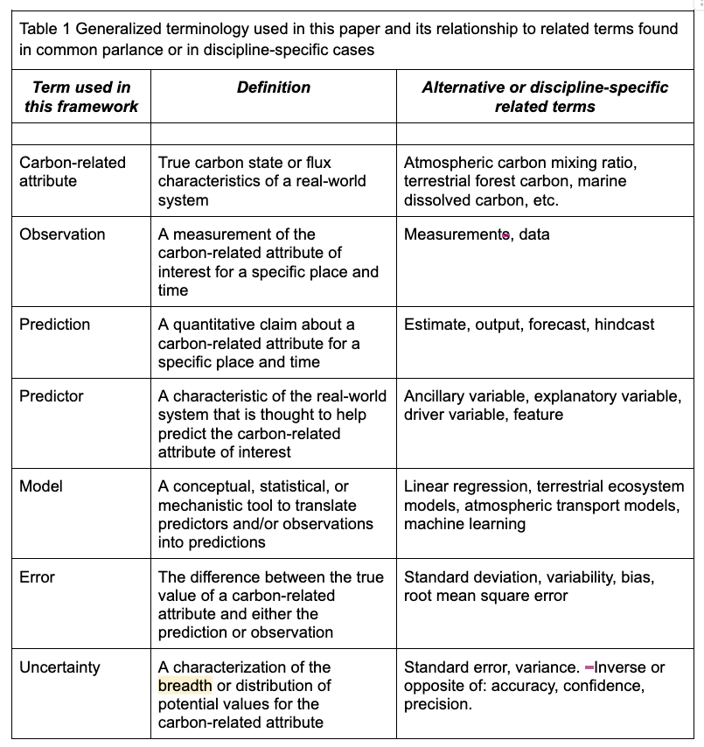
Definitions are tricky!

Slide 3
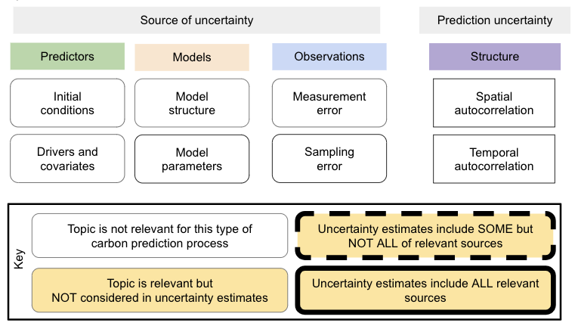
Conceptual heuristic

Slide 4
What We Talked About in the Uncertainty Working Group Breakout
Concentrated on Biomass/Carbon maps
Unsure how to use the pixel-level uncertainties
How do we compare maps using uncertainties?
uncertainty calculated differently project to project
How do we aggregate uncertainties, e.g., small area estimation?
How do we propagate uncertainties through subsequent analyses?
What We Decided to do About It
Develop a case study
Uses synthetic populations and/or well establish NFI data
Simulate the problems identified
Test out different ideas that we all have

