Slide 1
Meeting Summary
George Hurtt
Science Team Leader
September 26-28, 2023
Pasadena, CA

Slide 2
Great meeting!
Participation. Total= 111, In-person= 91, Virtual= 20;
Stakeholder Participation. Total= 17, Panels= 4, Listening session = 1, Keynote presentation = 1
CMS continues to be highly productive and impactful. 128 projects. 645 pubs, with 45 publications in top tier Nature (21), Science (9), PNAS (15). Publications cited 44,616 times, and 101 cited > 100 times each. 168 archived products, downloads >115,000. Several major success stories
CMS continues to engage relevant participants and stakeholders. CMS has engaged 861 Participants from 8 organizational types, > 200 stakeholders from 158 organizations, and operated in every major area of the Earth system.
CMS approach highly successful. An example for NASA Earth Action, and others
CMS research greatly needed. but science (+ next steps) not at pace needed
Needs for getting information to the places that need it, and tech technology transfer
Needs for broad coverage, high resolution, process detail, and policy relevance.
Importance of visualizations. “seeing is believing.”
Progress on previously identified challenges. wet carbon, lateral/vertical transport, alkalinity, …
Progress on Inter-agency collaboration and integration. AEOIP, EIS-GHG, National GHG Center
Progress enhancing, maturing, stakeholder engagement. New website!

Slide 3
Progress on continuing science projects. Forest carbon, crop carbon, atm flux, wet carbon, integration.
Progress on Working Groups. Multiple synthesis papers completed and in prep; Updated plans
Exciting new science projects. New topics, stakeholders, approaches, e.g. wet carbon and lateral
Critical role of remote sensing throughout. Initialization, assimilation, calibration, validation, monitoring,…
Critical role of field and atm data throughout. Cal/Val!
Critical role of models in scaling and for planning. Note increased role of machine learning
Challenges of reconciling top-down and bottom-up estimates. Land, ocean, spatially, temporally, multi-scale
Challenges of integrating multiple models. Variables, scales, data, computation,…
Challenge of capacity building. From data focus, to models, systems,… win-win collaborations.
Opportunity to contribute to NASA Hyperwall. Examples on website.
Opportunity to contribute to relevant reports/events/activities. AGU, COP28, National GHG center, …
Opportunity to continue and deepen discussions at AGU! Innovative Session on Carbon Monitoring
Research and Applications. See you there!
Opportunity to do more research! ROSES

Slide 4
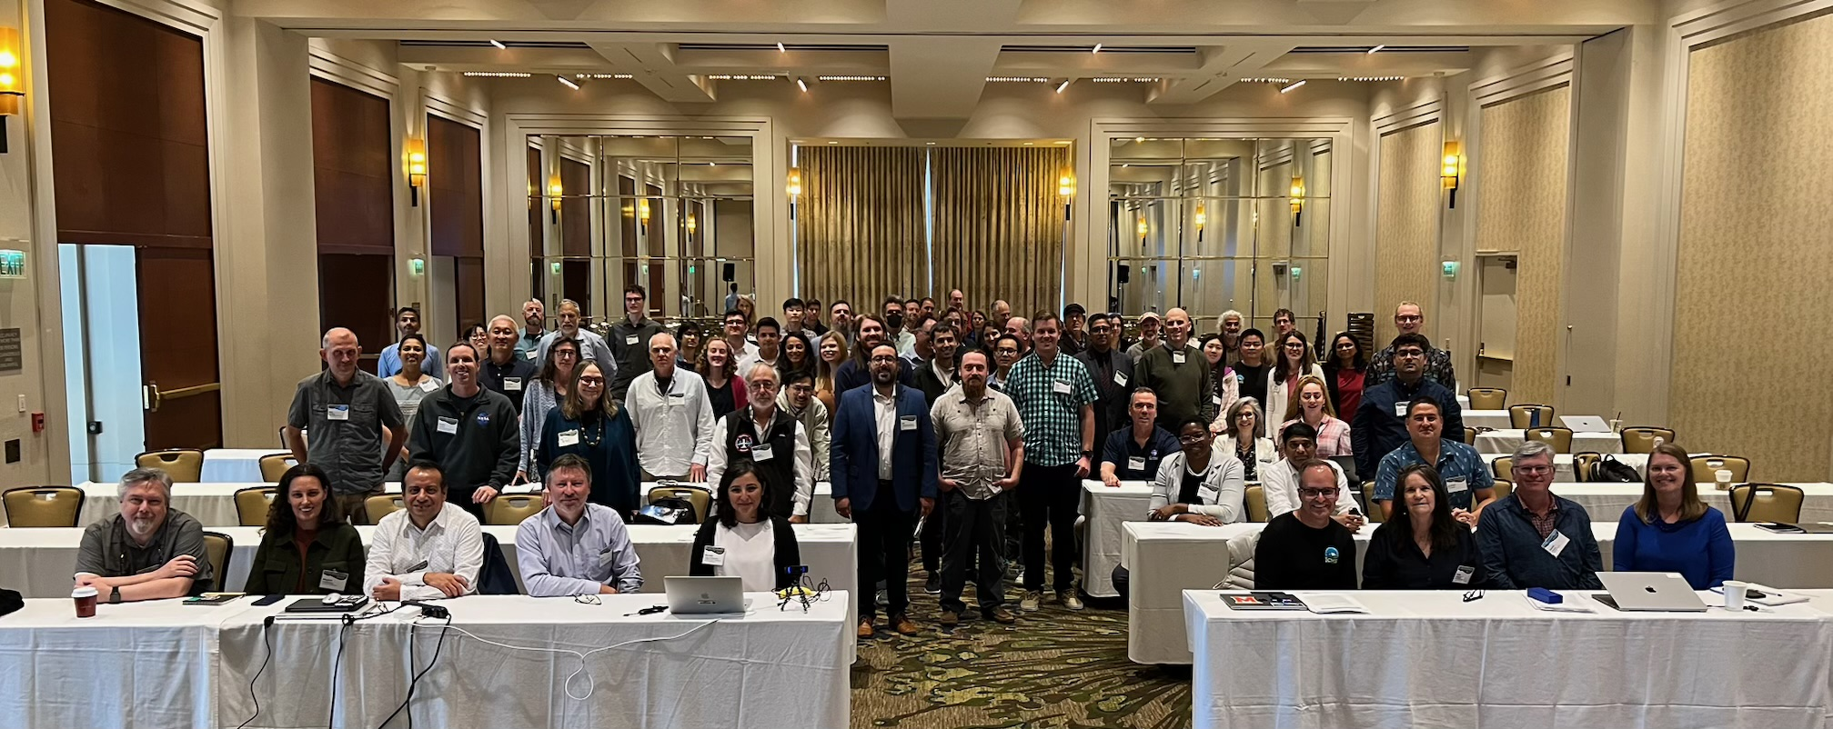
Thank you!

