Slide 1
The Dynamic Future of Maryland’s Natural Carbon Sinks:
Leveraging CMS Data to Chart a Policy Pathway to Net Zero
Rachel Lamb, PhD
CMS Science Team Meeting
September 27, 2023

Slide 2
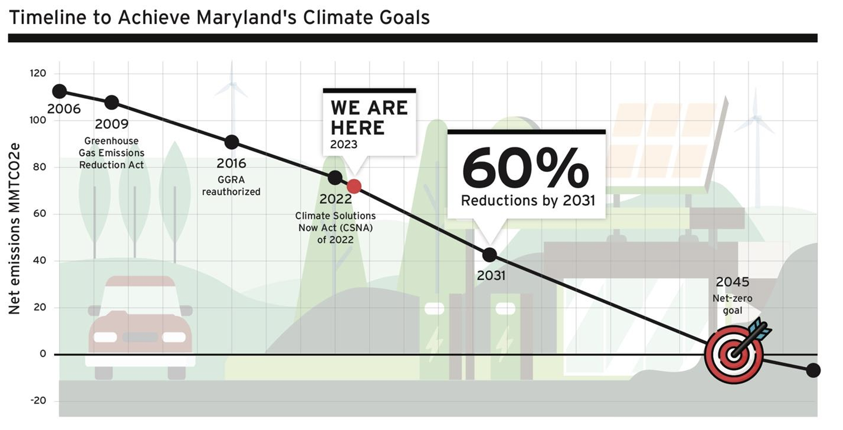
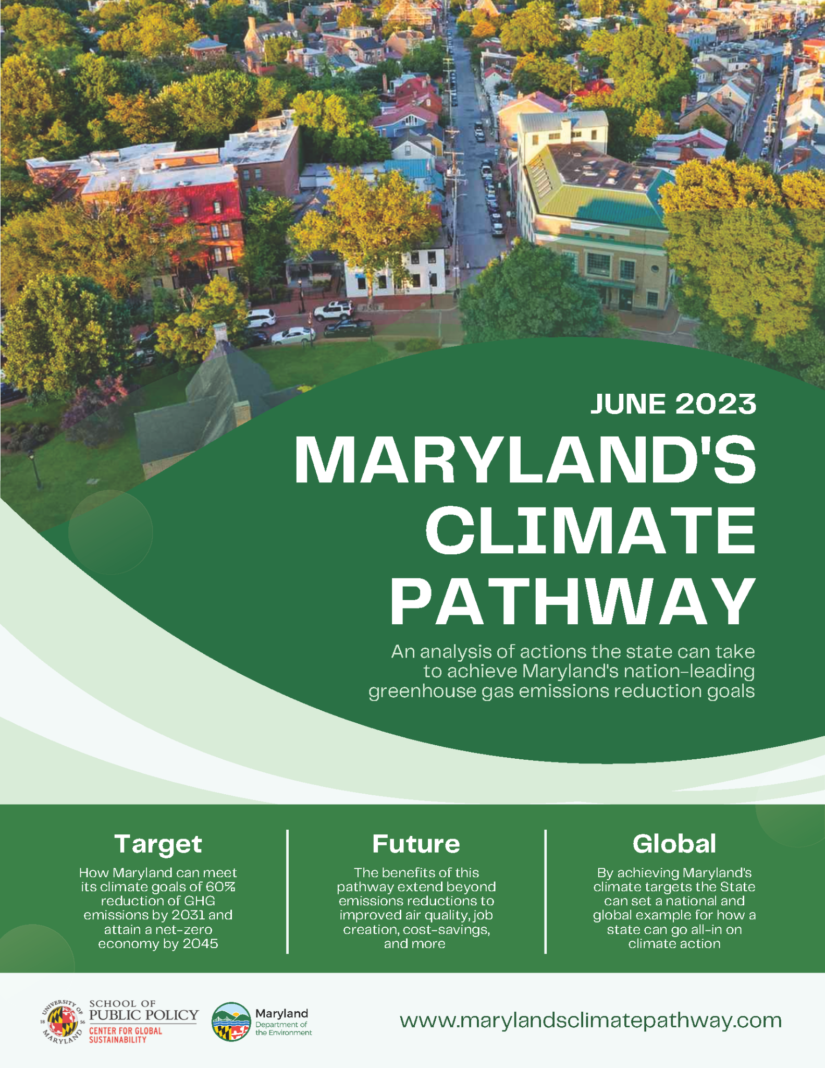
MD GHG Reduction Planning
December 2023: Final 2031 Plan
https://mde.maryland.gov/programs/air/ClimateChange/
Notes:
2009, reauthorized in 2016

Slide 3
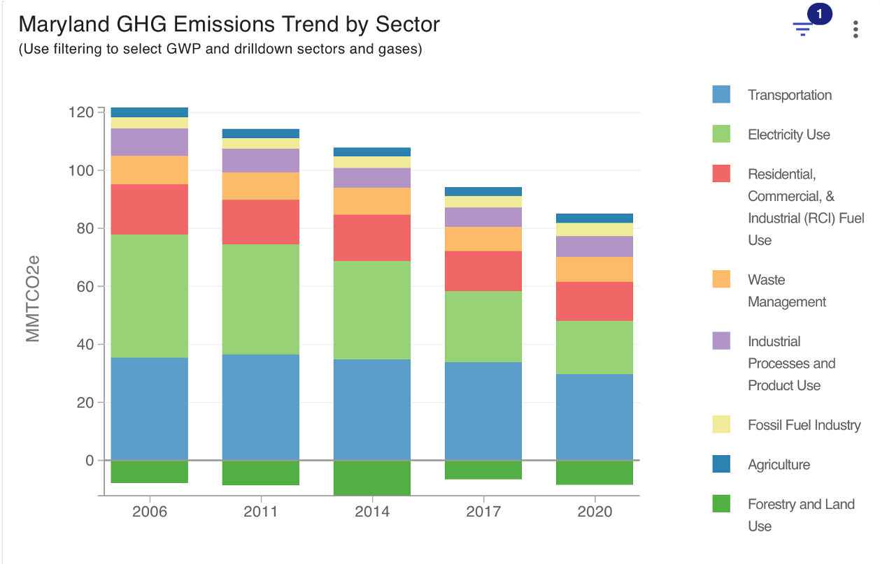
MD GHG Reduction Planning
2020

Slide 4
Net-zero Means Full Integration of NWL
Natural and Working Lands (NWL)
Assessment and Planning Tools

Slide 5
Net-zero Means Full Integration of NWL
Assessment and Planning Tools
Helps us harmonize from past (2006) to future (2045)
actual/known carbon impacts
known state and federal programs +
potential scale of implementation + projected C benefits
actual/known program implementation

Slide 6
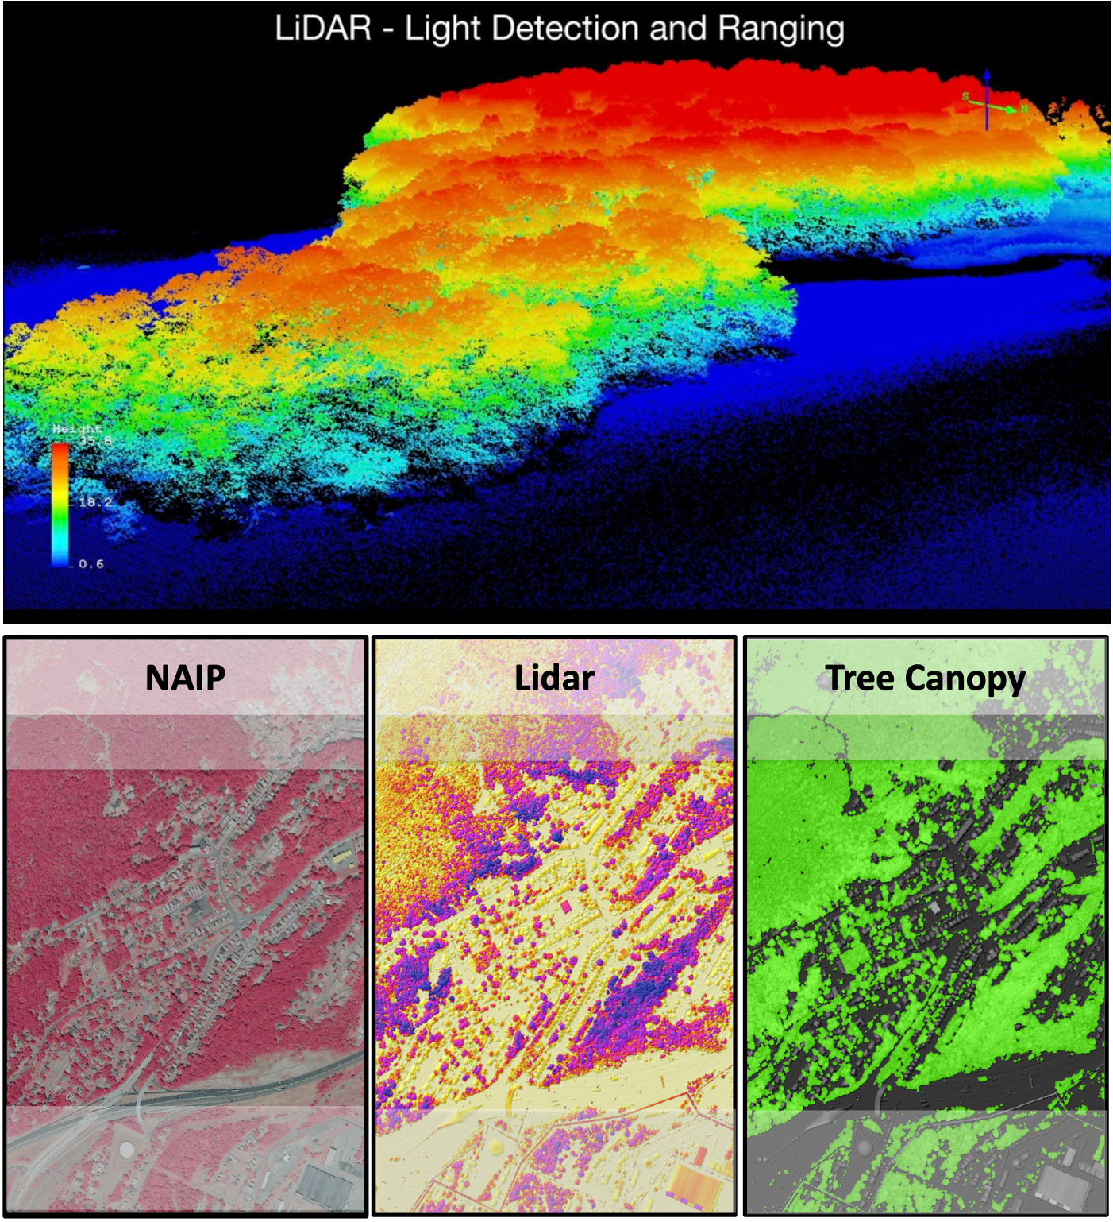
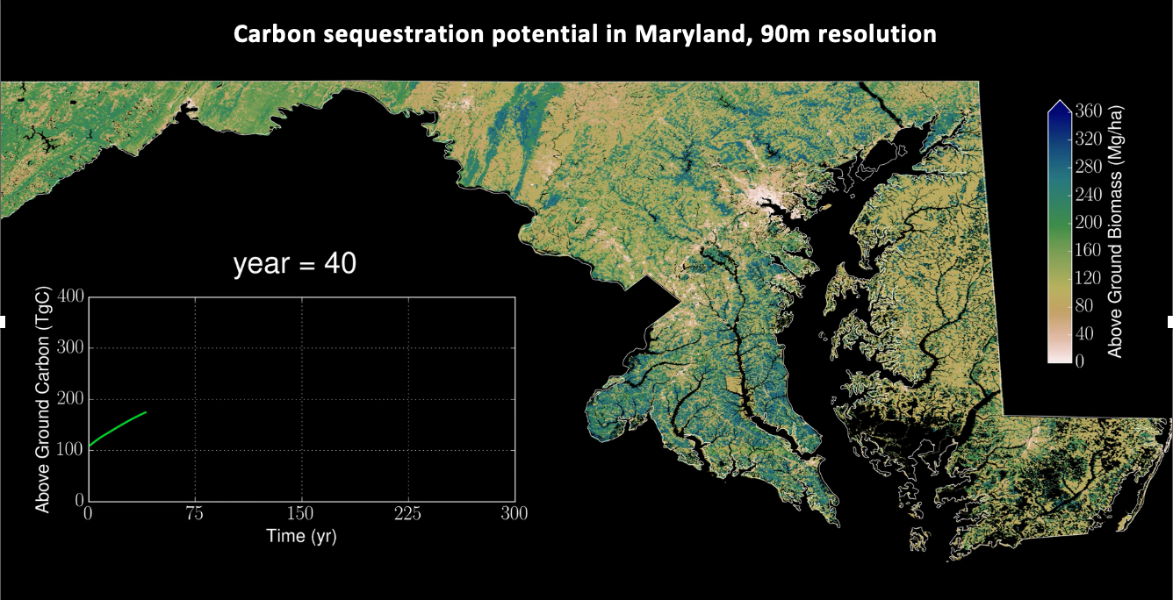
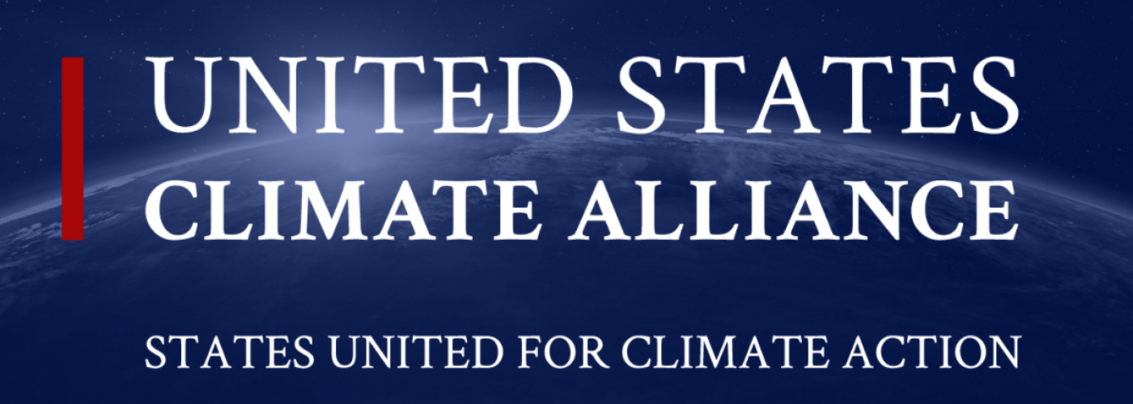
Connection to Global Science
Hurtt et al 2019, ERL
Ma et al 2021, ERL
Tang et al 2021, ERL
Hurtt et al 2023, in prep

Slide 7
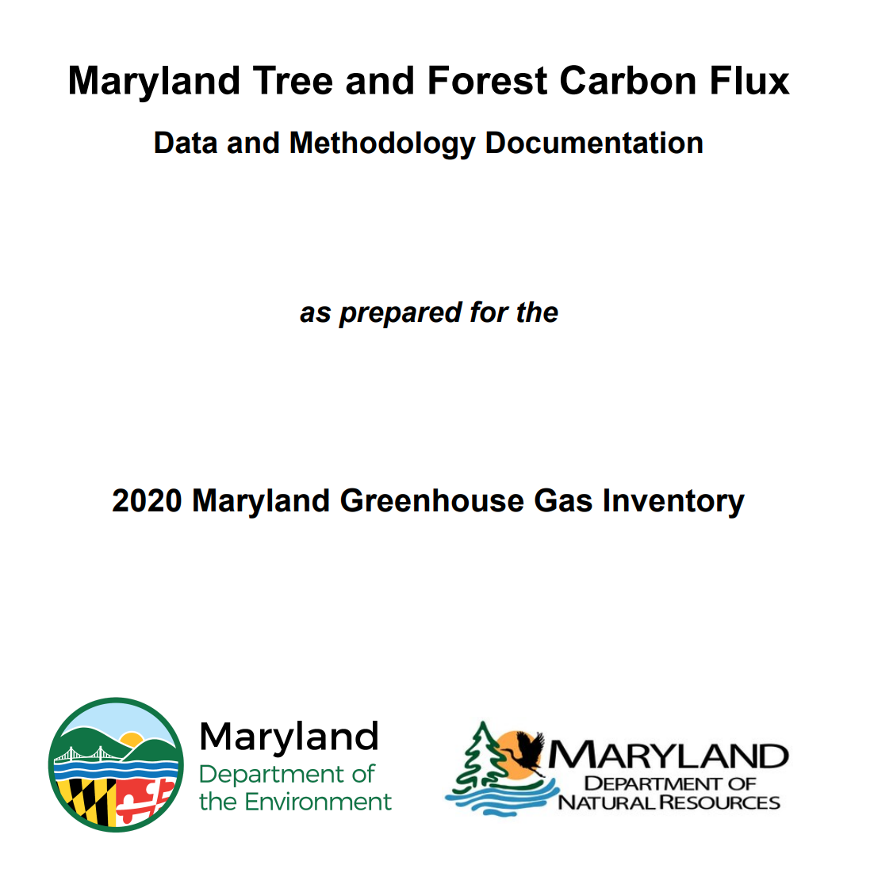
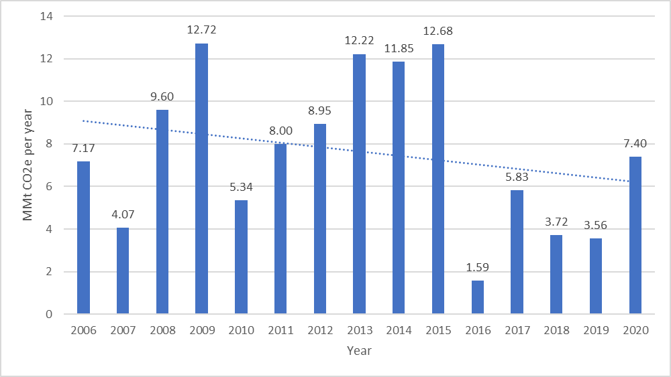
GHG Inventory - Forest Carbon
Figure 1. Trend of Forest Ecosystem Carbon Sequestration Per Year Over Time.
Hurtt et al 2023, in prep

Slide 8
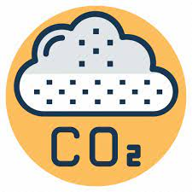
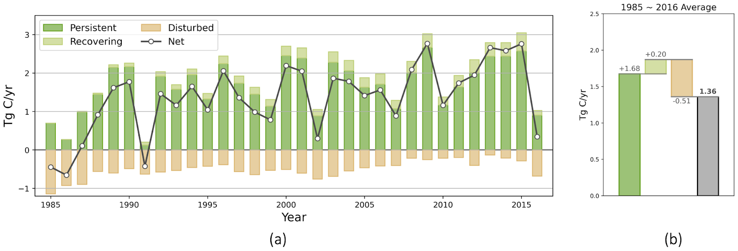
GHG Inventory - Forest Carbon
Beyond a single annual net flux #
Where and why is there change?
Hurtt et al 2023, in prep

Slide 9
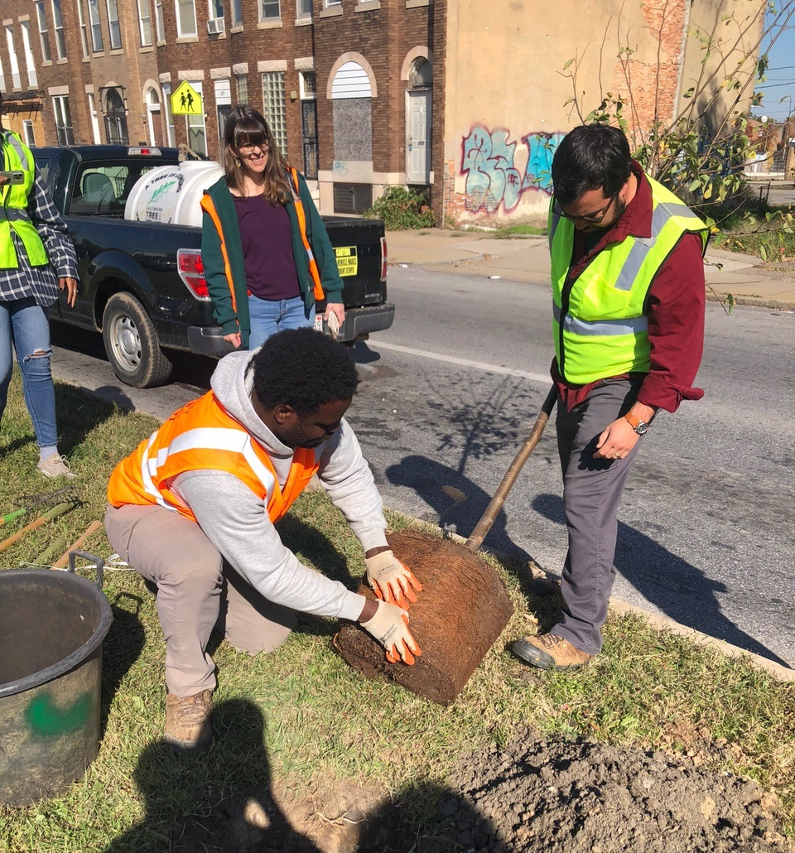
Tree Solutions Now Act of 2021
additional!
Notes:
$15 million coming from:
Bay Restoration Fund (Year 1)
DNR Trust Fund
Budget appropriations

Slide 10
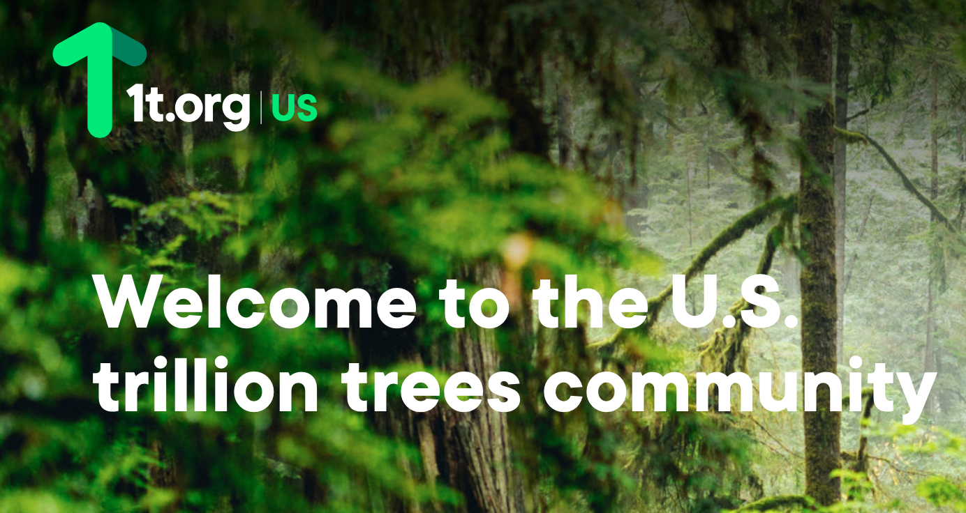
Connection to Global Goals
Notes:
and communities of practice

Slide 12
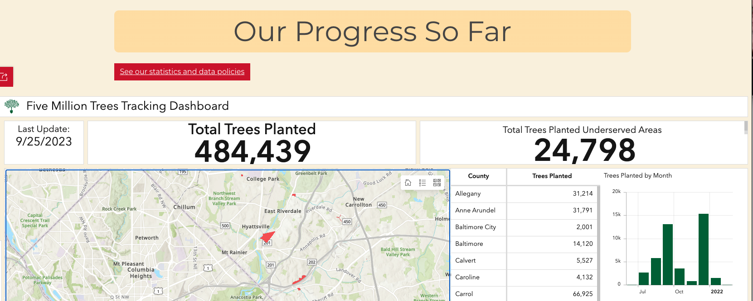
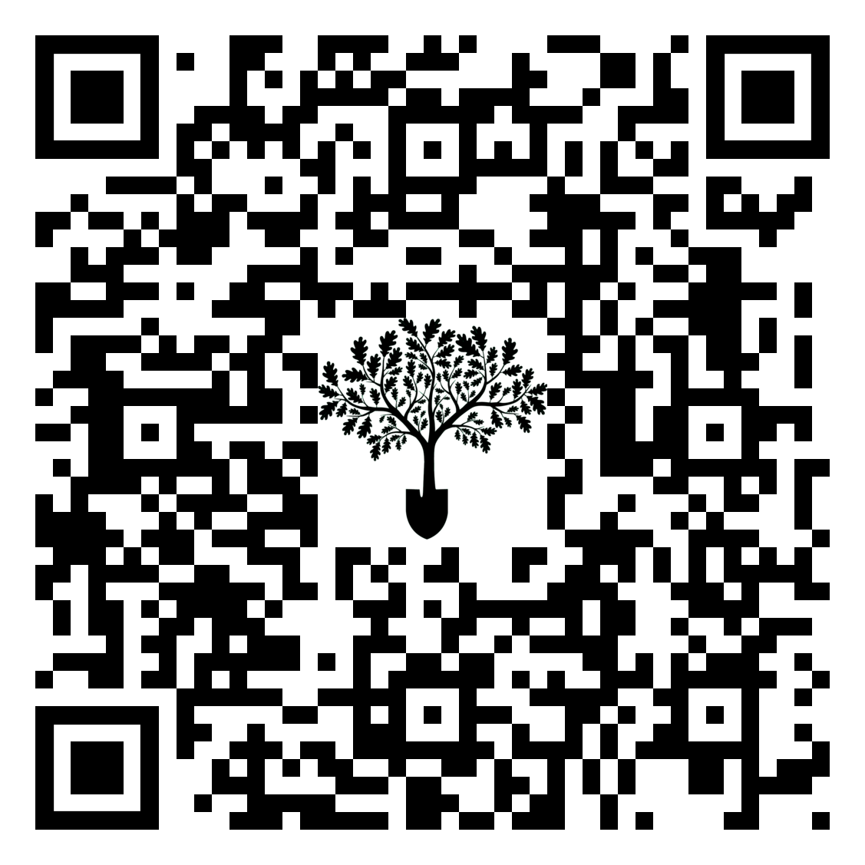
July 2021-June 2023
mde.maryland.gov/5Mtrees
12
Notes:
Given these reduction goals, the 5M trees initiative first tracks progress towards 5 million and specifically, gives us a way to track green infrastructure across the state. Secondly, we can use this data for MD’s own GHG reporting; The 5M tree goal directly support new targets established in the CSNA of 2022.
For the commission work plan goals, this creates a platform to see 1) carbon outcomes of funded tree planting projects 2) better understand which areas should be priortized for green infrastructure

Slide 13
Processing tree planting data
01
Enable progress tracking and confirm eligibility criteria
Number of Trees Planted
Species Name(s)
Planting Location
02
Support long term carbon monitoring and estimate forest carbon benefits
Planting Date
Tree Size
03
Planting Partners
Funding Sources
Track program efficacy and ensure no double counting
Additional collected data on planting design and maintenance can support longer term engagement with initiative participants and sustained tracking of tree planting health
Notes:
Part of this initiative is really being transparent about how submitted data is used. different attributes we collect are required to track progress towards the state’s 5 million trees goal (5MT). To enable progress tracking and confirm eligibility criteria we ask for:
To support long term carbon monitoring we ask for:
To track program efficacy and ensure no double counting we ask for, as applicable:
Additional collected data on planting design and maintenance makes sure we are monitoring tree health and survivorship Submitted tree planting data is also used to estimate related tree and forest carbon benefits, as already included in the state GHG inventory
We also have a schema for how we handle data privacy and I am happy to answe any questions as it relates to how this data is used

Slide 14
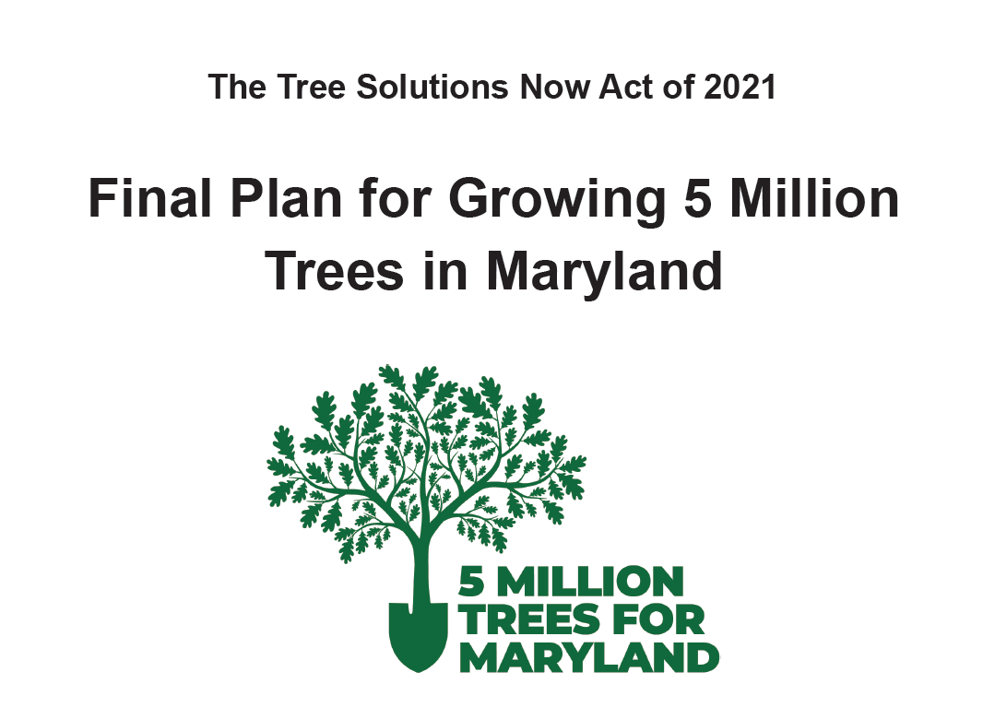
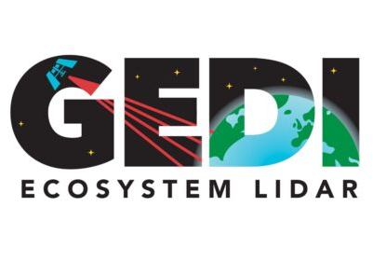
Opportunity for Science Alignment
MDE’s NEW Tree Registration and Tracking Tool
Report afforestation activity
(# trees, species, size, location, etc)
2. Initiate regrowth in model prior to
remote sensing detection (forests and TOF)
3. Monitor in the field/via remote sensing for long-term assessment
lidar and tree cover refresh?
Notes:
and communities of practice

Slide 15
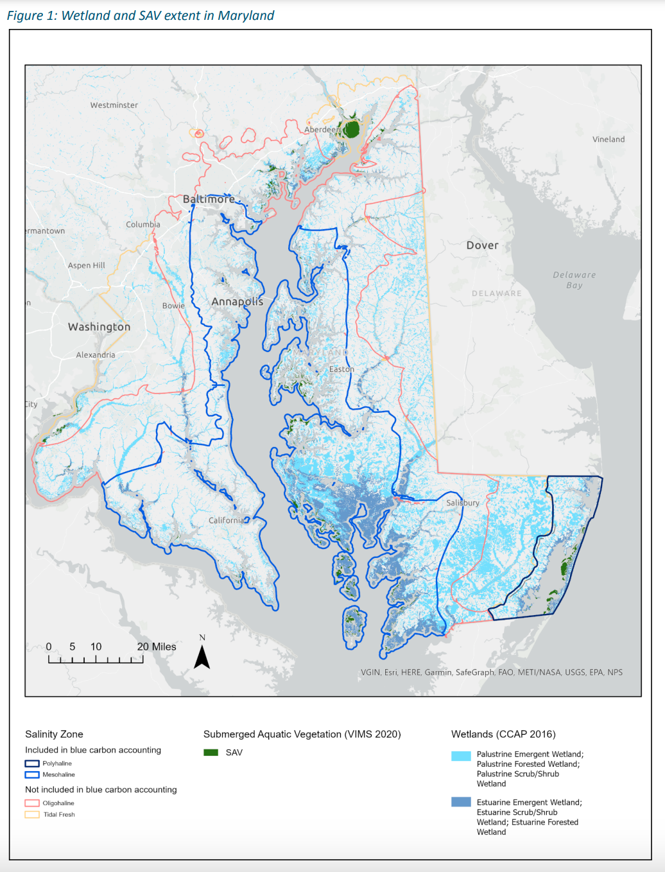
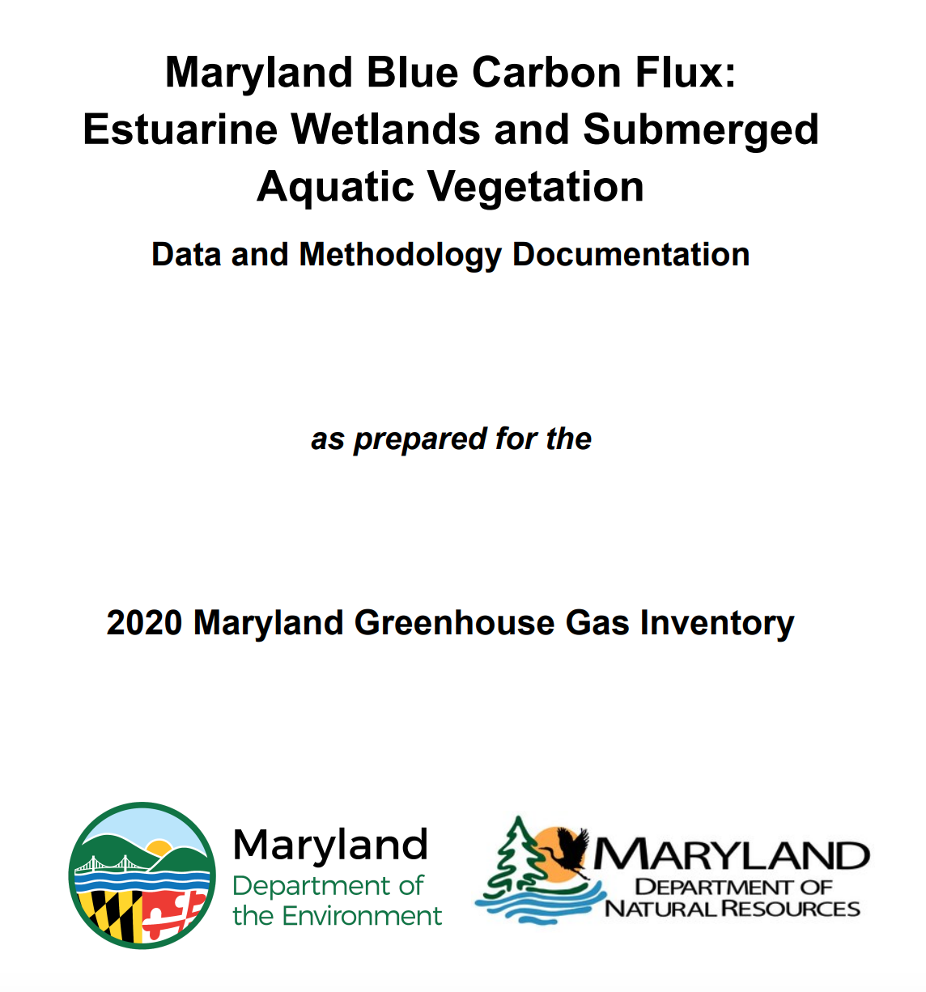
GHG Inventory - Blue Carbon
Newly included in 2020
Targeted improvements:
1. mapping against salinity gradient
2. geographically refined rates of carbon sequestration and methane
3. submerged aquatic vegetation
Science communication challenge: 20-yr GWP for methane means tidal wetlands are annually a net source of GHG emissions
Science communication challenge: changing impacts to flux with sea level rise and wetland migration
Leveraged CMS Wet Carbon data!
(CMS 2018 - Holmquist & Megonigal)

Slide 16
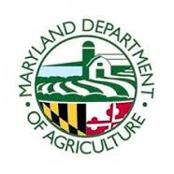
GHG Inventory - Ag Soil Carbon
High rates of BMP adoption by MD farmers
Incomplete representation by EPA SIT
Goals using state-specific data:
1) historical annual agricultural soil fluxes (2006-2021)
2) method to quantify annual soil fluxes for future inventories
3) estimated future soil fluxes under a range of planning scenarios
Role for remote sensing, but challenges with data sharing
Notes:
verbally mention ongoing project
https://agnr.umd.edu/news/umd-researcher-awarded-6-million-us-department-energy-create-value-added-biofuels-and

Slide 17
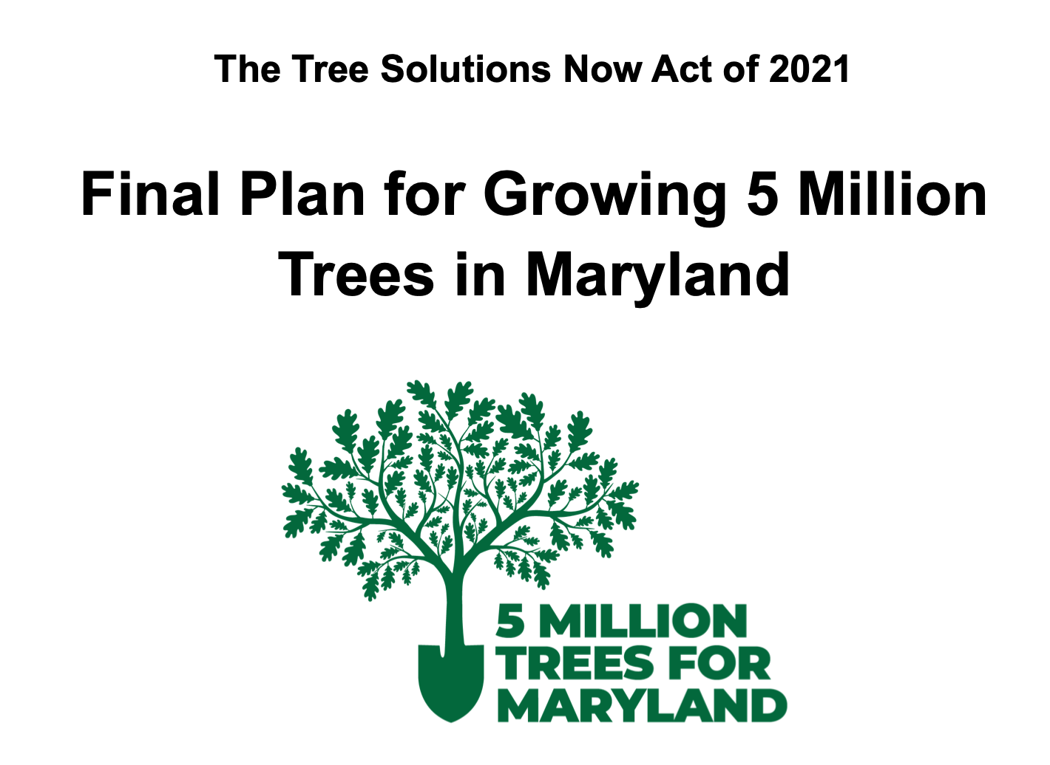
Iterate with new 2031 and 2045 Targets
2020 GHG Inventory: How do our carbon sinks support our GHG goals? What are the dominate factors affecting change?
2022 Progress Report: Does actual implementation of activities align with what was planned? Why or why not?
New 2031 Plan: Do we need additional programs or policies to reach existing (or new) targets?
What is the technical potential for MD NWL by 2045?
How can we connect to complementary goals?
e.g., 10% of new trees must be planted in underserved urban areas
(Equity and EJ)
Notes:
process led by the agencies but executed in conversation with the Maryland Commission on Climate Change.

Slide 18
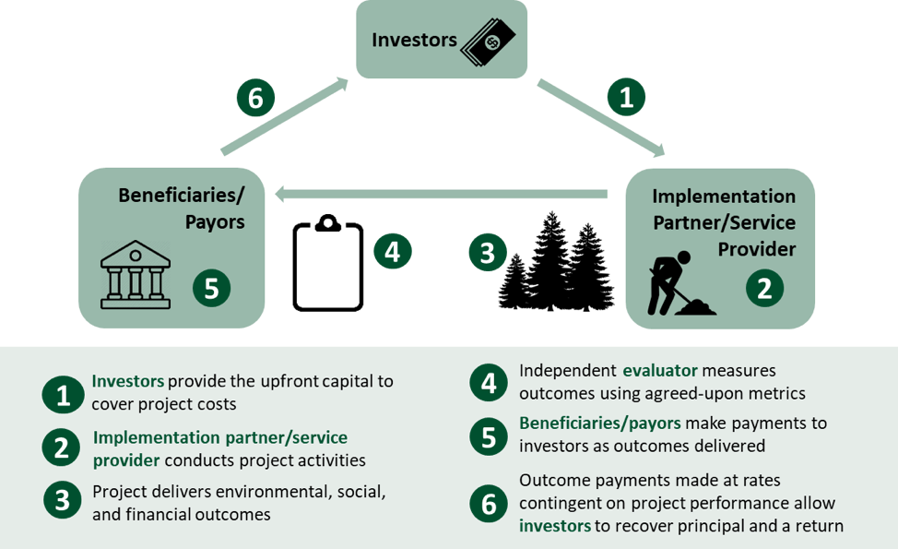
Attracting additional investment
Ground-breaking MD Conservation Finance Act
New Pay-for-Success model for restoration finance
Centers quantified/verified environmental outcomes
How can (or should) improved science at the state scale be leveraged to align accounting?
Image courtesy of the Conservation Finance Network

Slide 19
What has made this successful?
Long term partnership (federal, state, university)
Willingness to focus, fund, and frame the future
Strong support from state leadership
Willingness to version approaches with scientists
Strong support from science partners
Willingness to broaden applications with policymakers
How do we sustain and apply to other sectors?
How can we encourage broader adoption of innovation?

Slide 20
Contact
Rachel Lamb, PhD
Senior Climate Advisor, Office of the Secretary
Maryland Department of the Environment
rachel.lamb@maryland.gov

Slide 21
Links to more resources
June 2031 Pathway Report:
https://mde.maryland.gov/GGRA
GGRA Progress Report:
https://mde.maryland.gov/GGRA
GHG Emissions Inventory: https://mde.maryland.gov/programs/air/ClimateChange/Pages/GreenhouseGasInventory.aspx
Trees and Forest Data and Methodology Documentation:
https://mde.maryland.gov/programs/air/ClimateChange/Documents/VIMAL/MD_ForestCarbon_Flux_Methodology_01.06.23.pdf
Blue Carbon Data and Methodology Documentation:
https://mde.maryland.gov/programs/air/ClimateChange/Documents/VIMAL/MD_BlueCarbon_Flux_Methodology_01.06.23.pdf
Agricultural Soil Carbon Project Brief:
https://mde.maryland.gov/programs/air/ClimateChange/Documents/VIMAL/MD_AgriculturalSoils_Flux_Project_01.06.23.pdf

