Slide 1
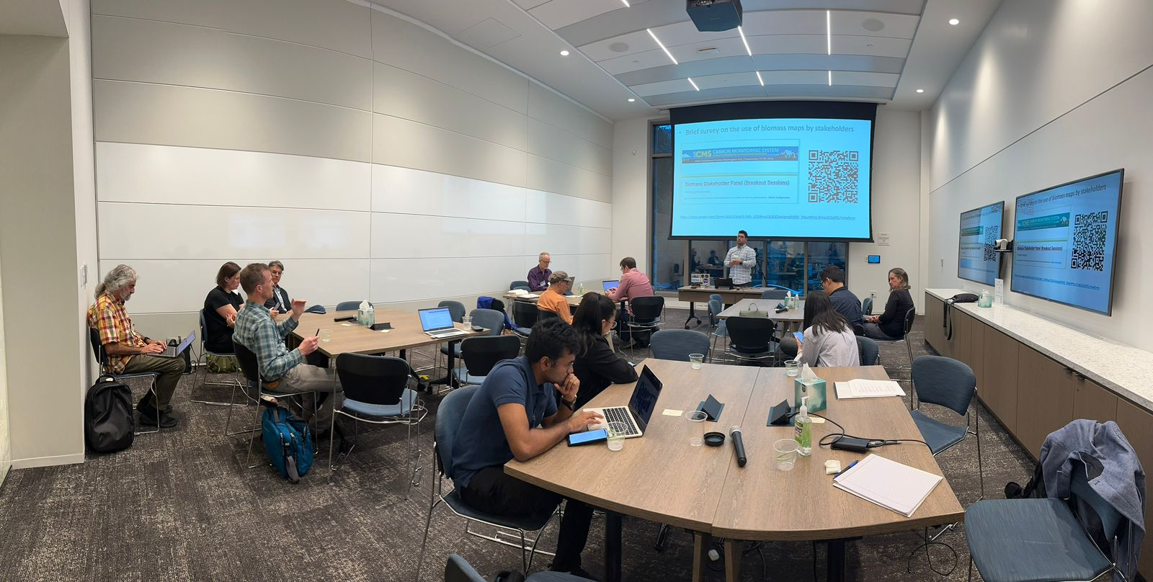
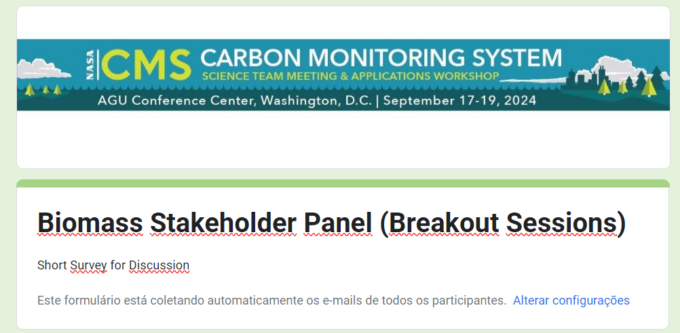
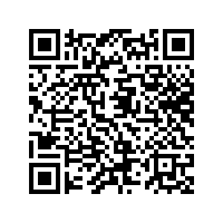
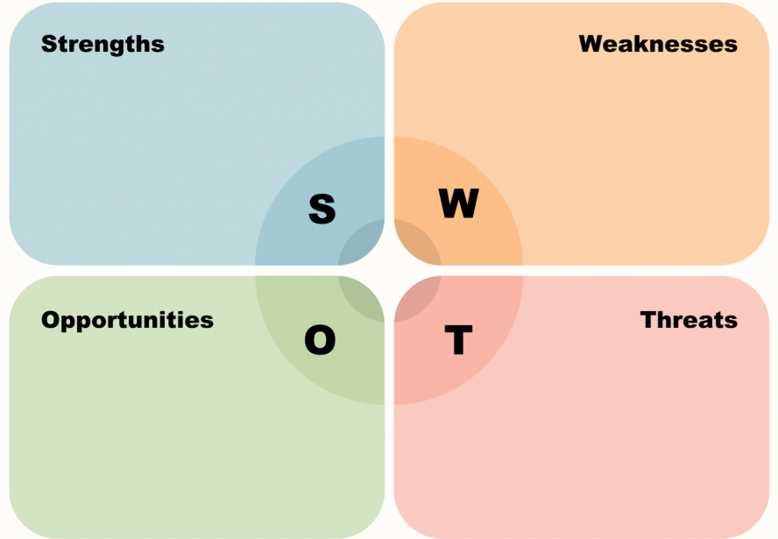
Breakout Sessions between CMS Science Team Members & Stakeholders (BIOMASS)
Brief survey on the use of CMS biomass products by stakeholders
SWOT Analysis for the CMS Program – Biomass and Stakeholder Focus
Notes:
Strengths:
Cutting-Edge Technology and Data: The NASA CMS program provides high-quality, accurate biomass and carbon maps, derived from advanced remote sensing technology, which are essential for understanding forest carbon dynamics.
Tailored Stakeholder Engagement: Stakeholders are carefully selected by principal investigators (PIs) during proposal submission, ensuring that the participants are aligned with project goals and can meaningfully contribute.
Focused Collaboration: With defined three-year project cycles, both stakeholders and science teams can work on specific, measurable outcomes, ensuring progress is tracked and evaluated.
Support for Climate Change Mitigation: The program directly supports national and global climate change mitigation efforts by providing data that stakeholders can use to manage carbon stocks and assess ecosystem services.

Slide 2
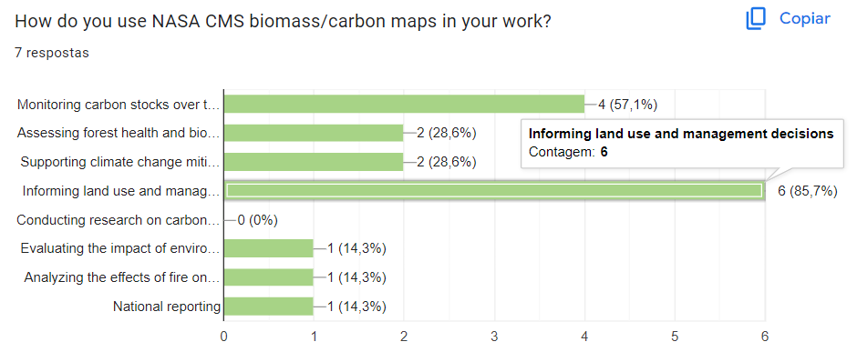
50% response rate (7 out of 14 responses)

Slide 3
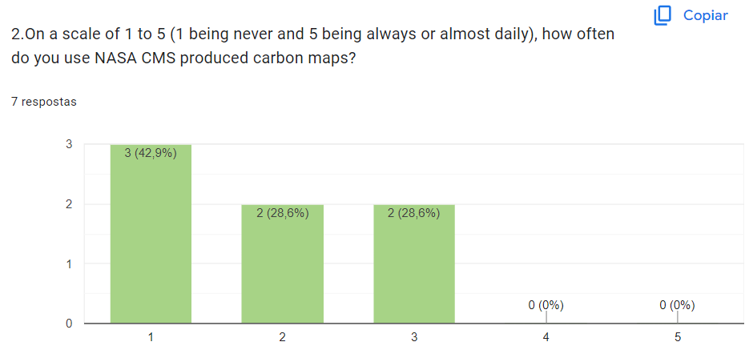

Slide 4
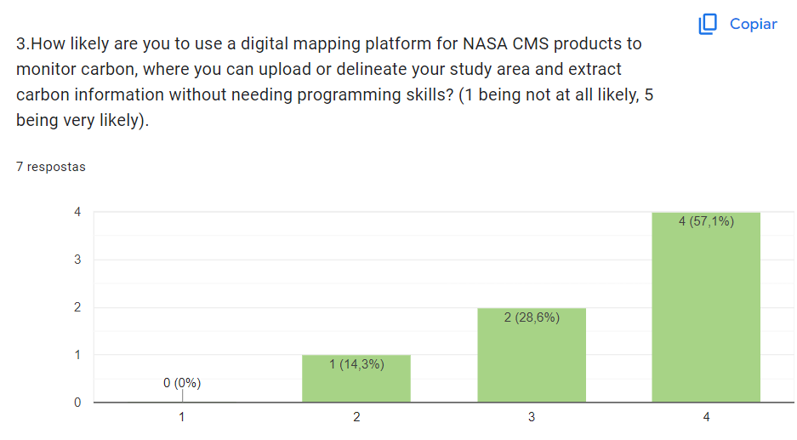

Slide 5
6.What spatial resolution do you find most useful for biomass/carbon monitoring in your application?
Less than 1 meter per pixel
1-5 meter per pixel
5-10 meter per pixel
10-30 meter per pixel
>30 meter per pixel

Slide 6
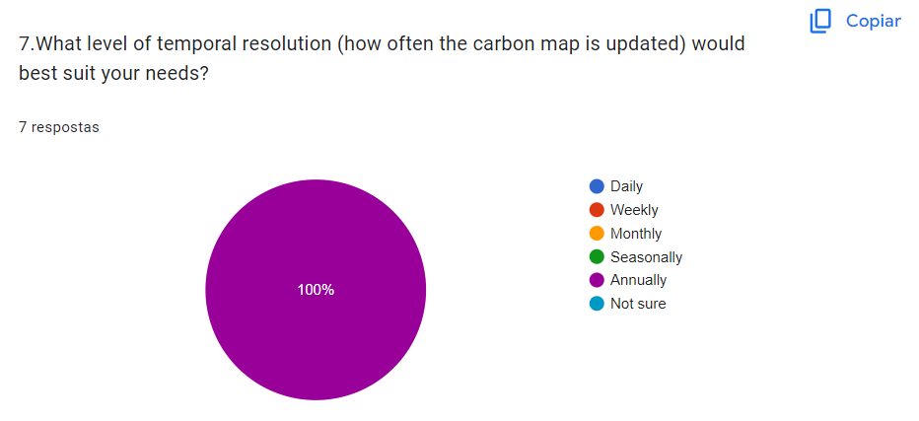

Slide 7
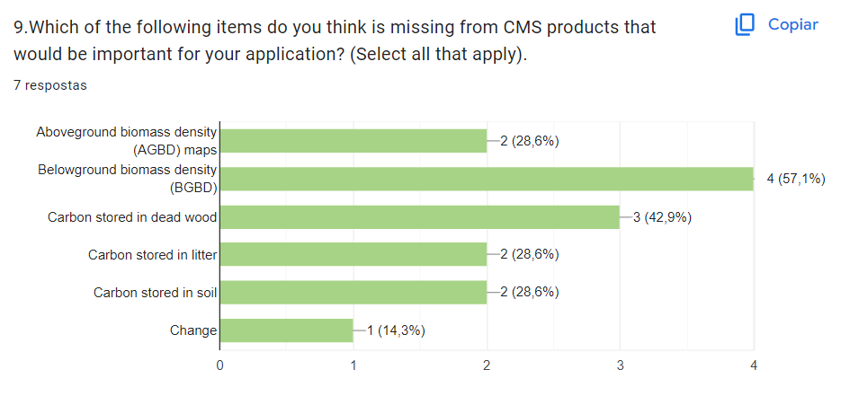
Notes:
Soil Carbon Sequestration
Land Use Management: Belowground carbon helps in assessing the impact of land use changes, such as deforestation, agriculture, and reforestation, on carbon storage and ecosystem health.
Agricultural Practices: Monitoring belowground carbon is important for sustainable agriculture practices like crop rotation, no-till farming, and agroforestry, which aim to preserve or enhance soil carbon stocks.

Slide 8
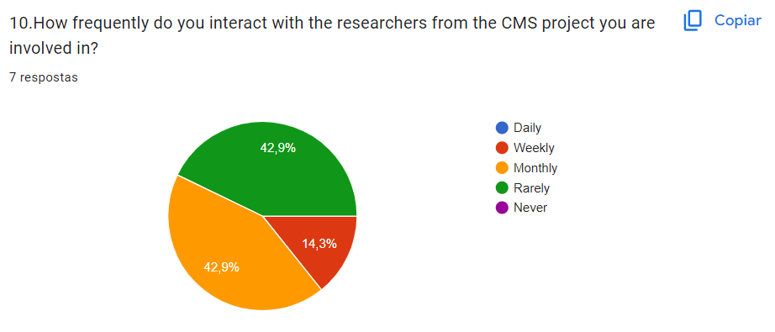

Slide 9
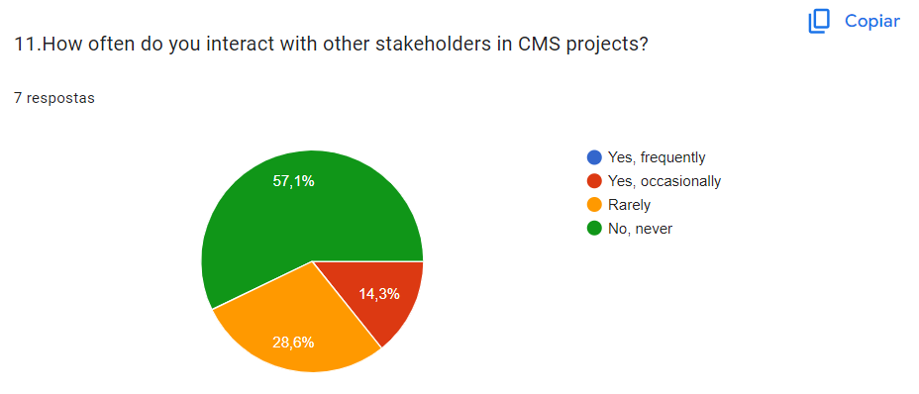

Slide 10
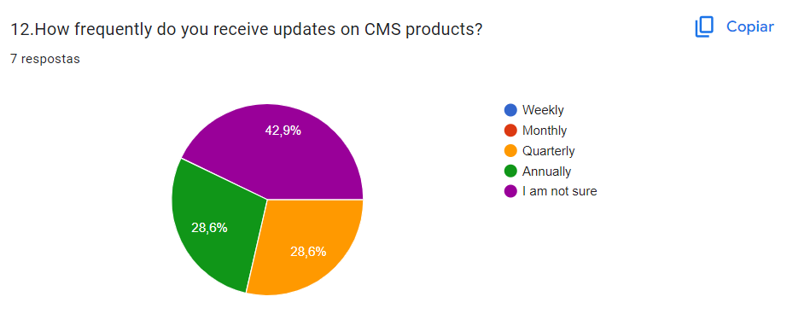

Slide 11
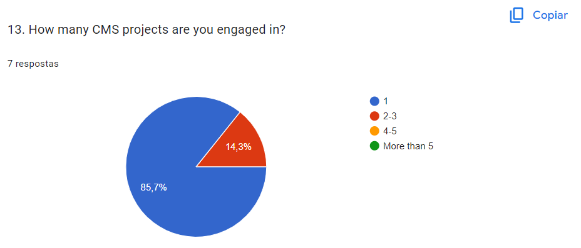

Slide 12
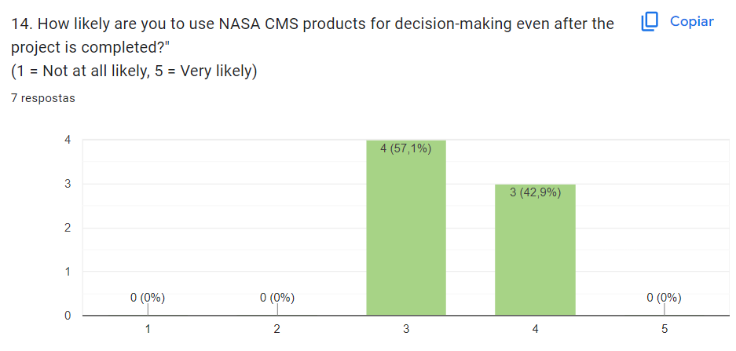

Slide 13
Breakout Sessions between CMS Science Team Members & Stakeholders (BIOMASS)
Cutting-Edge Technology and Data
Tailored Stakeholder Engagement
SWOT Analysis for the NASA CMS Program – Biomass and Stakeholder Focus
Focused Collaboration
Notes:
Strengths:
Cutting-Edge Technology and Data: The NASA CMS program provides high-quality, accurate biomass and carbon maps, derived from advanced remote sensing technology, which are essential for understanding forest carbon dynamics.
Tailored Stakeholder Engagement: Stakeholders are carefully selected by principal investigators (PIs) during proposal submission, ensuring that the participants are aligned with project goals and can meaningfully contribute.
Focused Collaboration: With defined three-year project cycles, both stakeholders and science teams can work on specific, measurable outcomes, ensuring progress is tracked and evaluated.
Support for Climate Change Mitigation: The program directly supports national and global climate change mitigation efforts by providing data that stakeholders can use to manage carbon stocks and assess ecosystem services.

Slide 14
Breakout Sessions between CMS Science Team Members & Stakeholders (BIOMASS)
Continuity/Limited Project Duration
Complex Data Usage
Resource Limitations for Stakeholders
Cutting-Edge Technology and Data
Tailored Stakeholder Engagement
SWOT Analysis for the NASA CMS Program – Biomass and Stakeholder Focus
Focused Collaboration
Notes:
Weaknesses:
Limited Project Duration: The three-year timeline might not be enough to fully implement or see the long-term impacts of carbon mitigation strategies.
Complex Data Usage: Stakeholders may find the biomass data technically challenging, limiting their ability to fully utilize it in decision-making processes or operationalize it effectively.
Resource Limitations for Stakeholders: Some stakeholders may lack the financial or technical resources to fully engage with the data or implement recommended strategies based on CMS outputs.
Risk of Narrow Stakeholder Involvement: The selection of stakeholders by PIs may unintentionally exclude other relevant voices or lead to underrepresentation of certain sectors or regions.

Slide 15
Breakout Sessions between CMS Science Team Members & Stakeholders (BIOMASS)
Continuity/Limited Project Duration
Complex Data Usage
Resource Limitations for Stakeholders
Cutting-Edge Technology and Data
Tailored Stakeholder Engagement
SWOT Analysis for the NASA CMS Program – Biomass and Stakeholder Focus
Focused Collaboration
Capacity Building
Policy and Decision-Making Influence
Scaling Up Impact
Innovation through Collaboration
Notes:
Opportunities:
Capacity Building: The program can offer targeted training to stakeholders on how to effectively use CMS biomass data, helping bridge the gap between science and application.
Policy and Decision-Making Influence: By collaborating with diverse stakeholders, the CMS program has the potential to significantly influence national and regional policy frameworks related to carbon management and climate action.
Scaling Up Impact: The lessons learned and partnerships formed during the three-year cycles can lead to broader, more comprehensive projects in the future, including international collaborations and expanded funding opportunities.
Innovation through Collaboration: The engagement with stakeholders opens avenues for the co-creation of innovative tools, models, or approaches to biomass management, enhancing the practical application of NASA data.
Nao listar nosso sucesso somente baseado em products

Slide 16
Breakout Sessions between CMS Science Team Members & Stakeholders (BIOMASS)
Continuity/Limited Project Duration
Complex Data Usage
Resource Limitations for Stakeholders
Cutting-Edge Technology and Data
Tailored Stakeholder Engagement
SWOT Analysis for the NASA CMS Program – Biomass and Stakeholder Focus
Focused Collaboration
Capacity Building
Policy and Decision-Making Influence
Scaling Up Impact
Innovation through Collaboration
Changing Priorities
Political and Regulatory Barriers
Stakeholder Commitment Issues
Data Accessibility
Notes:
Threats:
Political and Regulatory Barriers: Stakeholders may face political or regulatory obstacles in their respective regions, which could hinder the implementation of strategies based on CMS data.
Changing Priorities: Government or institutional priorities may shift, leading to a potential loss of interest or funding in biomass and carbon monitoring initiatives.
Stakeholder Commitment Issues: Some stakeholders may not remain consistently engaged throughout the three-year project cycle, affecting the overall collaboration and project outcomes.
Data Accessibility: Although the CMS program offers high-quality data, some stakeholders may find it difficult to access or integrate it into their own systems, limiting the program’s practical utility in certain regions.
Provide standard – CEOS guidelines

