Slide 1
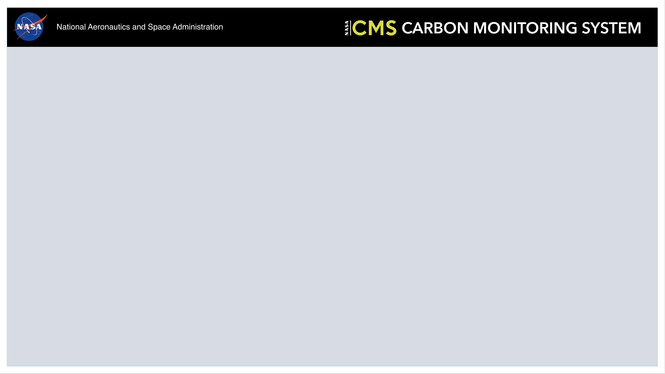
Welcome to:
The CMS Science Team Meeting & Applications Workshop

Slide 2
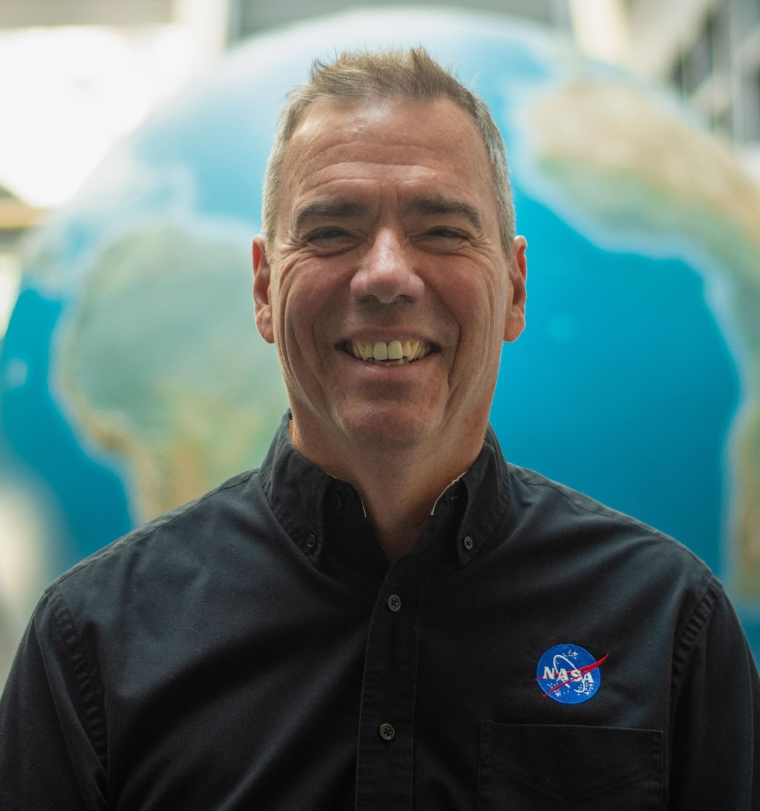
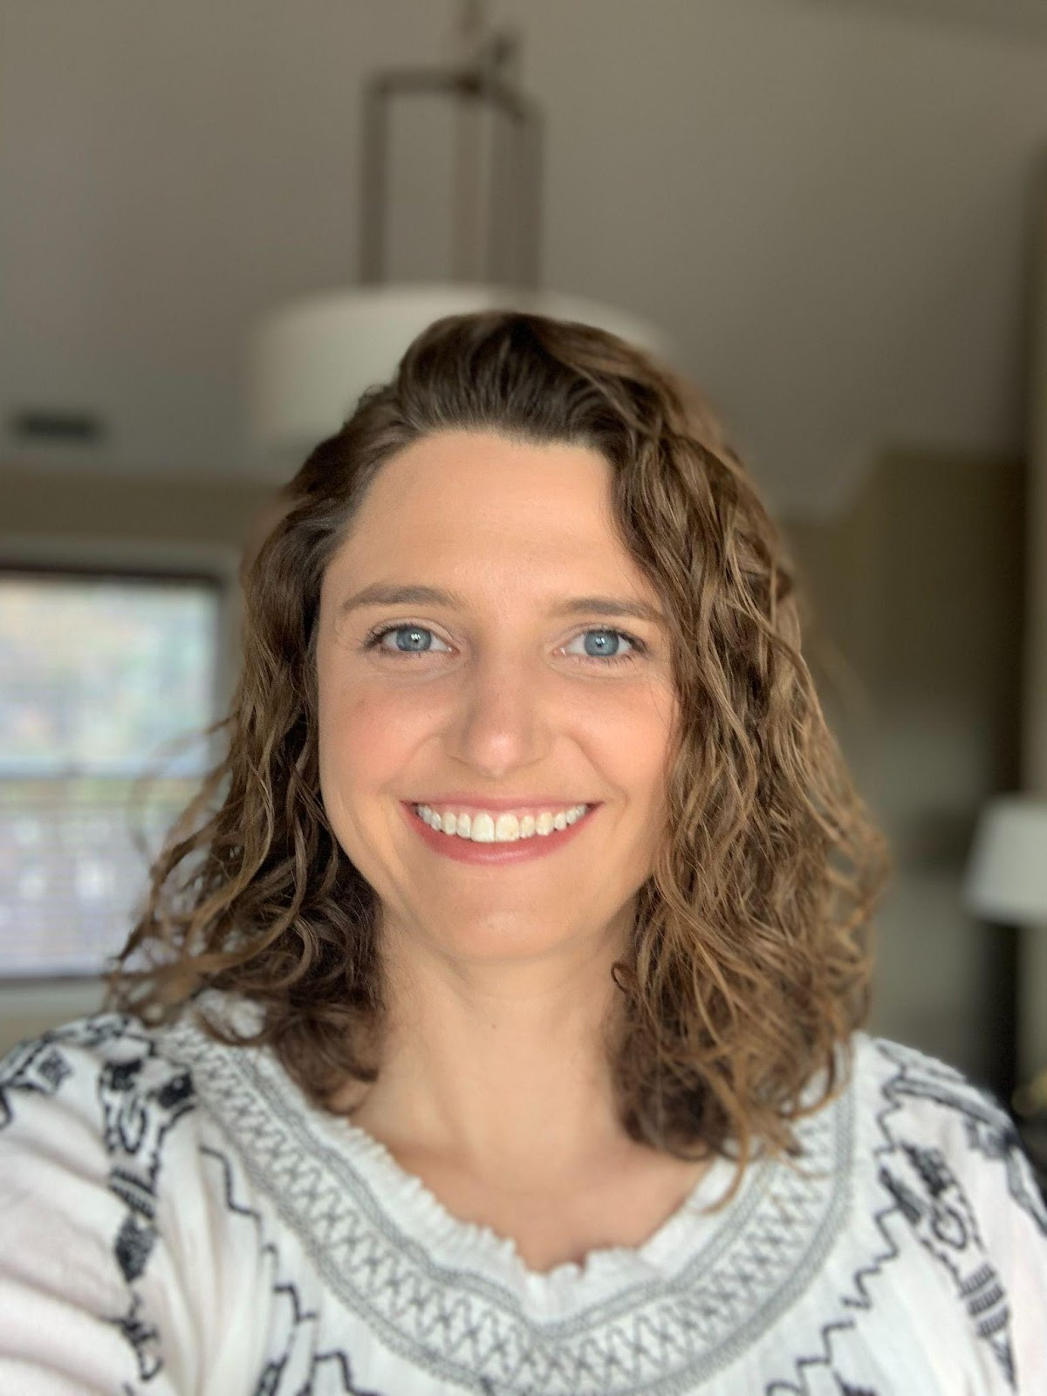
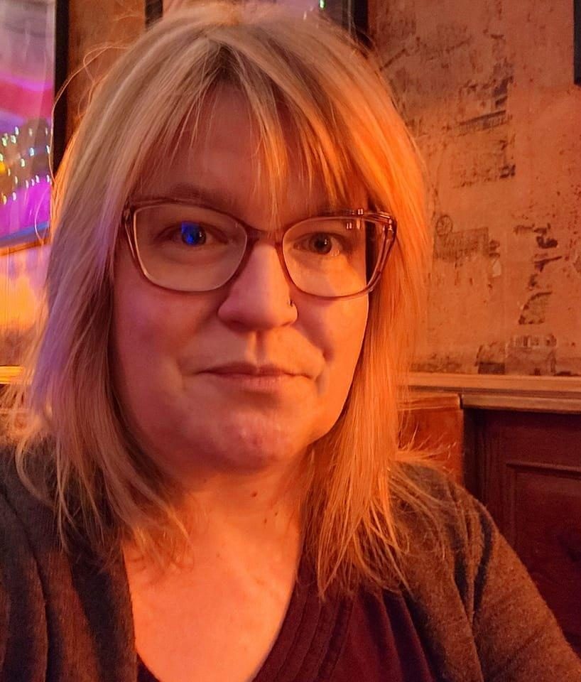
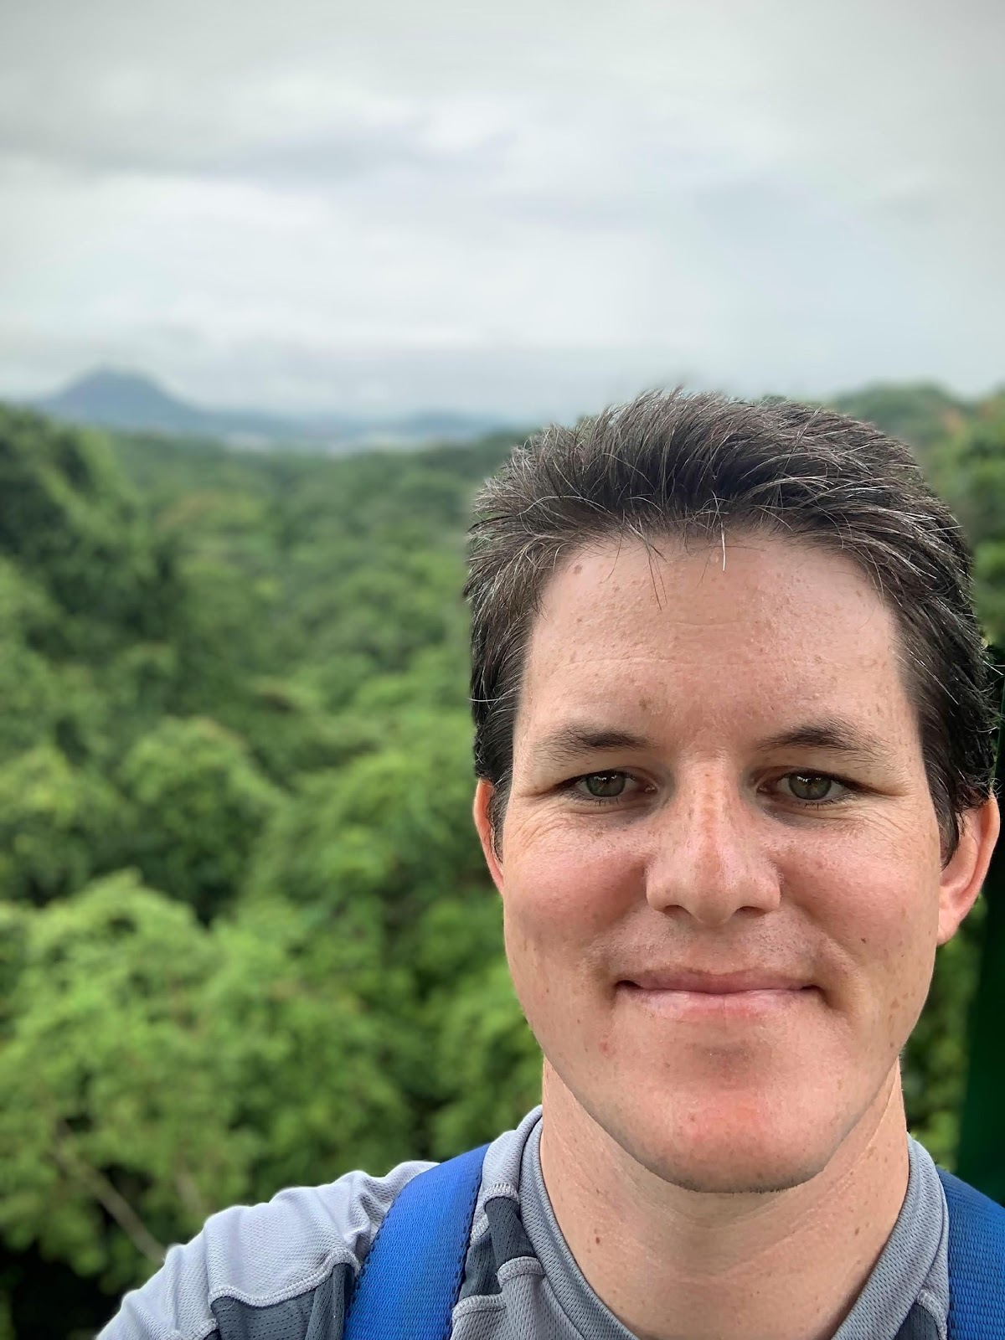
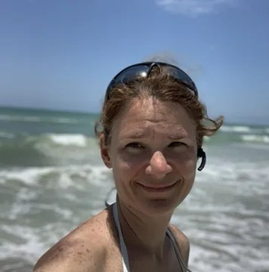
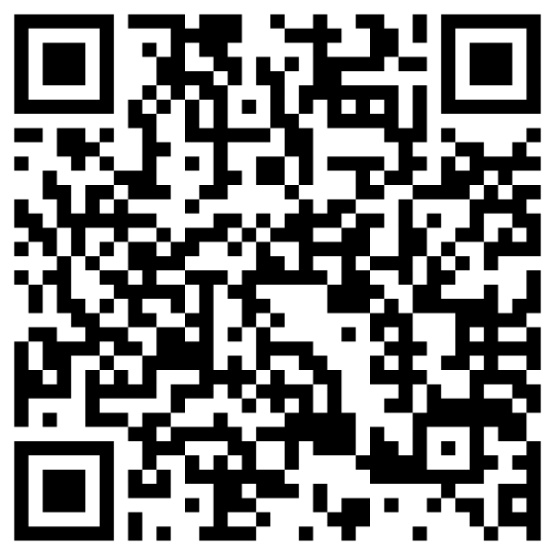
Code of Conduct Highlights
CMS is committed to providing safe, welcoming, and productive environments in the field and the lab, and at meetings and conferences
We have adopted the American Geophysical Union Scientific Code of Conduct
The AGU Code of Conduct "rejects discrimination and harassment by any means, based on factors such as ethnic or national origin, race, religion, citizenship, language, political or other opinion, sex, gender identity, sexual orientation, disability, physical appearance, age, or economic class."
The Code also includes information on expected behavior, unacceptable behavior, and consequences
If you have any concerns or need an ally contact: Peter Griffith (NASA GSFC), Liz Hoy (virtual, NASA GSFC), Libby Larson (NASA GSFC), Ryan Pavlick (NASA HQ), or Laura Lorenzoni (NASA HQ)
To formally file a complaint with NASA, consult Harassment and Discrimination Reporting for NASA Employees, Contractors and Grantee Beneficiaries.
Anonymous Reporting Form

Slide 3
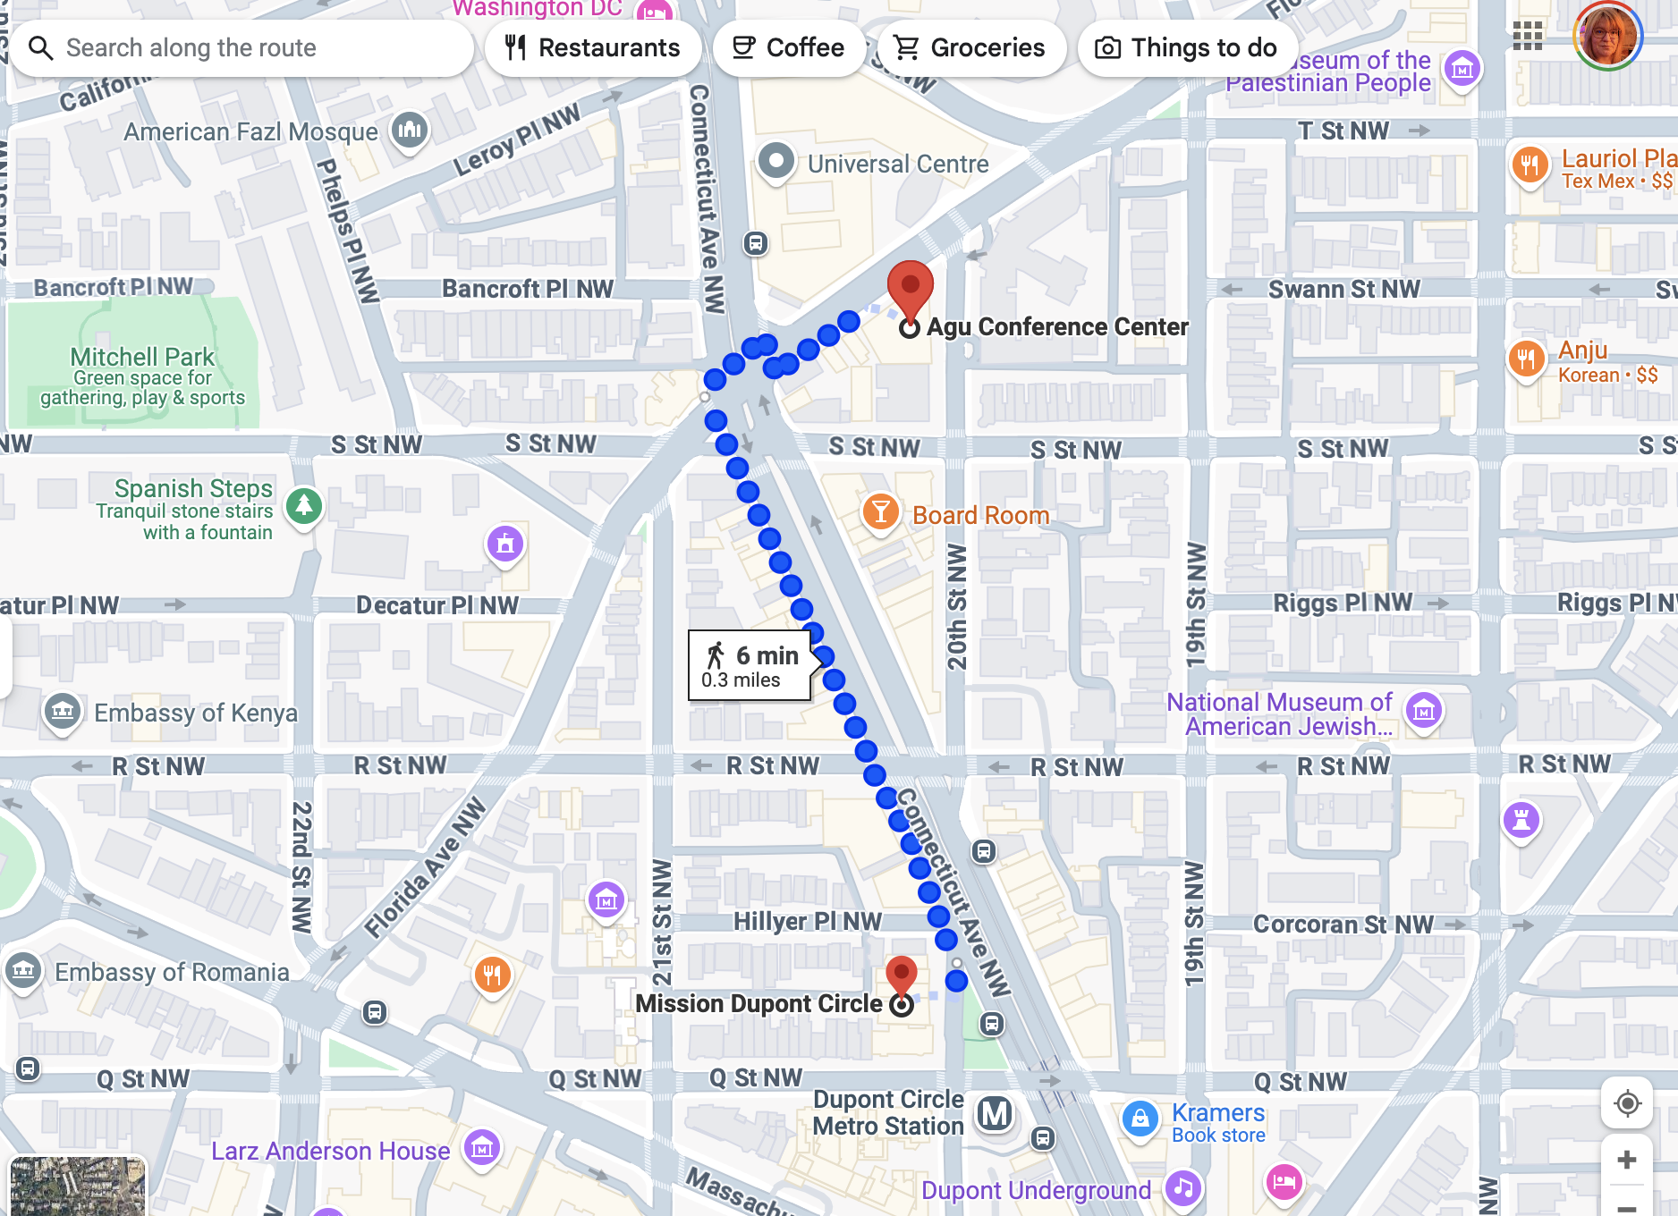
Announcements
Social Event Today, 6:30PM at:
  Mission Dupont Circle
  1606 20th Street NW
  Washington, DC 20009
  (0.3 mile/ 5 min walk from venue)
**Sign up at the registration desk this morning!**

Slide 4

Lunch
Info on the “Logistics” tab of meeting website
  List of nearby restaurants
  Information on placing a delivery order for CHOPT (warm bowls, salads, wraps, cookies, chips, drinks)

Slide 5
Poster Session: Wednesday 5:30
Posters will be up for the entirety of the meeting.
Your poster location will be printed on the back of your badge and posted online on the Poster Agenda prior to the meeting.
You may hang up your poster today, please take down your poster by 6:15 pm on Thursday

Slide 6
Presentations
During the meeting presentations are available behind sign-in
After the meeting presentations will be made public
If any slides shouldn’t be publicly available, send support@cce.nasa.gov a redacted version after the meeting

Slide 7
Breakout Sessions Today:
Between CMS Science Team Members & Stakeholders
  Biomass (Moderator: Carlos Silva)
  Atmospheric Flux (Moderator: Daniel Cusworth)
  Oceans and Wet Carbon (Moderator: Cecile Rousseaux)

Slide 8
Breakout Sessions Wednesday:
Working Group Breakouts
  Biomass (Andy Hudak & Neha Hunka)
  Flux (Junjie Liu & Andrew Schuh)
  Methane (Daniel Jacob)
  Uncertainties (Robert Kennedy)
  Wet Carbon (Blake Clark)

Slide 9
Breakout Sessions Thursday:
US GHG Center Breakout Sessions (4)
Discuss US GHG Center Integration of CMS Data Products & Collaboration in Stakeholder Engagement Efforts

Slide 10
WiFi
Name: AGU Guest WiFi
Password: Welcome2net0%

Slide 11
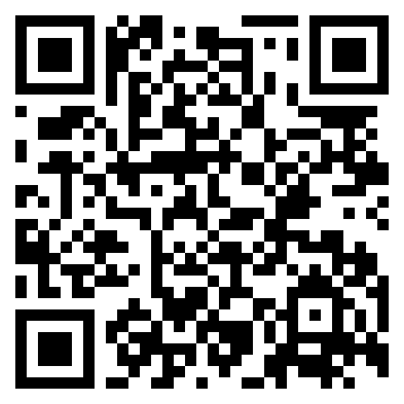
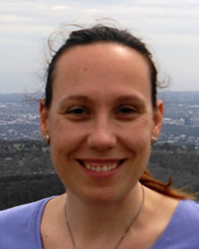
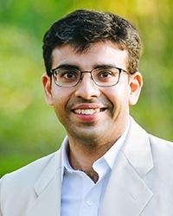
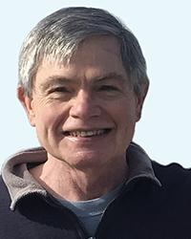
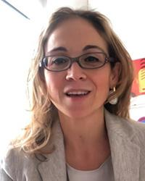
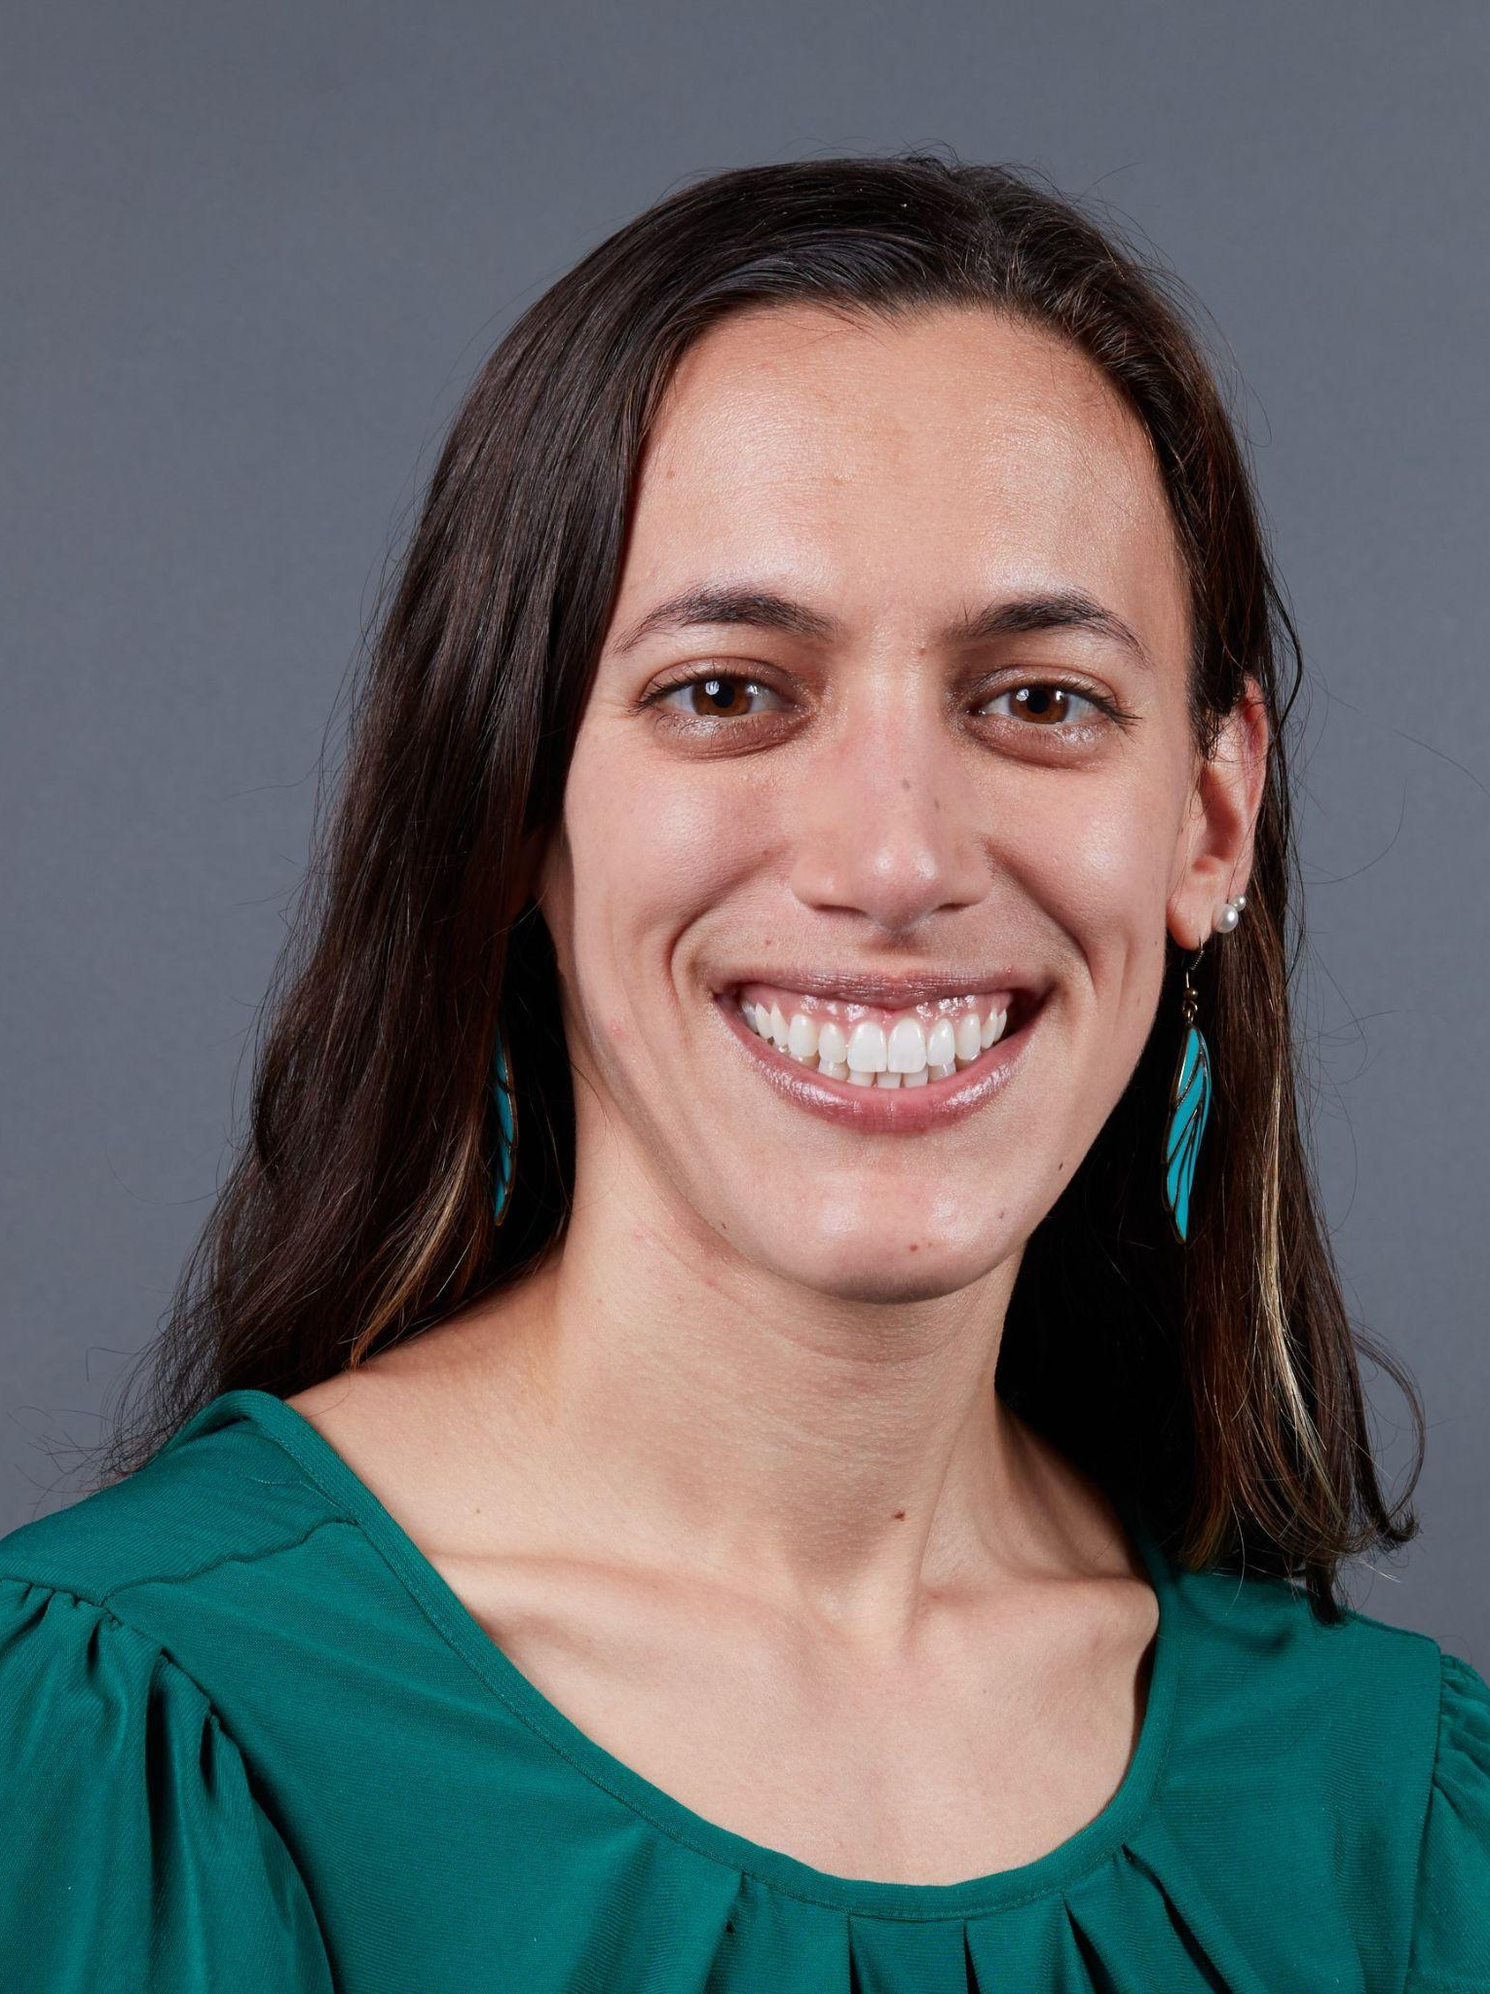

A Third Decadal U.S. Carbon Cycle Science Plan (USCCSP3)
The U.S. Carbon Cycle Science Program is a community-focused program that develops and implements multidisciplinary initiatives to advance U.S. carbon cycle science priorities.
The Third Decadal U.S. Carbon Cycle Science Plan will build on the two previous Decadal U.S. Carbon Cycle Science plans – the plan will identify which overarching questions highlighted in the previous plans have been adequately resolved over the past decade, those that still need to be addressed as well as propose new directions for the U.S. carbon cycle community.
Upcoming opportunities for feedback from the community:
              AGU Townhall (Washington DC, December 2024)
              AMS Townhall (New Orleans, January 2025)
Share your inputs, thoughts and feedback:
Use QR code to provide feedback Email Us: ccsp3-leadauthors@ucar.edu
L. Barbero A. Chatterjee E. Sundquist M. Tzortziou R. Stein

