Slide 1
NASA Carbon Monitoring System Overview
George Hurtt
NASA-CMS Science Team Leader
Department of Geographical Sciences
University of Maryland
gchurtt@umd.edu
NASA-CMS Science Team Meeting
September 17-19, 2024
AGU Conference Center, Washington, DC
http://carbon.nasa.gov

Slide 2
Congressional Direction in 2010:
Also included within the funds provided for other mission and data analysis, the conference agreement provides $6,000,000 for pre-phase A and pilot initiatives for the development of a carbon monitoring system. Any pilot developed shall replicate state and national carbon and biomass inventory processes that provide statistical precision and accuracy with geospatially explicit associated attribute data for aggregation at the project, county, state and federal level using a common dataset with complete market transparency, including extraction algorithms and correlation modeling.
Congressional Direction in 2011:
None
Congressional Direction in 2012:
The Committee recommends $10,000,000 from within available funds to continue the development of a carbon monitoring system initially funded in fiscal year 2010. The Committee expects no less than one-half of this amount shall be awarded externally.
Language in Senate Draft for 2013:
Of the funds provided within the earth science research and analysis activity, the Committee recommends $10,000,000 to continue efforts for the development of a carbon monitoring system initially funded in fiscal year 2010. The majority of the funds should be directed towards acquisition, field sampling, quantification and development of a prototype Monitoring Reporting and Verification [MRV] system which can provide transparent data products achieving levels of precision and accuracy required by current carbon trading protocols. The Committee recognizes that the current orbital and suborbital platforms are insufficient to meet these objectives. Therefore, the use of commercial off-the-shelf technologies is recommended as these products could provide robust calibration validation datasets for future NASA missions. Up to 20 percent of these funds should be made available to international Reducing Emissions from Deforestation and Forest Degradation [REDD] projects. Furthermore, the Committee is deeply disappointed with the lack of progress that NASA has made on this initiative thus far within the agency. Therefore, it directs that the above funds shall be competitively awarded within 120 days of enactment of this act.
Congressional Direction in 2014:
Carbon Monitoring- Of the funds provided within the Earth Science research and analysis activity, the Committee recommends $10,000,000 to continue efforts for the development of a carbon monitoring system. The majority of the funds should be directed toward acquisition, field sampling, quantification, and development of a prototype Monitoring Reporting and Verification [MRV] system which can provide transparent data products achieving levels of precision and accuracy required by current carbon trading protocols. The Committee is concerned that NASA has not established a program of record around the development of MRV system, and therefore expects a plan from NASA not later than 90 days after enactment of this act incorporating such a system into its operating plan and long-term budget projection. The Committee recognizes that the current orbital and suborbital platforms are insufficient to meet these objectives. Therefore, the use of commercial off-the-shelf technologies is recommended as these products could provide robust calibration validation datasets for future NASA missions.
…”pilot initiatives for the development of a carbon monitoring system…”
...”replicate state and national carbon and biomass inventory processes that provide statistical precision and accuracy with geospatially explicit associated attribute data…”
…”development of a prototype Monitoring Reporting and Verification (MRV) system which can provide transparent data products achieving levels of precision and accuracy required by current carbon trading protocols….”
...”[development of] a plan…incorporating such a [MRV] system into its operating plan and long-term budget projection…”

Slide 3



NASA-CMS Phase 1
Biomass Pilot. The goals of the Biomass Pilot are to:
Utilize satellite and in situ data to produce quantitative estimates (and uncertainties)
of aboveground terrestrial vegetation biomass on a national and local scale.
Assess the ability of these results to meet the nations need for monitoring
carbon storage/sequestration.
Flux Pilot. The objectives of the Flux Pilot are to:
Combine satellite data with modeled atmospheric transport initiated by
observationally-constrained terrestrial and oceanic models to tie the atmospheric
observations to surface exchange processes.
Estimate the atmosphere-biosphere CO₂ exchange.
Scoping Efforts. The objectives of the Scoping Efforts are to:
Identify research, products, and analysis system evolutions required to support carbon
policy and management as global observing capability increases.
Hurtt et al. (2014) Phase 1 Report

Slide 4






NASA-CMS Phase 2
Global Surface-Atmosphere Flux
2011: 2
2014: 3 (2)
2016: 2
Land-Atmosphere Flux
2011: 5
2013: 7 (4)
2014: 2 (2)
2015: 7 (7)
2016: 4 (2)
Land Biomass
2011: 8 (3)
2013: 9 (9)
2014: 8 (5)
2015: 7 (7)
2016: 7 (5)
Ocean-Atmosphere Flux
2011: 2
Ocean/Lake Biomass
2011: 2
2016: 1
Land-Ocean Flux
2011: 1
2014: 2 (2)
Stakeholder
2013: 1
2015: 1
Notes:
79 Projects
Projects listed by primary theme (one theme per project assigned by Peter Griffith- (I assigned Ocean biomass to Balch and Behernfeld 2011) 3 projects with MRV as primary theme not on this slide (Escobar 2013, Escobar 2015 and Poulter 2018).
Numbers in parentheses represent projects with MRV listed as a secondary theme within the year/primary theme category.
Numbers in parentheses are number of projects with either MRV or Decision Support as a selected keyword

Slide 5
CMS Phase 3 (2018-)
Themes Addressed
Notes:
**Updated 9/12/2024
Total of 65 (16 new 2023) phase 3 projects

Slide 6
NASA’s Approach to CMS/MRV
Recognizes that a sustained, observationally-driven carbon monitoring system using remote sensing data has the potential to significantly improve the relevant information base for the U.S. and world;
Recognizes multiple users, multiple scales, multiple quantities, and multiple frameworks for MRV (e.g. International, national and subnational, markets);
Recognizes the importance of user engagement to be responsive to stakeholder needs;
The goal for NASA’s CMS project is to prototype the development of carbon monitoring capabilities needed to support stakeholder needs for MRV.
Hurtt et al. (2014) Progress and Future Plans

Slide 7
Theme | Sub-theme | Number of Projects | Number of Publications | Number of Archived Products
Biomass | Land Biomass | 64 | 342 | 69
Atmosphere/Flux | Global-Surface Atmosphere Flux | 61 | 261 | 86
 | Land-Atmosphere Flux
 | Methane
Ocean/Wet | Ocean/Lake Biomass | 18 | 73 | 23
 | Ocean-Atmosphere Flux
 | Land-Ocean Flux
Stakeholder | Decision Support | 3 | 9 | 11
 | MRV
Unclassified |  | 22 | 9 | 0
Total: |  | 168 | 694 | 189
Notes:
** Updated 9/13/2024
Not all publications necessarily fit into these themes. They were matched by project, so the pubs sometimes might be related to a project’s secondary theme.

Slide 8
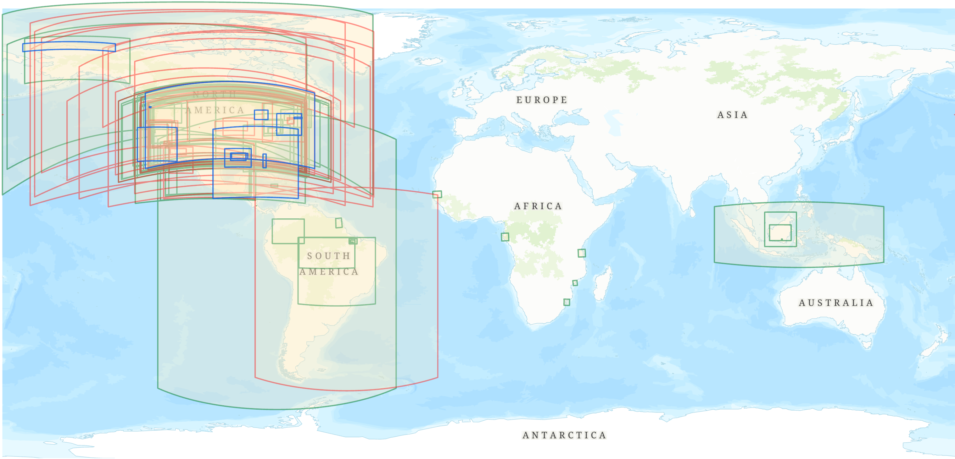
All CMS Product Boundaries by Theme
  Wet- 21 products
  Flux- 45 products
  Land Biomass- 69 products
Legend
 | Flux | Biomass | Wet Carbon
Global | 42 | 8 | 4
Continental | 9 | 2 | 0
National | 12 | 18 | 0
Regional | 10 | 22 | 8
Site | 14 | 27 | 13
Total | 87 | 77 | 25
*54 global products, not shown
Notes:
Updated 9/13/2024
Total number of products 189

Slide 9
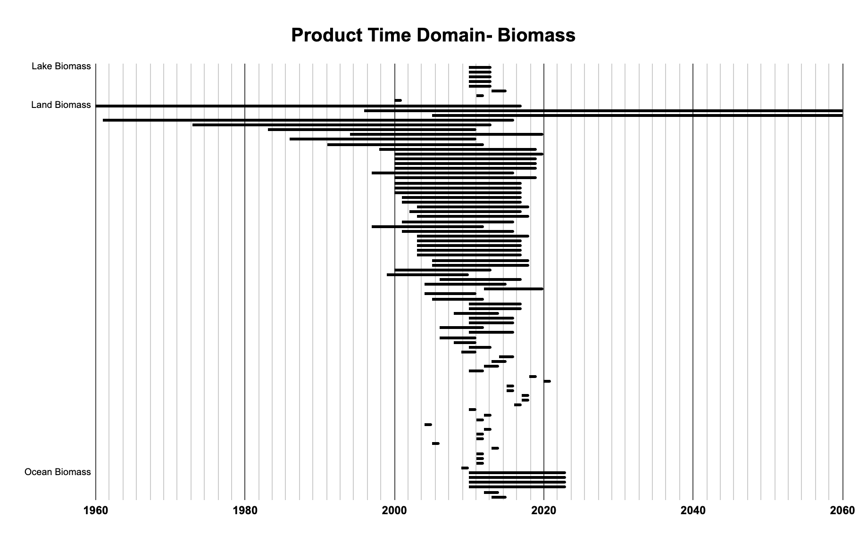
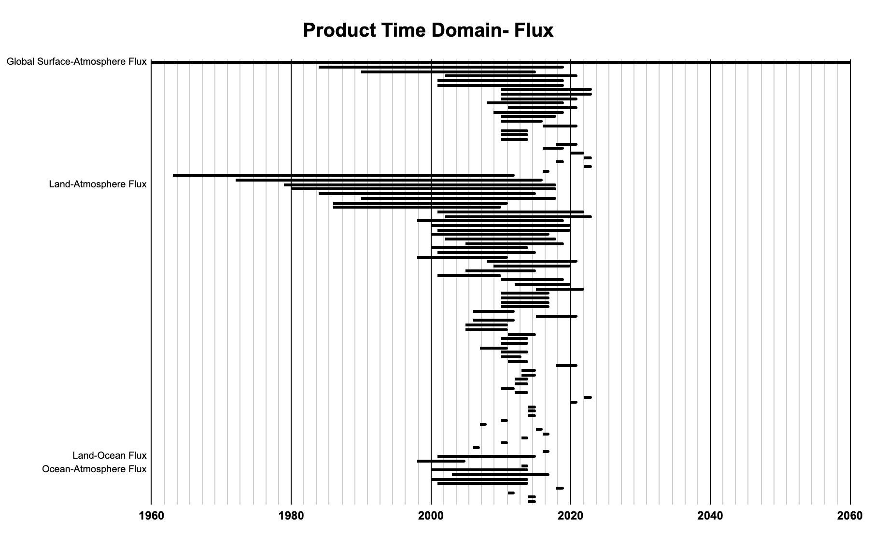
CMS
Product Time Domains
Period | Number | %
<2000 | 26 | 14
2000-2020 | 142 | 75
>2020 | 21 | 11
Notes:
** Updated 9/12/2024

Slide 10
CMS All Participants
TYPE (# unique) | US | UK/EU | Canada | Mexico | Brazil | Indonesia | Other | Total
University (121) | 322 | 11 | 3 | 6 | 4 | 4 | 23 | 373
Federal Agency (37) | 275 | 1 | 2 | 6 | 5 | 1 | 10 | 300
State Agency (25) | 40 |  |  |  |  |  |  | 40
Local Agency (9) | 12 |  | 1 |  |  |  |  | 13
Company (41) | 41 | 1 | 2 | 1 | 2 |  | 4 | 51
NGO (26) | 47 |  |  |  | 3 | 1 |  | 51
Research Institute (29) | 35 | 1 |  |  | 2 |  | 22 | 60
Other (27) | 22 | 2 |  | 1 |  | 1 | 10 | 36
Total | 794 | 16 | 8 | 14 | 16 | 7 | 69 | 924
Notes:
** Updated 9/11/2024
Total of 924 participants over 29 countries
539 participants in phase 3

Slide 11
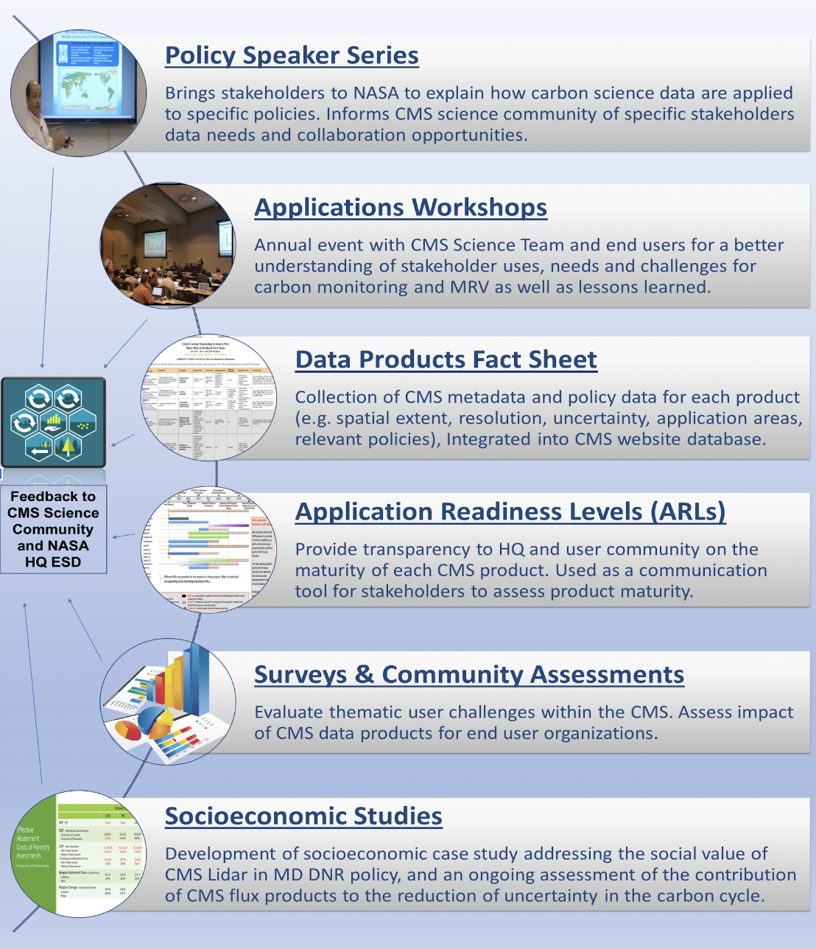
Scientists
Stakeholders

Slide 12
CMS All Stakeholders
Notes:
** Updated 9/11/2024
170 unique stakeholder orgs

Slide 13
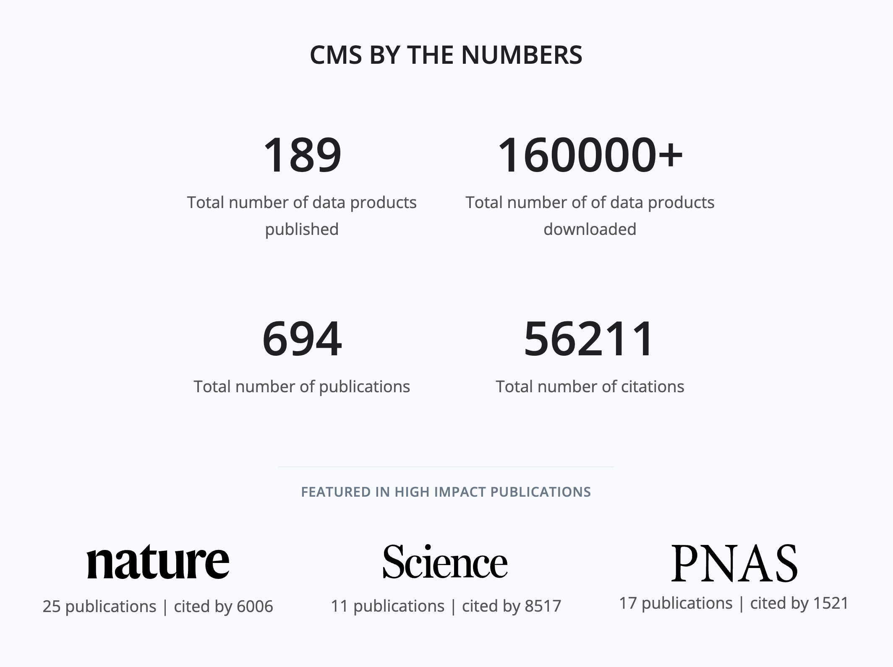
Productivity
(as of September 16th, 2024)
Notes:
** Updated 9/12/2024
Total 694 publications in CMS
Cited 55,955 (as of 9/12/24)
126 papers with > 100
25 in Nature
11 in Science
17 in PNAS

Slide 14
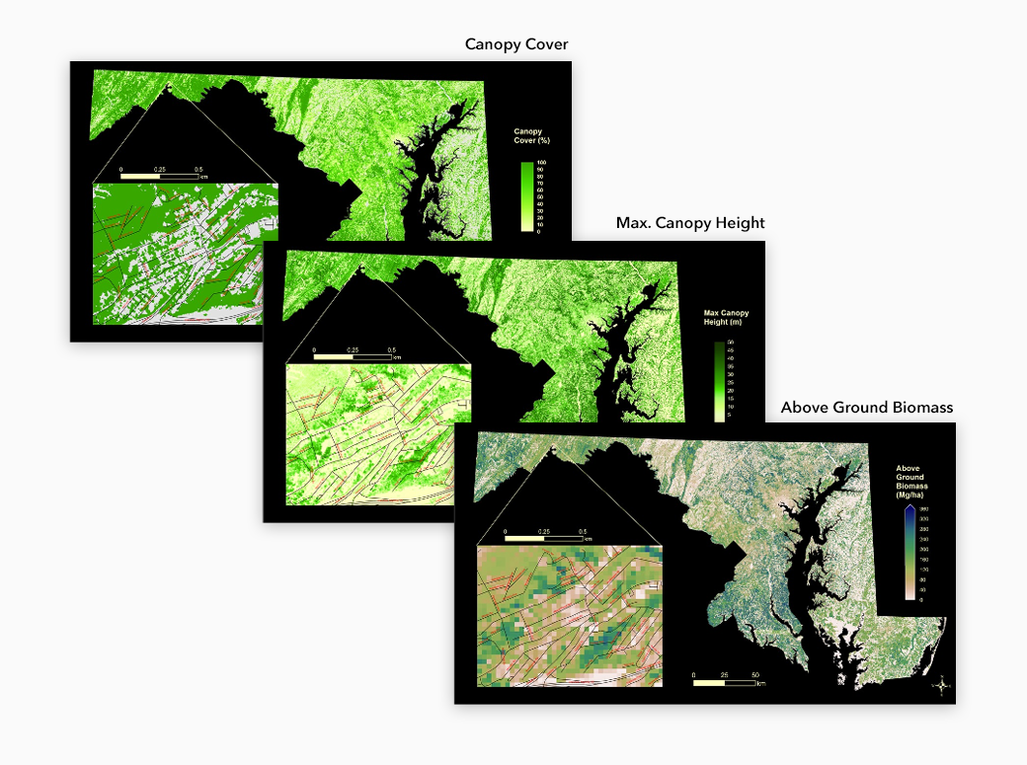
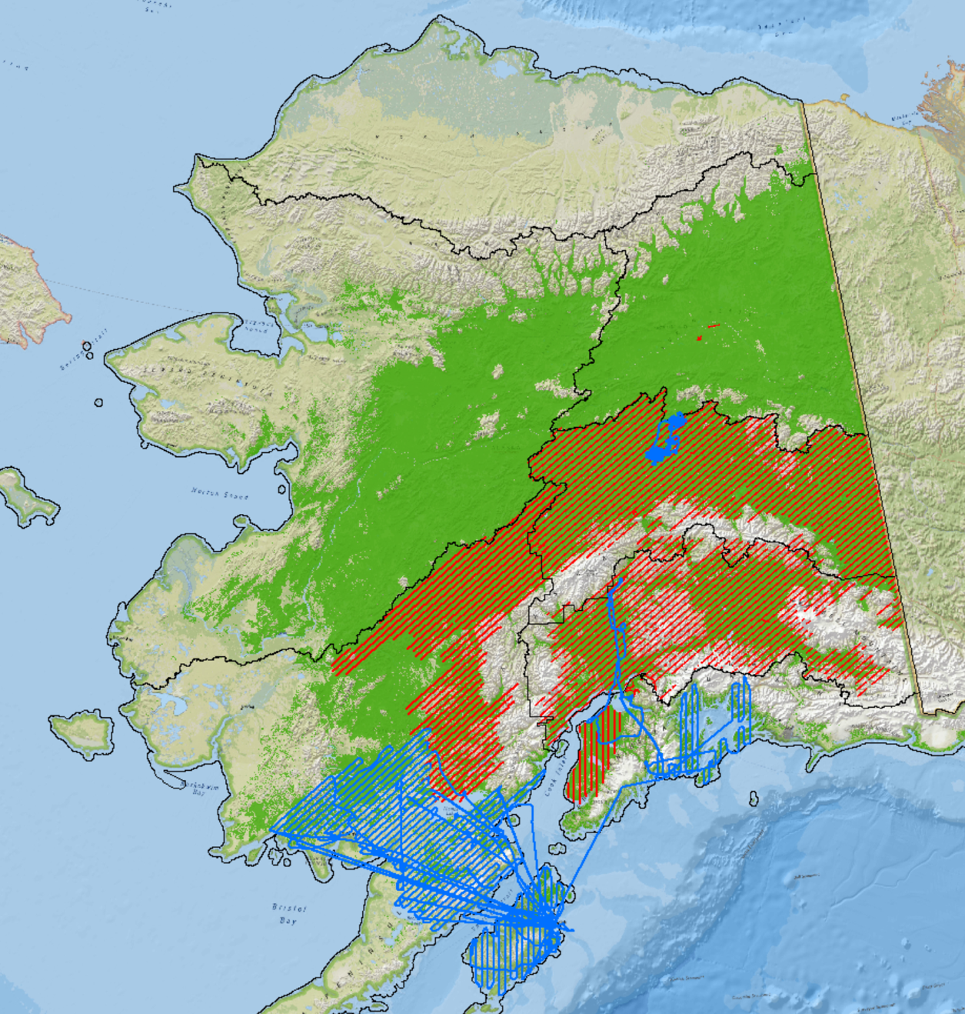
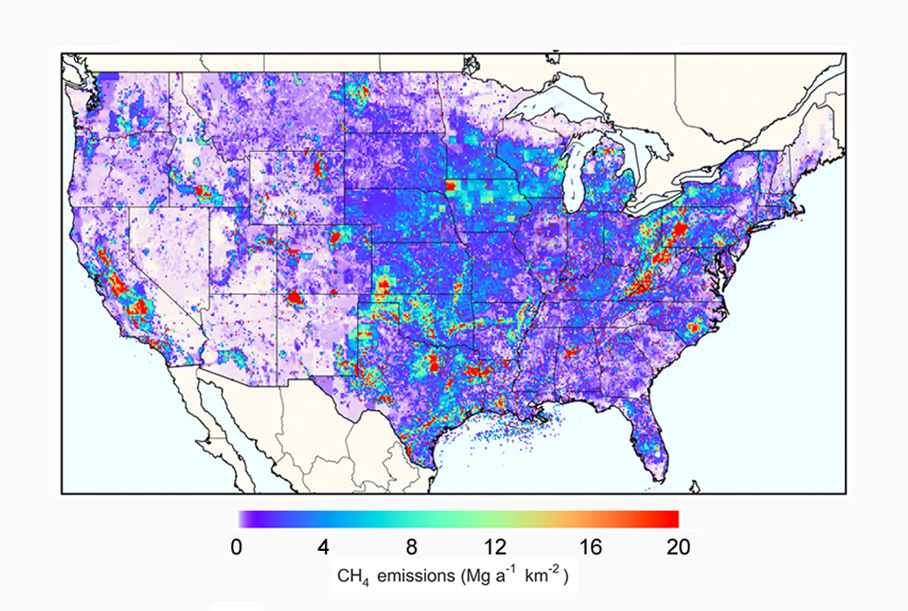
Example Success Stories
Maryland Department of Environment
USFS-Alaska
U.S. Environmental Protection Agency

Slide 15
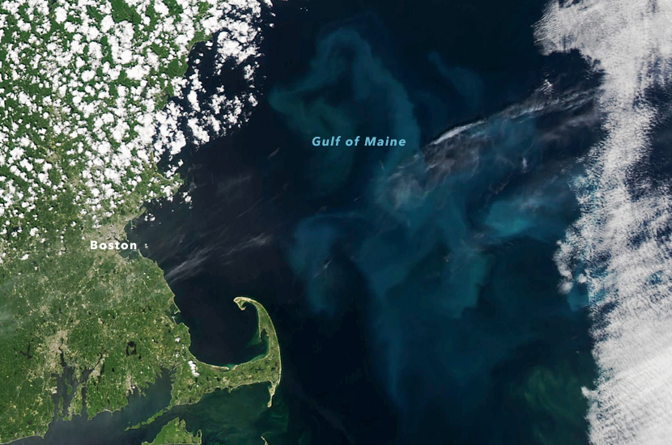
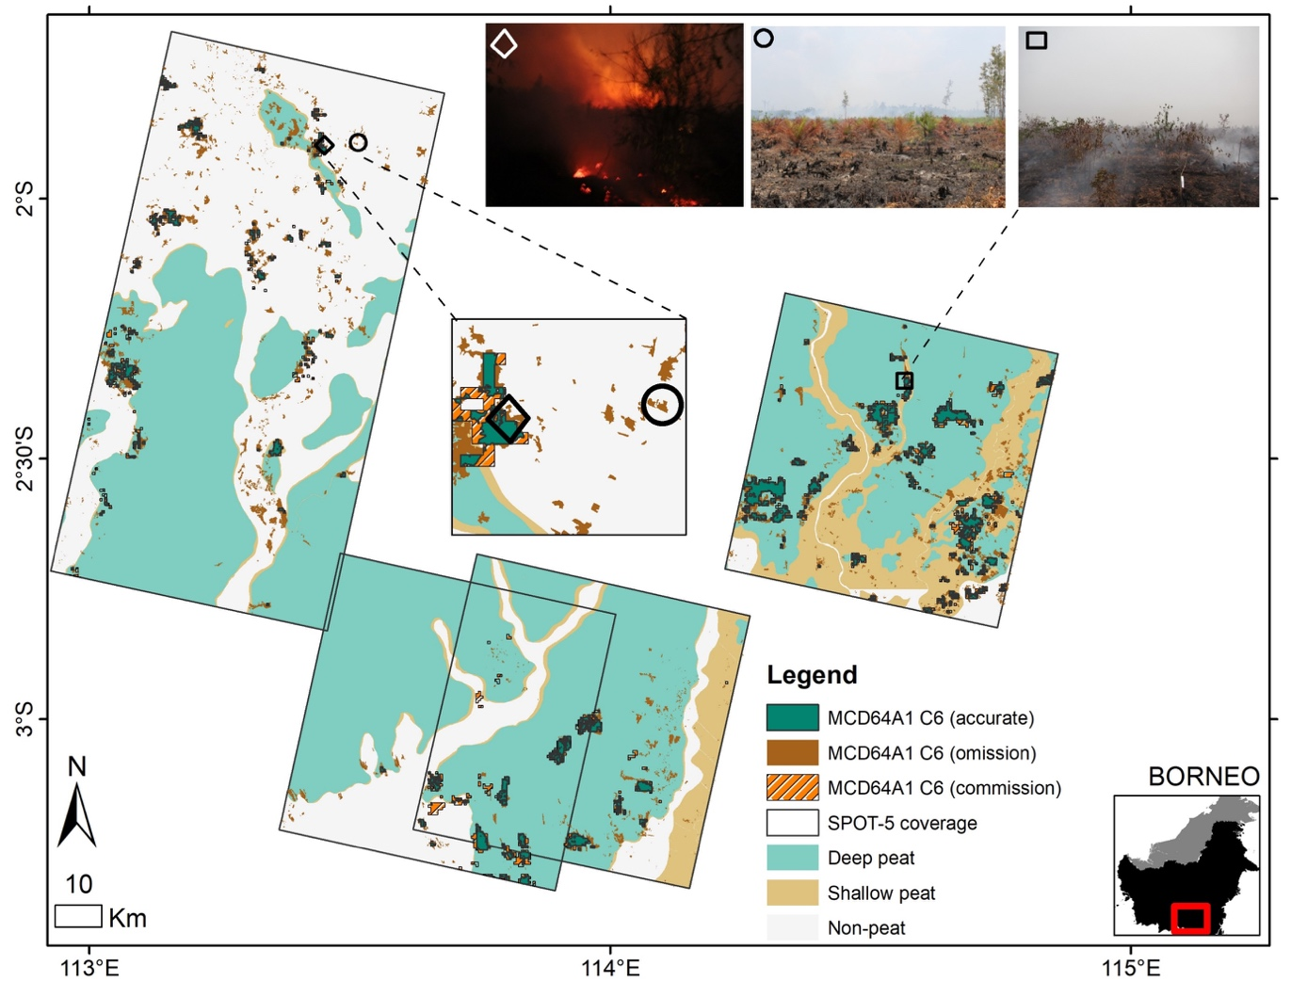
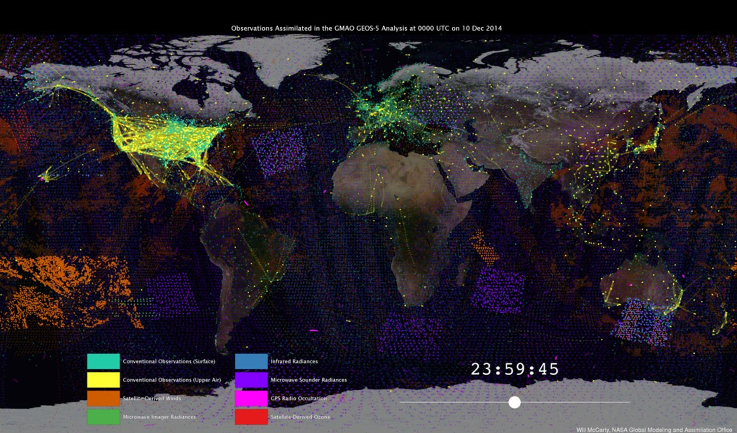
Example Success Stories
GNATS
Indonesia
Global (GEOS-5)

Slide 16





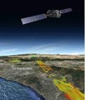
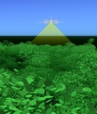
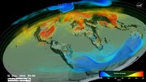







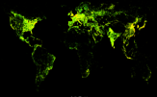

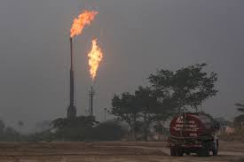


Examples of Data and Needs from Partners*
GHG System Integration
New Insights
Research &
Applications
End user system
(Front End)
Gridded anthropogenic emissions
Earth Observations
Modeling
Leverages ESDS/ VEDA capabilities
Test bedding of modeling, integration approaches
Thorough evaluation of new observations before transition
Advanced users
Leverages ESDS/VEDA
Public-facing
Curated, mature products representing consensus view
Science and
non-science users
Enhanced help desk support
Natural GHG Emissions
Detecting and tracking high emission events
Improvement of modeling, observing techniques
Incorporation of stakeholder needs and feedback
* Representative, but not comprehensive list

Slide 17
Prototype: FROM DATA TO NEW INSIGHTS
Examples of Data and Needs from Partners*
CMS
Pathway to innovation from research community
GHG System Integration
New Insights
EIS
Open system focused on integration and testing of new approaches, Earth system understanding and discoveries
GHG Center
End-user driven, reliable delivery of mature GHG monitoring products and tools, enhanced support for stakeholder engagement
Research &
Applications
End user system
(Front End)
Gridded anthropogenic emissions
Earth Observations
Modeling
Leverages ESDS/ VEDA capabilities
Test bedding of modeling, integration approaches
Thorough evaluation of new observations before transition
Advanced users
Leverages ESDS/VEDA
Public-facing
Curated, mature products representing consensus view
Science and
non-science users
Enhanced help desk support
Natural GHG Emissions
Detecting and tracking high emission events
Improvement of modeling, observing techniques
Incorporation of stakeholder needs and feedback
* Representative, but not comprehensive list

Slide 18
CMS Working Groups
Present:
Past:
Biomass
Flux
Methane*
Stakeholder*
Uncertainties
Wet Carbon*
*Synthesis paper published
Data/Data Management (2013-2019)
Atmospheric Validation (2013-2019)
External Communications (2012-2019)
Methane (2015-2019)
MRV (2013-2019)
Uncertainties/Algorithm Assessment/Inter-comparisons (2015-2019)
System Framework (2012-2015)
Algorithm Assessment/Inter-comparisons (2012-2014)
Biomass-Flux (2012-2014)
Capability Risk (2012-2014)
Responsiveness (2012-2014)
Uncertainties (2012-2014)
MRV (2020—2022)
Notes:
** Updated 9/12/2023

Slide 19
Goals for meeting
Update on NASA programmatic goals
Stakeholder engagement
Presentation of CMS Results and future plans
Advance and share progress of working groups & synthesis efforts
Discussion of science team activities for 2024-2025
Notes:
** Updated 9/5/2024

Slide 20
Meeting Planning, Logistics, and Leadership
Planning/Logistics
Peter Griffith, NASA GSFC
Amy Hodkinson, NASA GSFC
George Hurtt, UMD
Leanne Kendig, NASA GSFC
Libby Larson, NASA GSFC
Valeria Morales, UMD
Edil Sepulveda Carlo, NASA GSFC
Natalie Sharpe, NASA GSFC
Katharine Stover, NASA GSFC
David Stroud, NASA GSFC
Moderators:
Molly Brown, UMD
Daniel Cusworth, Carbon Mapper
Peter Griffith, NASA GSFC
Libby Larson, NASA GSFC
Ben Poulter, White House OSTP
Cecile Rousseaux, NASA GSFC
Carlos Silva, Univ. of Florida
Katharine Stover, NASA GSFC
Working Group Leads:
Brendan Byrne, JPL
Reem Hannun, University of Pittsburgh
Meghan Halabisky, University of Washington
Andrew Hudak, USFS
Neha Hunka, UMD
Daniel Jacob, Harvard
Robert Kennedy, OSU
Catherine Mitchell, Bigelow Laboratory
Notes:
** Updated 9/11/2024

