Slide 1
Meeting Summary
George Hurtt
Science Team Leader
September 17-19, 2024
Washington, DC

Slide 2
Great meeting!
Participation. Total= 132 , In-person= 97, Virtual= 35;
Stakeholder Participation. Total= 28, Panels= 4, Listening session = 1, Keynote presentation = 1. Stakeholders participated from the US, Canada, South Africa, Switzerland, Brazil, and the UK. These stakeholders were from a diverse set of organization types: Federal Government (8), NGO (5), University (4), Inter-governmental Organization (3), State Government (3), Company (3), Research Institute (2).
CMS continues to engage relevant participants and stakeholders. CMS has engaged 924 participants, and >200 stakeholders from 170 organizations.
CMS continues to be highly productive and impactful. To date, CMS has produced 695 publications cited 56,211 times, with 53 in top-tier (Science, Nature, PNAS). It has also archived 189 data products downloaded >160,000 times. Multiple success stories.
CMS Stakeholder Keynote presentation. Dr. Melissa Weitz (USEPA) highlighted the successful adoption of key CMS products for official US GHG reporting.
CMS approach highly successful. An example for NASA Earth Science to Action, GHG center and others

Slide 3
Progress on continuing science projects. Biomass, Flux, Wet. ARL advancements.
Exciting new science projects. New topics, stakeholders, e.g. wet carbon, fire
Progress on previously identified challenges. wet carbon, lateral/vertical transport, alkalinity, …
Progress on collaboration between projects. Biomass-Flux, Biomass-Wet, Wet-Flux.
Progress on Inter-agency collaboration and integration. National GHG Center
Progress enhancing, maturing, stakeholder engagement. New Stakeholder Engagement Lead!
Progress on Working Groups. Multiple synthesis papers completed and in prep; Updated plans;
    Updated membership, Co-Chairs, Proposed changes: Sunset Uncertainty. Add Fire, Add AI.
Critical role of remote sensing throughout. Initialization, assimilation, calibration, validation, monitoring,…
Critical role of field and atm data throughout. Cal/Val!
Critical role of models in scaling and for planning. Note increased role of machine learning
Challenges of reconciling top-down and bottom-up estimates. Land, ocean, spatially, temporally, multi-scale
Challenges of integrating multiple models. Variables, scales, data, computation,…
Challenge of capacity building. From data focus, to models, systems,… win-win collaborations.
Opportunity to contribute to NASA Hyperwall. Examples on website.
Opportunity to contribute to Special Issue. ERL Focus Collection on Carbon Monitoring Research
Opportunity to contribute to relevant reports/events/activities. AGU, COP29, National GHG center, …
Opportunity to continue and deepen discussions at AGU! Innovative Session on Carbon Monitoring
Research and Applications. See you there!

Slide 4
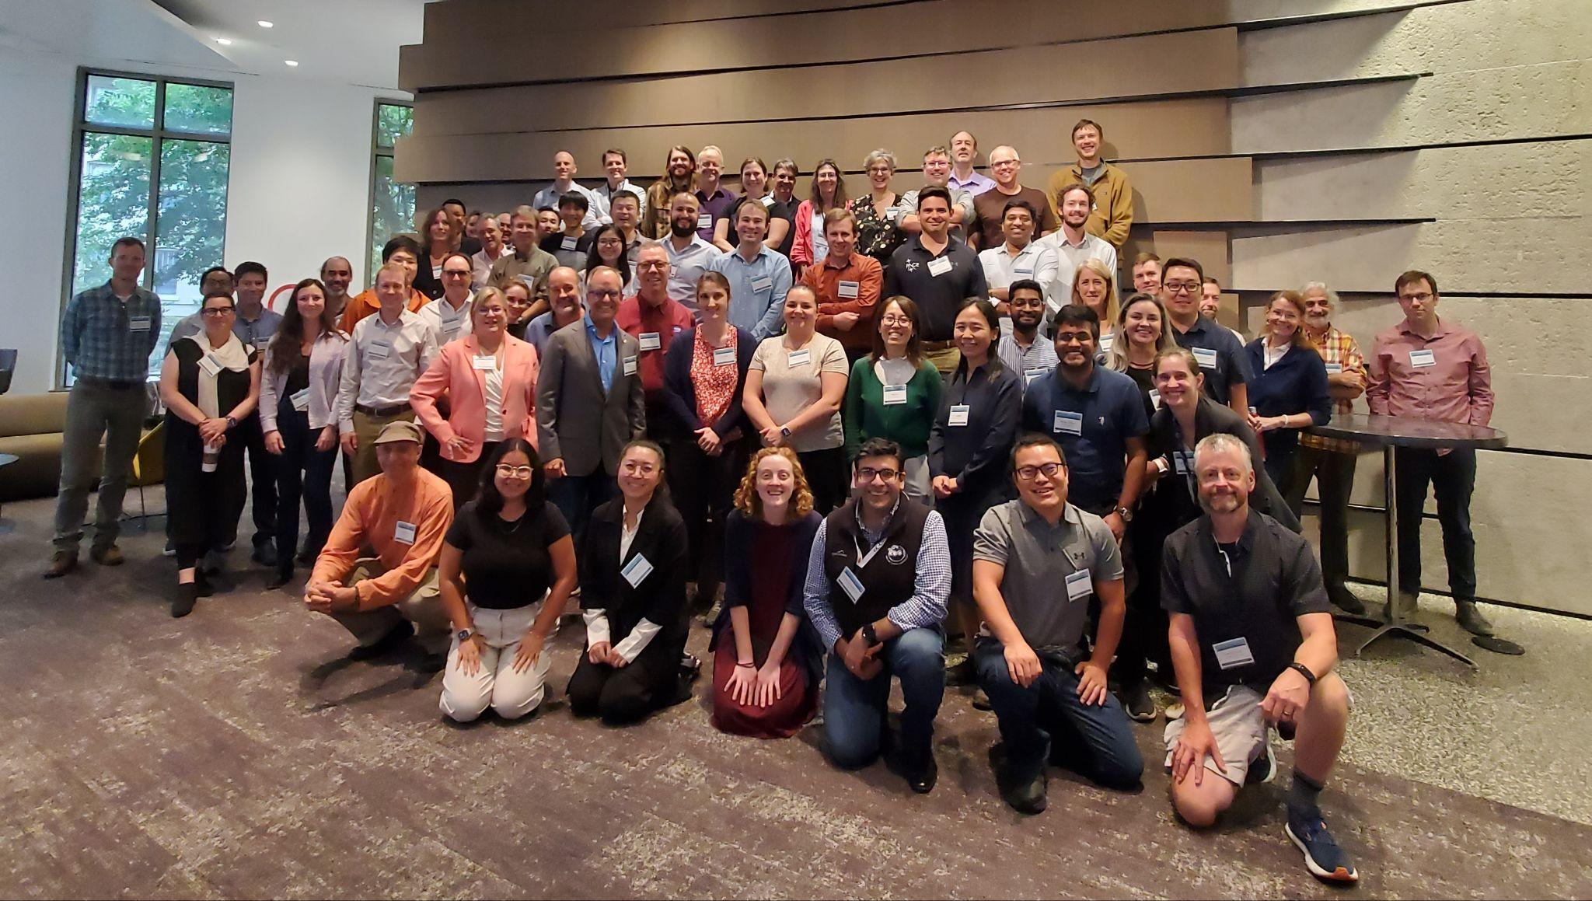
Thank you!

