Slide 1
Wet Carbon Working Group
CMS Science Team Meeting
September 17-19, 2024

Slide 2
Some background
22 people attended the WG breakout session
Diversity of projects
  Spatial scales from individual wetlands to the global ocean
  Temporal scales from seasonal to pre-industrial
Diversity of carbon
  Dissolved inorganic carbon
  Total alkalinity, pH, etc
  Dissolve and particulate organic carbon
  Carbon long buried that is now being eroded into aquatic systems
Projects focused on both stocks and fluxes

Slide 3
Ongoing work
Commentary on impact of lateral flows on Carbon Markets
  Submitted proposal to Nature, will be sending to Nature Comms today
  Still to write full draft, will send final draft in two months
Paper on Coastal and Inland Wetland ecosystems
  Demand for information across communities
  Supply of information for these potential stakeholders
  Still in conceptual stage, soliciting additional participants
  Key writing group is Molly, Dorothy, Meghan and Maria

Slide 4
Identifying synergies across CMS Wet Carbon Projects
A large diversity of topics with a large diversity of stakeholders, what do we have in common?
First Activity: Gather information from the Wet Carbon group about project composition
Compile an easily digestible synthesis document that shows where projects are occurring, the time scales they are characterizing, and the science questions they are addressing
Coincide with different types of products from ARL table so information is available in one easy to locate place
Also what is the potential of the projects, within reason

Slide 5
Identifying synergies across CMS Wet Carbon Projects
A large diversity of topics with a large diversity of stakeholders, what do we have in common?
Second Activity: Stakeholder survey from the CMS Wet Carbon projects on stakeholder expectations and perceptions
The needs of stakeholders within the scope of their projects
The prescient needs of stakeholders generally related to carbon
The perceptions of stakeholders of the potential (or actual) outcomes of their projects
The overall level of interaction between the project stakeholders and PIs

Slide 6
Identifying synergies across CMS Wet Carbon Projects
The Outcome
Extend and coordinate across Wet Carbon stakeholders
  Through survey and data mapping, connect and extend the reach of CMS projects in the wet carbon area
A publication that will
  Provide information to project scientists on stakeholders who already exist within CMS that might potentially be interested in their project
  Provide stakeholders with information on projects that could potentially provide a useful tool or product for their purpose
  Identify synergies between projects that allows for collaboration
  Identify gaps among the projects that are not addressing current or potential stakeholders

Slide 7
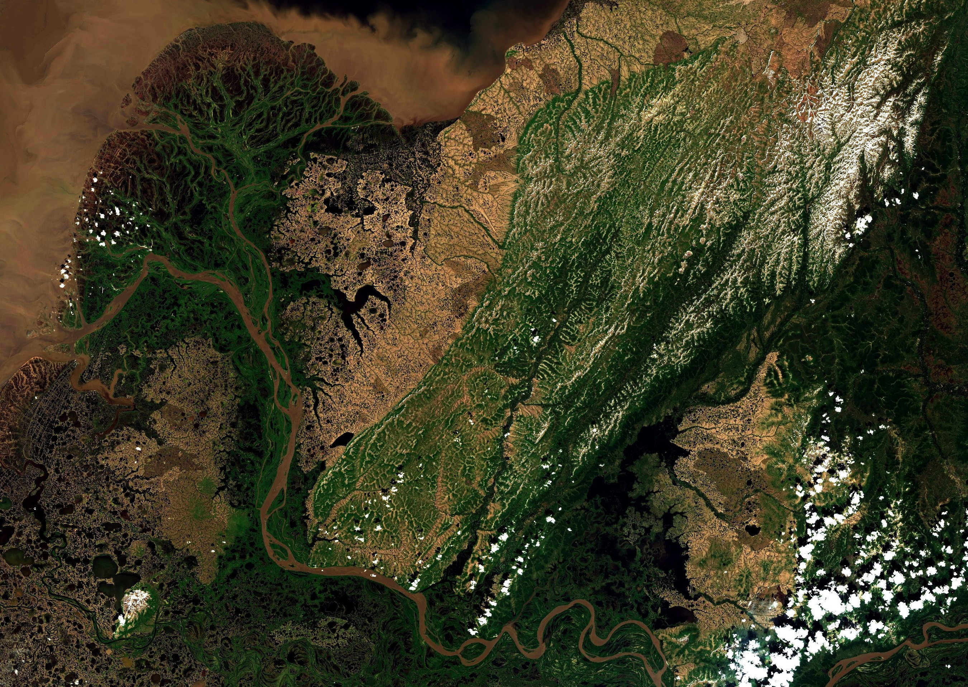
Thank You

