Slide 1
Flux WG Breakout Report
Abhishek Chatterjee and Reem Hannun (WG Leads),
Flux WG Members & contributions from Flux WG Breakout Attendees
Thursday, Sep. 11, 2025
2025 CMS Science Team Meeting

Slide 2
Tuesday Sep. 9 Flux WG Breakout
Part I
Introduction to the Flux WG (for non-Flux WG CMS ST members)
Stakeholder engagement and interaction, Discussion
Current Status and Plans for 2025–2026
Synthesis Paper Status, Spin-off Perspective Pieces, Discussion
Q&A + Walk-on Topics for Discussion
Part II – ran out of time
Phase 3 paper (Hurtt et al.) preparation
Flux Synthesis Paper writing + Subsection writing meetings + Figure Discussions
Notes:
Introduction to Flux WG
Goals
Members
Projects Involved
Stakeholder discussion
Synthesis paper discussion
Walk-through scope of the paper
GC Hurtt Phase 2 and Phase 3 reports
Open discussion
Perspective pieces
Other topics
Interactive writing sessions
Subsection writing meetings

Slide 3
Flux WG Description
https://carbon.nasa.gov/wg_cms.html
Focus of the Flux WG – determine and quantify the carbon balance at various spatiotemporal scales (individual point sources to state or multi-state regions to hemispheric and global domains), help understand processes at these scales, provide inputs for models, provide robust flux estimates for policy needs, i.e., emissions and sinks to stakeholders and decision-makers
Aim of the Flux WG –
facilitate communication between CMS-funded projects encompassing land-atmosphere flux, ocean-atmosphere flux, global surface-atmosphere flux
advance flux estimation methodologies,
identify community needs for observations, data synthesis and modeling,
raise awareness of current projects, esp. engagement with stakeholders and applied users
develop future flux research directions within the CMS program
Notes:
The focus of the Flux Working Group is to determine and quantify the carbon balance of individual point sources to state or multi-state regions to hemispheric or global domains. These estimates of carbon fluxes and stocks are needed to help understand processes at various spatiotemporal scales, to help develop and test hypotheses, to provide inputs for models, and to provide estimates for policy needs, such as reporting GHG emissions and sinks to stakeholders and decision-makers.

Slide 4
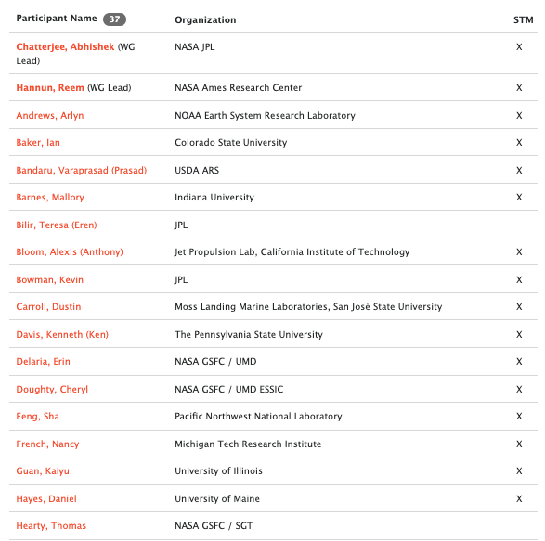
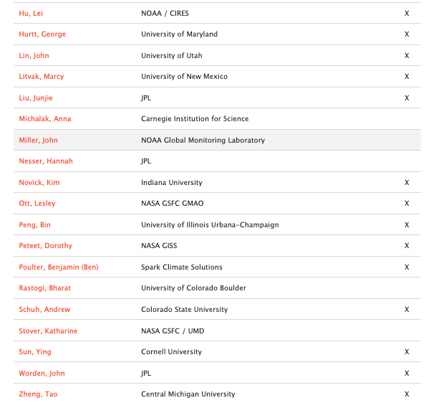

Slide 5
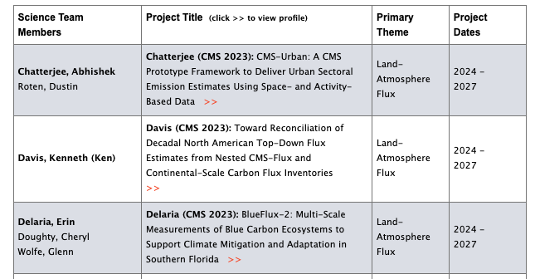
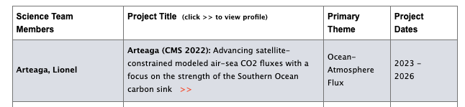
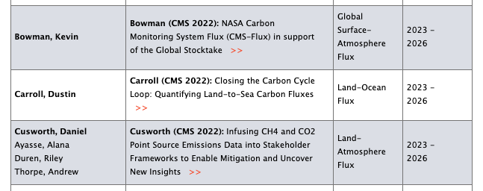
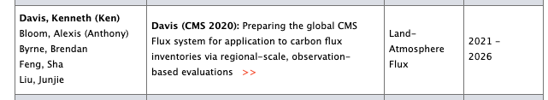
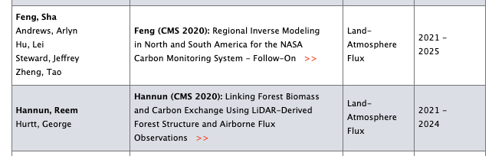
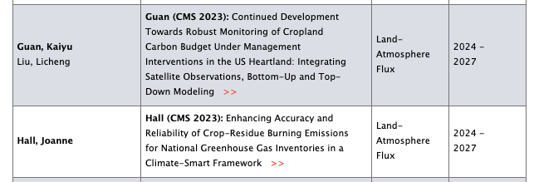
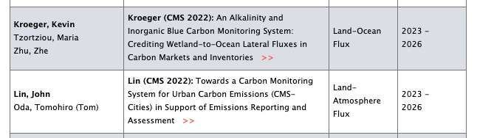

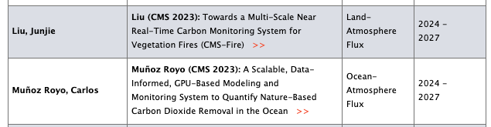
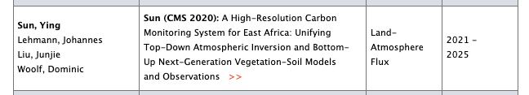
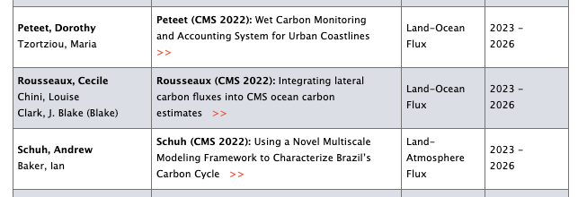
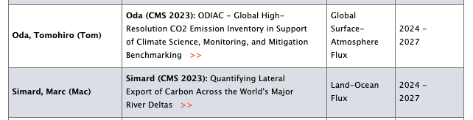
WG Current Projects (∼20 projects since 2020 selection)

Slide 6
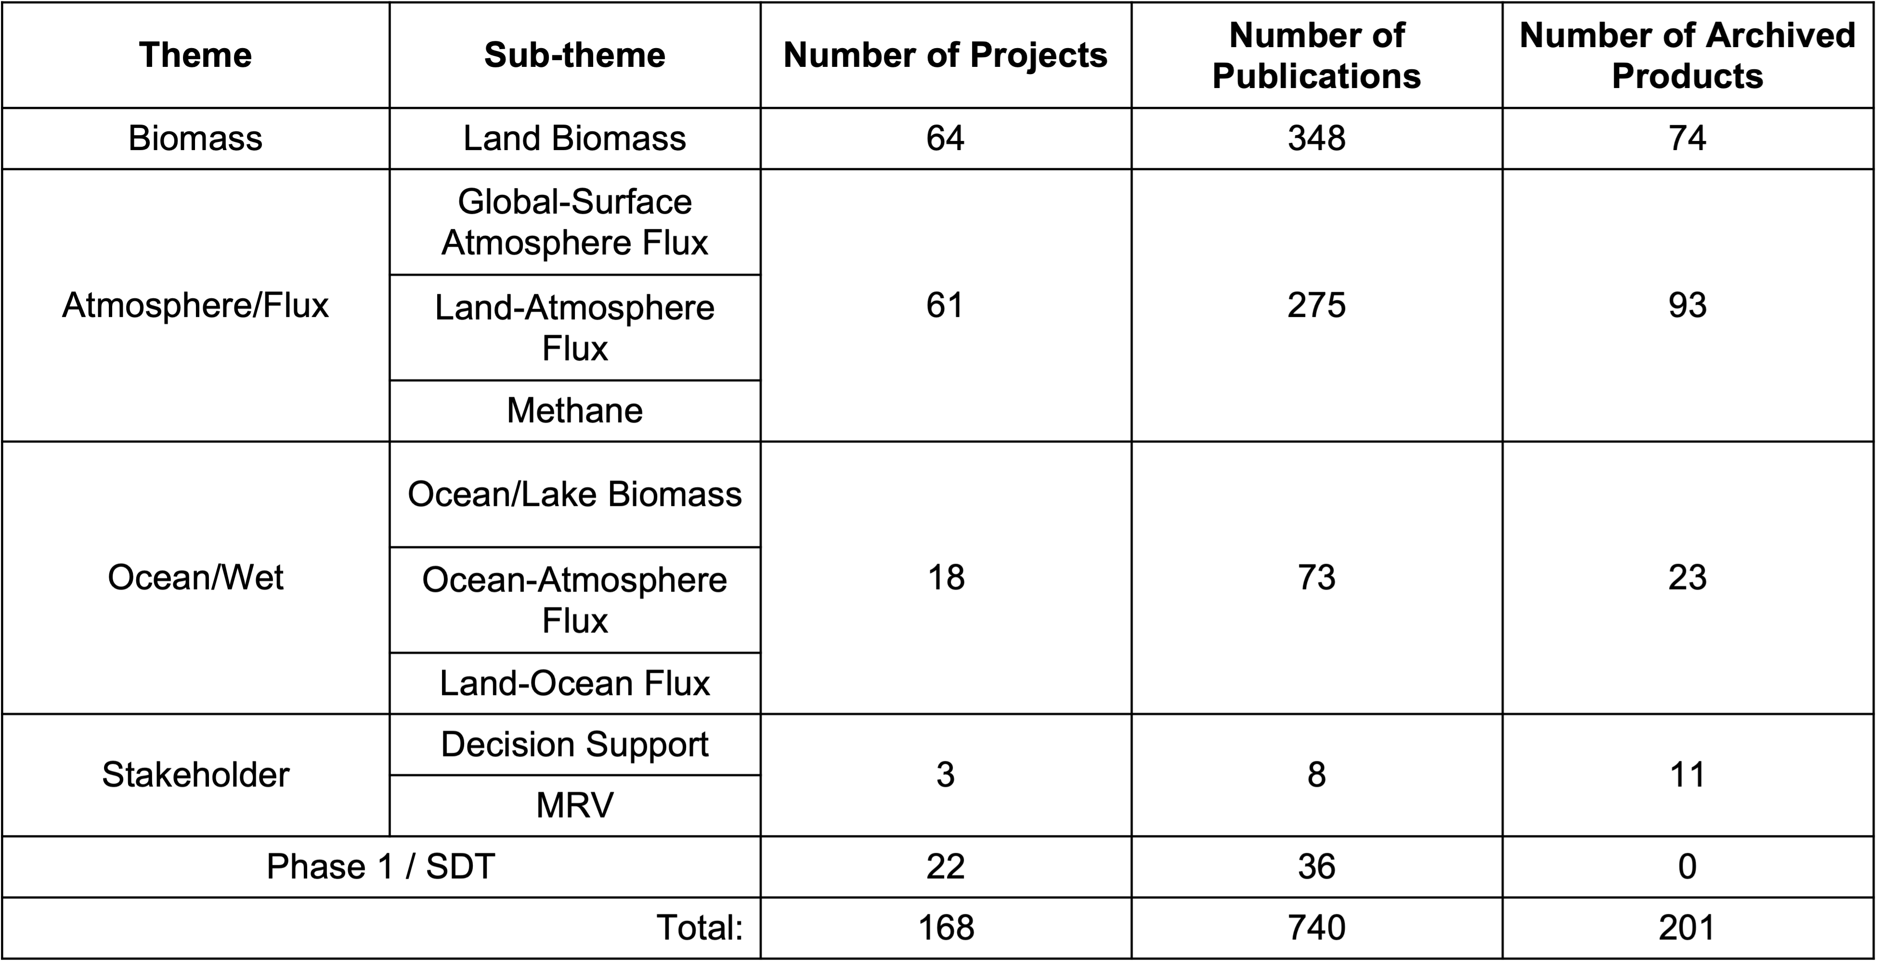
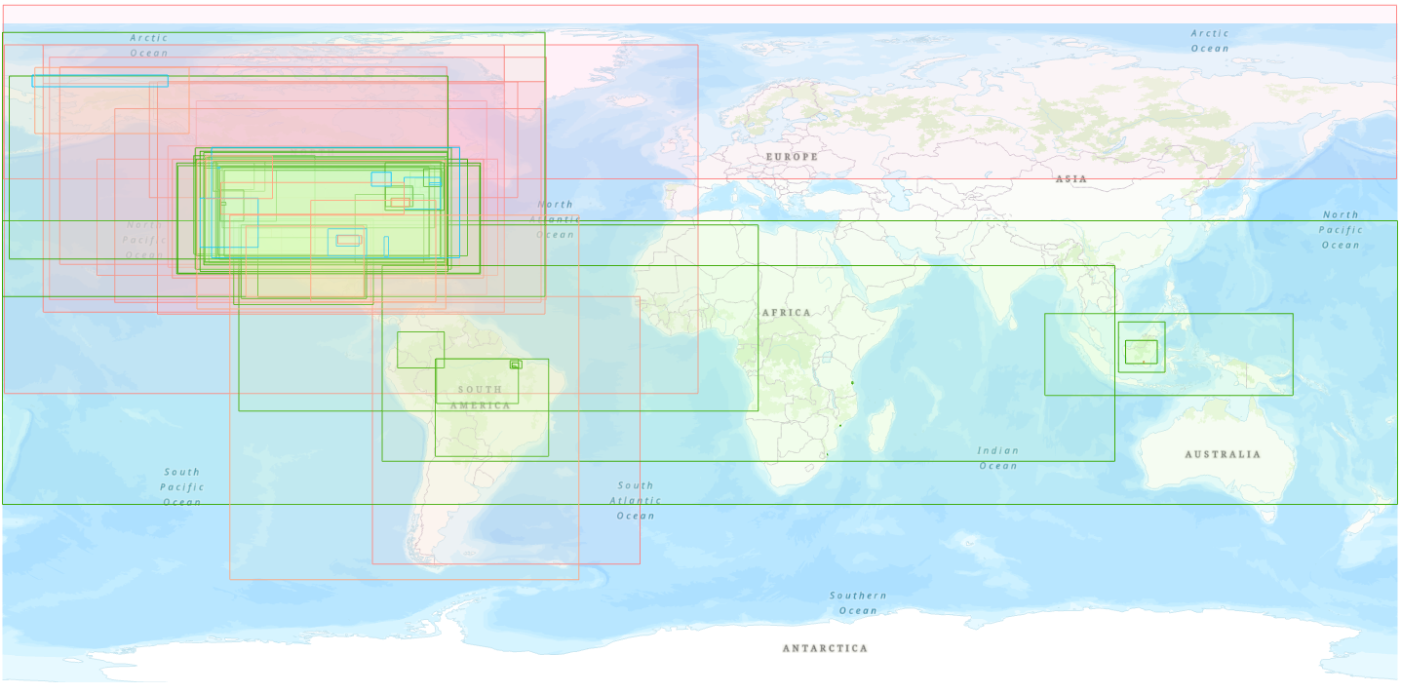
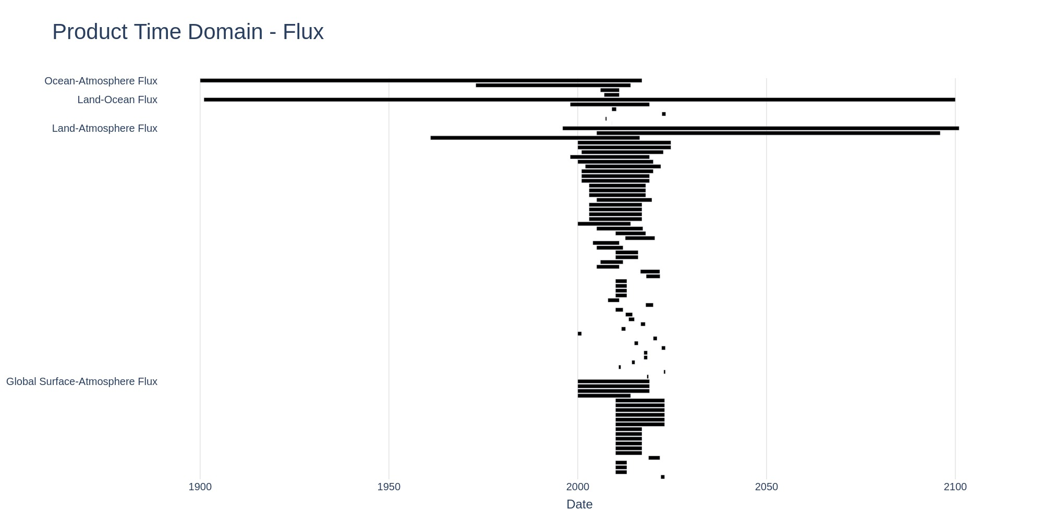
WG Metrics – Publications & Datasets archived
Notes:
Global – 46, Continental – 9, National -13, Regional -11, State -14
Temporal/Time Domain chart from George

Slide 7








WG Stakeholder Engagement and Interaction
Flux projects are engaging with a suite of stakeholders from the public and private sectors:
Maryland Department of Natural Resources (Hurtt 2023)
Maine Department of Environmental Protection (Hayes 2023)
Indiana Department of Natural Resources (Barnes 2022)
USDA Foreign Agricultural Service (Schuh 2022)
USDA Forest Service (Feng 2020, Davis 2023)
Google Research (Carroll 2022)
The Everglades Foundation (Delaria 2023)
Climate TRACE (Bowman 2022, Chatterjee 2023)
World Bank (Liu 2023, Chatterjee 2023)
World Meteorological Organization (Oda 2023)
Local Governments for Sustainability (ICLEI), C40 Cities Climate Leadership Group
(Lin 2022, Chatterjee 2023)
…and others
Stakeholder interactions:
Providing data products for government agencies to develop bottom-up inventories
Working with industry/NGOs to generate actionable data products
Creating new tools for data distribution and sharing
While the Flux WG continues to make progress in connecting with stakeholders at global, national, state and city level, stakeholder engagement remains a challenge ...
(esp. for projects working on delivering natural flux estimates)
Notes:
Key Points:
Good progress making connections at the state level
we have a lot of successful engagements with state level agencies, branching into NGO space, and private sector

Slide 8
WG Current Status and Plans for 2025-2026
Flux Synthesis paper – to be submitted to the ERL CMS Special Issue by March 2026
Title (working): Carbon Fluxes – Advancements and Opportunities for Research and Application Needs
Capture advances in understanding of carbon fluxes from observations and models across a range of spatial and temporal scales
Capture gaps and uncertainties towards a scalable flux MRV capability and carbon budgeting application
Capture the relevant needs from stakeholders that current flux products do meet (or fail to meet)
All are welcome to contribute!!!
https://docs.google.com/document/d/1MSB4FI6bT0KVzIuEhcl3wQ295IPfA1WElLNv-EeSzBA/edit?tab=t.0
Notes:
bullet point #2 – major findings, key accomplishments

Slide 9
Flux Synthesis Paper (1)
Introduction – Carbon Fluxes and the Global Carbon Cycle
Advances in understanding of carbon fluxes from observations and models
Estimating fluxes at different spatial and temporal scales
Available and required observations of fluxes at different scales
in situ (EC towers), airborne (CARAFE, AVIRIS), indirect measurements from atmospheric observations
Modeling of fluxes at different scales
inset box with key references to bottom-up, top-down and upscaling literature
Alternate approaches for estimating large-scale, decadal fluxes
from calculating changes in stocks
* Discussion/Ask - need inputs from the ocean community for #2

Slide 10
Flux Synthesis Paper (2)
Challenges and Opportunities
Research-to-operations – delivering low latency, high-resolution flux estimates
Validation of flux estimates at different scales
Interoperability between flux estimates from different approaches (aka “reconciliation of top-down & bottom-up approaches”)
Lateral fluxes
Source attribution and the need for observations of co-emitted species
Flux prediction/predictive capability

Slide 11
Flux Synthesis Paper (3)
Carbon fluxes for decision-making
Global stakeholders (e.g., GST, WMO G3W/I3GIS, etc.)
National to regional stakeholders (e.g., EPA, USFS, CARB, state level groups, etc.)
Local and urban stakeholders (e.g., World Bank, ICLEI, LA city, etc.)
Fluxes in carbon markets
5. Conclusions/Summary
Current Observation and Modeling gaps (implicitly covered in different sections, but will be spelled out more explicitly here)

Slide 12
Perspective Pieces – spinoff from synthesis paper
Perspective Piece 1 (Schuh, Davis et. al....)
What have we lost and what is at risk to lose if some of our current capabilities go away?
1. NOAA
a) MBL measurements? critical MLO and other observatories
b) Light aircraft profiles
c) Continental tower network
2. NIST
a) Urban testbeds
3. NASA
a) OCO2/3 Science
4. EPA
a) Inventory program
DOE
AmeriFlux
Urban program
As we refine the scope and content of the Flux Synthesis paper, there may be other elements that could lead to additional Perspective Pieces...
(e.g., linking Flux WG activities to stakeholders)

Slide 13
Summary of Breakout Discussion
A flux synthesis paper could provide consistent internal messaging for outward engagement
Guide CEOS best practices document on estimating and validating area fluxes
Stakeholder engagement remains a challenge
Building trust with stakeholders
Advancing ARL to get products fully operational
What are barriers to improving spatiotemporal resolution of atmosphere-based flux estimates to be useful to stakeholders?
Does the science community effectively reach stakeholders? Podcasts and social media can be more impactful alternatives to papers
National and state interest metrics offer a more engaging perspective
Framing of carbon monitoring and climate is less impactful than more tangible public health and economic value
Take science-based conclusions to dollars
E.g., public health, ecosystem health, ecosystem services, natural disasters such as loss due to wildfires, drought-induced mortality, crop failure, loss of timber → tangible benefits that matter to society
Notes:
CD - Constantly being reminded of the ARL levels - how do you make it operational? And hand it over to stakeholder?
Getting to know of the stakeholders at the beginning, working with end-users can be very challenging
KD - Has been hard to traditionally engage stakeholders for flux working group, spatiotemporal resolution is not at the scales that stakeholders want
KD - What are the barriers? What would push us through?
JL & RV - quantifying uncertainties - tying the Kennedy et al. uncertainty paper in here
JW - CEOS best practices document on area fluxes - make sure you connect #b and #c to here
JW - how is this different from Brendan’s paper?
AM - Synthesis paper can be a way of providing a consistent message - addresses the question of how this paper can be unique relative to information already available from previous studies.
AM - have you considered not writing a paper? Podcast - what is the way of getting to the audience? It is not through a paper. Need to get a consistent messaging across different forms of communication
Dig a little more into national interests. You can dig even into state interests. Framing our work about carbon and climate is not impactful. Rather - improve public health and safety, talk about natural resource and economic impacts. Taking things to dollars. The work has to be science-based and justified. The economic impact - getting those numbers out is meaningful.
Public health, ecosystem health, ecosystem services, natural disaster, economics, loss due to wildfires, drought-induced mortality, crop failure, loss of timber
Other ways of looking at CMS progress - national security. PG disagrees
NASA CMS does not do economics. Need to translate to economics - we are limited in what we can quantify, unless we try to make those connections

