Slide 1

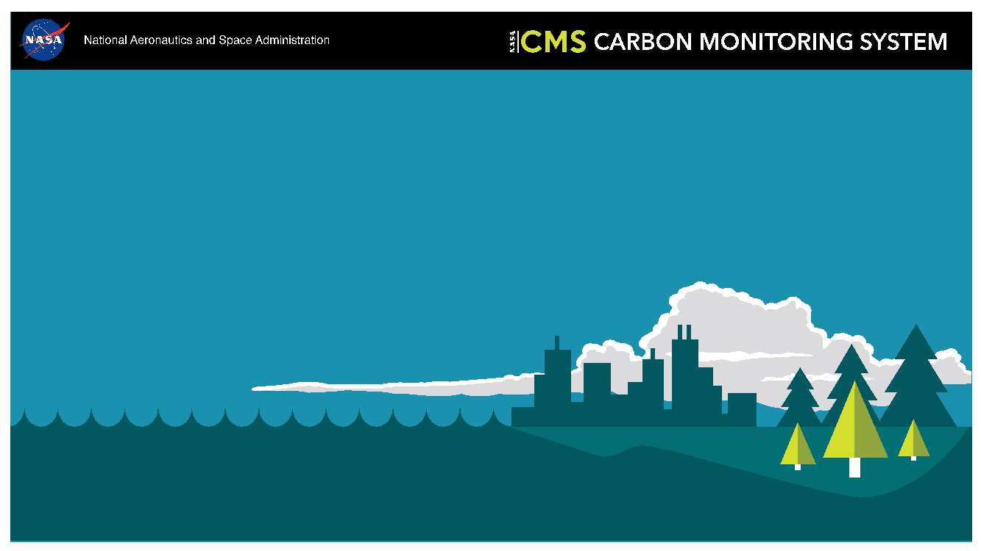
NASA Carbon Monitoring System Overview
George Hurtt
NASA-CMS Science Team Leader
Department of Geographical Sciences
University of Maryland
gchurtt@umd.edu
NASA-CMS Science Team Meeting
September 9-11, 2025
NASA AMES Research Center
http://carbon.nasa.gov

Slide 2
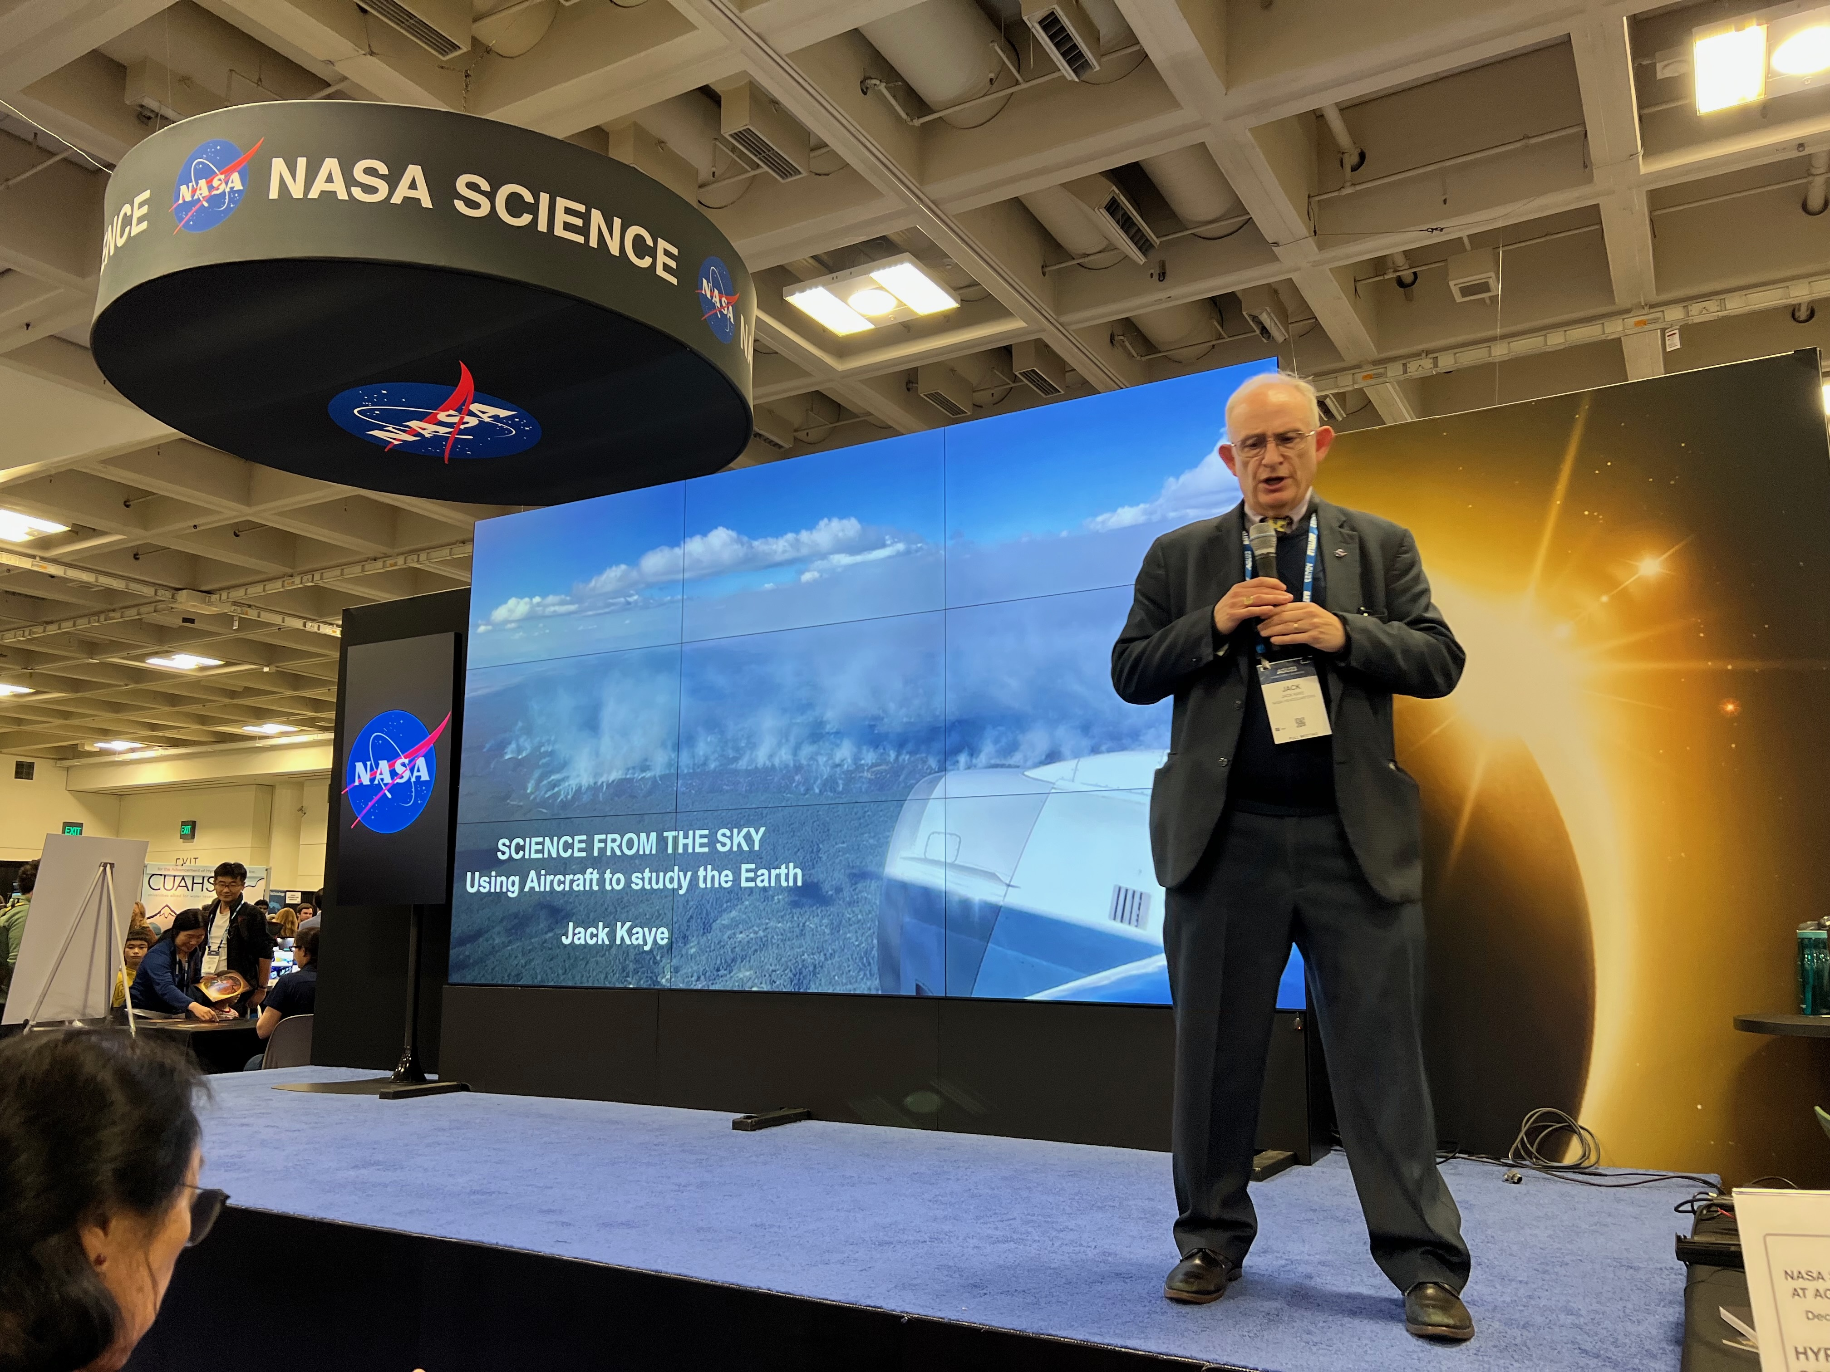
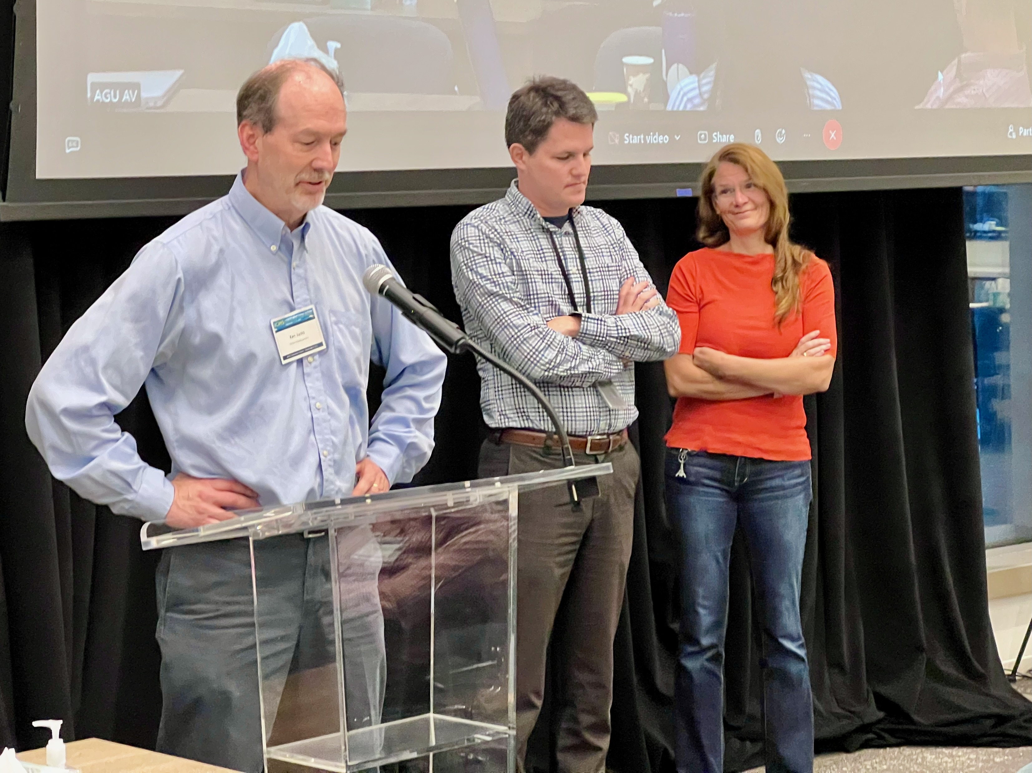




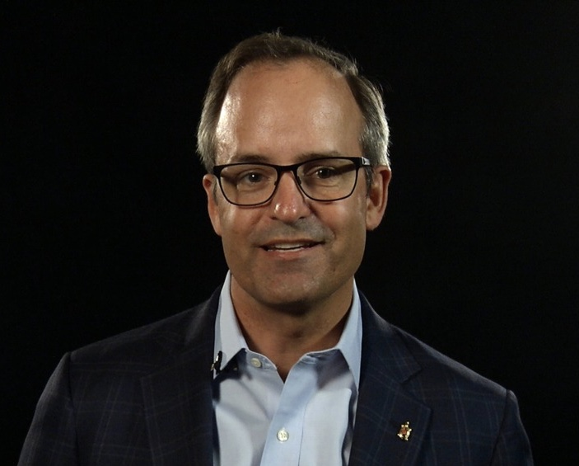

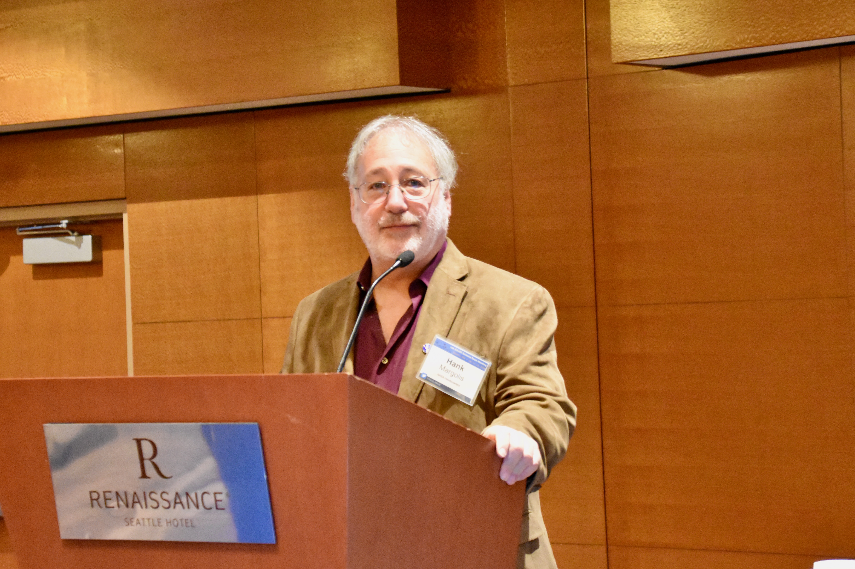

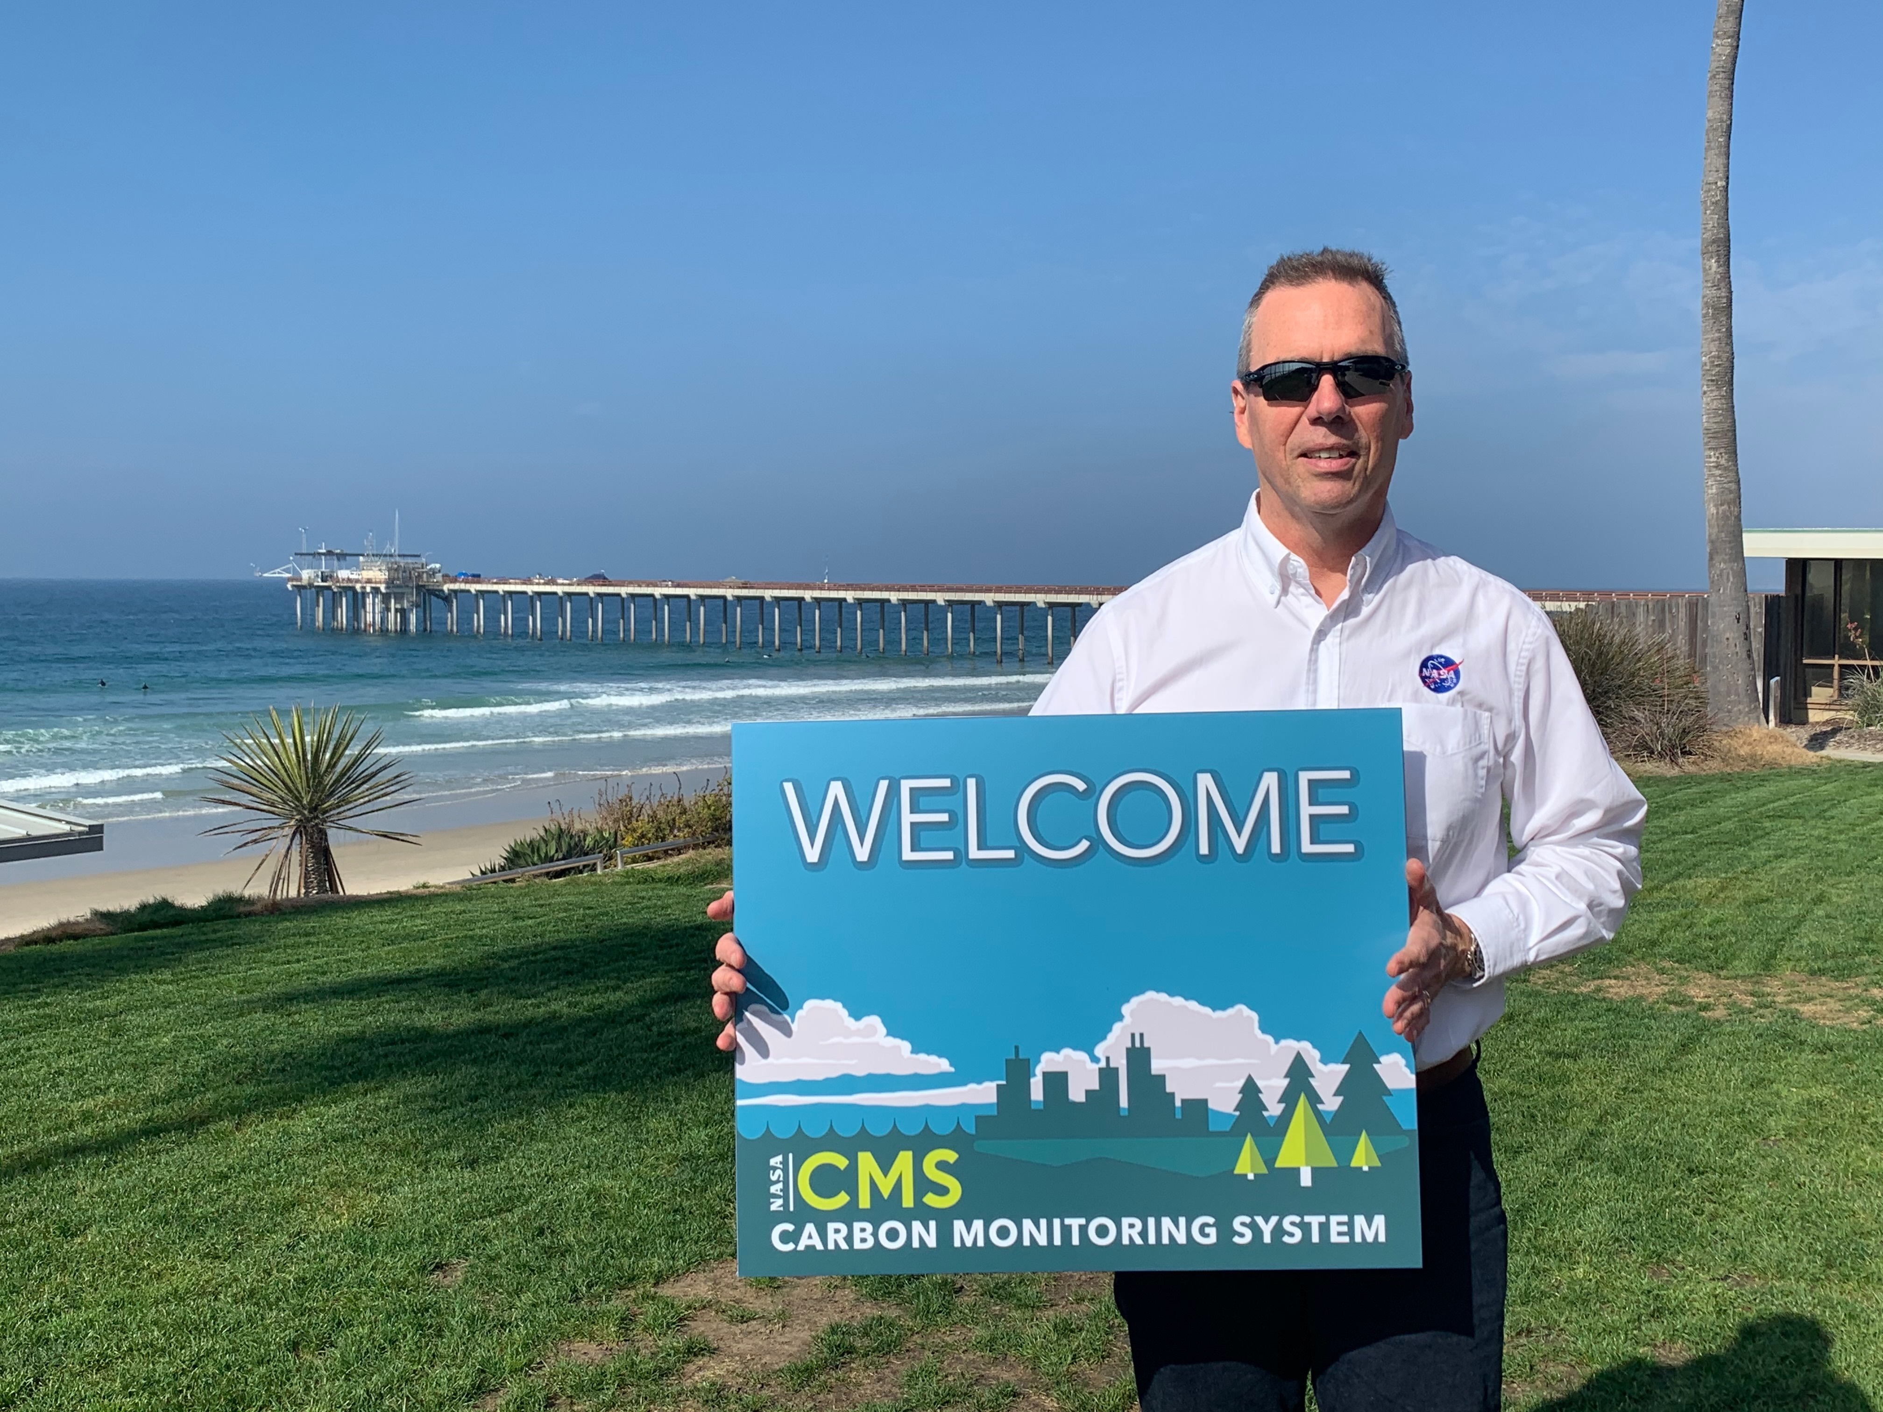




Notes:
Top: Jack Kaye, Ken Jucks, Ryan Pavlick, Laura Lorenzoni, Diane Wickland
Middle: Libby Larson, Molly Macaulley, Paula Bontempi, George Hurtt, Kathy Hibbard
Bottom: Peter Griffith, Hank Margolis, Megan McGroddy, Vanessa Escobar, Molly Brown, Mike Falkowski, Katharine Stover, Edil Sepulveda

Slide 3
Meeting Planning, Logistics, and Leadership
Planning/Logistics:
Peter Griffith, NASA GSFC
Amy Hodkinson, NASA GSFC
George Hurtt, UMD
Leanne Kendig, NASA GSFC
Libby Larson, NASA GSFC
Janna Chapman, UMD
Natalie Sharpe, NASA GSFC
Katharine Stover, NASA GSFC
David Stroud, NASA GSFC
Moderators:
Nancy French, MTRI
Daniel Cusworth, Carbon Mapper
Meghan Halabisky, UW
Jeff Atkins, VCU
Chad Babcock, UMN
Abhishek Chatterjee, JPL
Reem Hannun, NASA AMES
Daniel Cusworth, Carbon Mapper
Libby Larson, NASA GSFC
Katharine Stover, NASA GSFC
Working Group Leads:
Abhishek Chatterjee, JPL
Reem Hannun, NASA AMES
Meghan Halabisky, UW
Andrew Hudak, USFS
Jeff Atkins, VCU
Daniel Jacob, Harvard
Daniel Cusworth, Carbon Mapper
Joanne Hall, UMD
Junjie Liu, NASA JPL
Notes:
** Updated 9/3/2025

Slide 4
Congressional Direction in 2010:
Also included within the funds provided for other mission and data analysis, the conference agreement provides $6,000,000 for pre-phase A and pilot initiatives for the development of a carbon monitoring system. Any pilot developed shall replicate state and national carbon and biomass inventory processes that provide statistical precision and accuracy with geospatially explicit associated attribute data for aggregation at the project, county, state and federal level using a common dataset with complete market transparency, including extraction algorithms and correlation modeling.
Congressional Direction in 2011:
None
Congressional Direction in 2012:
The Committee recommends $10,000,000 from within available funds to continue the development of a carbon monitoring system initially funded in fiscal year 2010. The Committee expects no less than one-half of this amount shall be awarded externally.
Language in Senate Draft for 2013:
Of the funds provided within the earth science research and analysis activity, the Committee recommends $10,000,000 to continue efforts for the development of a carbon monitoring system initially funded in fiscal year 2010. The majority of the funds should be directed towards acquisition, field sampling, quantification and development of a prototype Monitoring Reporting and Verification [MRV] system which can provide transparent data products achieving levels of precision and accuracy required by current carbon trading protocols. The Committee recognizes that the current orbital and suborbital platforms are insufficient to meet these objectives. Therefore, the use of commercial off-the-shelf technologies is recommended as these products could provide robust calibration validation datasets for future NASA missions. Up to 20 percent of these funds should be made available to international Reducing Emissions from Deforestation and Forest Degradation [REDD] projects. Furthermore, the Committee is deeply disappointed with the lack of progress that NASA has made on this initiative thus far within the agency. Therefore, it directs that the above funds shall be competitively awarded within 120 days of enactment of this act.
Congressional Direction in 2014:
Carbon Monitoring- Of the funds provided within the Earth Science research and analysis activity, the Committee recommends $10,000,000 to continue efforts for the development of a carbon monitoring system. The majority of the funds should be directed toward acquisition, field sampling, quantification, and development of a prototype Monitoring Reporting and Verification [MRV] system which can provide transparent data products achieving levels of precision and accuracy required by current carbon trading protocols. The Committee is concerned that NASA has not established a program of record around the development of MRV system, and therefore expects a plan from NASA not later than 90 days after enactment of this act incorporating such a system into its operating plan and long-term budget projection. The Committee recognizes that the current orbital and suborbital platforms are insufficient to meet these objectives. Therefore, the use of commercial off-the-shelf technologies is recommended as these products could provide robust calibration validation datasets for future NASA missions.
…”pilot initiatives for the development of a carbon monitoring system…”
...”replicate state and national carbon and biomass inventory processes that provide statistical precision and accuracy with geospatially explicit associated attribute data…”
…”development of a prototype Monitoring Reporting and Verification (MRV) system which can provide transparent data products achieving levels of precision and accuracy required by current carbon trading protocols….”
...”[development of] a plan…incorporating such a [MRV] system into its operating plan and long-term budget projection…”

Slide 5



NASA-CMS Phase 1
Biomass Pilot. The goals of the Biomass Pilot are to:
Utilize satellite and in situ data to produce quantitative estimates (and uncertainties)
of aboveground terrestrial vegetation biomass on a national and local scale.
Assess the ability of these results to meet the nations need for monitoring
carbon storage/sequestration.
Flux Pilot. The objectives of the Flux Pilot are to:
Combine satellite data with modeled atmospheric transport initiated by
observationally-constrained terrestrial and oceanic models to tie the atmospheric
observations to surface exchange processes.
Estimate the atmosphere-biosphere CO₂ exchange.
Scoping Efforts. The objectives of the Scoping Efforts are to:
Identify research, products, and analysis system evolutions required to support carbon
policy and management as global observing capability increases.
Hurtt et al. (2014) Phase 1 Report

Slide 6
NASA’s Approach to CMS/MRV
Recognizes that a sustained, observationally-driven carbon monitoring system using remote sensing data has the potential to significantly improve the relevant information base for the U.S. and world;
Recognizes multiple users, multiple scales, multiple quantities, and multiple frameworks for MRV (e.g. International, national and subnational, markets);
Recognizes the importance of user engagement to be responsive to stakeholder needs;
The goal for NASA’s CMS project is to prototype the development of carbon monitoring capabilities needed to support stakeholder needs for MRV.
Hurtt et al. (2014) Progress and Future Plans

Slide 7
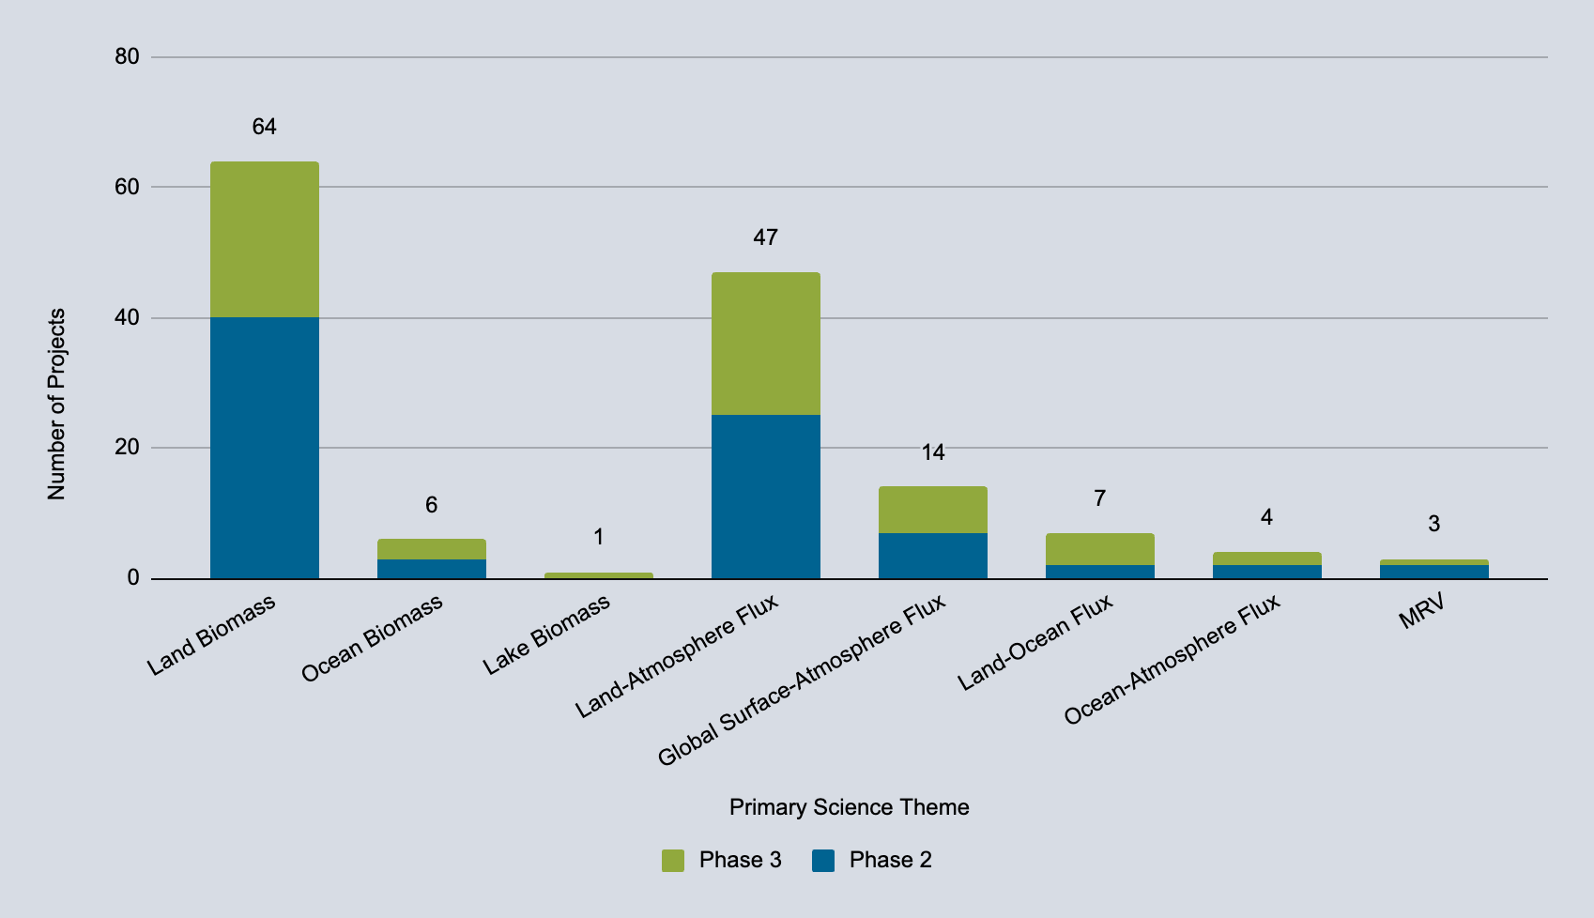






CMS Phase 2 & 3 (2011-) Project Themes Addressed
Notes:
**Updated 9/4/25
Total of 146 projects in Phase 2 and 3. 81 in Phase 2. 65 in Phase 3.

Slide 8
Theme | Sub-theme | Number of Projects | Number of Publications | Number of Archived Products
Biomass | Land Biomass | 64 | 348 | 74
Atmosphere/Flux | Global-Surface Atmosphere Flux | 61 | 275 | 93
 | Land-Atmosphere Flux
 | Methane
Ocean/Wet | Ocean/Lake Biomass | 18 | 73 | 23
 | Ocean-Atmosphere Flux
 | Land-Ocean Flux
Stakeholder | Decision Support | 3 | 8 | 11
 | MRV
Phase 1 / SDT |  | 22 | 36 | 0
Total: |  | 168 | 740 | 201
(2025)
Notes:
** Updated 9/4/2025; Projects and Publications columns are done;
There will be 12 added datasets since last Sept. 5 Biomass theme and 7 Atmosphere/Flux theme. I propose to just update the numbers with the new products rather than recalculating them completely.
Not all publications necessarily fit into these themes. They were matched by project, so the pubs sometimes might be related to a project’s secondary theme.

Slide 9
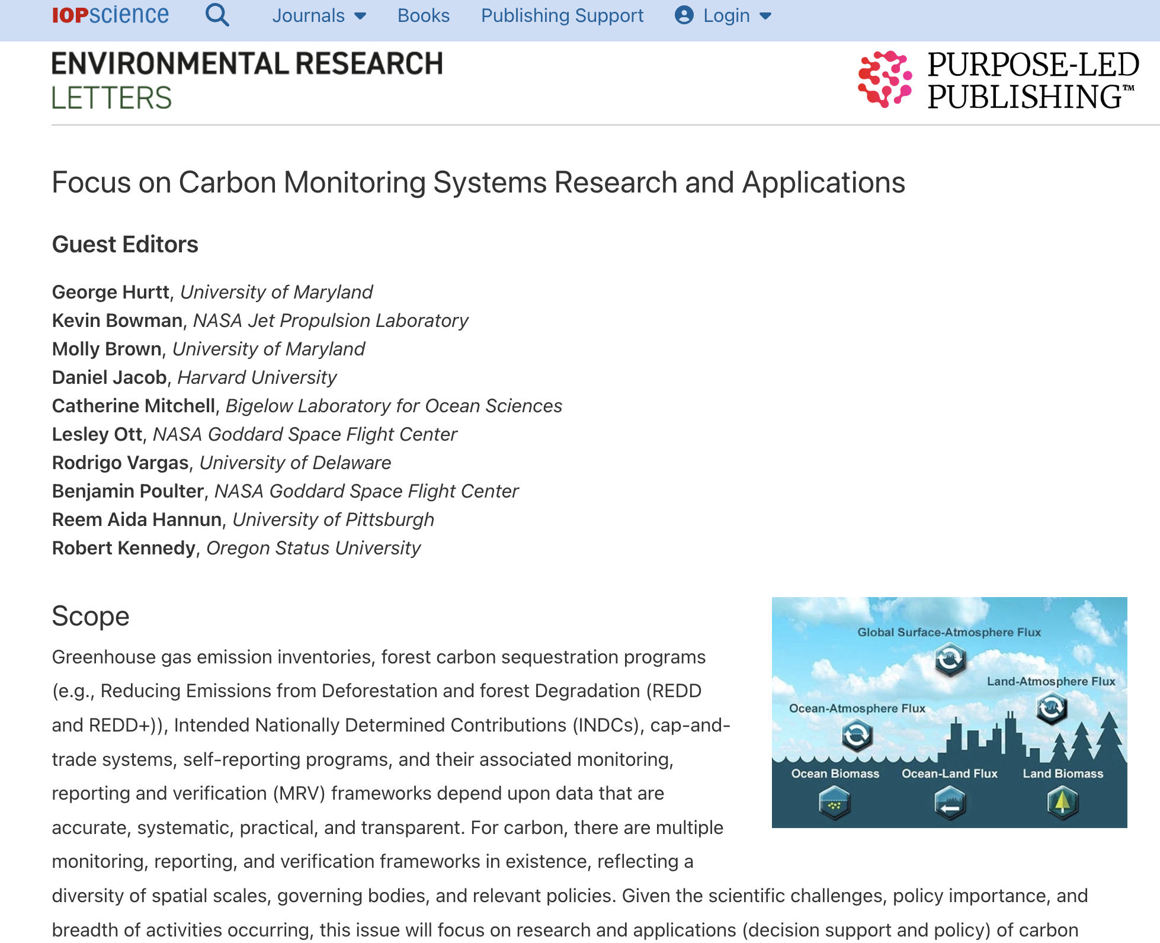




Slide 10
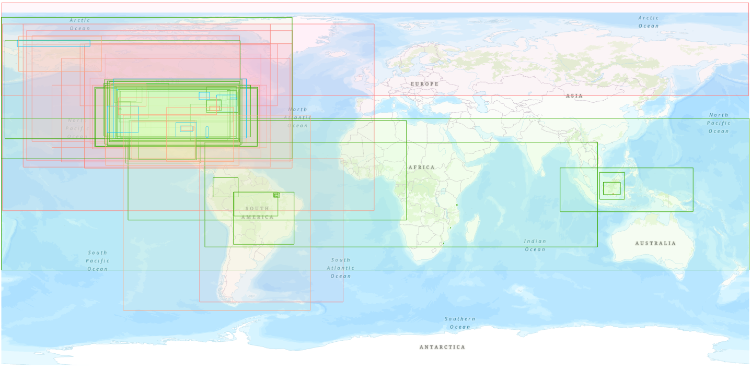
All CMS Product Boundaries by Theme
Legend
  Wet - 23 products
  Flux - 93 products
  Land Biomass - 74 products
  Stakeholder - 11 products
 | Flux | Biomass | Wet Carbon | Stakeholder
Global | 46 | 8 | 4 | 1
Continental | 9 | 3 | 0 | 2
National | 13 | 20 | 0 | 1
Regional | 11 | 14 | 10 | 5
Site | 14 | 29 | 9 | 2
Total | 93 | 74 | 23 | 11
*59 global products, not shown
Notes:
Updated 9/5/2025
Total number of products 201

Slide 11
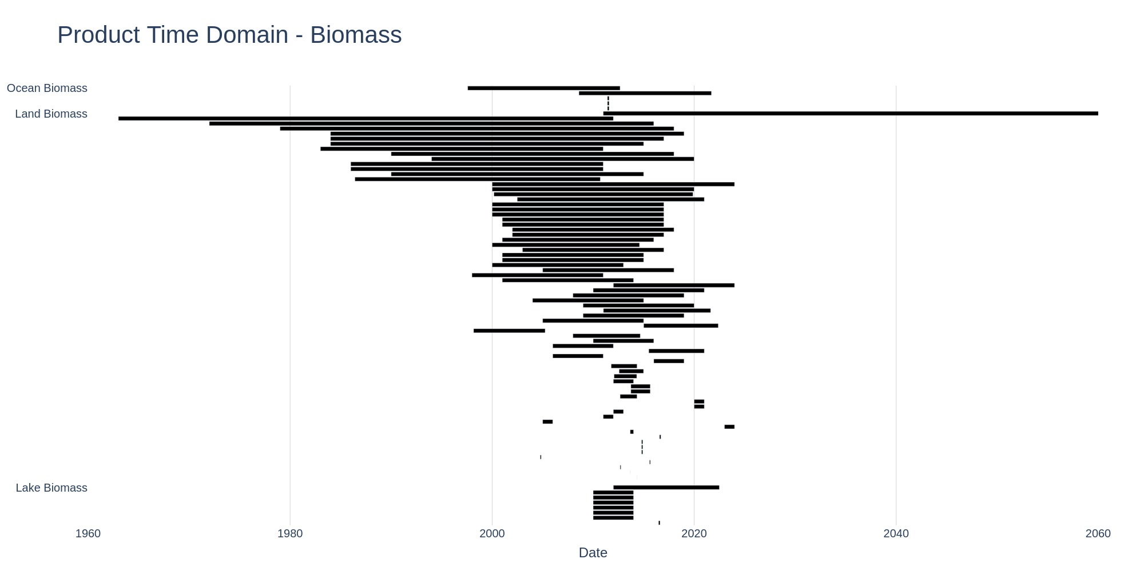
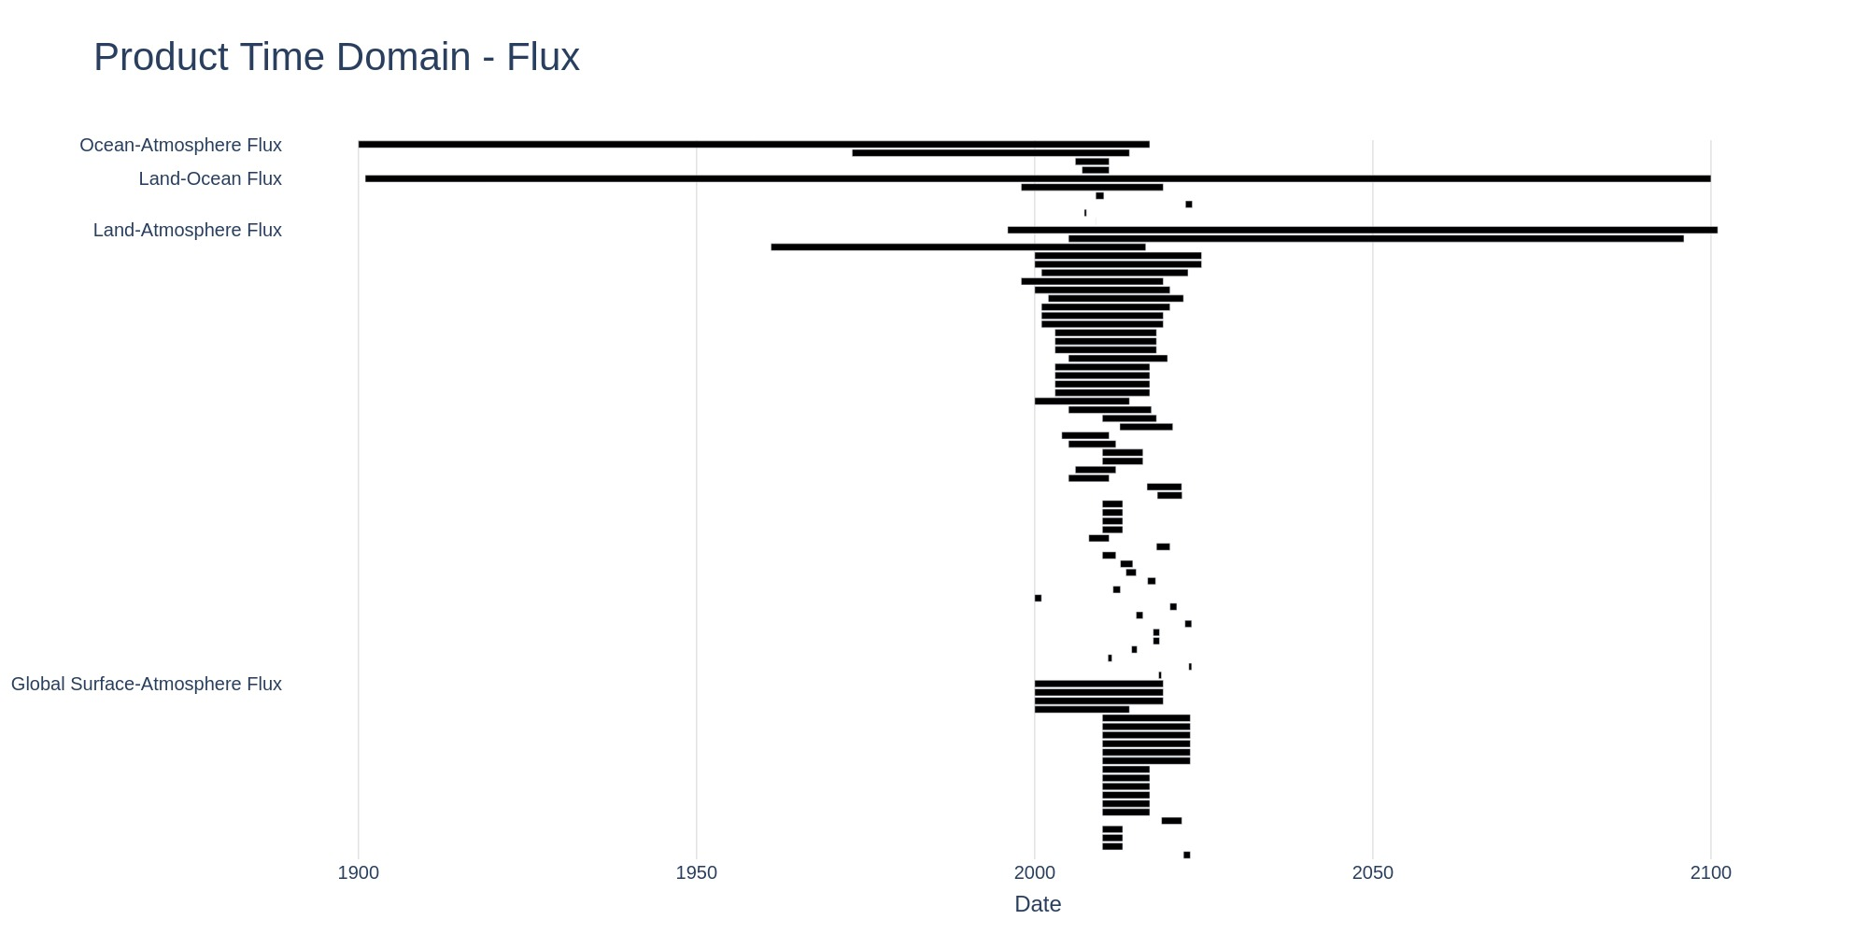
CMS Product Time Domains
Period | Number | %
<2000 | 27 | 13
2000-2020 | 152 | 76
>2020 | 22 | 11
Notes:
** Updated 9/5/2025

Slide 12
CMS All Participants
TYPE (# unique) | US | UK/EU | Canada | Mexico | Brazil | Indonesia | Other | Total
University (129) | 366 | 22 | 3 | 6 | 4 | 4 | 15 | 420
Federal Agency (37) | 287 | 4 | 2 | 6 | 5 | 1 | 8 | 313
State Agency (27) | 46 |  |  |  | 1 |  |  | 47
Local Agency (10) | 13 |  | 1 |  |  |  |  | 14
Company (43) | 50 | 3 | 2 | 1 | 2 |  | 2 | 60
NGO (30) | 51 |  |  |  | 5 | 1 |  | 57
Research Institute (31) | 37 | 16 |  |  | 2 |  | 9 | 64
Other (29) | 25 | 9 |  | 1 |  | 1 | 5 | 41
Total | 875 | 54 | 8 | 14 | 19 | 7 | 39 | 1,016
Notes:
** Updated 9/4/2025
Total of 1016 participants over 32 countries
639 participants in phase 3

Slide 13
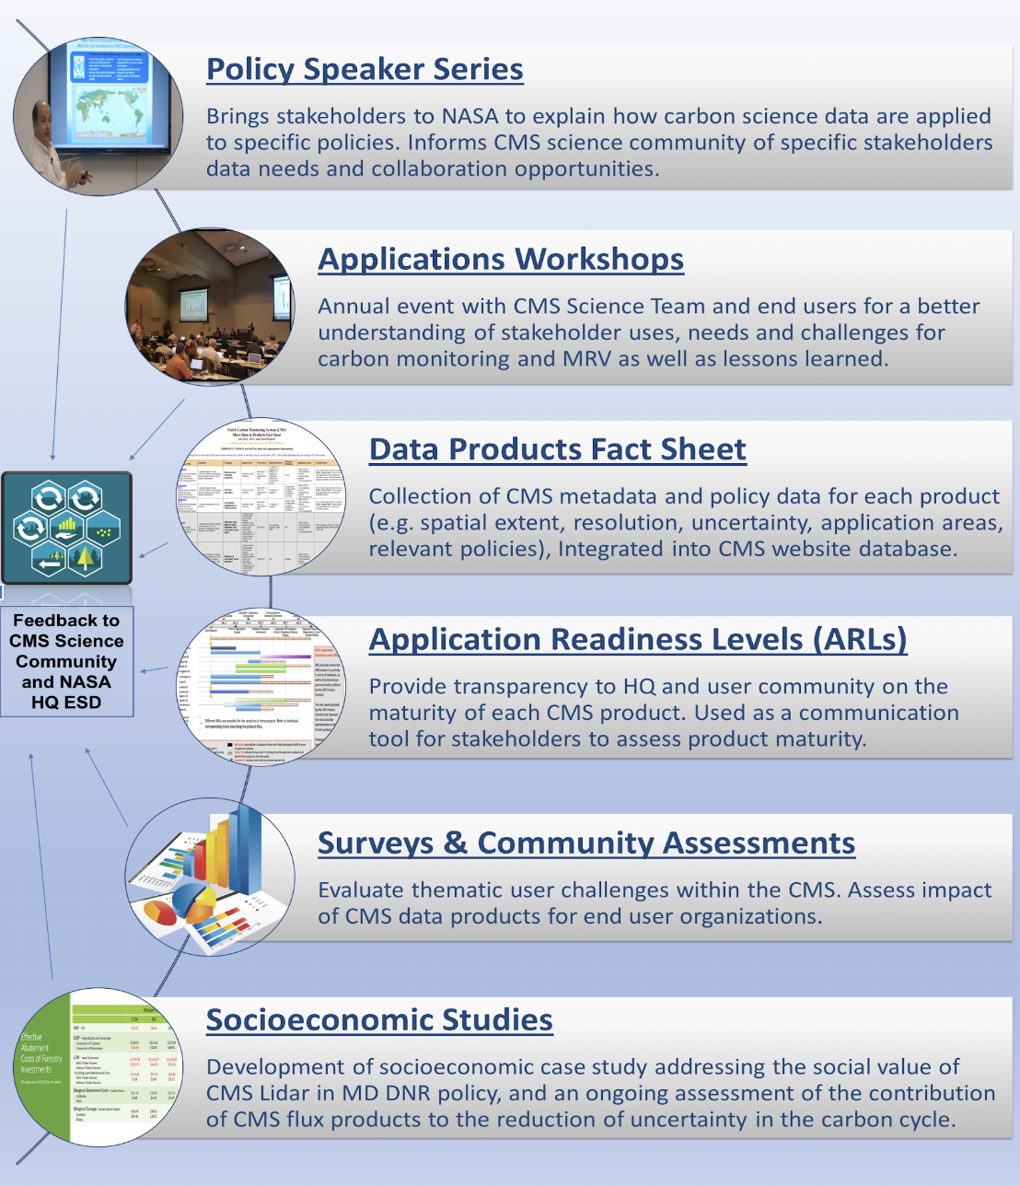
Scientists
Stakeholders

Slide 14
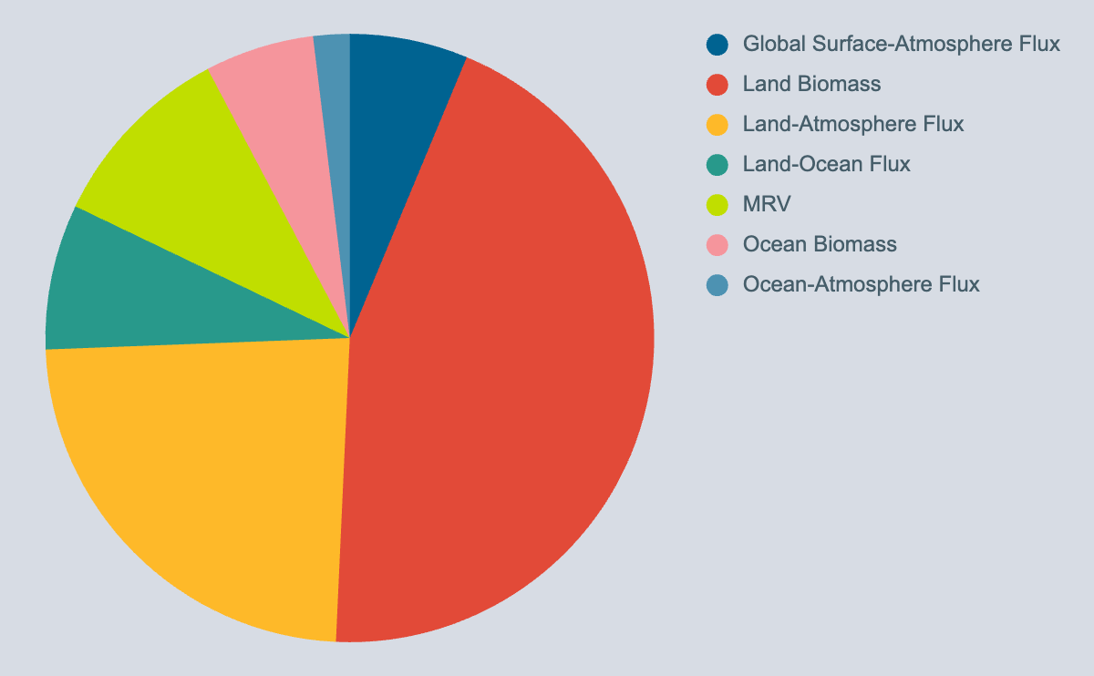
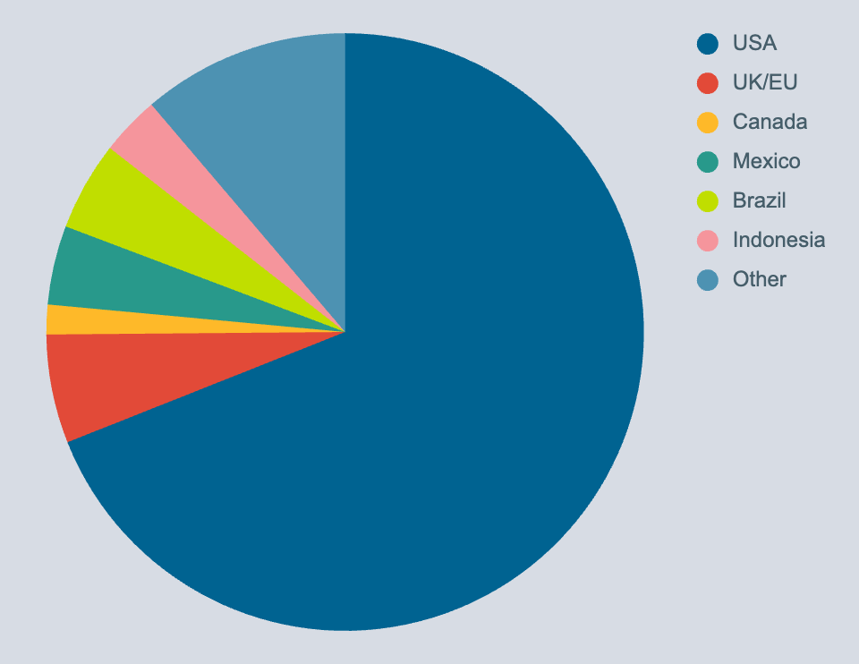
CMS All Stakeholders
Notes:
** Updated 9/4/2025
186 unique stakeholder orgs
1016 Participants across 32 countries

Slide 15
CMS Working Groups
Present:
Past:
Biomass*
Flux*
Methane**
Fire*
Wet Carbon**
*Synthesis paper in prep
**Synthesis paper published
Uncertainties** (2020-2024)
Stakeholder** (2020-2024)
MRV (2020—2022)
Data/Data Management (2013-2019)
Atmospheric Validation (2013-2019)
External Communications (2012-2019)
Methane (2015-2019)
MRV (2013-2019)
Uncertainties (2015-2019)
System Framework (2012-2015)
Algorithm Assessment/Inter-comparisons (2012-2014)
Biomass-Flux (2012-2014)
Capability Risk (2012-2014)
Responsiveness (2012-2014)
Uncertainties/Algorithm Assessment/Inter-comparisons (2012-2014)
Notes:
** Updated 9/12/2023

Slide 16
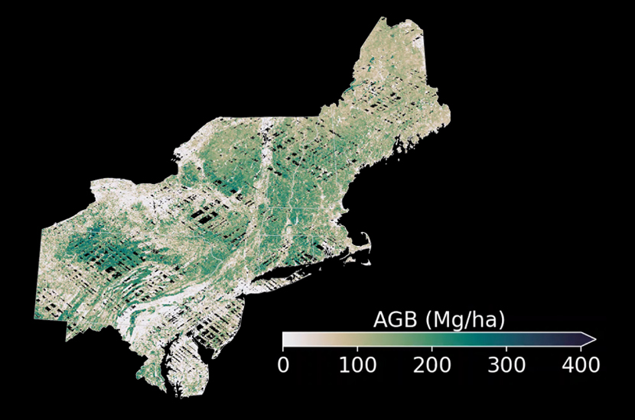
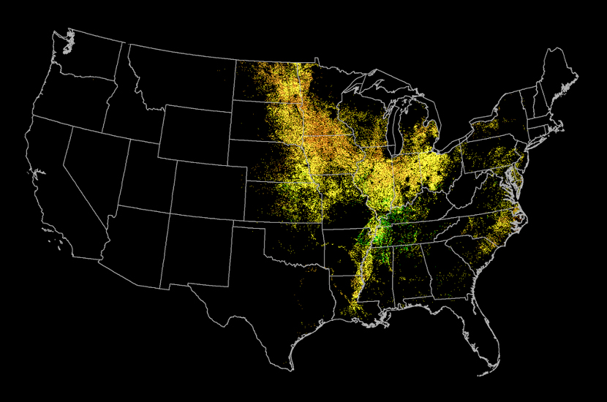
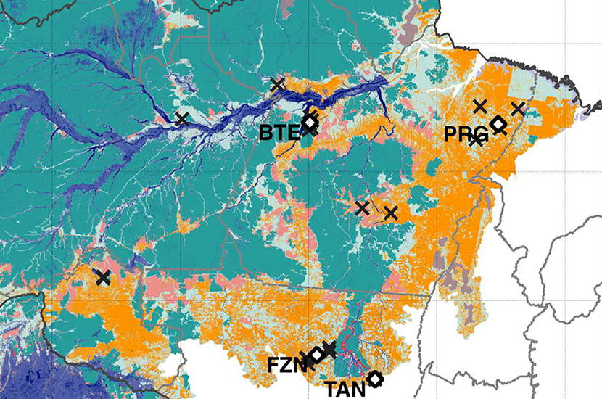
Example Success Stories: Land
High-Resolution Forest Carbon Monitoring and Modeling
Cropland Carbon Monitoring System (CCMS)
Understanding Amazon Forest Degradation

Slide 17
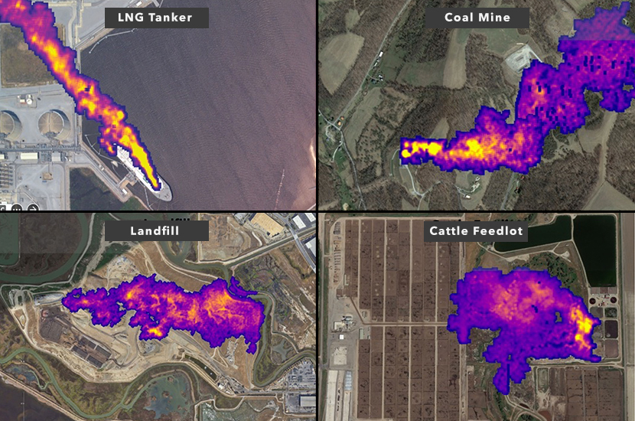
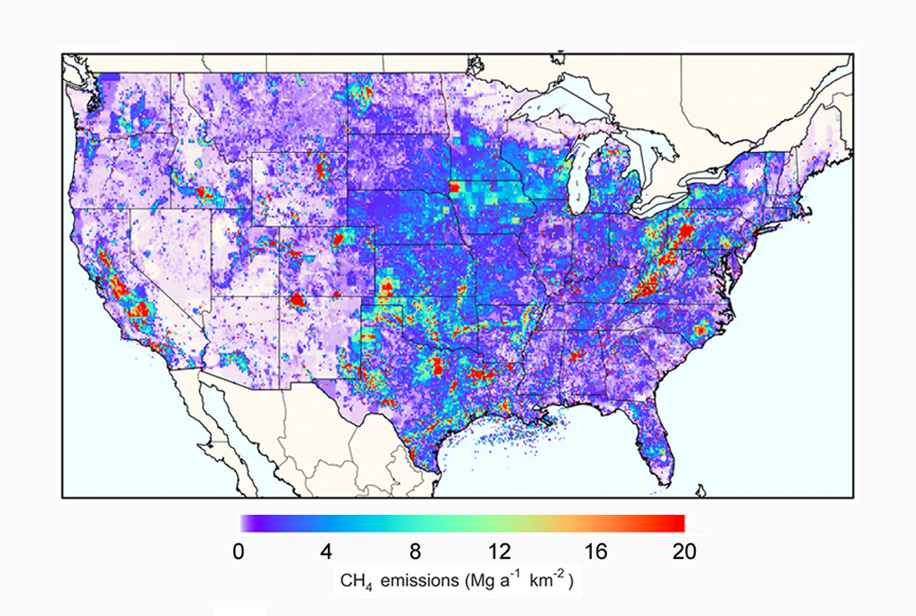
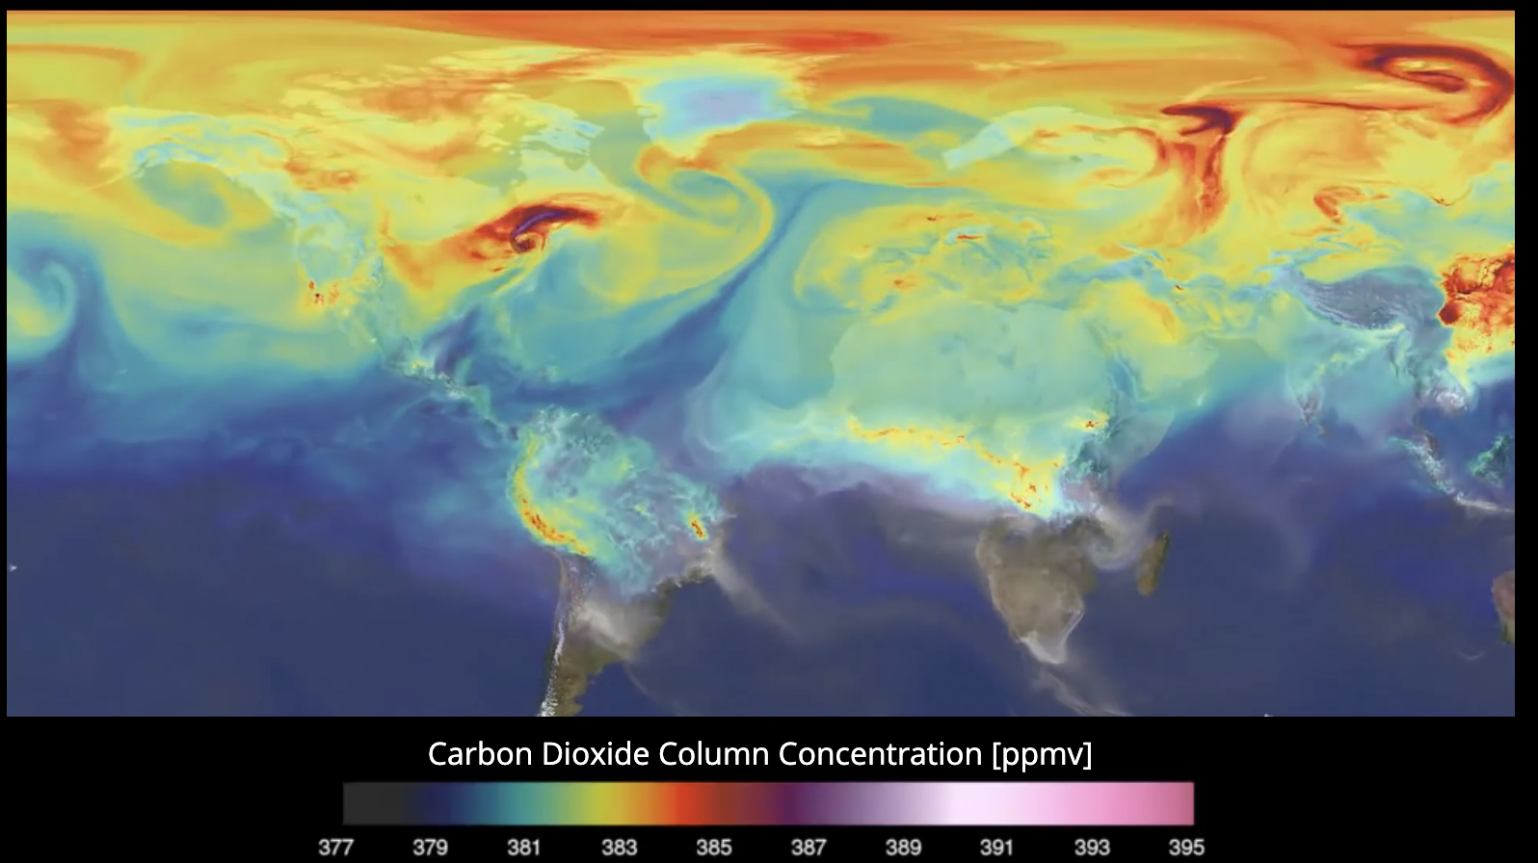
Example Success Stories: Atmosphere
Methane Observing System
National Methane Inventory
Carbon Monitoring Datasets

Slide 18
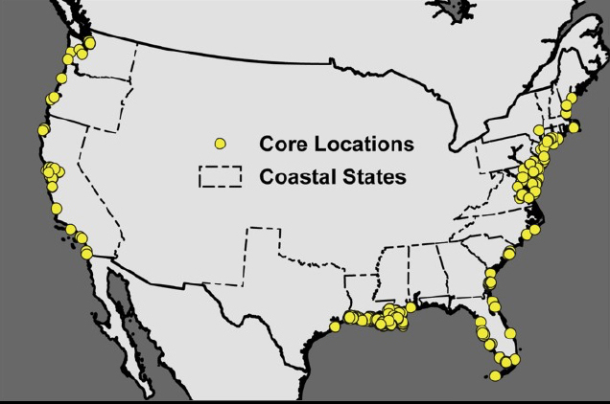
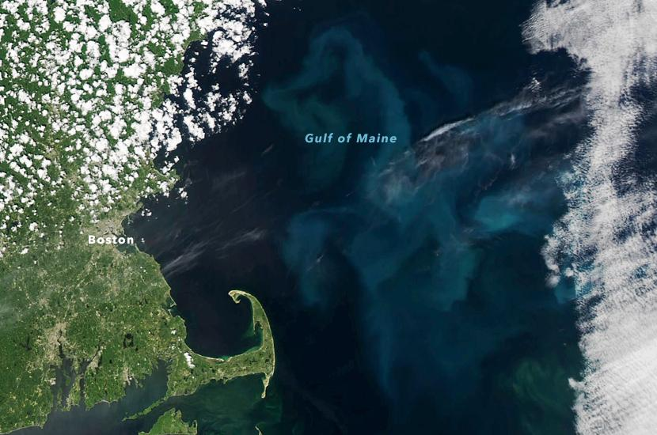
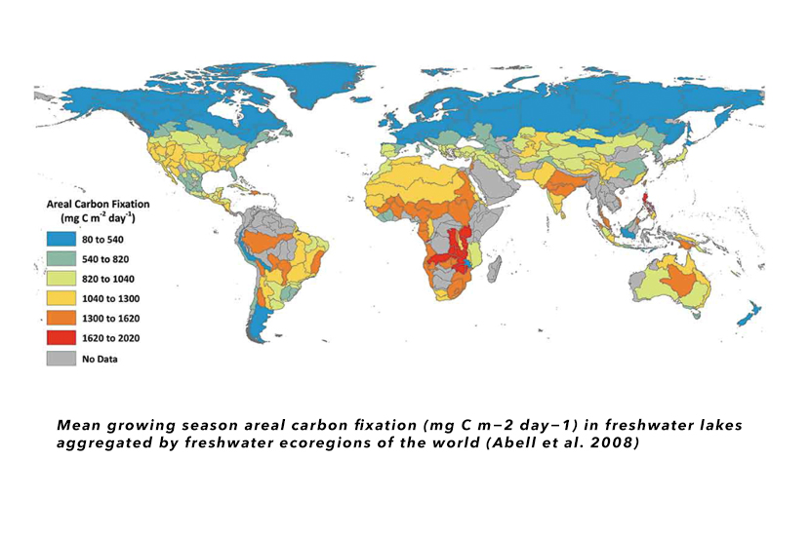
Example Success Stories: Water
Costal Wetlands
Gulf of Maine
Freshwater Lakes

Slide 19





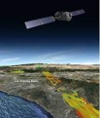

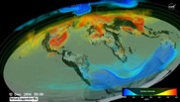







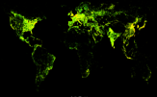

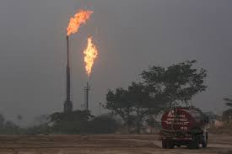


Examples of Data and Needs from Partners*
GHG System Integration
New Insights
Research &
Applications
End user system
(Front End)
Gridded anthropogenic emissions
Earth Observations
Modeling
Leverages ESDS/ VEDA capabilities
Test bedding of modeling, integration approaches
Thorough evaluation of new observations before transition
Advanced users
Leverages ESDS/VEDA
Public-facing
Curated, mature products representing consensus view
Science and
non-science users
Enhanced help desk support
Natural GHG Emissions
Detecting and tracking high emission events
Improvement of modeling, observing techniques
Incorporation of stakeholder needs and feedback
* Representative, but not comprehensive list

Slide 20
Prototype: FROM DATA TO NEW INSIGHTS
Examples of Data and Needs from Partners*
GHG System Integration
New Insights
CMS
Pathway to innovation from research community
EIS
Open system focused on integration and testing of new approaches, Earth system understanding and discoveries
GHG Center
End-user driven, reliable delivery of mature GHG monitoring products and tools, enhanced support for stakeholder engagement
Research &
Applications
End user system
(Front End)
Gridded anthropogenic emissions
Earth Observations
Modeling
Leverages ESDS/ VEDA capabilities
Test bedding of modeling, integration approaches
Thorough evaluation of new observations before transition
Advanced users
Leverages ESDS/VEDA
Public-facing
Curated, mature products representing consensus view
Science and
non-science users
Enhanced help desk support
Natural GHG Emissions
Detecting and tracking high emission events
Improvement of modeling, observing techniques
Incorporation of stakeholder needs and feedback
* Representative, but not comprehensive list

Slide 21
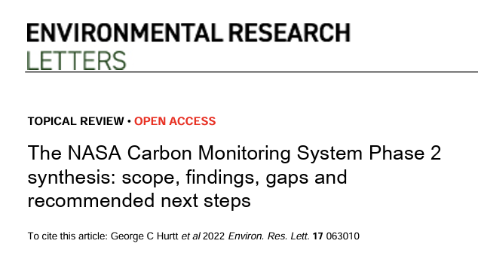
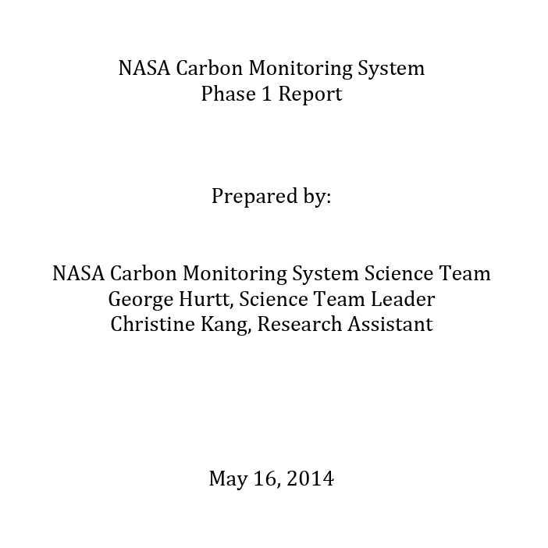
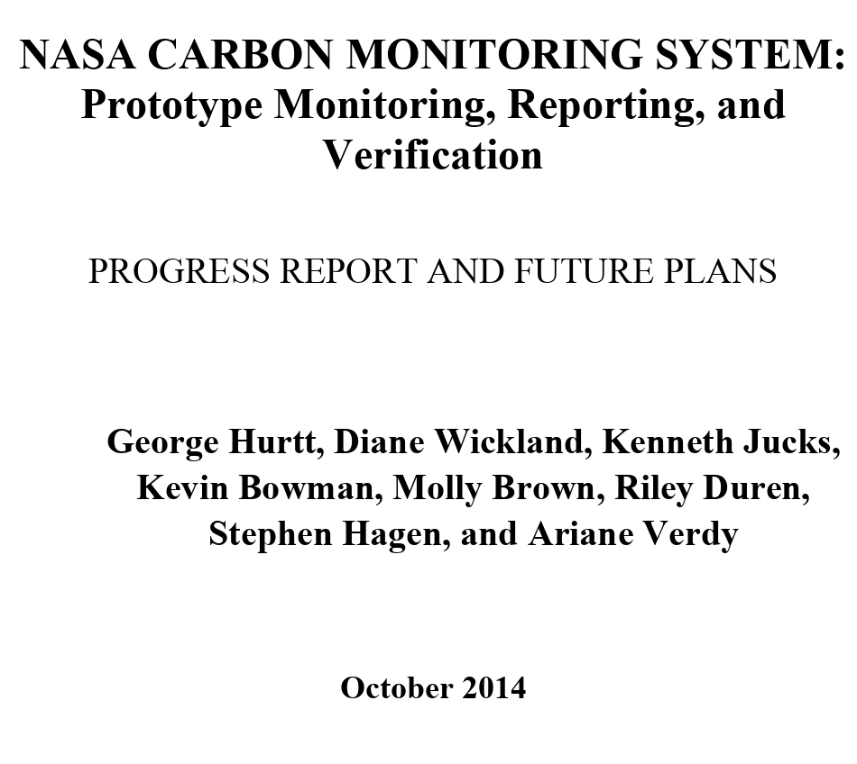


Slide 22
Syhtheses & Topical Reviews (examples)
Zhu Q, Jacob D J, Yuan K, Li F, Runkle B R K, Chen M, Bloom A A, Poulter B, East J D, Riley W J, McNicol G, Worden J, Frankenberg C and Halabisky M 2025 Advancements and opportunities to improve bottom–up estimates of global wetland methane emissions Environ. Res. Lett. 20 023001 10.1088/1748-9326/adad02
Duncanson L, Hunka N, Jucker T, Armston J, HArris N, Fatoyinbo L, Williams C A, Atkins J W, Raczka B, Werbin S, Keller M, Dubayah R, Babcock C, Cochrane M A, Hudak A, Hurtt G C, Montesano P M, Moskal L M, Park T, Saatchi S, Silva C A, Tang H, Vargas R, Weiskittel A, Weswsels K and Goetz S J 2025 Spatial resolution for forest carbon maps Science 387 370–1 10.1126/science.adt6811
Kennedy R E, Serbin S P, Dietze M C, Andersen H-E, Babcock C, Baker D F, Brown M E, Davis K J, Duncanson L, Feng S, Hudak A T, Liu J, Patterson P L, Raczka B, Cochrane M A, Carlo E A S and Vargas R 2024 Characterizing and communicating uncertainty: lessons from NASA’s Carbon Monitoring System Environ. Res. Lett. 19 123003 10.1088/1748-9326/ad8be0
Campbell A D, Fatoyinbo T, Charles S P, Bourgeau-Chavez L L, Goes J, Gomes H, Halabisky M, Holmquist J, Lohrenz S, Mitchell C, Moskal L M, Poulter B, Qiu H, Sousa C H R D, Sayers M, Simard M, Stewart A J, Singh D, Trettin C, Wu J, Zhang X, Lagomasino D 2022 A review of carbon monitoring in wet carbon systems using remote sensing Environ Res Lett 10.1088/1748-9326/ac4d4
Brown M E, Escobar V, Younis F M, Carlo E S, McGroddy M E, Arias S D, Griffith P and Hurtt G 2022 Scientist-stakeholder relationships drive carbon data product transfer effectiveness within NASA program Environ Res Lett 10.1088/1748-9326/aba300
Jacob, D.J., D.J. Varon, D.H. Cusworth, P.E. Dennison, C. Frankenberg, R. Gautam, L. Guanter, J. Kelley, J. McKeever, L.E. Ott, B. Poulter, Z. Qu, A.K. Thorpe, J.R. Worden, and R.M. Duren 2022 Quantifying methane emissions from the global scale down to point sources using satellite observations of atmospheric methane, Atmos. Chem. Phys., 22, 9617–9646 10.5194/acp-22-9617-2022
Lamb R L, Hurtt G, Boudreau T J, Campbell E, Carlo E S, Chu H-H, Mooy J de, Dubayah R O, Gonsalves D, Guy M, Hultman N E, Lehman S, Leon B, Lister A, Lynch C, Ma L, Martin C R, Robbins N P, Rudee A, Silva C E, Skoglund C and Tang H 2021 Context and future directions for integrating forest carbon into sub-national climate mitigation planning in the RGGI region of the U.S. Environ Res Lett 10.1088/1748-9326/abe6c2
Brown M E, Cooper M W and Griffith P C 2020 NASA’s Carbon Monitoring System and Arctic-Boreal Vulnerability Experiment (ABoVE) social network and community of practice Environ Res Lett 10.1088/1748-9326/aba300
Jacob, D.J., A.J. Turner, J.D. Maasakkers, J. Sheng, K. Sun, X. Liu, K. Chance, I. Aben, J. McKeever, and C. Frankenberg 2016 Satellite observations of atmospheric methane and their value for quantifying methane emissions, Atmos. Chem. Phys., 16, 4371-4396, doi:10.5194/acp-16-14371-2016

Slide 23
201
Datasets
CMS By the Numbers
168
Projects
740
Publications
34
Nature
12
Science
17
PNAS
186
Stakeholder Orgs
68,420
Citations
1,016
Participants
400,000+
Data Downloads
Notes:
As of 9/5/25

Slide 24
Goals for the Meeting
Update on NASA programmatic goals
Stakeholder engagement
Discussion of Phase III synthesis report and national interest metrics
Presentation of CMS results and future plans
Advance and share progress of working groups & synthesis efforts
Discussion of science team activities for 2025-2026
Notes:
** Updated 9/3/2025

