Slide 1
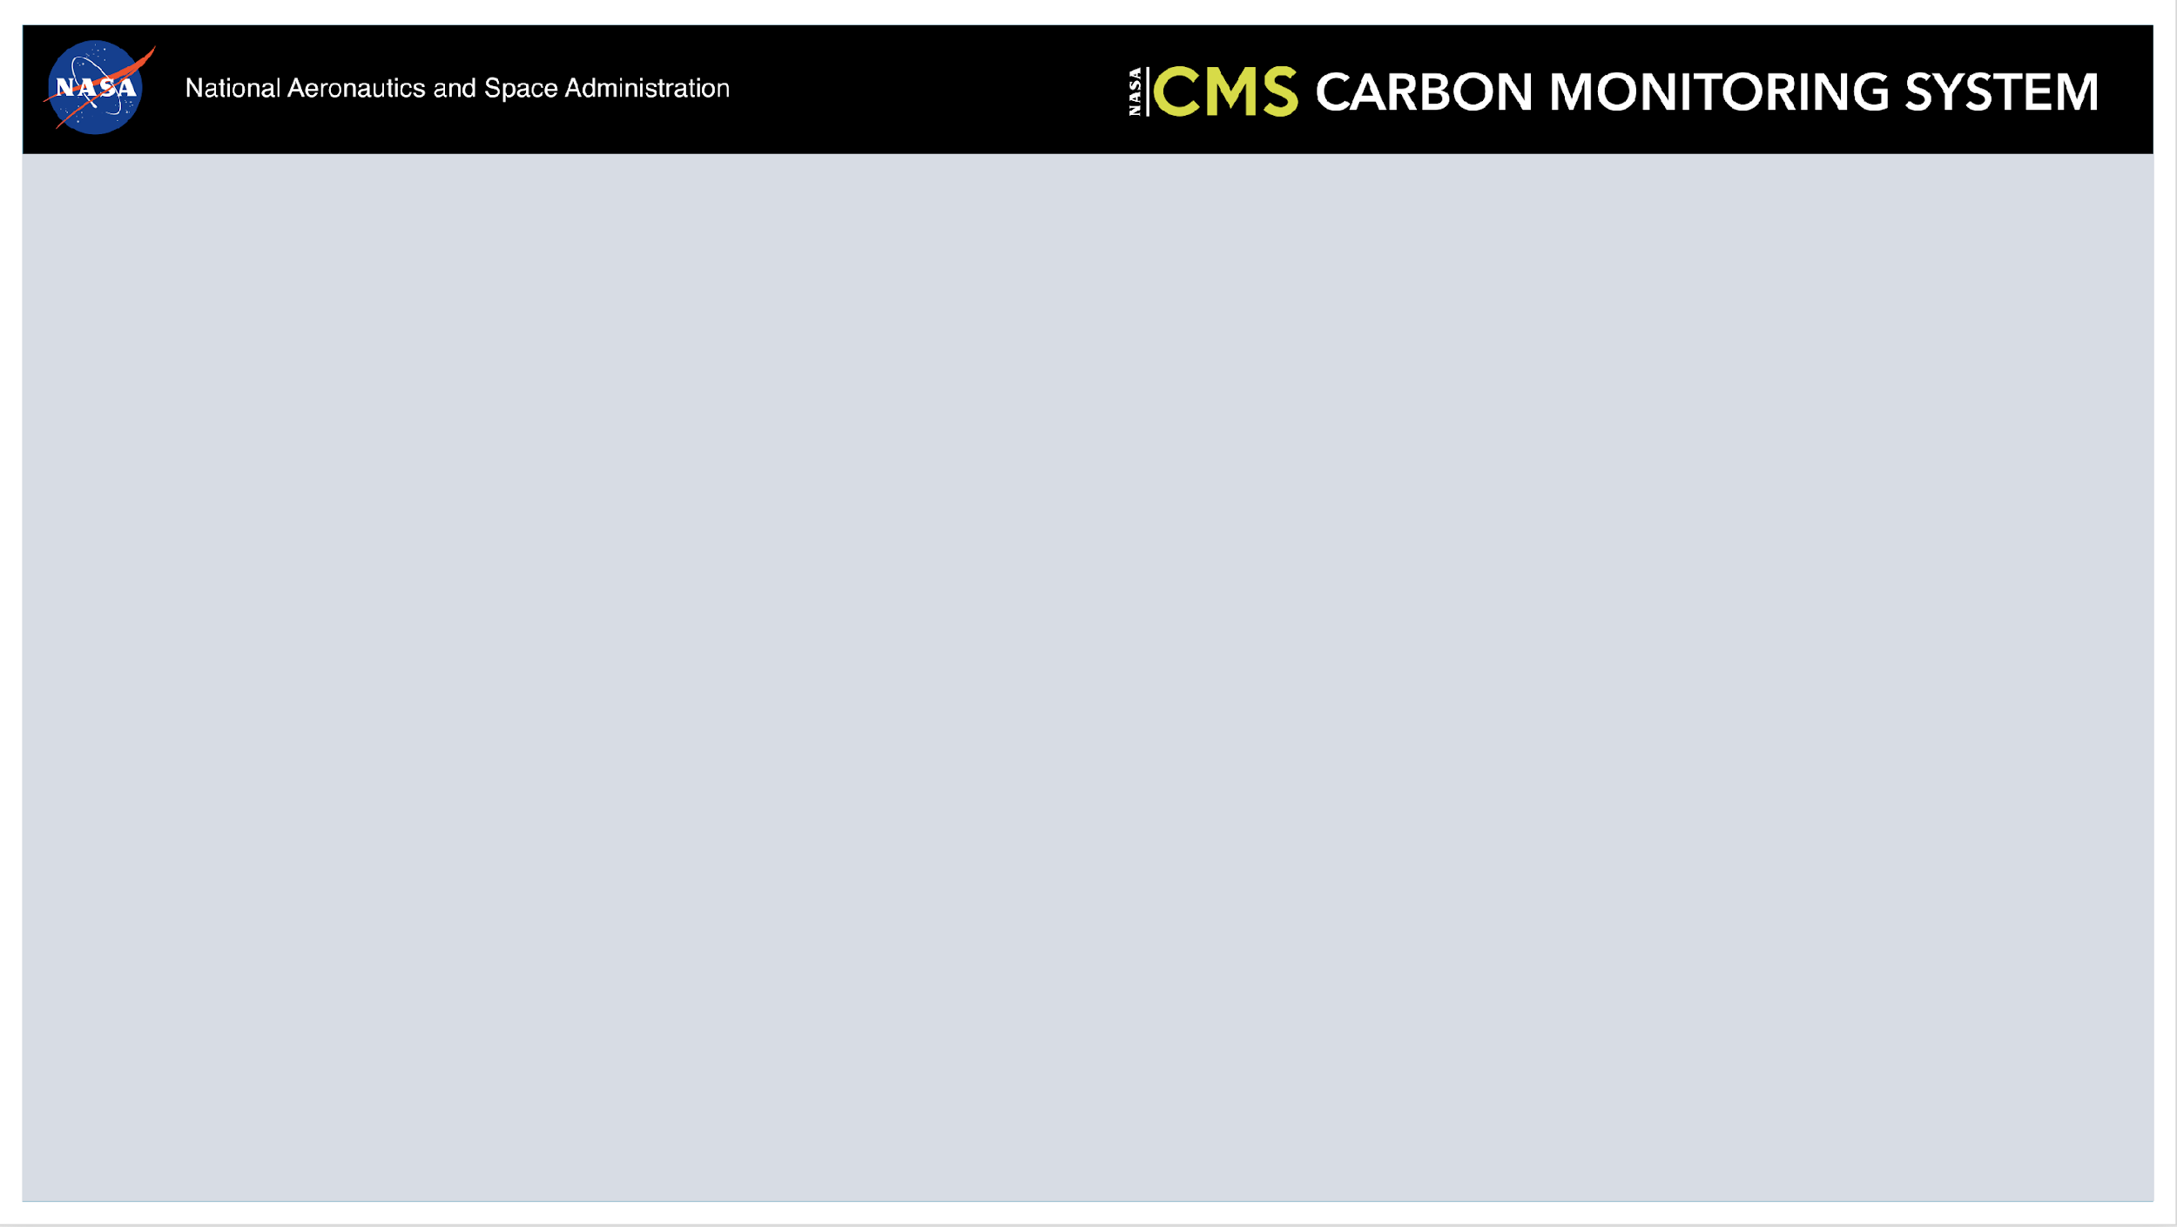
2025 CMS Science Team Meeting
Working Group Breakout Report

Slide 2
Fire Working Group Description
The NASA Carbon Monitoring System (CMS) Fire Working Group is a collaborative initiative aimed at advancing our understanding of fire dynamics and their role in the global carbon cycle. Fires, both natural and anthropogenic, contribute significantly to carbon emissions, altering terrestrial carbon stocks and atmospheric chemistry. This working group integrates satellite observations, field measurements, and modeling approaches to develop robust, actionable datasets that improve the quantification of fire-driven carbon fluxes and their impact on ecosystems and climate.
Short Term Objectives:
Foster collaboration across NASA CMS projects to ensure consistency in fire-related carbon monitoring outputs.
Identify and address data gaps, particularly in understudied fire-prone regions and small-scale fires.
Long Term Objectives:
Facilitate the integration of CMS fire products into national and international carbon monitoring frameworks.

Slide 3
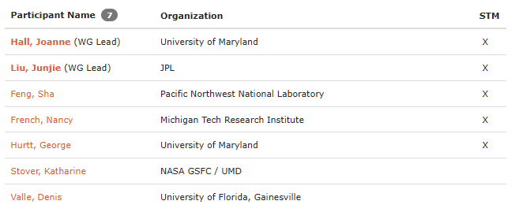
Fire Working Group Members

Slide 4
Breakout Attendees
Joanne Hall
Nancy French
Junjie Liu
George Hurtt
Kevin Bowman
Peter Griffith
John Lin
Clare Saiki
Andrew Schu
Reem Hannun
Jackie Schuman (NASA FireSense)
Harrison Raine (NASA FireSense)
Sha Feng (Virtual)
Amanda Whitehurst (virtual)

Slide 5
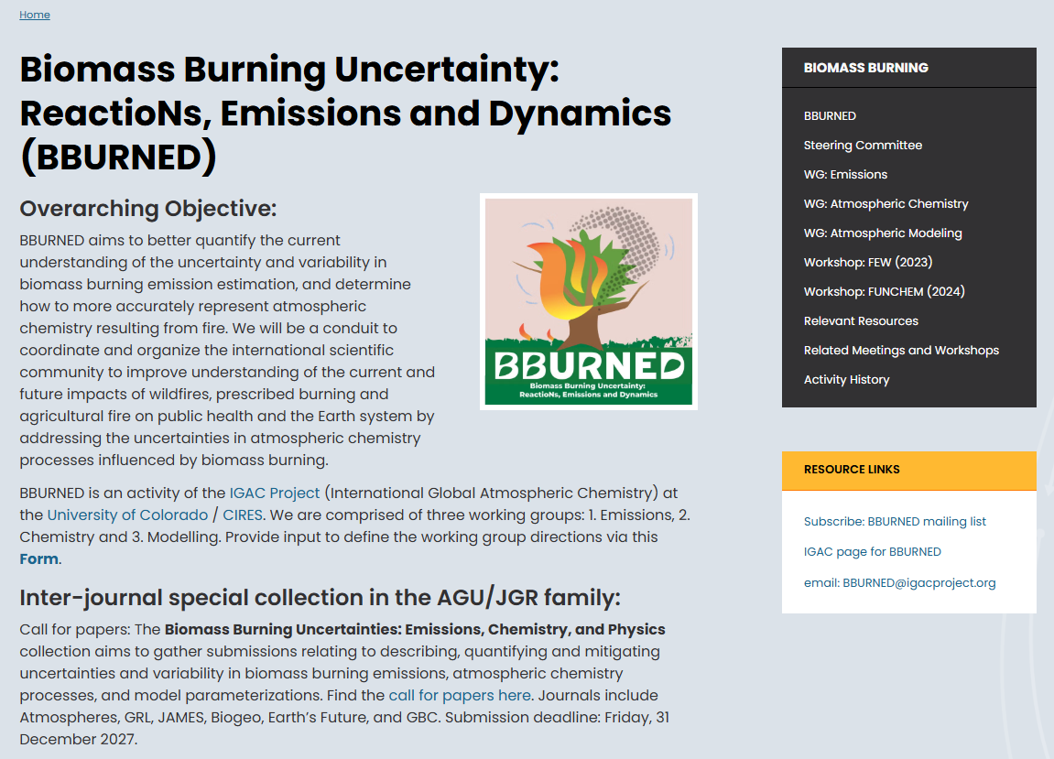
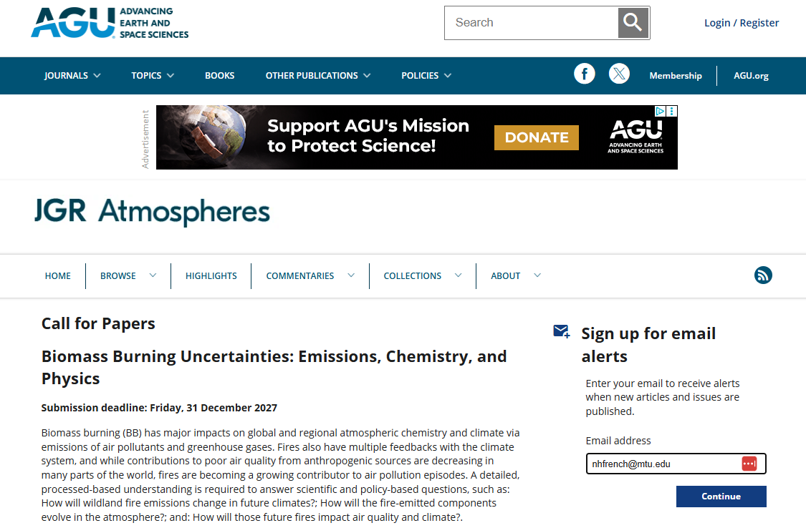
Special Issue Call for Papers:
https://www2.acom.ucar.edu/bburned

Slide 6
Perspective Paper (Outline)
Challenges and gaps with quantifying carbon emissions from fire
How the CMS funded projects can fill some of those gaps
Stakeholder needs
Future directions on CMS fire-related activities
Action: What challenges and gaps do you see related to fire?
Action: Does your CMS project help address any of these challenges?

Slide 7
Perspective Paper Discussion
Challenges and gaps in carbon emission quantification from fires
Transition from MODIS to VIIRS
Reconciling between inventory-based fire emissions estimates and atmospheric CO-based estimates
Challenges in inventory-based fire emission estimates
Uncertainties in fuels and consumption rate
Dynamic updates of fuel loading data
Challenges in atmospheric CO-based estimates
Limitation in spatial resolution
Uncertainties in emission factors, atmospheric transport
Limitation in attribution of total emissions to specific processes

Slide 8
Perspective paper (2)
Future directions
Extreme fires due to climate perturbations
Urban fires
Evaluation of inventory-based emissions with atmospheric trace gases observations
Reconcile burned area and fire radiative power derived from MODIS and VIIRS
Improve temporal resolution of fuel mapping
Reconcile fire emission estimates from inventories and atmospheric CO-based estimates.

