Slide 1
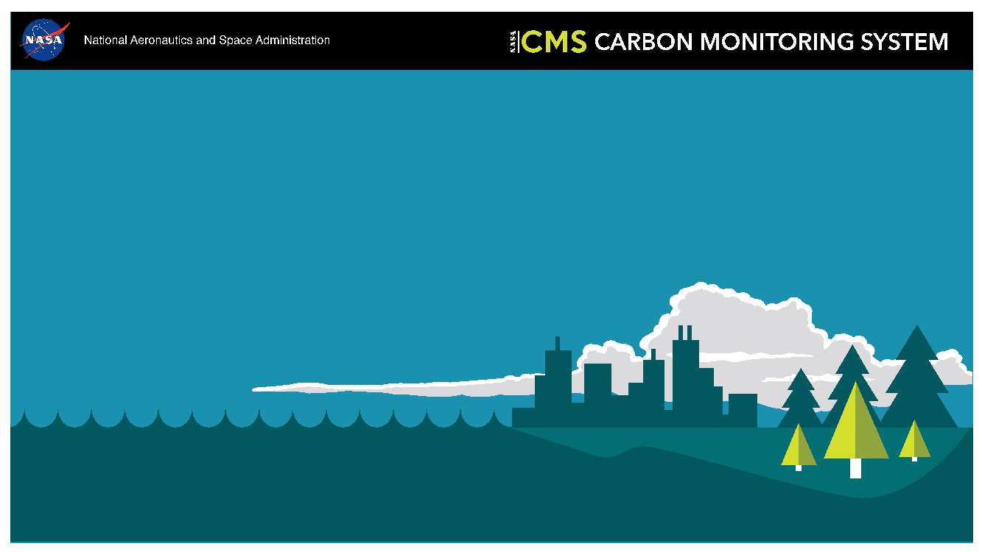
Meeting Summary
George Hurtt
Science Team Leader
September 9-11, 2025
Moffett Field, CA

Slide 2
Great meeting!
Participation. Total= 129 , In-person= 60, Virtual= 69;
Stakeholder Participation. Total= 32, Panels= 5, Keynote presentation = 1. Stakeholders participated from the US, Canada, and Singapore. These stakeholders were from a diverse set of organization types: Federal Government (4), NGO/Non-Profit (4), University (5), Inter-governmental Organization (2), State Government (9), Company (5), Research Institute (3).
CMS continues to engage relevant participants and stakeholders. 1,016 participants, and >300 stakeholders from 186 organizations
CMS continues to be highly productive and impactful. To date, CMS has produced 740 publications cited 68,420 times, with 63 in top-tier (Science, Nature, PNAS). It has also archived 201 data products downloaded >400,000 times. Multiple success stories.
CMS Stakeholder Keynote presentation. Deborah Gordon (RMI) highlighted the successful adoption of key CMS products to monitor methane emissions from oil and gas, and remaining challenges for continued CMS
CMS approach highly successful. A key example for NASA Earth Science to Action, innovation engine for the nation
Notes:
** Updated 9/3/2025

Slide 3
Progress on science projects. Biomass, Flux, Methane, Wet, Fire.
Progress on previously identified challenges. Scaling, lateral fluxes, alkalinity, …
Progress on collaboration between projects. Biomass-Atm, Biomass-lateral flux, Biomass-Fire-Flux,...
Progress on Inter-agency collaboration and integration. Synergy with USFS, GHG Center, Others
Progress on meeting format. Increased opportunities for discussion in plenary and poster sessions
Progress enhancing, maturing, stakeholder engagement. NRT Product fact Sheets, User working groups
Progress on metrics of impact. Publications, Citations, ARLs, Success Stories, New national Interest Metrics
Progress on Working Groups. New membership, plans, synthesis papers. New Fire working group high interest
Progress on data archive. DAAC migration to Earthdata
Critical needs. For CMS from diverse set of scientists and stakeholders
Critical need for remote sensing. Geospatial and temporal coverage…
Critical need for models. For monitoring and future planning from stakeholders
Critical need field and atm data. Throughout. Cal/Val!
Challenges. Changing context for science and stakeholders
Challenges scientific. New and remaining topics, E.g. Reconcile Top-down/Bottom-up,
Challenges of capacity building. Build upon proven strategies, ARSET example
Opportunity for perspective. Broaden relevance of carbon and expand stakeholder types
Opportunity to contribute to Special Issue. ERL Focus Collection on Carbon Monitoring Research
Opportunity to continue and deepen discussions at AGU! Innovative Session on Carbon Monitoring Research and Applications. See you there!

Slide 4
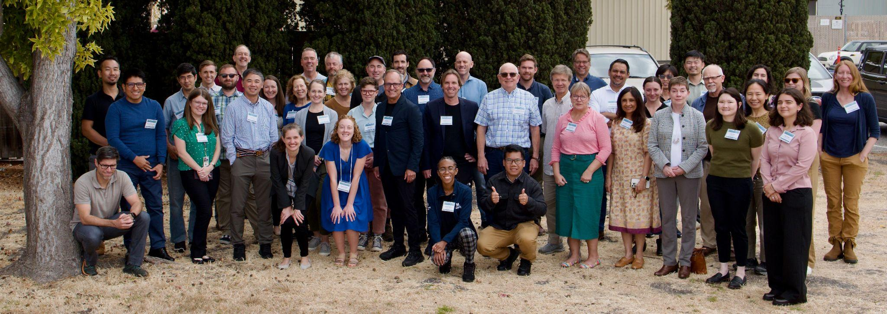
Thank you!

