Slide 1
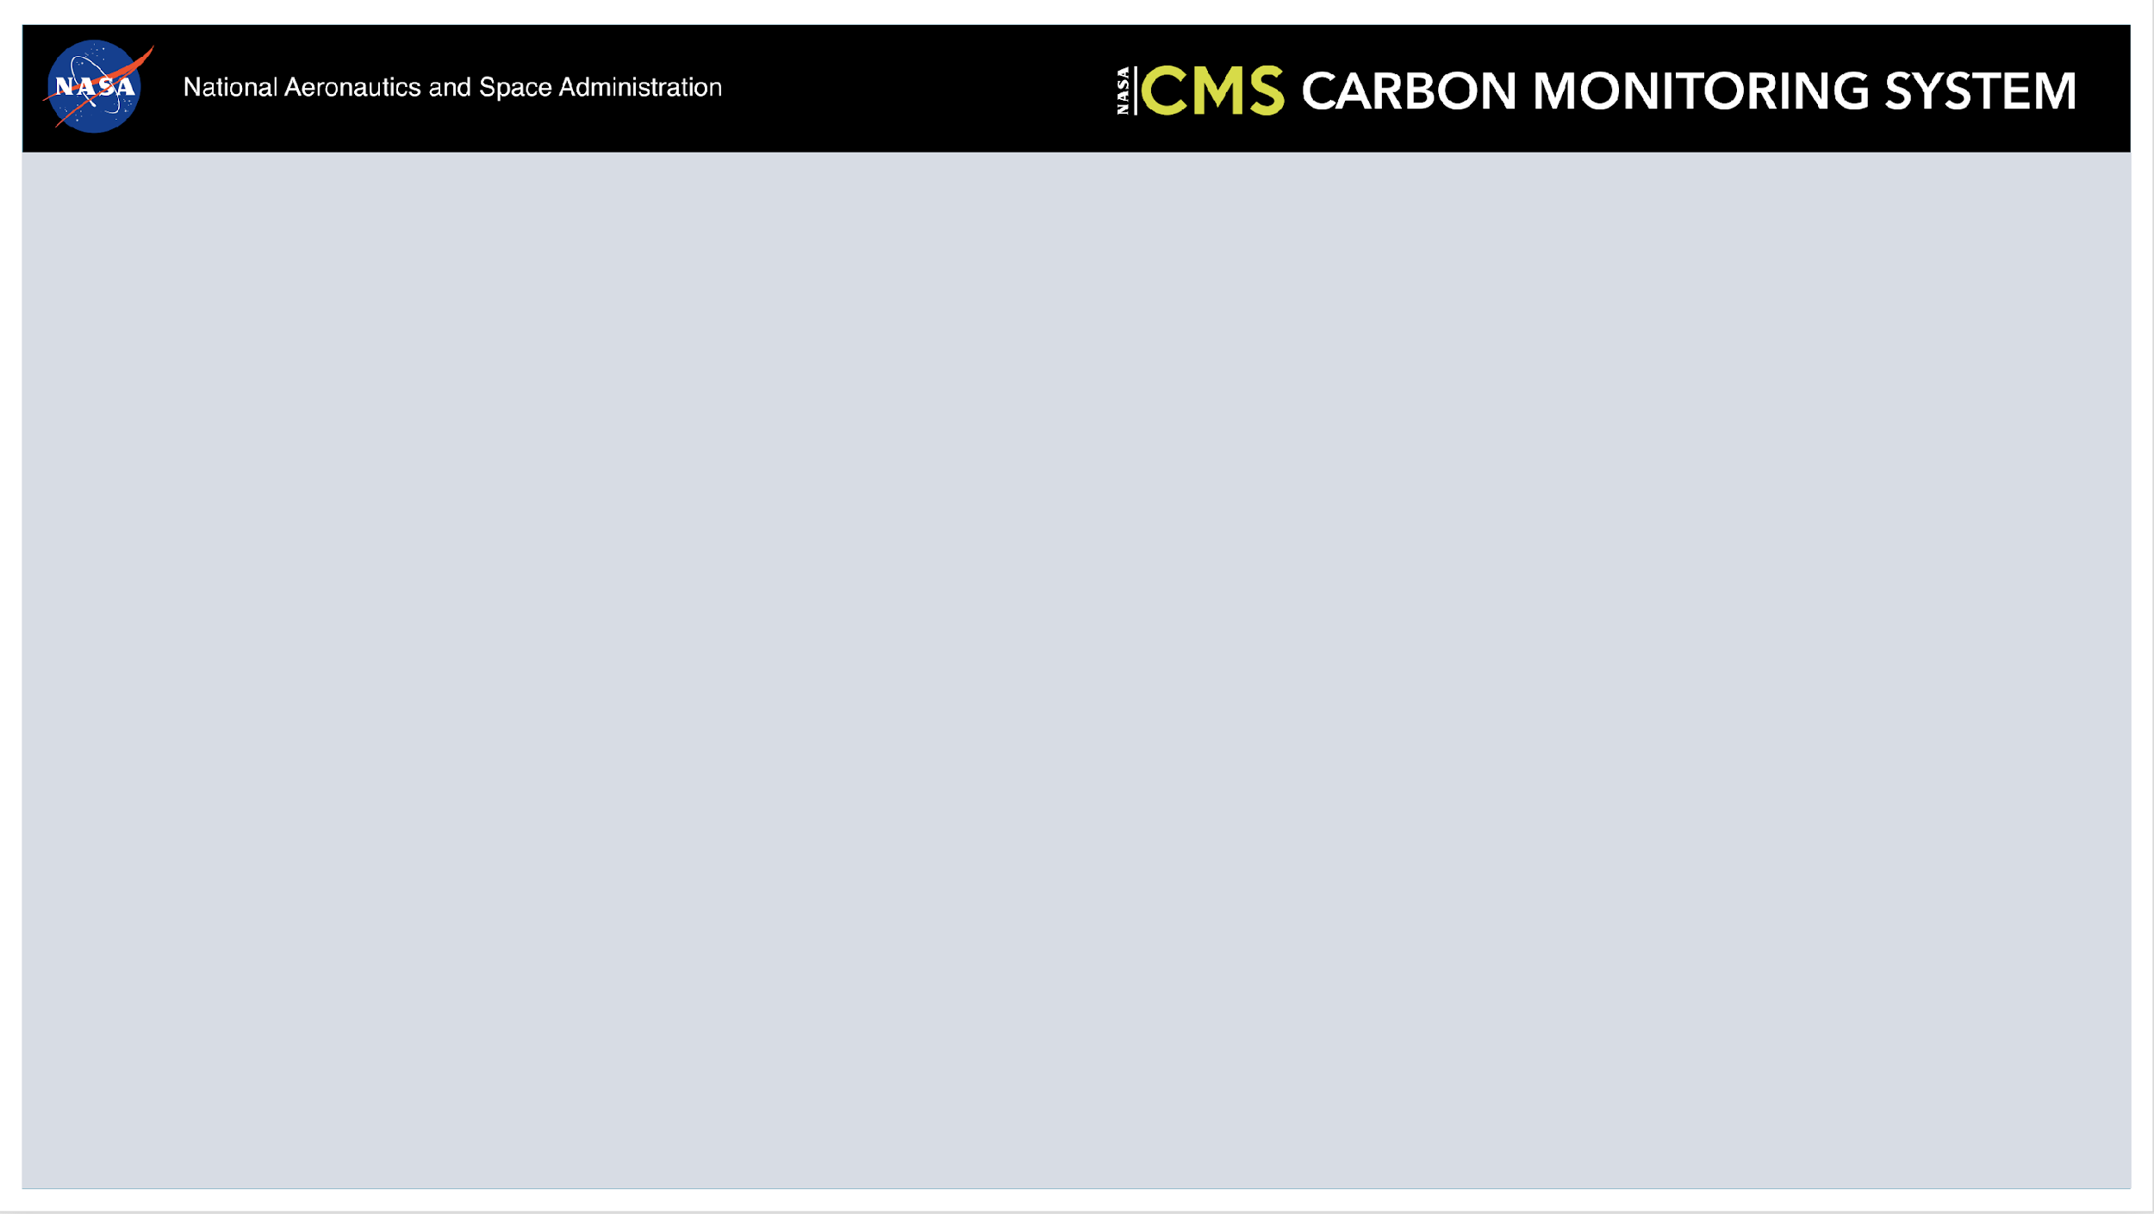
2025 Methane Working Group Breakout Summary

Slide 2
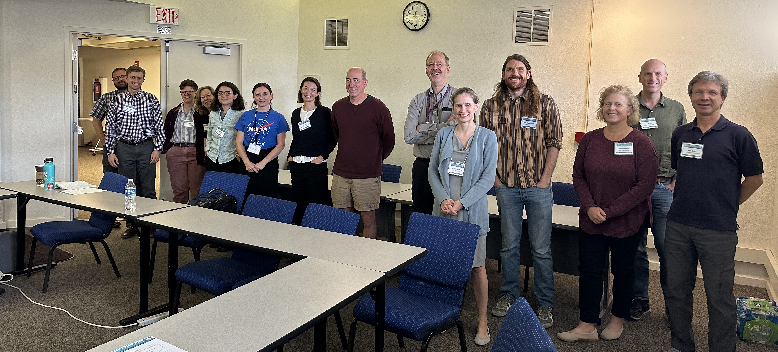
CMS Methane WG Breakout Meeting
17 attendees (in person + online)
U Arkansas, Penn State, U Utah, NASA, JPL, Cal State East Bay, UW, Harvard, RMI

Slide 3
Review of Working Group Description/Goals
Goals/charge:
Better quantify the contributions of different source regions, source sectors, and sink processes to the global methane flux;
Better understand the biogeochemistry of ecosystems producing methane and the sensitivity to climate, surface properties, and carbon;
Identify methane research needs that may guide future CMS solicitations.
Proposed addition
Need for a stakeholder driven goal: Discussed overarching goal to synthesize stakeholder needs/requirements and translate to products CMS Methane WG develops

Slide 4
Progress since last WG meeting
Started work on anthropogenic point source synthesis review paper to describe current state of technology, examples of successful application, describe gaps, and recommend research directions. (Carbon Mapper, Harvard, others)
Participated and contributed to CEOS-led document that describes community best practices on facility-scale methane quantification (JPL, Carbon Mapper, others)
Intercompare bottom-up wetland emission inventories within TROPOMI inversion framework (Harvard, LBL)

Slide 5
Plans for next year
Publish on anthropogenic point source synthesis review paper (Carbon Mapper, Harvard, others)
Perspectives paper on reconciliation of inverse products with inventories. Goal – highlight a working proof of concept (JPL, Carbon Mapper, others)
Compare satellite TROPOMI inversions to fluxes derived from tower networks (e.g., southeast US) (Harvard, JPL, NASA, CSU-EB, others)
Complete rice emission inventory for US and apply to evaluation of global inventory
(U. Arkansas, Harvard)
Support the state of Colorado in quantifying point, regional, and natural methane sources, and evaluating the impact of action on point sources (Carbon Mapper, Harvard, Penn State)

