Slide 1
Overview of California Cap-and-Trade Program
Rajinder Sahota
July 2020

Slide 2
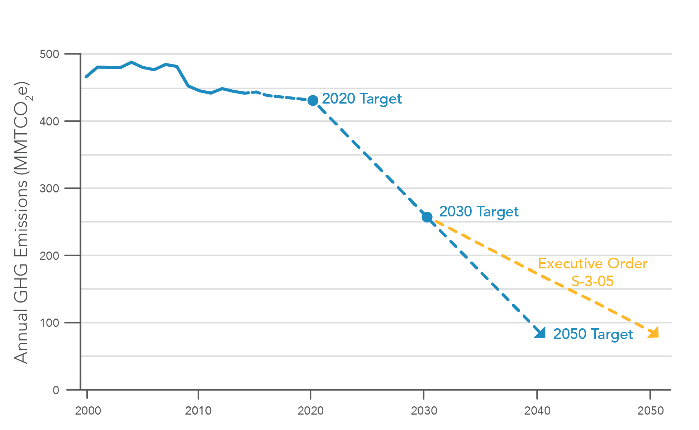
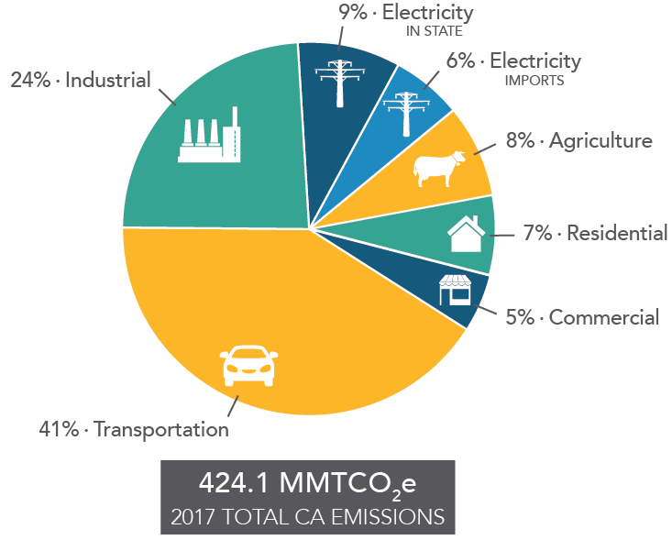
CA GHG Reduction Targets and Sources
Source: CARB, 2017

Slide 3
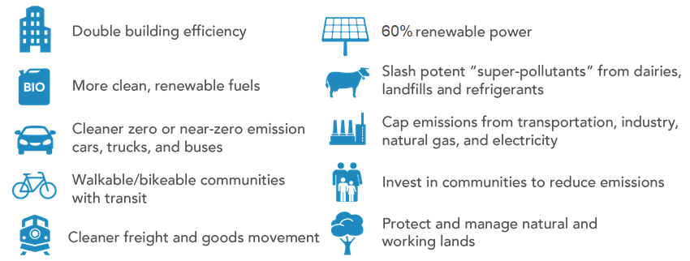
CARB’s Climate Portfolio for 2030 Target
Notes:
Comprehensive strategy to meet California’s 2030 GHG target
Approved by CARB in December 2017
Suite of complementary measures builds on past success
All policies interact with the transportation sector

Slide 4
Cap-and-Trade Program Background & Goals
Declining Caps
Steadily Increasing Price Signal
Targets Lowest Cost Reductions First
Long-Term Price Signal for Clean Technology Investments
Critical part of State strategy to achieve AB 32 and SB 32 GHG reduction targets
Ensure GHG reduction targets are realized through a strict limit
2017 Scoping Plan that includes Cap-and-Trade is four times less costly than alternatives
Works in concert with other complementary air quality and climate policies
Program designated in AB 398 to reduce GHG emissions for oil and gas extraction and refinery sectors
Provide compliance flexibility to achieve cost-effective reductions
Facilitate integration of regional, national, and international GHG emissions reduction programs
Notes:
→ Declining Caps, Steadily Increasing Price Signal, Market that Targets the Lowest Cost Reductions, and a Long-Term Price Signal for Investment Certainty
The Program establishes a hard declining cap on major sources of statewide GHG emissions, and it creates a strong economic incentive for investments in cleaner, more efficient technologies.
Each entity covered by the Program has a compliance obligation that is set by its GHG emissions, and entities are required to meet that compliance obligation by acquiring and surrendering allowances and a limited quantity of offset credits in an amount equal to their compliance obligation.
CARB creates allowances equal to the total amount of permissible emissions (i.e., the cap) over a given compliance period. One allowance equals one metric ton of carbon dioxide equivalent (using the 100-year global warming potentials).
Because the cap declines, fewer allowances are created each year and overall emissions decrease over time.
The auction mechanism, helps establish a steadily increasing price signal to invest in cleaner technologies and facilitates addressing the lowest cost reductions first.
The Cap-and-Trade Program is one part of our overall climate change strategy to reach our emission reduction goals. It helps ensure we reach those goals at a much lower cost than an approach that does not include cap-and-trade.
The Program works in concert with our air quality and other climate policies.

Slide 5
Cap-and-Trade: Facts and Figures
Covers ~80% of State’s emissions
~450 covered entities in the Program
Large industrial sources & electricity generators with emissions ≥ 25,000 MTCO₂e per year
Electricity importers, natural gas suppliers, and transportation fuel suppliers
31 auctions held to-date (23 joint-auctions)
First joint auction with Québec was held in November 2014
Over $13 billion generated for California Climate Investments
~50% of investments are benefiting disadvantaged communities
Notes:
This slides highlights some key facts and figures about the Program.
The Cap-and-Trade Program is economy-wide. It covers more than 80% of the State’s greenhouse gas emissions.
The Program covers large emitters with greater than 25k MT CO2e, electricity importers, natural gas suppliers, and transportation fuel suppliers.
High levels of compliance with Program requirements. 100% of entities were in compliance for the most recent compliance event on November 1, 2019
Through the auction mechanism, the Program has resulted in over $13 billion that are being directed into investments in California, with more than 50% of investments going directly to benefit the most impacted communities.

Slide 6
Cap-and-Trade Accounting
Cap-and-Trade Program and Mandatory Reporting Regulation (MRR) collect emissions data and calculate compliance obligations annually based on covered emissions
In-state industrial facilities report facility-level emissions
Electricity importers report imports based on physical delivery of electricity. Based on emissions factor of source, if known, or “unspecified” if not
Upstream reporting of fuels
Transportation fuels and natural gas suppliers report emissions that would result from complete combustion/oxidation of the fuel by end-users
Cap-and-Trade Program compliance is based on compliance instruments retired
One allowance = one offset credit = permit to emit one MTCO₂e
Notes:
So how does the accounting in Cap-and-Trade work?
The MRR annually collects data which is verified by third party accreditors. Good data is fundamental to the Program. It is essential in setting caps and establishing compliance obligations, as well as allocating free allowances to entities.
Annual reporting provides ongoing data on emissions, production, and electricity sales and purchases, among other information.
Emissions are reported at the facility level and for electricity imports based on physical delivery by source
NG Suppliers have the obligation on behalf of the end user, except for natural gas combusted by another covered entity
Compliance obligations are based on covered MT of carbon emitted. Some emissions, for example biogenic emissions, are reported but do not have a compliance obligation.
One allowance = one offset credit = a permit to emit one MTCO₂e

Slide 7
Criteria for Inclusion Under Cap-and-Trade Program
Cap-and-Trade requires consistent, high-accuracy, and timely emissions data
Covered emissions must be verified by a third-party
Most point sources of emissions are covered because they can be accurately quantified and verified under MRR
Area source emissions, like landfills or leaks from the natural gas supply system, are difficult to measure and are not covered when they cannot meet the same level of accuracy
California addresses non-covered emissions through other regulations and programs
Current satellite data that provide a snapshot of emissions at a point in time are not suited for this purpose, but can be useful for other applications
Notes:
CARB uses satellite data in a number of ways, which I will cover in a moment

Slide 8
MRR Reporting
Annual Reporting of CO₂, CH₄, N₂O emissions by
Facilities that emit greater than 10,000 MT CO₂e per year and “opt-in” facilities
Utilities and electricity importers/exporters (no threshold)
Natural gas and transportation fuel suppliers (10,000 MT CO₂e threshold)
Comprehensive and consistent reporting requirements across the state built on international standards
Independent third-party verification and internal quality assurance checks; critical for program integrity
Data Stability
Strict reporting and verification deadlines to support Cap-and-Trade Program
Stable emissions data required for implementation and market certainty in Cap-and-Trade
Notes:
The reporting threshold of 10,000 MT is different from the 25, 000 MT C&T threshold, by design, to get reported data from smaller entities and to track their emissions in case they reach the 25,000 MT threshold.
Opt-in facilities, e.g. refineries and cement production
Verification is akin to financial auditing
QA checks performed to ensure all facilities are captured, completeness of data, consistency, comparability and accuracy.

Slide 9
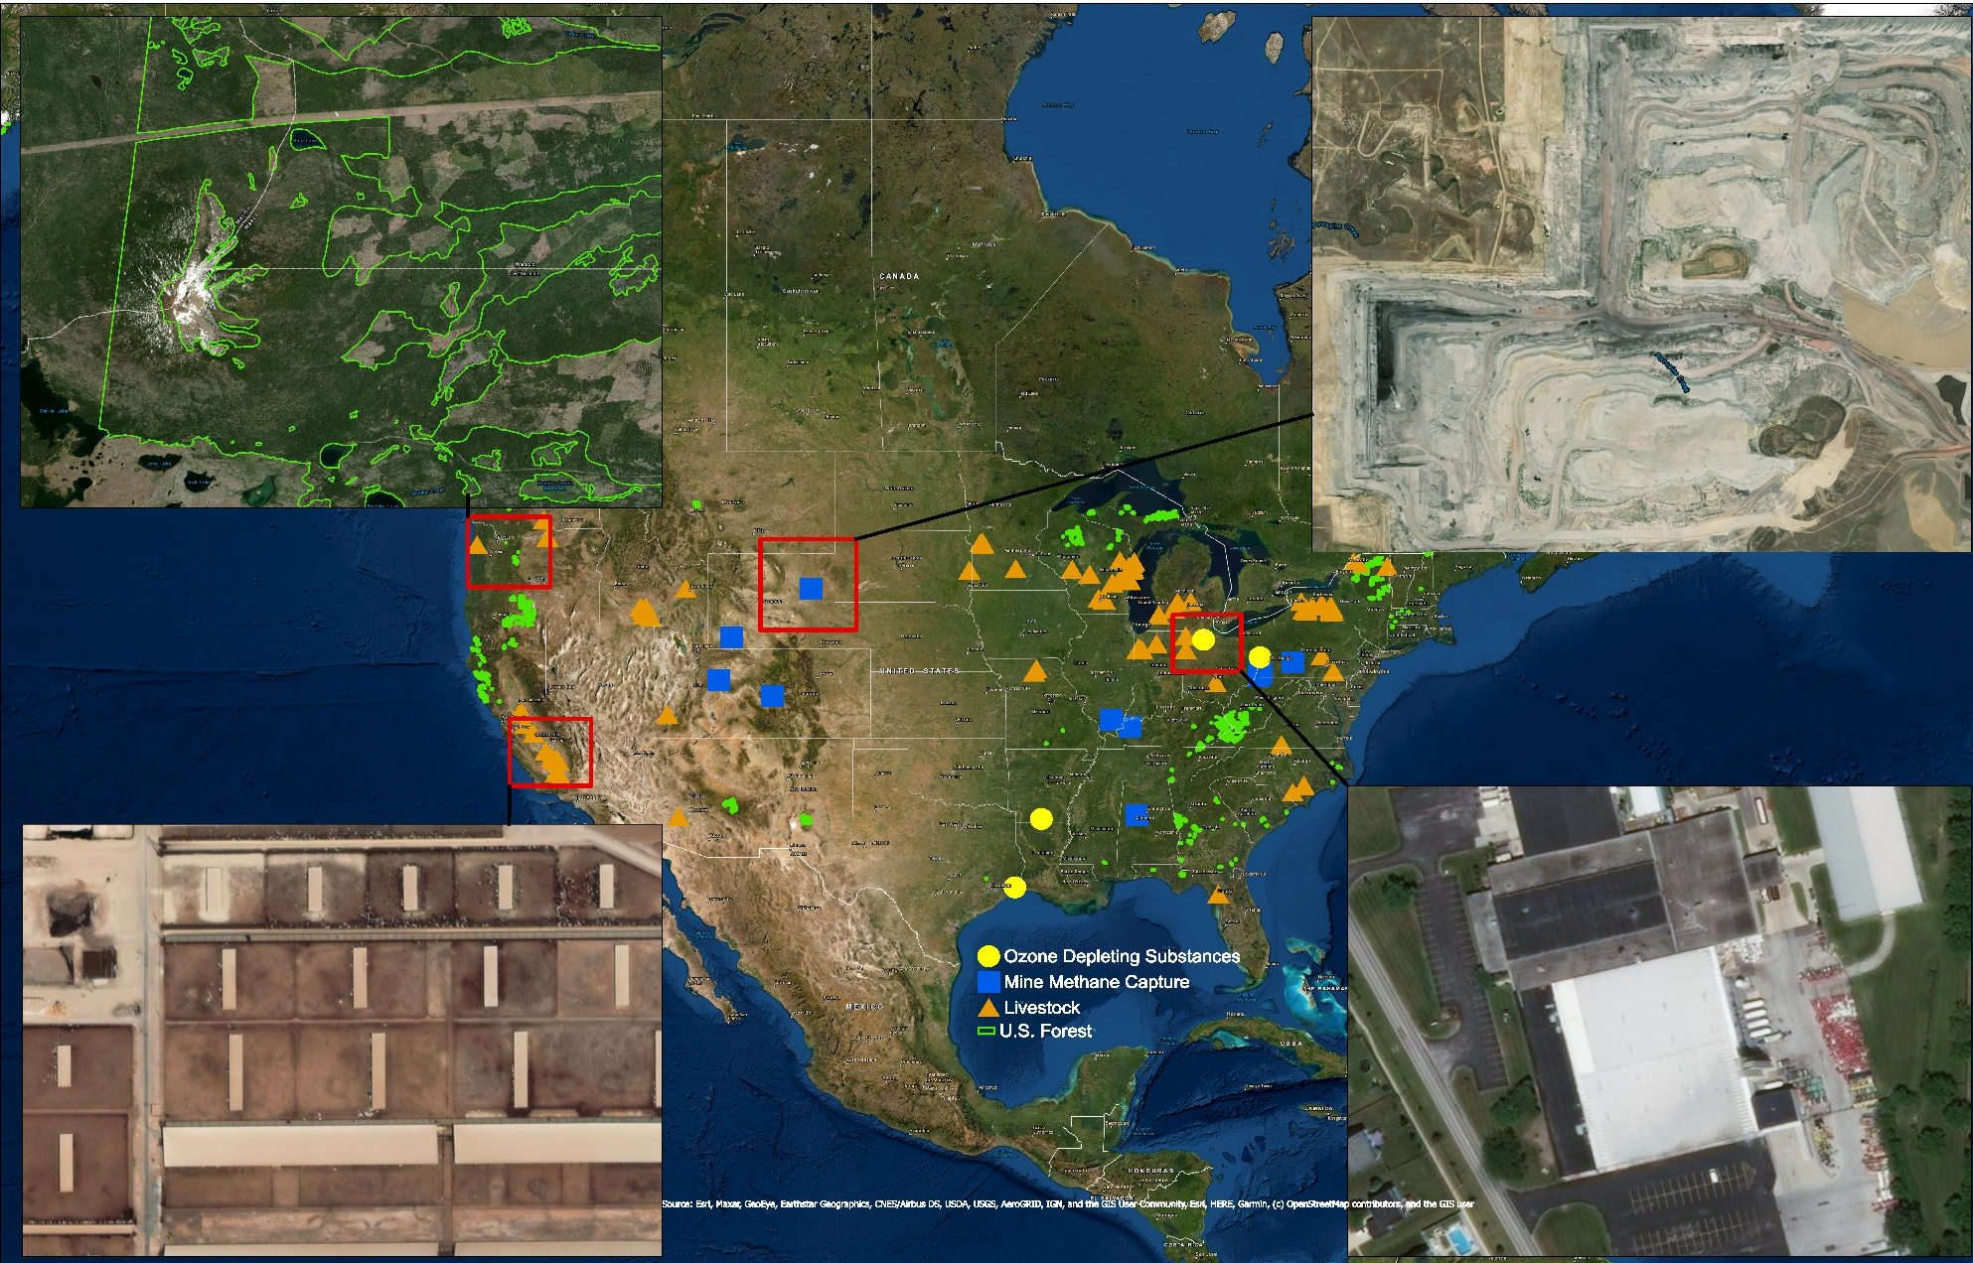
Compliance Offset Program
U.S. Forest
Mine Methane
Capture
Ozone Depleting
Substances
Livestock
Notes:
The Program provides compliance flexibility, which leads to cost-effective emission reductions. There are several features that provide this flexibility, including allowing the use of a limited number of compliance offset credits. Offset credits represent verified GHG emissions reductions or removal enhancements made in sources outside of the California Cap-and-Trade Program. Offset usage limits restrict the quantity of offset that can be surrendered in any compliance period.
To date, CARB has issued over 186 million offset credits, and about 30 million credits have been surrendered which is below the current 8% usage limit.
This slide shows offset project locations as of June 2020 and satellite imagery of the four offset project types.
Satellite imagery used when establishing projects by offset project developers, by verifiers during site visits and field reconnaissance, and by CARB during project review and tracking.
This information is available on CARB website (link is in final slide)

Slide 10
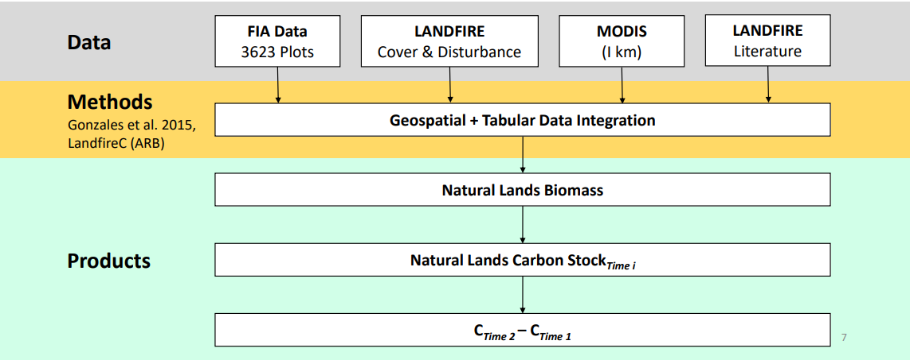
Natural Working Lands Inventory
A quantitative estimate of the existing state of ecosystem carbon stored in the State’s land base
Follows IPCC GHG Inventory Guidelines - Atmospheric Flow Approach, using a combination of tier 1, 2, and 3 methodologies
Uses USFS FIA plot data in combination with geospatial vegetation data
Notes:
NWL plays an important role in the State’s climate strategy by contributing to carbon sequestration and GHG reductions, and the NWL Inventory is a key tool for tracking the impacts of these strategies.
Based on the Guidelines for National Greenhouse Gas Inventories of the IPCC, CARB developed a NWL Inventory focused on ecosystem carbon accounting to meet the following design objectives: the inventory is geospatially and temporally explicit, utilizes input datasets that are refreshed regularly, and allows continual improvements as science advances and new data become available.
Different IPCC tiers are used in the Inventory. For example, forest biomass uses tier 3, while soil organic carbon uses tier 1. All land types utilize a combination of remote sensing data and ground-based measurement data. For forests and other natural lands, the Inventory uses ground-based FIA plot measurements with remote sensed, geospatial vegetation data from LANDFIRE and MODIS to estimate carbon stock change over time.
The NWL inventory includes:
- Forest and other natural lands (woodland, shrubland, grassland, and other lands with sparse vegetation): live and dead plant materials and their roots
- Urban land: trees in urban area
- Cropland: woody biomass in orchards and vineyards
- Soil Carbon: organic carbon in soils for all land types
- Wetlands: CO2 and CH4 emissions from wetland ecosystem
Details of methodology are provided in the Inventory technical document available on our website, e.g. if you google “carb NWL inventory”

Slide 11
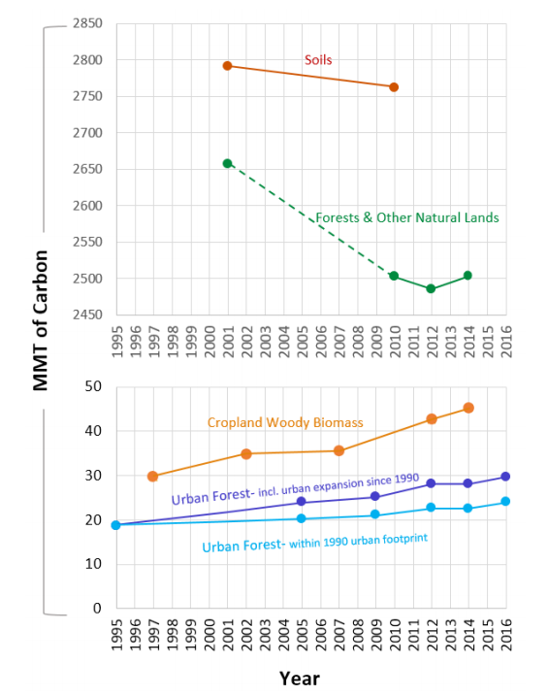
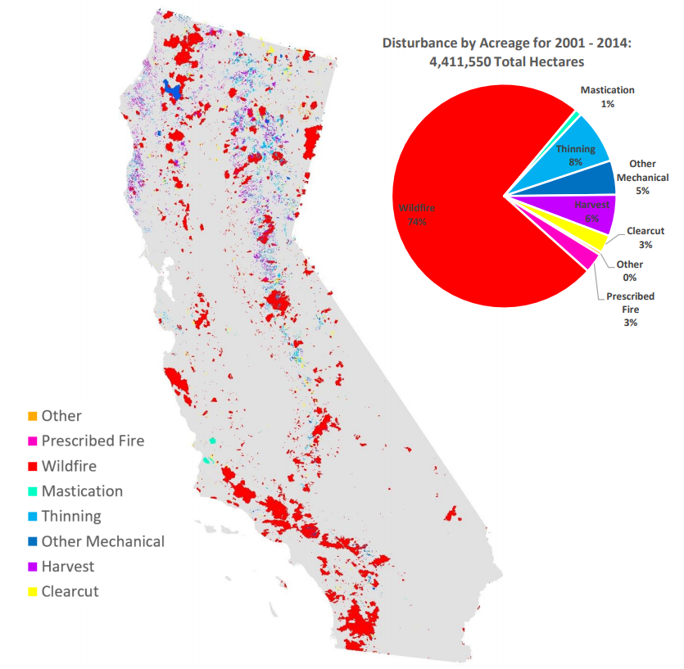
California’s NWL Inventory
2014 carbon stocks were published in 2018
Provides “snapshots” in time to estimate stock change, land use change, and resulting GHG flux
An important tool for tracking the impacts of interventions, such as projects funded by California Climate Investments and bond funds, and informing how California’s land base contributes to the State’s climate goals
Notes:
CARB is continually working on improving the inventory, including moving from lower to higher methodology tiers, identifying the highest quality data to use, and incorporating expertise from the scientific community and sister agencies
Having remote sensed data available more frequently would help CARB: Inventory estimates are subject to data availability, which is why we only have estimates for certain years and why there is a delay in inventory estimates. CARB is working on annualizing the inventory to give a general idea of annual trends between inventory vintages, and to estimate current carbon stocks when data is not yet available.
More accurate vegetation type classification would help CARB: The major source of uncertainty in CARB’s land carbon quantification method is due to existing vegetation type (EVT) classification (Battles et al. 2013; Gonzalez et al. 2015). Future work will explore options for improving EVT products used in the Inventory. Special attention will be paid to increasing the accuracy of wetlands and cropland mapping so that land-use change from these categories can be included in future iterations of the Inventory.
Uses for Inventory data: Inventory can help identify areas where additional investment in interventions could result in more impact to meet our climate goals. It is important to note that the Inventory complements, but does not replace, project-level tracking and monitoring by capturing the effects of implemented interventions, along with any impacts from regulatory and policy changes and other gains or losses that occur over the same timeframe.
(These points are all discussed in the NWL Inventory published document on CARBs website)

Slide 12
Resources
Cap-and Trade Website:
https://ww2.arb.ca.gov/our-work/programs/cap-and-trade-program
Mandatory Reporting Website:
https://ww2.arb.ca.gov/our-work/programs/mandatory-greenhouse-gas-emissions-reporting
Compliance Offset Program Map:
https://webmaps.arb.ca.gov/ARBOCIssuanceMap/
Natural and Working Lands Inventory:
https://ww2.arb.ca.gov/nwl-inventory
Rajinder Sahota
California Air Resources Board
Rajinder.Sahota@arb.ca.gov
1.916.323.8503

